Slide 1



LLM Based Web Application for SQAG Document’s Verification
Manual verification of SRS is time-consuming, inconsistent, and difficult. This work addresses the need for an LLM-based web application that automatically analyzes SRS documents, checks compliance against SQAG checklist, highlights compliance and non compliance areas, and generates explainable reports rapidly.
Presented by: Aayush Anand
Guided By:
 | MB Sai Charan, Scientist-C A Kalidasu, Scientist-E
Directorate of Artificial Intelligence and Visualization

Slide 2
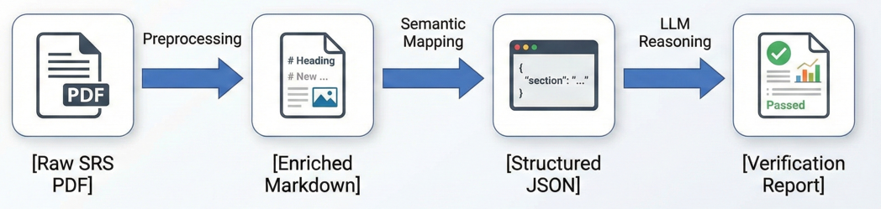
Methodology
Our proposed solution follows a three-phased approach to transform unstructured PDF documents into verifiable, structured intelligence:
Phase I: Data Ingestion & Enrichment Extracts raw content while preserving visual context through multimodal captioning, converting PDFs into rich Markdown.
Phase II: Structural Standardization Uses semantic analysis to map inconsistent section headers to a unified template, creating a normalized JSON dataset.
Phase III: Automated Logic Verification Deploys GLM-4 to audit requirements against a standard checklist, providing Compliance and Non Compliance with Explanation.

Slide 3
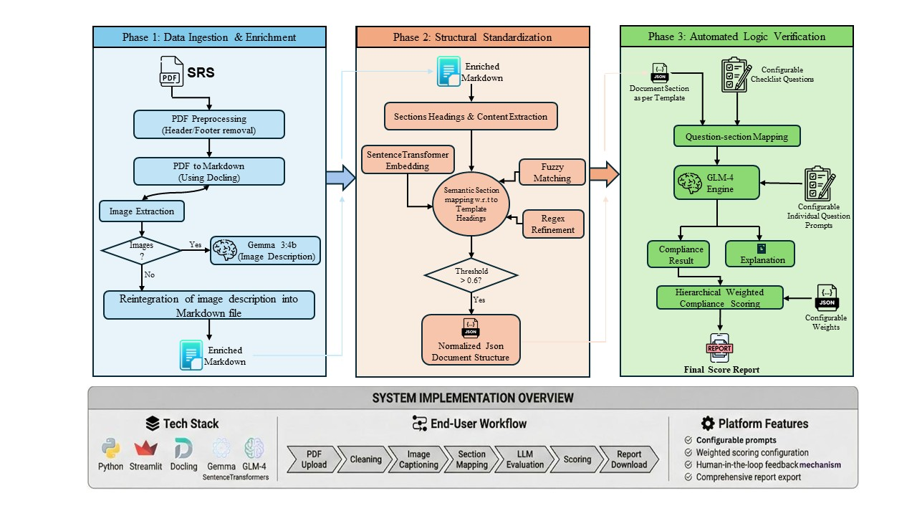
System Implementation

Slide 4
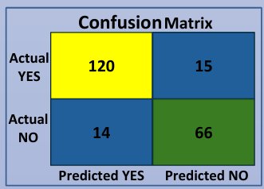
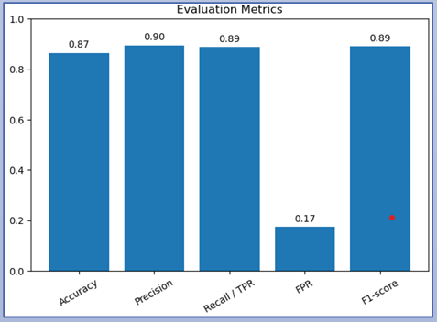
Evaluation
Checklist-Level Classification Performance: To assess classification performance, automated compliance predictions were compared with manually annotated ground truth labels.
Quantitative Evaluation Metrics: Standard classification metrics were computed to further evaluate system performance.

Slide 5
continue…
Explanation Quality Evaluation: Beyond classification accuracy, the interpretability of model outputs is critical for real-world adoption. The quality of generated explanations was evaluated using three qualitative metrics: faithfulness, relevance, and contextual accuracy.
Metric | Score | Interpretation
Faithfulness | 0.783 | Most explanations are well-grounded in the source document content.
Relevance | 0.849 | It ensures the answer directly addresses the user query
Contextual Accuracy | 0.616 | Is the retrieved information is actually relevant to the prompt.

Slide 6
Conclusion
Automated SQAG compliance verification using a multimodal LLM framework
Enables rapid pre-screening, generating compliance reports in ~2 minutes
Highly configurable for new document types through checklist, prompt, and weight updates
Supports text and diagram understanding for complex SRS documents
Works as a decision-support tool.

Slide 7
Thank you

