Slide 1


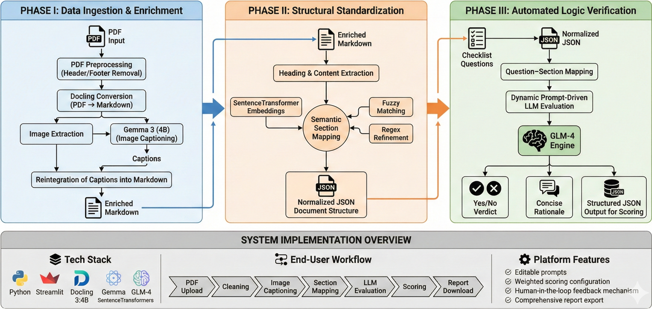
LLM Based Web Application For SQAG Document’s Verification
Aayush Anand M.B Sai Charan (Sci-C), A.Kalidasu (Sci-E)
Overview
Software Quality Assurance Group (SQAG) under DRDO reviews a large number of technical documents such as SRS, SDD, ICD, and test plans.
Many incoming documents suffer from incorrect templates, missing sections, irrelevant content, and unclear diagrams, making manual review slow and inconsistent.
This project proposes an AI-assisted initial screening and verification system to reduce reviewer burden and improve standardization.
Problem Statement
Manual verification of Software Requirement Specification (SRS) documents within SQAG is time-consuming due to inconsistent formats, non-standard terminology, and structural variations. Many submissions contain missing or poorly defined sections that do not follow prescribed templates, complicating systematic review. Embedded images and vector diagrams are not machine-readable and often lack descriptive context which increasing reviewer workload. These issues result in longer review cycles and reduced verification efficiency.
Objective
Develop an LLM-based web application for SRS verification
Build a modular AI pipeline with independent components
Automate PDF pre-processing and image understanding
Perform semantic section mapping to SQAG templates
Enable prompt-driven compliance checking.
Provide an interactive Streamlit dashboard with scoring, feedback and reports to download.
System Architecture
Phase I: Data Ingestion & Enrichment
PDF preprocessing (header/footer removal)
PDF → Markdown conversion using Docling
Image extraction and captioning using Gemma 3 (4B)
Reintegration of captions into Markdown
Phase II: Structural Standardization
Heading & content extraction
Semantic section mapping using:
  SentenceTransformer embeddings
  Fuzzy matching
  Regex refinement
Normalized JSON document structure
Phase III: Automated Logic Verification
Checklist question–section mapping
Dynamic prompt-driven LLM evaluation
GLM-4 generates:
  Yes/No verdict
  Concise rationale
Structured JSON output for scoring
CHALLENGES
Irregular SRS templates
Complex diagrams and multi-part figures
Noisy PDF layouts
Semantic variation in section names
LLM prompt sensitivity
Preventing hallucination and ensuring grounding
RESULTS & EVALUATION
Tested on 7 SRS documents
100% heading mapping accuracy
100% image caption reintegration
80–90% LLM reasoning consistency
Review time reduced from hours to minutes
High repeatability and stability
Strong alignment with real SQAG workflows
CONCLUSION
Successfully developed a LLM-based SRS verification system
Reduced manual review effort significantly
Achieved structured, explainable compliance evaluation
Demonstrated practical use of multimodal LLMs in defense documentation
Validated modular AI pipelines for document intelligence
FUTURE SCOPE
Support for SDD, ICD, STR documents
Automatic template detection User authentication & access control
Improved UI/UX and feedback-driven learning

