Slide 1
EXPLORATORY DATA ANALYSIS
Swiggy Sales Analysis
Uncovering Revenue Trends & Customer Behavior in Food Delivery
197K+
orders analyzed
₹5.3 Cr+
total revenue
4.34 ★
average rating
10
key visualizations
Ayush Tiwari
Python · Pandas · NumPy · Matplotlib · Seaborn · Plotly

Slide 2
THE OBJECTIVE
Turning Orders Into Insight
Every order on a food delivery platform carries a story — when people order, what they order, and how happy they are with it. This project explores 8 months of Swiggy transaction data to uncover patterns in revenue, geography, and customer satisfaction that can guide real operational and marketing decisions.
DATASET SNAPSHOT
197,430
Total orders (Jan–Aug 2025)
Where is revenue concentrated?
Which states, cities and restaurants drive the bulk of sales.
10
Data fields per order
When do customers order most?
Daily, weekly and monthly demand patterns for better planning.
₹268.5
How satisfied are customers?
Average order value
What ratings reveal about food quality and service experience.
₹5.30 Cr
Total revenue generated
Swiggy Sales Analysis • EDA Project
2

Slide 3
REVENUE TRENDS
Monthly Revenue Stays Resilient
INSIGHT
Stable demand, no major drop-offs
Revenue stays within a tight ₹6.27–6.83 Cr band every month — demand is consistent rather than spiky, with a mild peak in January and July–August.
Business Impact
Predictable monthly demand allows confident inventory and staffing forecasts without large seasonal buffers.
Total revenue (₹) by month, Jan–Aug 2025
Swiggy Sales Analysis • EDA Project
3

Slide 4
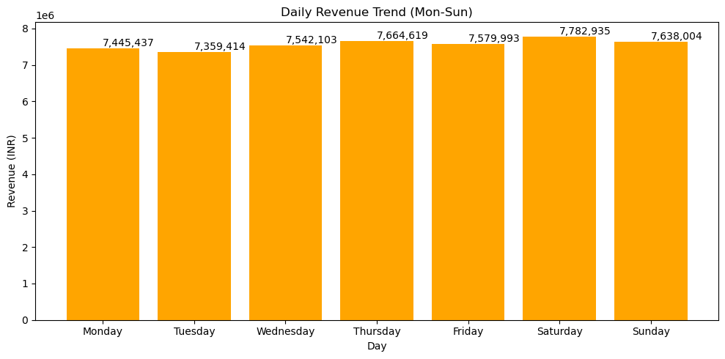
REVENUE TRENDS
Weekends Drive the Peaks
Weekly revenue fluctuates
Across 35 weeks of data, revenue consistently lands near ₹1.5M per week, with select weeks outperforming others — a sign of promotional or seasonal effects.
Weekends lead, but not by a wide margin
Saturday revenue tops the week while Tuesday lags — demand is fairly stable day-to-day, with only a modest weekend lift.
Business impact
Replicate strategies from high-performing weeks; use Tuesdays for promotions to balance demand across the week.
Total revenue by day of week (Mon–Sun)
₹7.78M
Saturday — peak day
₹7.35M
Tuesday — lowest day
Swiggy Sales Analysis • EDA Project
4

Slide 5
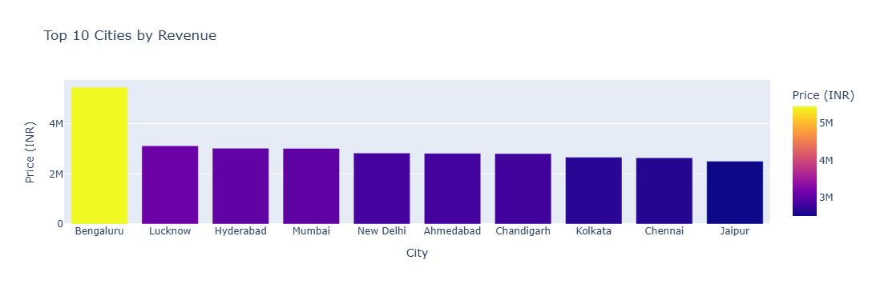
GEOGRAPHY
Karnataka Leads, Metros Dominate
States: clear regional concentration
Karnataka alone generates ~₹5.46 Cr — nearly 75% more than the next-highest state, Uttar Pradesh, followed closely by Telangana and Maharashtra.
Cities: metro dominance
The top 10 cities by revenue are almost entirely Tier-1 metros — confirming where current demand, and growth, is centered.
Business impact
Prioritize marketing and restaurant partnerships in top states/cities, while testing expansion plays in mid-tier markets.
Swiggy Sales Analysis • EDA Project
5

Slide 6
RESTAURANT PERFORMANCE
A Few Brands Drive the Bulk of Sales
Top 10 restaurants by total revenue (₹)
Swiggy Sales Analysis • EDA Project
6

Slide 7
CUSTOMER EXPERIENCE
Ratings Skew Strongly Positive
AVERAGE RATING
4.34 / 5
88% of all orders are rated 4.0 or higher, with very low variance — a strong, consistent satisfaction baseline.
Business Impact
Strong ratings are a trust signal worth featuring in marketing; low-rated outliers flag where service recovery is needed.
Distribution of customer ratings across 197,430 orders
Swiggy Sales Analysis • EDA Project
7

Slide 8
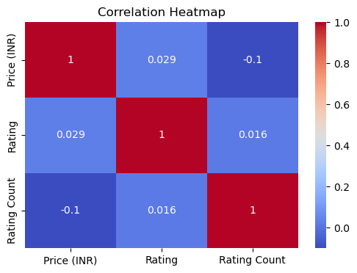
DEEPER ANALYSIS
Price Doesn't Buy Better Ratings
Weak price–rating correlation
Price (INR) and Rating show only a weak relationship — paying more doesn't reliably translate into a better-rated experience.
Quality over cost
Customers appear to value taste and service consistency more than the price point itself when rating their order.
Business impact
Investment in food quality and delivery experience will move ratings more than pricing strategy alone.
Correlation: Price, Rating & Rating Count
Swiggy Sales Analysis • EDA Project
8

Slide 9
CONCLUSION
From Raw Orders to
Actionable Business Strategy
₹5.30 Cr
Total revenue analyzed
Analyzed 197K+ Swiggy orders across 8 months to map revenue patterns by time, geography and restaurant. Demand is steady through the week with a mild weekend lift, Karnataka and metro cities lead revenue, and customer satisfaction stays high (4.34★) regardless of price — insights that directly inform marketing, staffing and partnership decisions.
197,430
Orders processed
4.34 ★
TECH STACK
Average customer rating
Python
Pandas
NumPy
10
Matplotlib
Seaborn
Visual insights delivered
Plotly
Ayush Tiwari | ayusharies1o@gmail.com

