Slide 1

Classification of Brain Tumor using Image Analysis
Ayush Arora | MS in Information Sciences and Technology, Golisano College of Computing and Information Sciences
November 22, 2019

Slide 2
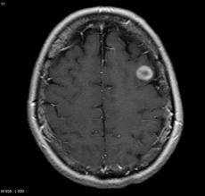
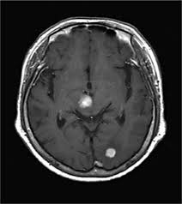
Introduction to Brain Tumors
Classification of Brain Tumor using Image Analysis
Neoplasm is a new abnormal growth of tissue in a part of the body, especially as a characteristic of cancer.
Primary Brain Tumors that start in the brain and tend to stay there.
Secondary Brain Tumors that start in a part of the body and travel to the Brain. These are in most of the cases cancerous in nature.
Malignant Brain Tumors are cancerous in nature and fatal in nature.
Benign Brain Tumors are those which are non- cancerous in nature and generally not cause any major loss to human body.

Slide 3
Introduction to Medical Imaging Process
Classification of Brain Tumor using Image Analysis
The major techniques of Imaging a Brain Tumor are CT (Computerized Tomography) and MRI (Magnetic Resonance Imaging).
CT uses computer-processed combinations of X-Ray measurements taken from angles to produce cross- sectional images of the specific parts of the body.
Magnetic resonance imaging or nuclear magnetic resonance is a technique for creating detailed images of human body. This technique uses a very powerful magnet to align the nuclei of atoms inside the body, and a variable magnetic field that causes the atoms to resonate, a phenomenon called nuclear magnetic resonance. The nuclei produce their own rotating magnetic fields that a scanner detects and uses to create an image.

Slide 4
Problem Statement
Classification of Brain Tumor using Image Analysis
A Tumor in the brain is dangerous regardless of its cancerous nature.
Hence its treatment is completely depended on the images captured.
Cancer is know to be the second highest life taker after Cardio- Vascular Arrests.
The life ending prognosis in case of a Brain Cancer is highly likely because of the millions of the motor-controlling neurons.

Slide 5
Objective
Classification of Brain Tumor using Image Analysis
Over the past years a lot of systems for the classification of Brain Tumors into Malignant or Benign.
These systems are expected to have a high accuracy for the classification of a tumor and hence is the reason for their non-use in the field.
The aim here in building this project is to increase the accuracy of the systems developed earlier for the application with regard to the older systems.
The major objective for the development of the project is to use various algorithms at different stages of classification using Image Processing techniques to increase the accuracy of the system as a whole.

Slide 6
Objective
Classification of Brain Tumor using Image Analysis
Over the past years a lot of systems for the classification of Brain Tumors into Malignant or Benign.
These systems are expected to have a high accuracy for the classification of a tumor and hence is the reason for their non-use in the field.
The aim here in building this project is to increase the accuracy of the systems developed earlier for the application with regard to the older systems.
The major objective for the development of the project is to use various algorithms at different stages of classification using Image Processing techniques to increase the accuracy of the system as a whole.

Slide 7
Proposed System
Classification of Brain Tumor using Image Analysis
Image in Jpeg Format
Image Enhancement
The system takes in Image from MRI machine in JPEG format.
The Image is enhanced to ensure optimum presentation of all digital computer processing.
Further, the image is segmented to extract the edges, features and other necessary datapoints.
Finally Classification of the dataset is run to classify the Brain Tumor as Malignant or Benign
Classification
Segmentation and Edge Detection

Slide 8
Image Preprocessing
Classification of Brain Tumor using Image Analysis
The representation of the color model of the image with the intensities ranging from 0-255 mapping the various shades of gray is Gray Scaling the image.
Contrast enhancement is a process that makes the image features stand out more clearly by making optimal use of the colours available on the display or output device.
The conversion of a gray-scale image into Binary Images is known as Thersholding.
Original Image
Gray-Scaled Image
Contrast Enhanced Image
Thresholded Image

Slide 9
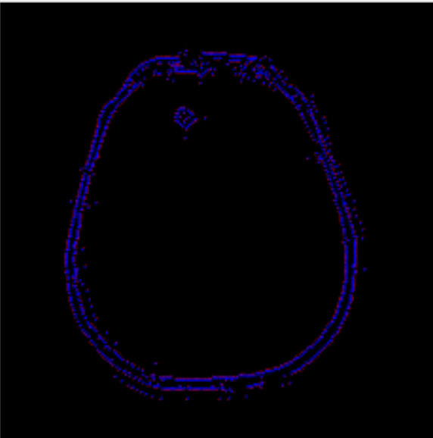
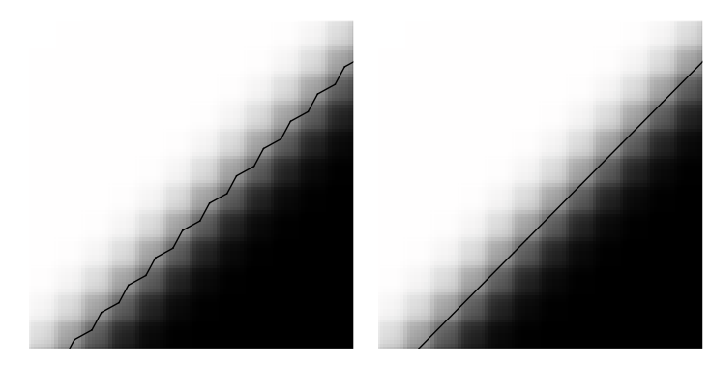
Feature Detection
Classification of Brain Tumor using Image Analysis
Segmentation is the process of extraction of the Region of Interest from an image.
Edge detection is an image processing technique for finding the boundaries of objects within images. It works by detecting discontinuities in brightness.
The Edge Detection Algorithm used in the system calculates the edges to a Sub – Pixel Accuracy over the potential edge detected by using Gaussian Filters and Supressions.
Edge Detection on a Brain Tumor
Simple versus Sub – Pixel Accuracy

Slide 10
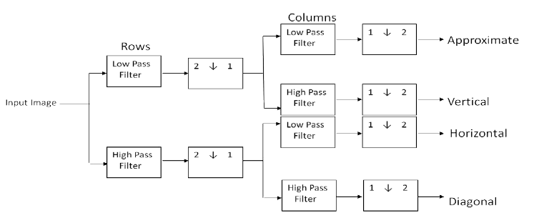
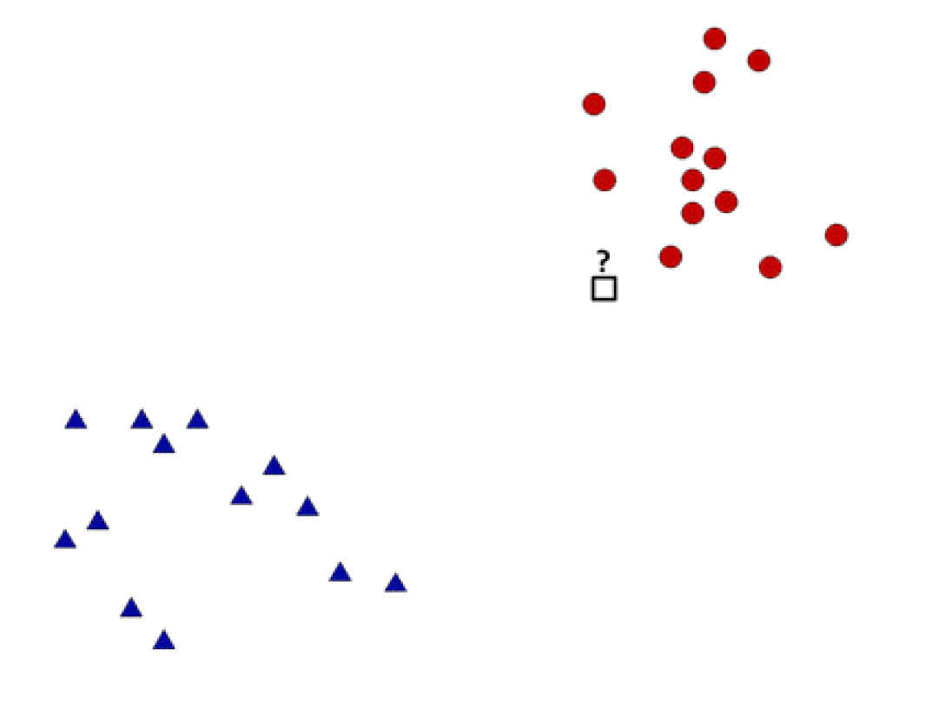
Classification
Classification of Brain Tumor using Image Analysis
The Processed Image is passed through a DWT Algorithm to receive a functional matrix with tens of thousands of values.
Further it is passed through the Principal Component Analysis (PCA) which aggregates and reduces the matrix by a ratio of 1024 to 7.
Finally Supervised Learning process is run using the K- Nearest Neighbors Algorithm to classify the type of the Tumor.
Discrete Wavelength Transformation
K- NN Algorithm

Slide 11
Demonstration
Classification of Brain Tumor using Image Analysis

Slide 12
Conclusions
Classification of Brain Tumor using Image Analysis
The main focus of this system is to work with an old system of a Brain Tumor classification and work on increasing it’s accuracy and efficiency.
A classification process of a Brain Tumor has multiple stages. Updating the algorithms at the different stages like Pre-Processing, Edge Detection, Feature Extraction and Reduction and finally the classification provided us with better accuracy.
After working and researching a set of algorithms were integrated to bring a better accuracy percentage of 95.14% for a testing cycle of ‘50’ for about of 60 test data images which we hope will be maintained for the further iterations of the testing.
The system can be taken as a properly functioning system for the classification of the Brian Tumors into Malignant and Benign.

Slide 13
Publication Details
Classification of Brain Tumor using Image Analysis
[1]. Ayush Arora, Priyangshu Roy, “k-NN Based Classification of Brain MRI Images using DWT and PCA to Detect Different Types of Brain Tumour” published at “International Journal of Medical Research & Health Sciences”, 2017, 6(9): 15-20.
[2]. Ayush Arora, Ritesh Kumar, Shubham Tiwari, “Classification of Brain Tumor using Devernay Sub-Pixel Edge Detection and K-nearest Neighbours Methodology” at Neuroimmunology and Neuroinflammation- Special Invitation Based Issue Journal on “Immunotherapeutic Approaches for Treatment of Brain Tumors” by Dr. Terry Lichtor, from Rush University Medical Center in Chicago.
Manuscript ID: NN-11-18

Slide 14


