Slide 1
Error Correction Codes for
On-Chip Memory
Hamming SECDED Design, RTL Implementation, and Reliability Analysis
Aayush Attal | Dept. of Electronics & Telecommunication Engineering
Vidyalankar Institute of Technology | ASIC Design

Slide 2
Why On-Chip Memory Needs ECC
Soft errors are real
Cosmic-ray neutrons, alpha particles, and electrical noise silently flip stored bits -- no physical damage, but corrupted data.
Consequences scale with stakes
Crashes in commodity systems; unsafe outcomes in aerospace, automotive ADAS, medical devices, and data centers.
Standard mitigation: ECC
Store redundant parity bits alongside data so a decoder can detect, and within limits correct, errors on readout.

Slide 3
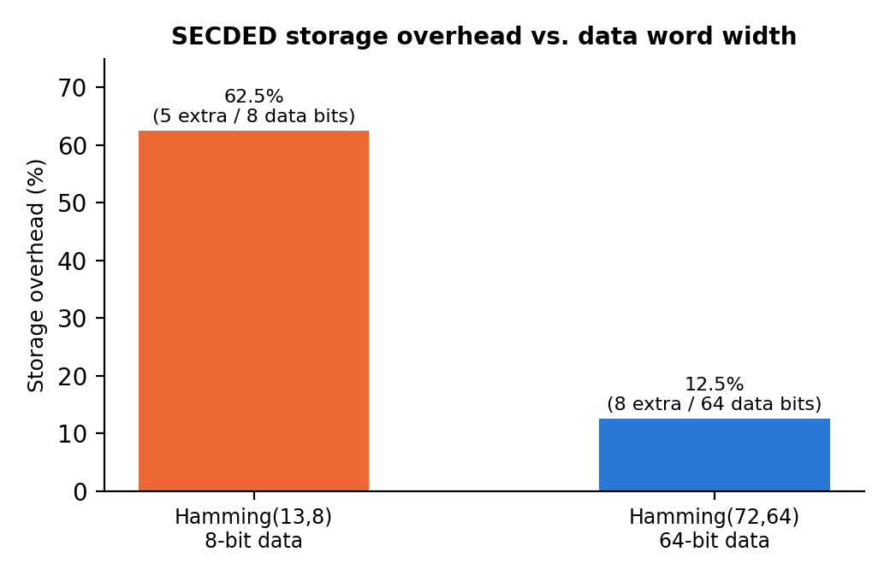
Hamming SECDED: Concept
Single Error Correction, Double Error Detection
r parity bits satisfy 2^r ≥ k + r + 1
p_i = XOR of data bits whose position has bit i set
+1 overall parity bit → distinguishes 1-bit vs 2-bit errors
Two instantiations studied
Overhead falls sharply as word width grows
(parity scales as O(log k), data scales linearly)
Hamming(72,64) — 64-bit data, 12.5% overhead
Hamming(13,8) — 8-bit data, 62.5% overhead

Slide 4
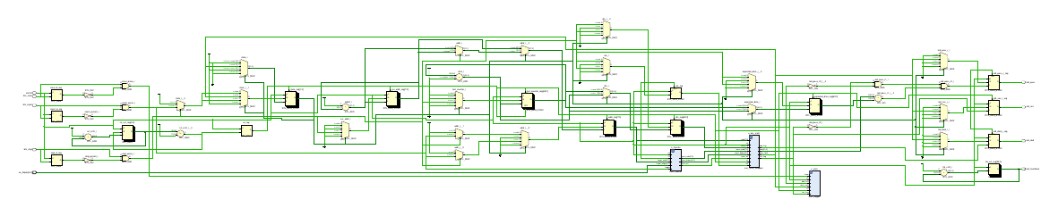
RTL Architecture & FPGA Implementation
Encoder + decoder
Combinational XOR-tree RTL, synthesizes directly to gate logic
ECC-protected memory
Wrapped around inferred Block RAM, 2-cycle read latency
Fault-injection port
Dedicated port emulates single-event upsets for test purposes
Target device
Xilinx Spartan-7 xc7s50csga324-1 (RealDigital Boolean Board)
Vivado-elaborated schematic: top_ecc_demo on xc7s50csga324-1 — u_ecc_sram, u_injector, u_stats instantiated as symbols

Slide 5
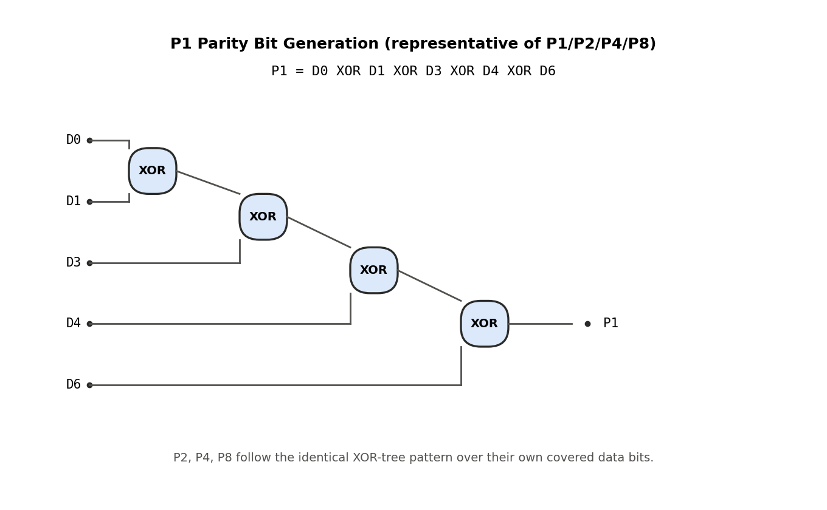
ASIC Realization: Gate-Level Design
From RTL to transistors
• Each parity bit = one XOR tree over its covered data bits
• Behavioural RTL unrolls to this exact gate structure at synthesis
• Full-custom path (planned): CMOS inverter, NAND2, NOR2 cells at transistor level in Cadence Virtuoso
• Cells to be composed hierarchically into the parity/syndrome logic
Figure: P1 parity-bit XOR tree (representative of P1/P2/P4/P8)

Slide 6
Experimental Results
Hamming(72,64) — randomized 200-trial sweep
Errors | Corrected | Detected | Miscorr.
1 bit | 200 | 0 | 0
2 bits | 0 | 200 | 0
3 bits | 0 | 0 | 200
Key finding
Within its design guarantee (≤2 bits), Hamming SECDED is 100% reliable.
99.3%
Hamming(13,8) — exhaustive 286-combination sweep (3-bit)
Outcome | Count | %
Corrected (lucky) | 2 | 0.7%
Miscorrected | 284 | 99.3%
Detected as double-error | 0 | 0.0%
silent miscorrection rate at 3 simultaneous bit errors — the decoder reports success while returning wrong data, and double_error is never raised.

Slide 7
Conclusion & Future Work
Complete, simulation-verified Hamming SECDED codec (FPGA-targeted), two data widths
Future Work
• BCH(t=2) codec benchmarked against this SECDED baseline
100% correctness within the code's design guarantee
• FPGA resource utilization (LUT/FF) and timing closure analysis
Exhaustive fault injection quantifies failure beyond that guarantee
• On-hardware radiation / fault-injection validation

