Slide 1
Domestic Load Usage Replicator
Rachana A Bujurke (1DS16EE072)

Slide 2
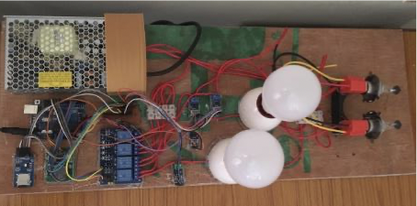
Why?
Eliminate complex circuitry
Eliminate hazardous operations
Easier to implement for a prototype
Eliminates the need to invert or rectify the power input

Slide 3
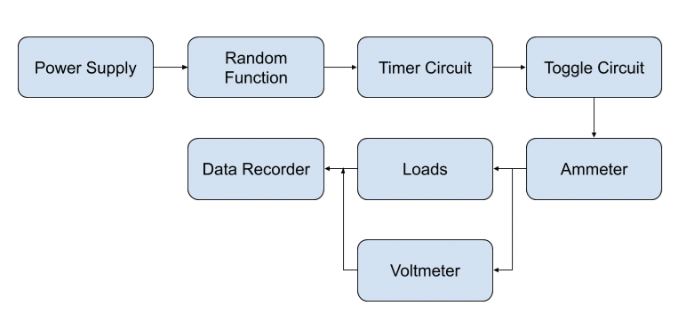
Process Flow

Slide 4
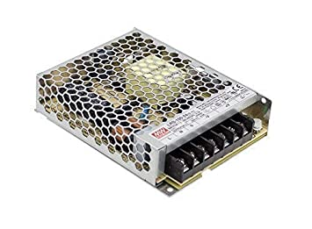
Power Supply
Brand/Model: Meanwell/ RS-12-25
4 Channel
Peak current rating of 25A

Slide 5
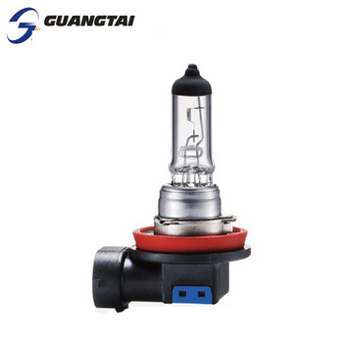

Loads
Load 1: H4 Rally lamp (12v/150W)
Load 2: 12V DC LED Bulb

Slide 6
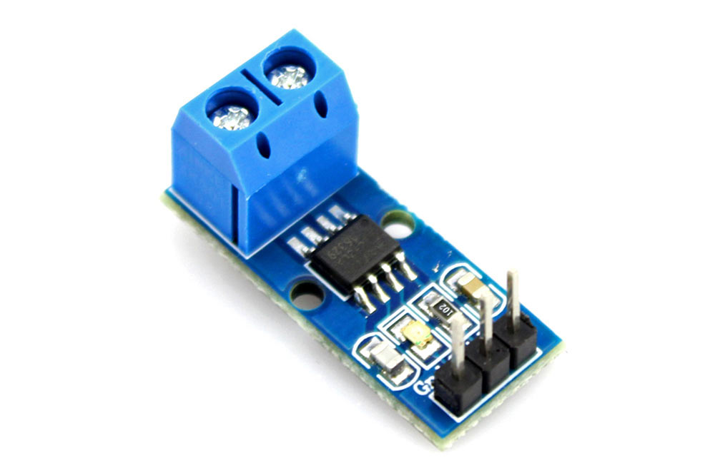
Ammeter
Hall Effect based ammeter
Connects to analog pins of the Arduino
Output ranges from 0-1023.
0 equaling to 0A and 1023 equaling to 5A/15A/30A
Load 1: 30A ACS712
Load 2: 5A ACS712

Slide 7
Control Code
Arduino IDE/ C++

Slide 8
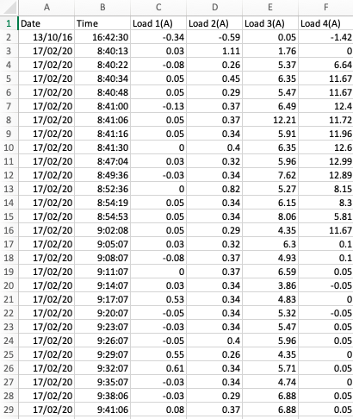
Data Snap

