Slide 1
Machine Learning
Aayush Basavesh (1DS16EE001)

Slide 2
What is Machine Learning?
Notes:
Giving computers the ability to learn without being explicitly programmed

Slide 3
Classification of Machine Learning
Based on Nature of learning signal
Based on required output
Machine Learning
Supervised Learning
Unsupervised Learning
Reinforcement Learning
Classification
Regression
Clustering

Slide 4
Supervised Learning
Simple Linear Regression
Multiple linear regression
Gradient Descent
Decision Tree
Random Forest

Slide 5
CODE
Linear Regression in Python

Slide 6
Classification Algorithms
Linear Models
Logistic Regression
Support Vector Machines
Nonlinear models
K-nearest Neighbors (KNN)
Kernel Support Vector Machines (SVM)
Naïve Bayes

Slide 7
K-Nearest Neighbours
Most basic yet essential classification algorithms
Finds intense application in pattern recognition, data mining and intrusion detection

Slide 8
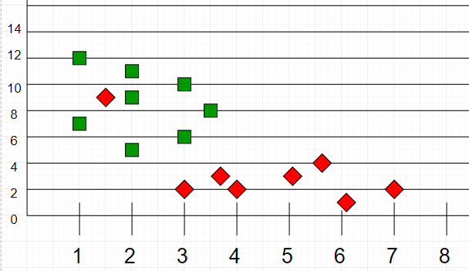
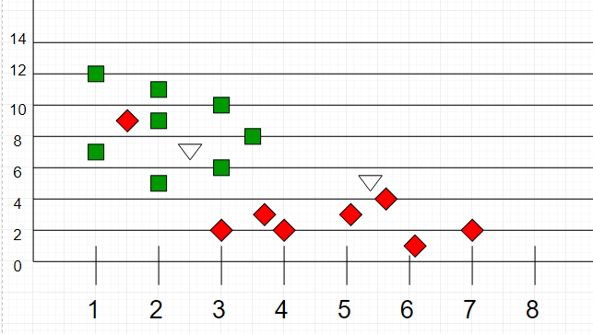
Simple Example
Notes:
Image one Training data
Image two testing data

Slide 9
CODE
KNN in Python

Slide 10
Time Series Forecasting
Series of data points indexed in time order
Some Use Cases
To predict the number of incoming or churning customers.
To explaining seasonal patterns in sales
To detect unusual events and estimate the magnitude of their effect
To Estimate the effect of a newly launched product on number of sold units

Slide 11
Components of a Time Series
Trend
Seasonality
Cyclical Component
Irregular Variation
ETS Decomposition

Slide 12
CODE
Time Series Forecasting in Python

Slide 13
Result comparison for Solar Power Generation Prediction
Linear Regression
K-Nearest Neighbors
Training error | 13.67%
Training accuracy | 86.33%
Test error | 7.88%
Test accuracy | 92.11%
Training error | 1.370%
Training accuracy | 98.62%
Test error | 1.60%
Test accuracy | 98.39%

Slide 14
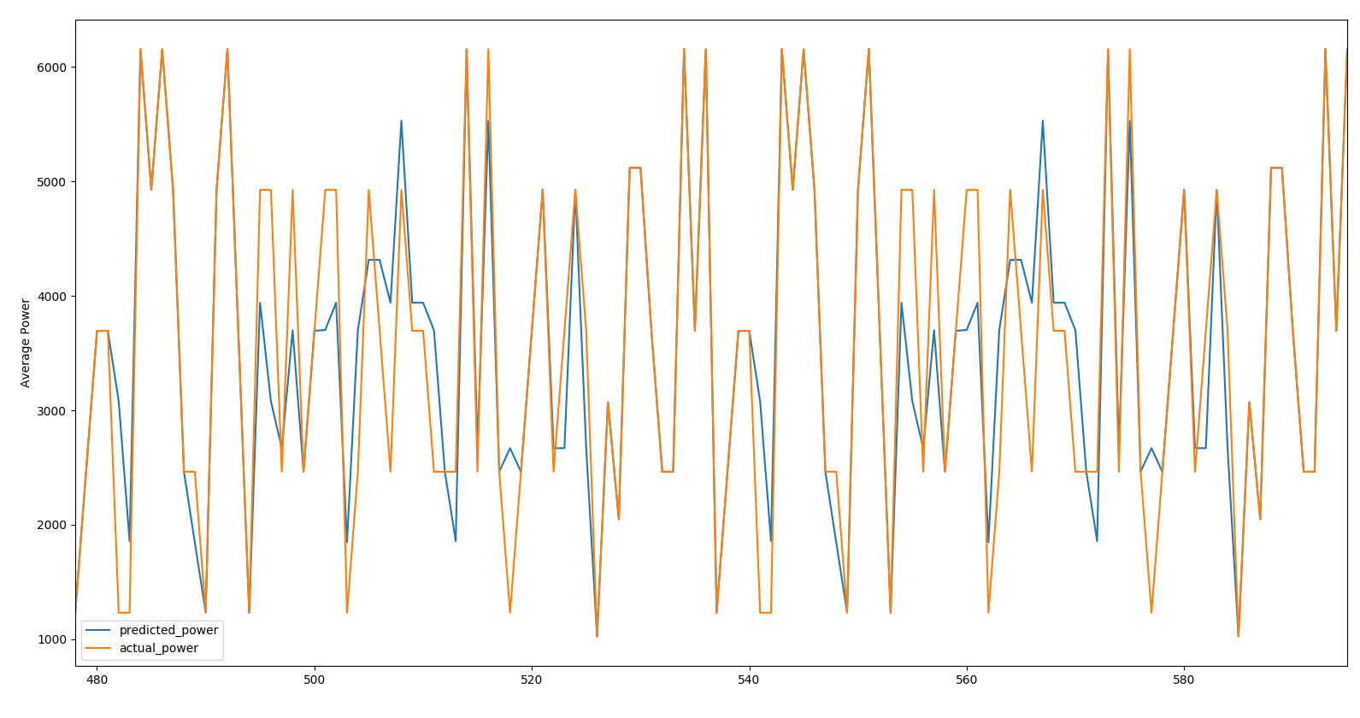
Power Consumption Prediction
Plot
Result
Training error | 21.35%
Training accuracy | 78.65%
Test error | 17.27%
Test accuracy | 82.73%
Fig. 6.3 Forecast Plot

