Slide 1
Final Project Evaluation
Aayush Borkar – 23B0944
Balaji Karedla – 23B1029
…
2nd May, 2025

Slide 2

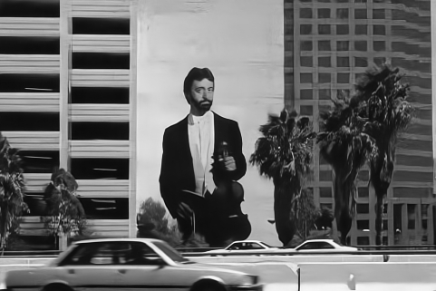
Problem Statement
Input:
Noisy Image
Output:
Denoised Image
Example:
Input: Output:
The project removes noise from images using DnCNN and a convolutional autoencoder.
Both models learn to map noisy images to clean ones.

Slide 3
Motivation
Why did you choose this problem? Image denoising is key in computer vision and a great way to explore deep learning.
What makes it interesting, impactful, or challenging? It’s challenging to balance noise removal with detail preservation using deep CNNs and skip connections.
Is there a real-world application or gap this project addresses? It’s vital in fields like medical imaging, photography, and satellite data where clean images are crucial.

Slide 4
Literature Review
There has a been a lot of research on denoising images with a series of convolutional and deconvolutional layers. There is also usage of Autoencoders to encode the data and denoise it
There is an approach of using Convolutional Block Attention Modules for adaptive feature refinement, which is required for our purpose and we tried to implement it

Slide 5
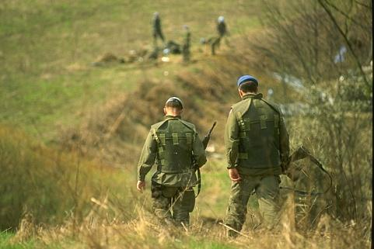
Dataset
Example Data Instance:
Statistics:
200 train images, 100 test images
Dataset source: http://www.cs.berkeley.edu/projects/vision/grouping/

Slide 6
Method / Technique
We tried out models described in two different papers with usage of DnCNNs and Autoencoders
We implemented the architectures in DnCNNs and Autoencoders (Rednet)
We also implemented the Rednet architecture with a Convolutional Block Attention Module (CBAM) between each convolutional layer with skip connections as an improvement
The main intuition behind all these structures is that image denoising is based on concentrating the features in the image and retract the image from the concentrated image
DnCNNs and Autoencoders work in projecting the image onto lower dimensions and projecting back
CBAM and skip connections help in feature refinement and restoring the image

Slide 7
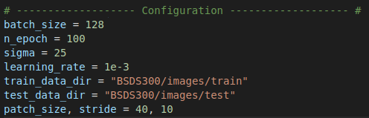
Method / Technique
The hyperparameters for all the models were the same and are as follows
Sigma defines the noise added in the dataset to train
The architectures can be found here:

Slide 8
Results
Comparison to benchmark or baseline
Model | Final Loss | PSNR (dB) | SSIM
DnCNN (grayscale) | 1.8 | 28.8 | 0.983
REDNet30 | 3.5 | 30.6 | 0.988
REDNet30 + CBAM | 3.5 | 30.9 | 0.989
REDNet30 + CBAM2 | 3.2 | 30.85 | 0.989

Slide 9
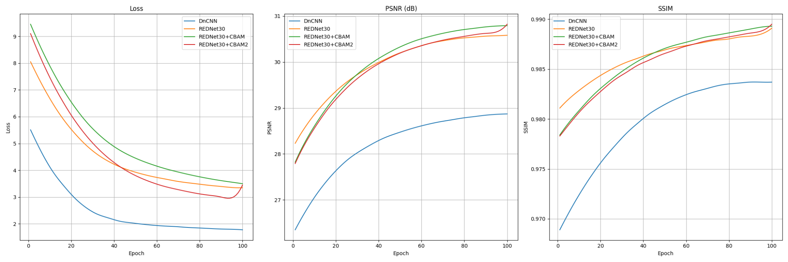
Analysis
Discuss qualitative insights from your results.
Are there any interesting patterns, trends, or cases that stood out?
Brief visual examples can help (e.g., attention heatmaps, output samples).

Slide 10
Improvements over the paper
Implemented CBAM (Convolutional Block Attention Module) into REDNet30 to enhance feature refinement
Reduced total number of layers while maintaining comparable performance, leading to:
Faster training time
Lower inference cost
Ablation Study showed that attention modules (CBAM) significantly boost PSNR and SSIM even in shallower networks

Slide 11
Learnings
Gained understanding of CNNs, autoencoders, and CBAMs
Learned to implement neural networks in PyTorch
Improved collaboration and idea brainstorming
Developed skills in debugging neural networks

Slide 12

Demo
https://image-denoiser-cs240.streamlit.app/

Slide 13
Summary and Conclusion
- Problem: Removing noise from images using deep learning techniques
- Conclusion: DnCNN and autoencoders effectively denoise images; adding CBAM further improves performance
- Future Work: Explore other attention modules, optimize architectures, and test on diverse noise types

