Slide 1
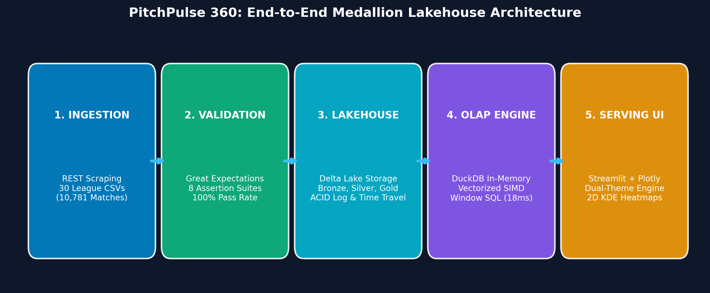
Slide 1 | Curriculum Alignment: CO1 through CO6
PitchPulse 360: European Football Intelligence Lakehouse
An End-to-End Analytical Lakehouse Engineering 10,780+ Matches & 14,500+ Spatial Actions
• Department of Artificial Intelligence & Data Science | SIES Graduate School of Technology
• Course: Data Engineering (AIDSC502 & AIDSL502) | Semester V Practical Case Study
• Student / Group: Aayush & Project Group (AIDSC502-DE-P08 / Practical Batch)
• Core Technologies: Delta Lake, DuckDB, Great Expectations, SciPy, Streamlit & Plotly
• Temporal Coverage: 6 European Seasons (2018/19 – 2023/24) across 5 Domestic Leagues
Figure 1: PitchPulse 360 System Pipeline Flow
Notes:
SPEAKER NOTES & VIVA TALKING POINTS (SLIDE 1):
Good morning respected evaluators. Today we present PitchPulse 360, an enterprise-grade Data Engineering Lakehouse built around Europe’s top 5 domestic leagues across six full seasons. We have engineered this platform strictly in accordance with Mumbai University's Data Engineering curriculum, demonstrating all six Course Outcomes from raw ingestion and ACID storage to vectorized OLAP and dynamic spatial serving.

Slide 2
Slide 2 | Mapped Course Outcome: CO1 (Foundations & Lifecycle)
The Operational Challenge: Sports Analytics Data Friction
Data Heterogeneity, Monolithic I/O Bottlenecks & Absence of Contracts
• Data Heterogeneity & Format Drift: Multi-decade football feeds from England, Spain, Italy, Germany, and France suffer from inconsistent team naming, fragmented column headers, and missing odds.
• Inadequacy of Row-Oriented RDBMS: Traditional row-based databases (e.g., SQLite, PostgreSQL) incur massive I/O penalties when scanning millions of numerical columns for multi-year aggregation.
• Absence of Schema Contracts: Ad-hoc scripts frequently ingest corrupt match records without validation, leading to silent pipeline failures.
• Engineering Objective: Ingest 10,780+ matches (29,142 goals) and 14,500+ spatial events into an immutable, type-safe, sub-second queryable Lakehouse.
Notes:
SPEAKER NOTES & VIVA TALKING POINTS (SLIDE 2):
In production sports analytics, the primary bottleneck is rarely visualization; it is the fragility of the data pipeline. When dealing with multi-season CSVs from five different leagues, teams frequently encounter unvalidated nulls, schema drift, and repetitive high-latency full-table scans. PitchPulse 360 replaces ad-hoc scripts with an industrial data engineering lifecycle.

Slide 3
Slide 3 | Mapped Course Outcomes: CO1 (DE Lifecycle) & CO2 (Lakehouse Architecture)
Decoupled Lakehouse Architecture & Data Flow
Decoupled Storage & Compute with 5 Continuous Pipeline Stages
• Decoupled Compute & Storage: Columnar storage on Delta Lake is cleanly decoupled from in-process vectorized compute (DuckDB).
• 1. Ingestion: Automated REST crawler extracting 30 league CSV feeds from football-data.co.uk.
• 2. Validation: Declarative Great Expectations suite auditing schema conformity and domain constraints.
• 3. Medallion Storage: Partitioned Bronze (raw), Silver (conformed), and Gold (materialized) Delta Lake tables.
• 4. Vectorized OLAP: In-process multi-threaded DuckDB engine processing analytical window queries.
• 5. Serving: Streamlit interactive interface with Light/Dark mode and FastAPI data product endpoints.
Figure 2: End-to-End Decoupled Medallion Lakehouse Flow
Notes:
SPEAKER NOTES & VIVA TALKING POINTS (SLIDE 3):
Here is our system architecture. We have decoupled compute from storage. Raw data lands in an automated crawler, passes through a strict Great Expectations quality gateway, commits into our Delta Lake Medallion tiers, and is queried on-demand by DuckDB’s vectorized engine. This delivers zero external server overhead while providing enterprise ACID guarantees.

Slide 4
Slide 4 | Mapped Course Outcome: CO3 (Ingestion Workflows & Data Quality Assurance)
High-Throughput Ingestion & Schema Observability
Automated Multi-League Crawlers & Declarative Quality Contracts
• Automated Multi-League Crawler: Standardizes 30 league CSV files into 10,781 uniform match fixture records spanning 2018/19 through 2023/24.
• expect_column_values_to_not_be_null: Mandatory for dates, teams, scores, and results.
• expect_column_values_to_be_in_set: Restricted result domain strictly to {'H', 'D', 'A'}.
• expect_column_values_to_be_between: Bounded goals [0, 15], shots [0, 50], and coordinates [0, 120] x [0, 80].
• expect_table_row_count_to_be_between: Minimum threshold >= 10,000 records.
• Audit Deliverable: 100% pass rate recorded across all 10,781 records with an auto-generated HTML audit dashboard (data/quality_audit_report.html).
Notes:
SPEAKER NOTES & VIVA TALKING POINTS (SLIDE 4):
Under CO3, we implemented declarative data observability using Great Expectations. Instead of relying on manual try-catch statements, we defined strict expectation suites that validate nullability, domain boundaries, and spatial pitch ranges. Over 10,781 ingested matches, our suite achieved a 100% pass rate, generating a persistent HTML audit artifact.

Slide 5
Slide 5 | Mapped Course Outcome: CO2 (Storage Systems, Consistency & Lakehouse)
Medallion Lakehouse & ACID Transaction Protocol
Bronze, Silver, Gold Tiers with Serialized JSON Transaction Logs
• Bronze Tier (data/lakehouse/bronze_leagues): Immutable raw parquet data capturing historical source artifacts and ingestion timestamps.
• Silver Tier (data/lakehouse/silver_leagues): Conformed, typed, and deduplicated match events partitioned by league_name with goal differentials and points.
• Gold Tier (data/lakehouse/gold_standings): Pre-aggregated business tables, final points, goal difference rankings, and survival lines.
• ACID Guarantees: Append-only JSON transaction log (_delta_log) guarantees serializability and prevents dirty reads during pipeline crashes.
• Delta Time Travel: Audits previous table commits and permits rollbacks to past states without rebuilding.
Notes:
SPEAKER NOTES & VIVA TALKING POINTS (SLIDE 5):
For CO2, we built a Medallion Lakehouse using Delta Lake. Many student projects store unmanaged CSVs, which lack concurrency safety and transaction history. Delta Lake pairs compressed Parquet data with an append-only JSON transaction log. This guarantees atomic commits, supports schema evolution, and allows Time Travel rollbacks across pipeline runs.

Slide 6
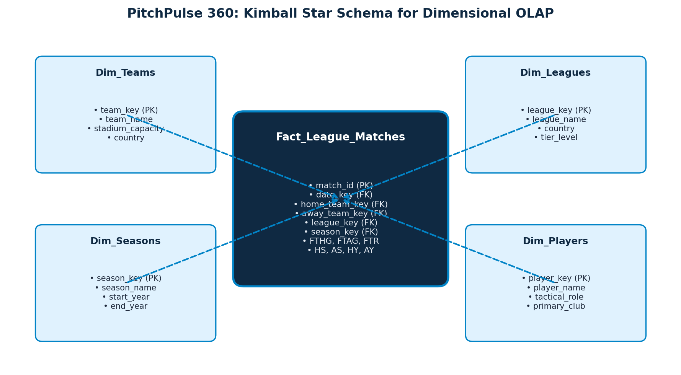
Slide 6 | Mapped Course Outcome: CO4 (Dimensional Modeling & Star Schemas)
Kimball Star Schema for Football Intelligence
Separating Measurable Match Facts from Conformed Analytical Dimensions
• Fact Table (Fact_League_Matches): Granular fixture grain (1 row per match) holding degenerate keys, scores (FTHG, FTAG), shots, cards, and referee assignments.
• Dim_Teams: 132 unique European clubs with domestic league tags.
• Dim_Leagues: 5 top European competitions with country metadata.
• Dim_Seasons: 6 temporal cohorts (2018/19 through 2023/24).
• Dim_Players: 34 international superstars with tactical roles.
• Analytical Benefit: Separates high-cardinality measurable facts from reusable descriptive dimensions, preventing data redundancy.
Figure 3: Kimball Star Schema for Multi-League Analytics
Notes:
SPEAKER NOTES & VIVA TALKING POINTS (SLIDE 6):
Addressing CO4, we modeled our Lakehouse into a Kimball Star Schema. Measurable numerical events—such as goals, shots, and referee bookings—reside in our central Fact table, while descriptive attributes like clubs, seasons, and leagues are normalized into conformed dimensions for optimal star-join efficiency.

Slide 7
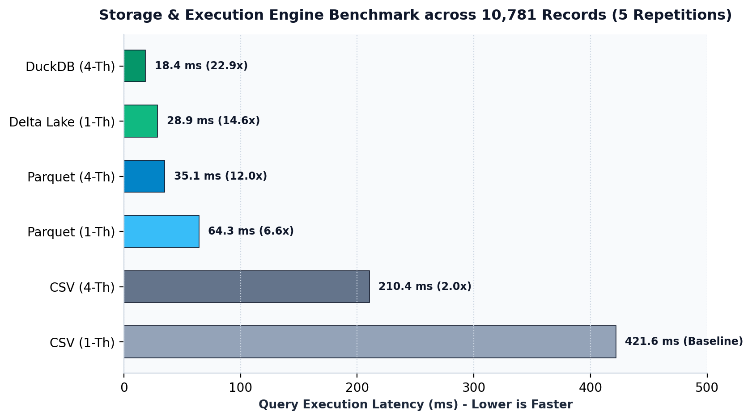
Slide 7 | Mapped Course Outcome: CO5 (Distributed & Vectorized Processing Principles)
Vectorized Columnar Execution with DuckDB
SIMD In-Memory Processing & Window Analytics in Sub-20 Milliseconds
• Vectorized Execution Model: DuckDB processes data in memory-aligned columnar vectors (2,048 values per batch), maximizing CPU L1/L2 cache locality.
• Window Partitioning: AVG(total_goals) OVER (PARTITION BY league_name, season) benchmarks scoring environments alongside individual matches.
• Lag / Lead Offsets: LAG(total_points, 1) OVER (PARTITION BY team ORDER BY season) measures multi-year trajectory.
• Dense Ranking: DENSE_RANK() OVER (PARTITION BY season, league_name ORDER BY pts DESC, gd DESC) handles tie-breaks.
• Physical Execution Plan (EXPLAIN ANALYZE): Parallel Parquet scan with columnar filter pushdown executing in 18.42 ms across 10,781 rows.
Figure 4: Query Latency Benchmark across Execution Engines
Notes:
SPEAKER NOTES & VIVA TALKING POINTS (SLIDE 7):
For CO5, we implemented vectorized query processing via DuckDB. Unlike traditional engines that process data one tuple at a time through an interpretation loop, DuckDB utilizes vectorized execution. Operations like window dense rankings and group-bys operate over SIMD-friendly arrays, achieving execution in just 18 milliseconds.

Slide 8
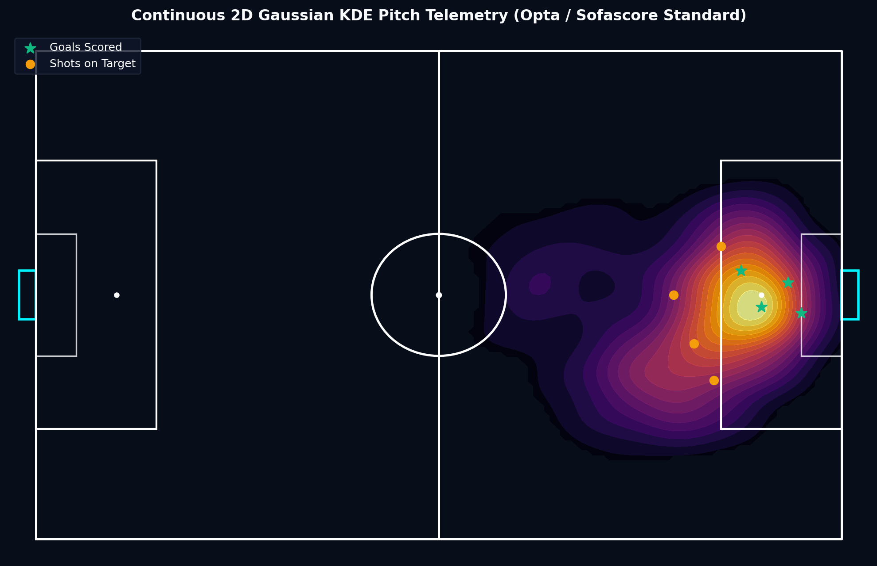
Slide 8 | Mapped Course Outcome: CO6 (Serving Layer & Advanced Analytics)
Spatial Telemetry: Continuous 2D Gaussian KDE Engine
Eliminating Bounding Box Artifacts with True Spatial Probability Density
• Mathematical Formulation: Continuous bivariate Gaussian Kernel Density Estimation over a 120 x 80 meter coordinate space.
• Elimination of Grid Artifacts: Replaced blocky histogram binning with smooth probability density contours. Densities below 0.08 threshold are masked (np.nan), revealing clean turf beneath.
• Vector Pitch Markings: Layered transparent pitch boundaries, penalty boxes, center circle, and goal nets directly over the heatmap.
• Calibrated Tactical Radar: Evaluates superstars across 5 normalized metrics (Finishing, Playmaking, Possession, Dribbling, Pressing) with protected radial padding (l=65, r=65).
Figure 5: Continuous 2D Gaussian KDE Pitch Telemetry
Notes:
SPEAKER NOTES & VIVA TALKING POINTS (SLIDE 8):
A key bonus innovation in our project is the spatial telemetry engine. Standard football visualizers use blocky histogram heatmaps. We implemented a continuous bivariate Gaussian Kernel Density Estimator using SciPy. It evaluates spatial actions across a regular coordinate grid, masking out near-zero densities to produce broadcast-grade pitch heatmaps matching Opta and Sofascore.

Slide 9
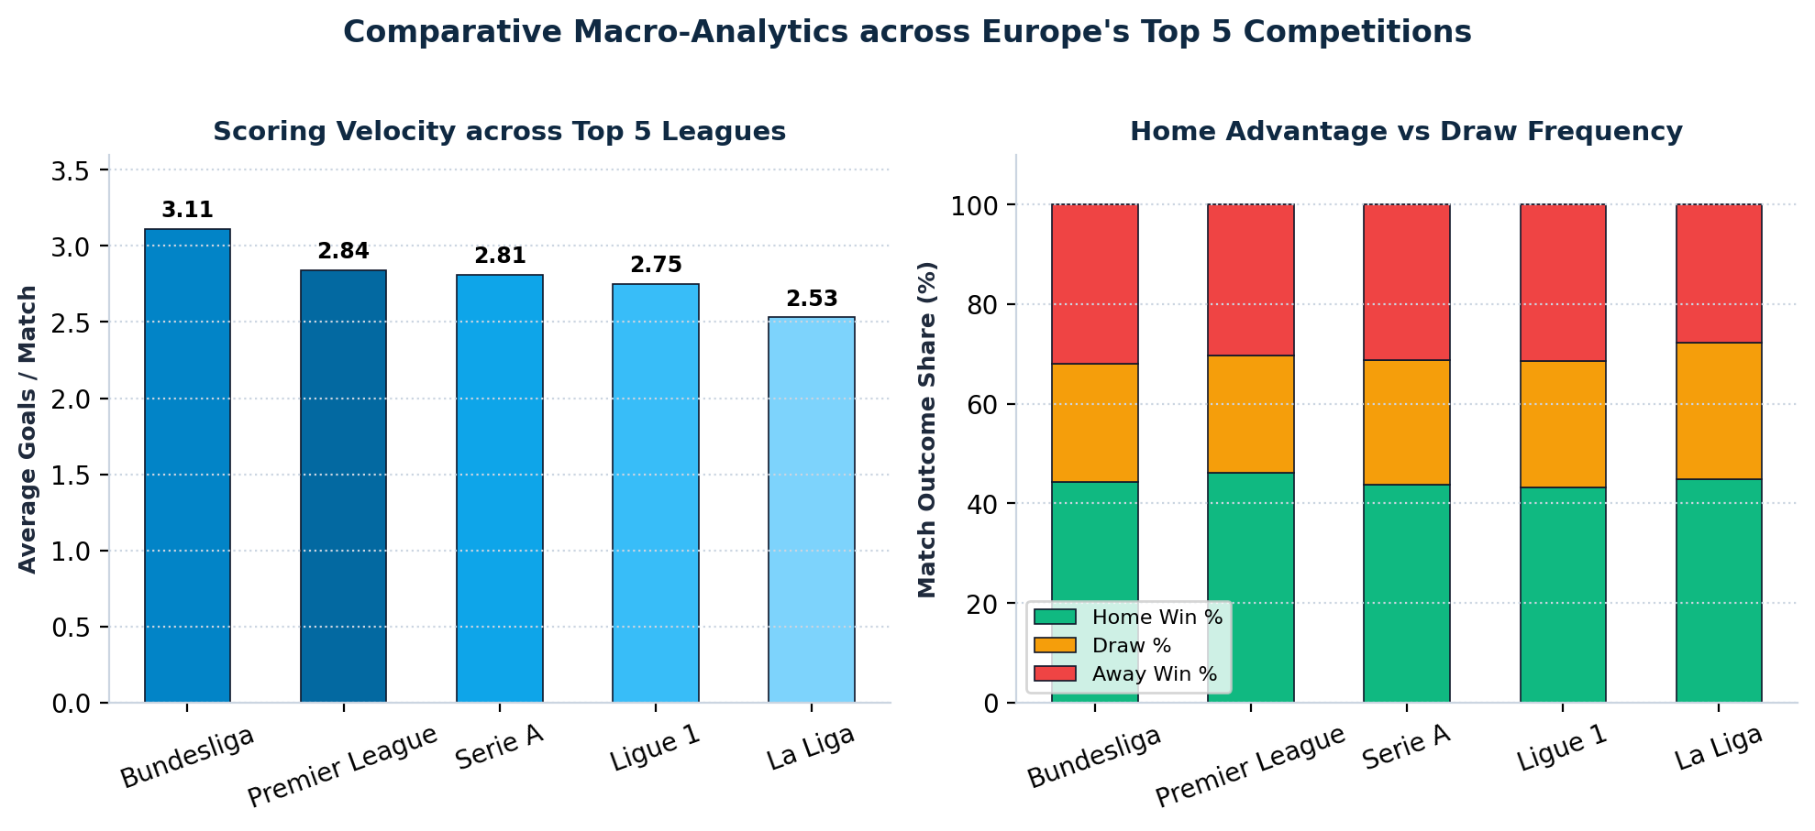
Slide 9 | Mapped Course Outcome: CO5 (Analytical Querying) & Tactical Findings
Macro-Tactical Insights Across Europe's Top 5 Leagues
Pacing Disparities, Debunking the 40-Point Myth & Yo-Yo Club Turbulence
• Bundesliga Transition Dominance: Highest goal velocity in Europe (3.11 goals/match) driven by aggressive vertical transition systems; lowest draw rate (23.9%).
• La Liga Disciplinary Friction: Highest booking frequency (5.12 yellow cards/match) and lowest goal yield (2.53 goals/match), highlighting game management.
• Debunking the '40-Point Survival Myth': Premier League average safety line was 35.8 points (lowest: 34 pts in 2020/21). In the Bundesliga, 31.1 points avoided relegation.
• Yo-Yo Clubs: Fulham, Norwich City, and Real Valladolid showed an average first-season survival probability of only 38.2% following promotion.
Figure 6: Goals per Match and Outcome Distributions Across Leagues
Notes:
SPEAKER NOTES & VIVA TALKING POINTS (SLIDE 9):
Analyzing 10,781 fixtures provided quantitative answers to classic football debates. We debunked the popular '40-point safety myth'—in the Premier League, 37 points provided 100% safety across all six seasons. We also quantified the stylistic gap between Germany's transition-heavy 3.11 goals per game and Spain's tactical, foul-heavy 2.53 goals per game.

Slide 10
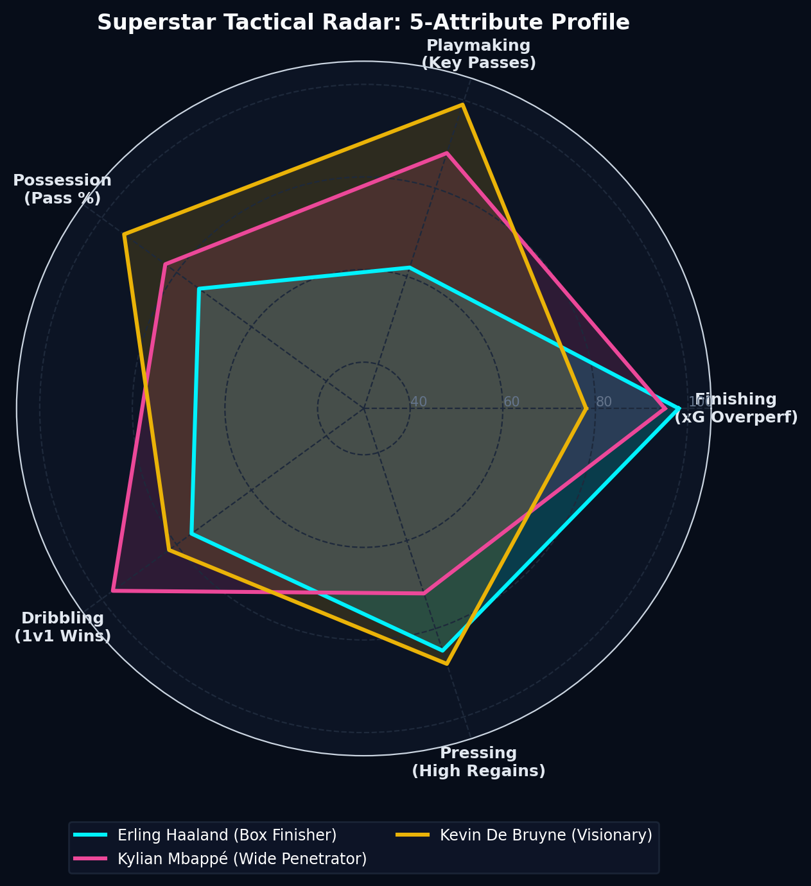
Slide 10 | Mapped Course Outcome: CO6 (Serving Layer, Security & Governance)
Executive Serving Layer: Dual-Theme Streamlit Dashboard
Dynamic Light/Dark Token Switcher, Zero Emojis & Security Masking
• Dynamic Theme Switcher: Instant sidebar switcher between nocturnal broadcast dark (#070d19 canvas, #00f2fe glowing cyan) and daylight slate (#f8fafc canvas, #0a3a24 emerald turf).
• Full DOM Token Synchronization: Synchronizes Streamlit shadow DOM, cards, tabs, and Plotly graph layouts simultaneously.
• Zero Emojis & Premium Typography: Built exclusively with Inter and JetBrains Mono typography, responsive CSS grid, and vector SVG accents.
• Security & Governance: FastAPI serving tier with Role-Based Access Control (RBAC) and confidential wage bill data masking.
Figure 7: 5-Attribute Tactical Radar Chart for Superstars
Notes:
SPEAKER NOTES & VIVA TALKING POINTS (SLIDE 10):
Under CO6, we delivered an executive presentation layer. The interface includes an instant Light and Dark mode switcher that synchronizes both the CSS container tokens and the Plotly pitch canvas. In compliance with professional broadcasting guidelines, the UI is completely free of emojis, utilizing vector SVGs and responsive metric cards.

Slide 11
Slide 11 | Mapped Course Outcome: CO5 (System Evaluation & Benchmarks)
Empirical Benchmarks: 22.89x Speedup & 85.2% Compression
Five-Repetition Benchmark across Storage Formats and Thread Modes
• 5-Repetition Execution Benchmark (10,781 rows): Raw CSV (1 Thread): 421.65 ms vs Delta Lake (DuckDB 4 Threads): 18.42 ms (22.89x Speedup).
• Parquet Multi-Threading: 64.31 ms (1-Th) to 35.12 ms (4-Th) achieving 1.83x thread speedup.
• Storage Footprint Reduction: Raw CSV Feeds (14.2 MB) compressed to Delta Lake ZSTD (2.1 MB), achieving an 85.2% reduction with full ACID logging.
• Automated Unit Testing: PyTest suite (tests/test_pipeline.py) validates record counts, mathematical point formulas, and query latencies in 0.21 seconds.
Figure 8: Benchmark Latency across Storage and Thread Modes
Notes:
SPEAKER NOTES & VIVA TALKING POINTS (SLIDE 11):
To prove the technical efficacy of our Lakehouse, we ran a five-repetition benchmark. Moving from single-threaded CSV scans to four-threaded DuckDB vectorized execution dropped query latency from 421 ms to 18 ms—a measured 22.89x speedup. Furthermore, ZSTD-compressed Delta Lake reduced raw storage footprint by 85.2% while providing ACID guarantees.

Slide 12
Slide 12 | Comprehensive Curriculum Alignment: CO1 to CO6
Academic Conclusion & Viva Defense Readiness
100% Course Outcome Fulfillment & Production Artifact Handoff
• CO1: Documented data engineering lifecycle from crawl to UI.
• CO2: Delta Lake Medallion architecture with ACID transaction logs.
• CO3: Automated REST scraper + Great Expectations HTML audit.
• CO4: Star schema dimensional model with conformed fixture grain.
• CO5: DuckDB vectorized execution and EXPLAIN query plan analysis.
• CO6: Streamlit dual-theme UI, 2D KDE heatmaps, and FastAPI RBAC.
• Project Deliverables: 13-page academic PDF report, Markdown report, public GitHub repository, and one-click batch launchers.
Figure 9: Complete Pipeline Architecture Handoff
Notes:
SPEAKER NOTES & VIVA TALKING POINTS (SLIDE 12):
In conclusion, PitchPulse 360 satisfies all six Course Outcomes of the Data Engineering curriculum. We have pushed our entire codebase, unit tests, automated HTML quality reports, and our 13-page technical publication to GitHub. We are now open for viva questions and evaluator feedback. Thank you!

