Slide 1
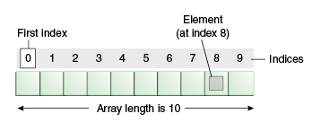
ARRAY
An array is a collection of similar type of elements that have a contiguous memory location.
Java array is an object which contains elements of a similar data type. It is a data structure where we store similar elements. We can store only a fixed set of elements in a Java array.
Array in java is index-based, the first element of the array is stored at the 0 index.

Slide 2
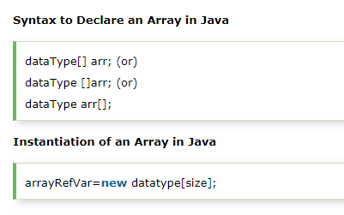
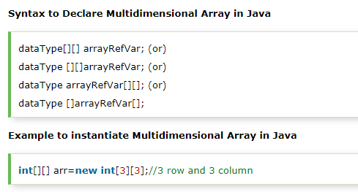
SINGLE DIMENSIONAL ARRAY
MULTIDIMENSIONAL ARRAY

Slide 3
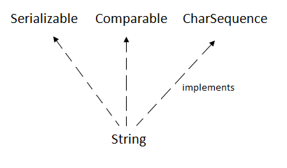
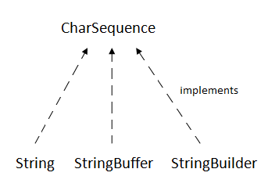
STRING
In Java, string is basically an object that represents sequence of char values. An array of characters works same as Java string.
For example:
char[] ch={'j','a','v','a','t','p','o','i','n','t'};
String s=new String(ch);
Java String class provides a lot of methods to perform operations on string such as compare(), concat(), equals(), split(), length(), replace(), compareTo(), intern(), substring() etc.

Slide 4
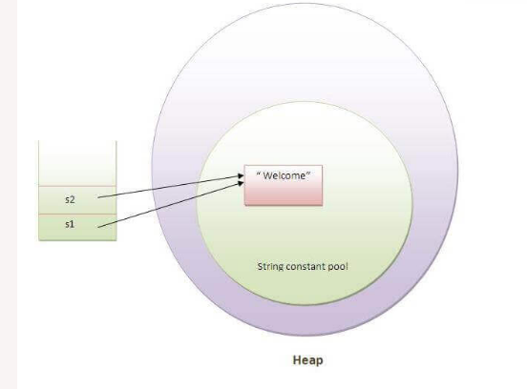
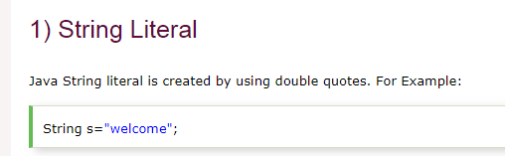
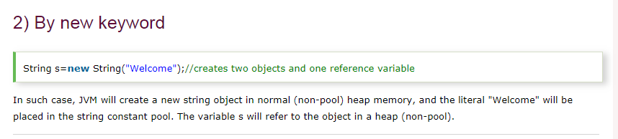
How to create a String Object?

Slide 5
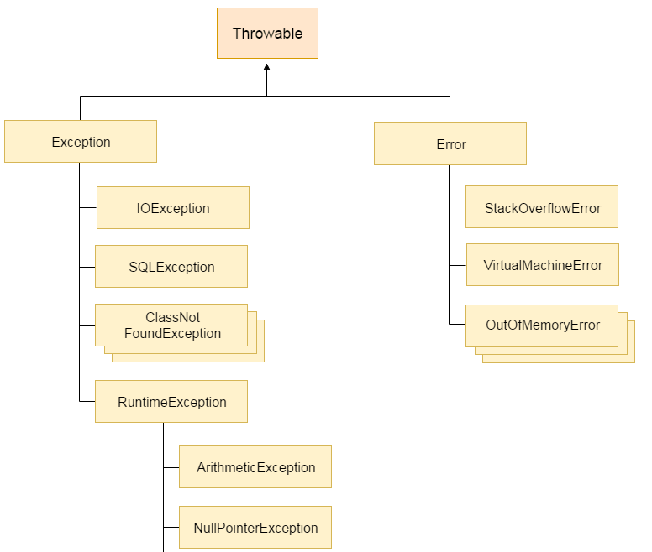
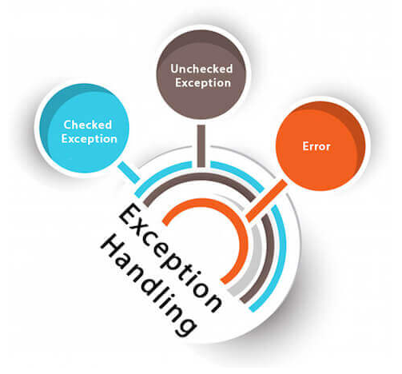
EXCEPTIONAL HANDLING
The Exception Handling in Java is one of the powerful mechanism to handle the runtime errors so that normal flow of the application can be maintained.

