Slide 1



Communication Systems for Schools
Jaypee University of Information Technology
Department of Computer Science and Engineering and Information Technology
Major Project - II (18B19CI891) | AY 2024-25
End-Term Evaluation | May 16-17, 2025.
Group No.: 123
Team Member (s)
Aayush Girdhar (211548)
Designation: Frontend Intern
Organization: Toddle
Location: Remote
Supervisor (s)
Name: Ms. Seema Rani
Department: Comp. Sci. and Engg.
Name: Mr. Gaurav Negi
Department: Comp. Sci. and Engg.

Slide 2
Outline
Introduction
Problem Statement
Objectives
Work Done (after Mid-Term Evaluation)
Project Design
Implementation
Experimental Results and Evaluation
Key Learnings
Future Work
Work Contribution and Attendance
Supervisor Interactions
References

Slide 3
Introduction
The Announcement and Messaging modules are central to enhancing transparent, real-time communication between teachers, students, and parents. Together, they streamline the flow of academic updates, instructions, and personalized interactions - all within a unified platform.
Key Enhancements & Functionality:
Auto-Save & Drafts: Both announcements and message drafts are auto-saved to safeguard progress during interruptions.
Soft Deletion & Recovery: Announcements can be soft-deleted and restored via a Bin tab; messages support archiving and flagging.
Granular Roles & Permissions: Role-based access controls ensure controlled communication across Account, Program, and Class levels.
Real-Time Messaging: Enables direct, low-latency one-to-one and group chats with full support for attachments, search, and notifications.
School Directories: Facilitates communication with predefined groups (e.g., admin bodies), allowing parents and students to resolve queries with the right school representatives easily.

Slide 4
Problem Statement
Traditional communication between schools, students, and parents faces key challenges, leading to inefficiencies and miscommunication.
Key Challenges:
Delayed or Missed Communication: Critical updates often fail to reach the intended recipients on time.
Lack of Real-Time Interaction: Communication between teachers, students, and parents is not immediate or contextual.
Scattered Communication Tools: Use of third-party platforms causes disjointed experiences and scattered data.
Absence of Automation: Missing features like auto-save, soft deletion, and intelligent filtering hinder organization.

Slide 5
Objectives
Streamline Communication: Build a unified platform to support efficient, real-time interaction among teachers, students, and parents through announcements, messaging, and directories.
Personalized Announcement Creation: Use AI-powered tools to assist teachers in composing relevant, class-specific announcements quickly.
Efficient Organization and Retrieval: Enable robust search and filtering for both announcements and messages based on class, date, sender, or recipient type.
Enhanced Usability and Accessibility: Ensure a smooth user experience through features such as soft-deletion and recovery, autosave, etc.
Direct Messaging Support: Provide real-time one-to-one and group communication with support for attachments, message search, etc.
Structured School Directory Communication: Allow users to communicate with predefined groups or departments to resolve queries related to school administration or support.

Slide 6
Work Done (after Mid-Term Evaluation)
I have worked on several key enhancements, primarily focusing on revamping the announcement creation flow and developing a submodule under Messaging - School Directory .
Revamp of Announcement Creation Flow
Overhauled the entire UI for a more intuitive experience and refactored nearly 80% of the underlying logic to improve maintainability and performance.
Added announcement preview which gives users a sense of what their announcement would look like on web, tablet and mobile.
Development of School Directory (Messaging Submodule)
Designed and implemented the School Directory feature, enabling institutes to configure predefined official groups (e.g., Academics, Finance).
This allows parents to directly initiate conversations with these groups, which dynamically creates a dedicated communication channel with relevant staff.
Bug Fixes and Refinements Actively addressed and resolved reported issues to ensure smoother user interaction and platform stability.

Slide 7
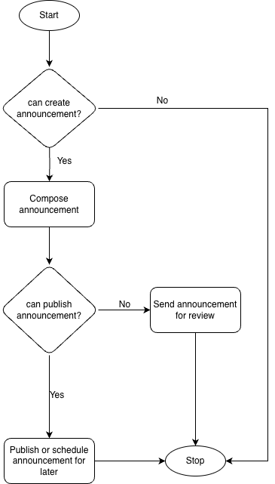
Project Design (cont…)
Fig 1: High level overview of announcement creation

Slide 8
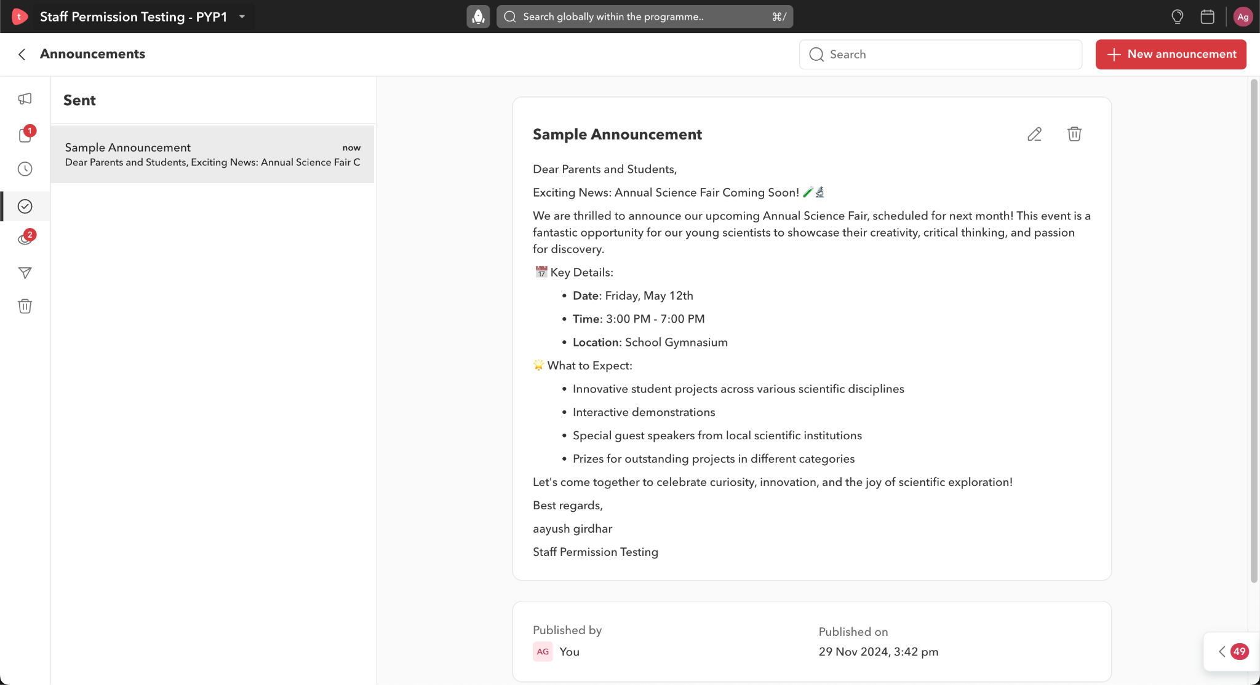
Implementation
Fig 2: Announcement Module with a sample announcement

Slide 9
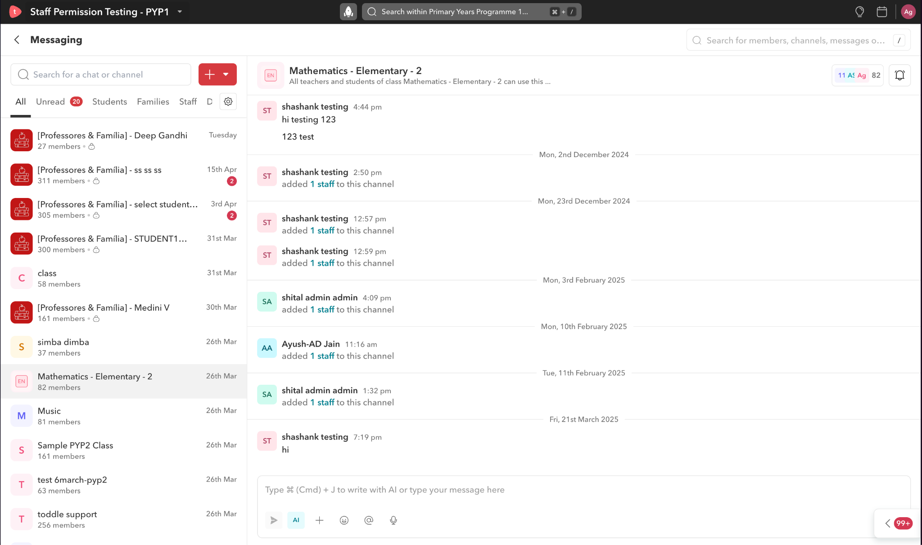
Implementation (cont…)
Fig 3: Messaging Module with Sample Messaging Thread

Slide 10
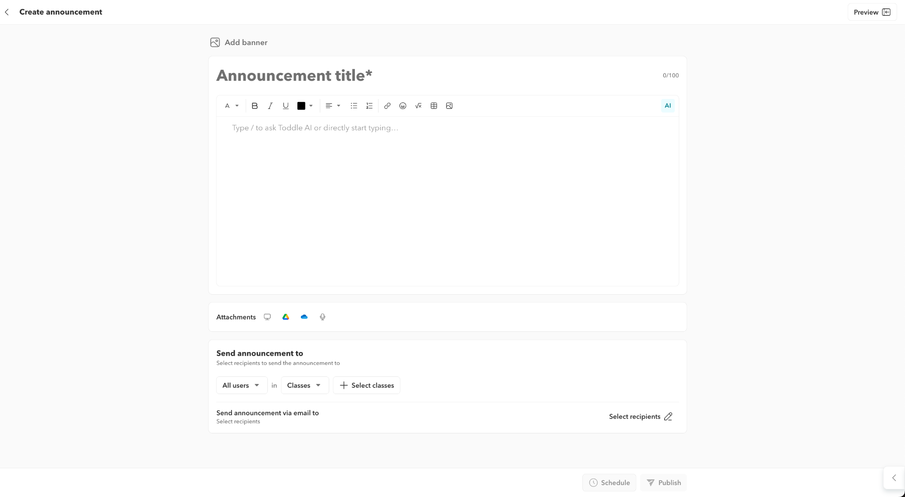
Implementation (cont…)
Fig 4: Announcement compose screen

Slide 11
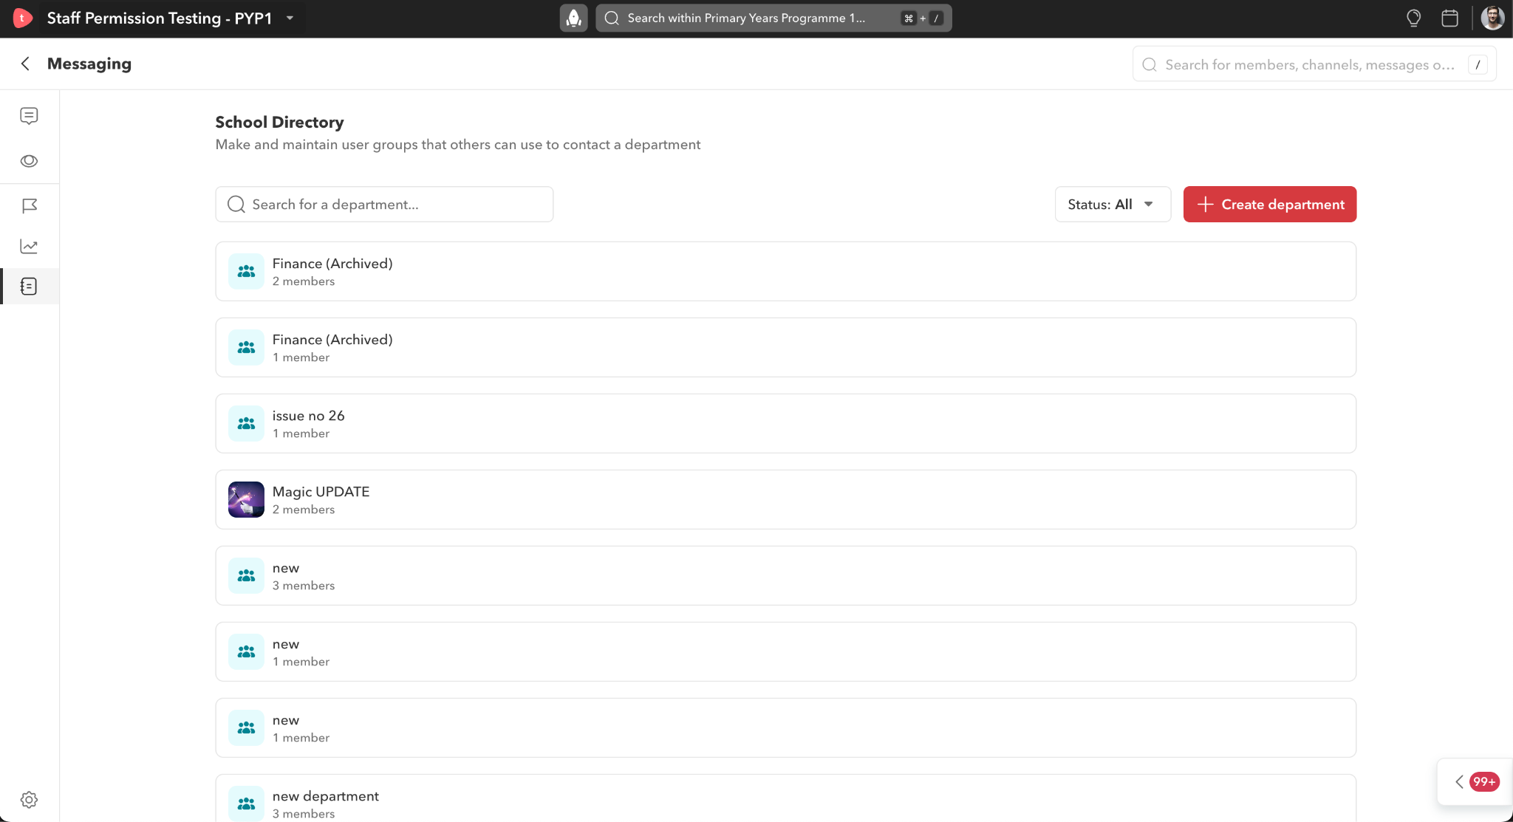
Implementation (cont…)
Fig 5: Staff Directory with sample directories

Slide 12
Experimental Results and Evaluation
System Performance
Multi-Environment Testing: The announcement module was deployed and tested in three different environments before production to ensure stability.
Optimized Response Time: The system achieved an average response time of under 400 ms for announcement creation, retrieval, and updates, ensuring a smooth user experience.
Scalability & Concurrency: Successfully handled simultaneous inputs from multiple users (teachers, students, and admins) without significant performance degradation.

Slide 13
Experimental Results and Evaluation (cont…)
Announcements
Response Time: Mean system response for creating, publishing and retrieving announcements was kept below 350 ms.
Data Consistency: Automated validation and recovery logic had made state management uniform across edge cases like abrupt re-loads, or disconnections.
Optimistic Updates: Confirmed that the UI behaved as expected when all changes (draft, edit, delete) appear immediately to give a perceived response speed and usability.
State Management: Tested transitions between Draft, Review, Published and Archived with 100% accuracy in all environments.

Slide 14
Experimental Results and Evaluation (cont…)
Messaging
Low-Latency Delivery: Messages were always sent with low latency (~120-180 ms average), so that interaction was real time.
Scalable Thread Handling: Individual and group chat threads were scalable, within delivery order and consistency even with concurrent inflow of messages.
Threaded Conversations: Functionality for viewing, replying to, and traversing threaded conversations was confirmed under multiple edge cases.
Role-based Restrictions: Verified sender-receiver access control according to user roles (students cannot initiate messages to other students etc.).
Delivery Receipts: Message delivery and read indicators all worked well across the platform.

Slide 15
Key Learnings
Modular Development & Refactoring: Understood how to break down a legacy flow (announcement creation) and refactor ~80% of logic while ensuring minimal disruption to existing users.
End-to-End Feature Ownership: Gained experience in taking full ownership from design to implementation of a complete submodule (School Directory) in the messaging system.
System Design & Architecture: Learned how to make design decisions that support scalability, maintainability, and performance in a real-world application.
Role-based Access Control: Implemented granular permissions with precision to ensure security and correct visibility across modules.
Collaboration & Review Cycles: Improved ability to collaborate with cross-functional teams and incorporate feedback through structured review workflows.

Slide 16
Future Work
Moving forward, the primary focus will be on integrating AI-driven enhancements to significantly improve user experience and operational efficiency. By automating routine tasks, the productivity of staff members can be greatly increased.
Planned Enhancements:
AI-Based Recipient Suggestions: Implement intelligent recipient prediction for announcements based on historical communication patterns and the contextual relevance of the announcement content.
Automated Responses in School Directory: Enable AI-powered replies to frequently asked questions within the school directory, minimizing the need for manual intervention in handling standard queries related to institutional policies.

Slide 17
Work Contribution and Attendance
GitHub Repository URL: https://github.com/aayushgirdhar/major-project
Team Member | Roll No. | Work Done (provide complete details) | Work Contribution (%) | Lines of Code (LoC) | Lab Attendance (%)
1. | 211548 | 100% of the work mentioned is done by me. | 100% | - | N/A

Slide 18
Supervisor Interactions (as mentioned in weekly log)
No. of Meetings with Supervisor: 7
Week No. | Duration | Remarks (as mentioned in the weekly log)
1. | 24/03/2025 to 29/03/2025 | Start scoping staff directory feature. Understand design and functional requirements
2. | 31/03/2025 to 05/04/2025 | Develop Initial UI for staff directory. Develop Dumb components.
3. | 07/04/2025 to 12/04/2025 | Add CRUD logic to staff directory. Test the whole feature.
4. | 14/04/2025 to 19/04/2025 | Work on DQC changes. Work on Bug fixes.

Slide 19
Supervisor Interactions (cont…)
Week No. | Duration | Remarks (as mentioned in the weekly log)
5. | 21/04/2025 to 26/04/2025 | Start scoping Announcement Revamp. Understand design and functional requirements
6. | 28/04/2025 to 03/05/2025 | Develop Initial UI for Announcement creation flow. Develop Dumb components. Refactor legacy logic.
7. | 05/05/2025 to 10/05/2025 | Integrate logic to the revamp. Test the whole feature. Work on DQC changes Work on bug fixes.

Slide 20
References
[1] Toddle, "Internal guidelines and system documentation," Proprietary documentation, 2024. [2] Apollo GraphQL, "Apollo Client: A fully-featured caching GraphQL client," Apollo Documentation, Aug. 2024. [Online]. Available: https://www.apollographql.com/docs/ [3] GraphQL Foundation, "GraphQL: A data query language," GraphQL Documentation, Jul. 2024. [Online]. Available: https://graphql.org/ [4] Meta Platforms, Inc., "React – A JavaScript library for building user interfaces," React Documentation, Jul. 2024. [Online]. Available: https://react.dev/ [5] Meta Platforms, Inc., "React Native – A framework for building native apps," React Native Documentation, Oct. 2024. [Online]. Available: https://reactnative.dev/ [6] Frontend Masters, "Advanced Web Development Learning Platform," Frontend Masters Course Materials, Jul. 2024. [Online]. Available: https://frontendmasters.com/

Slide 21

Thanks.

