Slide 1

BTI DS · SEMESTER 11 · DEVOPS PROJECT
PriceScope
Containerised, Orchestrated and Automated
Docker
Compose
Package
Run locally
A retail price tracker delivered with Docker, Kubernetes and a CI/CD pipeline
Kubernetes
GitHub Actions
Orchestrate
Automate
E007
Aayush Nayak
E008
Ritwik Shetty
Trivy
Prometheus metrics
E037
Iram Shaikh
Secure
Monitor
SVKM’s NMIMS
Mukesh Patel School of Technology Management and Engineering, Vile Parle, Mumbai- 400056
Department of Data Science
Notes:
Greet the audience. Introduce the project and the three of us. PriceScope is a working price tracker application. This project is about how we package, deploy, test and run it the DevOps way. Ritwik covers why, Aayush covers what we built step by step, and Iram covers the results.

Slide 2
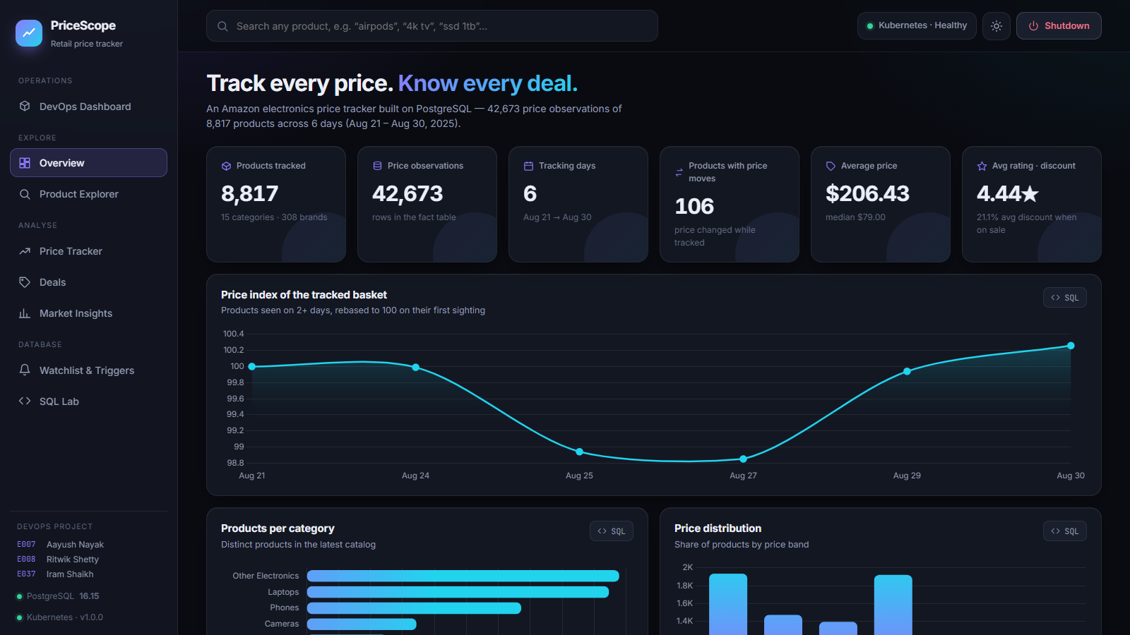
The Application: PriceScope
A real, data-heavy web app is what we took through the DevOps journey.
1
What it does
Tracks prices of 8,817 products and shows history, deals and alerts.
2
How it is built
Python Flask web server, PostgreSQL database, and a JavaScript front end.
3
Why it suits DevOps
Three parts must start in the right order: database, then data load, then the app.
Notes:
Keep this short. PriceScope tracks 8,817 Amazon electronics products. It has a Flask API, a PostgreSQL database and a web interface. It is a good DevOps subject because it has several moving parts: a web server, a database and a data-loading step that all need to start in the right order.

Slide 3
Problem Statement
“It works on my machine” is not good enough.
WHAT COULD GO WRONG
THE MANUAL WAY: RUNNING THE APP ON A NEW LAPTOP
1
Install PostgreSQL by hand
1
Different machines, different results
Another Python or PostgreSQL version can break the app.
2
Create a .env file and type the password
3
pip install every Python library
2
One crash means downtime
4
Run the data cleaning script
If the server stops, nobody restarts it until someone notices.
5
Run the database load script
3
Changes are risky
6
Start the Python server
No automatic tests, so a bug can reach users unnoticed.
Notes:
This is the core problem DevOps solves. Done by hand, running an app like this on a new laptop takes six steps, and any different version or missing step breaks it. If the server crashes, it stays down. Without automated tests, bugs slip through. Read the steps on the left, then the consequences on the right.

Slide 4
Objectives
Four goals, each solving one problem from the last slide.
01
Containerise
02
Orchestrate
Package the app and everything it needs into one Docker image that runs anywhere.
Use Kubernetes to run several copies, replace failures and update with no downtime.
03
Automate
04
Monitor
Use a GitHub Actions pipeline to lint, test, scan and publish on every push.
Add health checks, Prometheus metrics and a live DevOps dashboard in the UI.
Notes:
One line per objective. Each one maps to a step in Part 2. Containerise solves the different-machines problem, orchestrate solves crashes, automate solves risky changes, and monitor tells us the app is healthy.

Slide 5
What is DevOps?
Building software and running software, treated as one continuous process.
1
2
3
4
5
6
7
Code
Test
Build
Scan
Publish
Deploy
Monitor
Git, GitHub
pytest, ruff
Docker
Trivy
GHCR
Kubernetes
Probes, /metrics
Save every change with history
Check nothing is broken
Package the app into an image
Look for known security holes
Store the image online
Run it, with no downtime
Watch that it stays healthy
The idea in one line
If a step is done by hand, it can be done wrong. So we turn every step into code that runs the same way every time.
Notes:
DevOps joins development and operations. Instead of developers throwing code over a wall, every step is automated and repeatable. Walk through the seven steps left to right, naming the tool we used for each. The rest of the talk covers these in detail.

Slide 6
End-to-End Architecture
Two paths: how code becomes an image, and how a user reaches the app.
BUILD PATH
Developer
GitHub
GitHub Actions
Container Registry
git push
stores the code
tests, scans, builds
GHCR stores the image
image
RUN PATH
User's browser
K8s Service
App pods × 2
PostgreSQL pod
Volume
localhost:8081
shares the traffic
Flask + gunicorn
the database
data survives restarts
All of this is defined in code: Dockerfile, docker-compose.yml, k8s/*.yaml and .github/workflows/ci-cd.yml
Notes:
This is the whole project on one slide. Top row is the build path: a developer pushes code, GitHub Actions tests and builds it, and the image is published to the GitHub Container Registry. Bottom row is the run path: a user's browser reaches a Kubernetes Service, which shares traffic between two app pods, which talk to PostgreSQL, whose data lives on a persistent volume. For this demo the cluster runs on our laptop using Docker Desktop, so the deploy script builds the image locally. A cloud cluster would pull the same image from the registry.

Slide 7
Step 1: Prepare the App
Making the app behave well inside a container.
1
Settings from the environment
Devops_Project_Sem_11/
├── app/ Flask API + web UI
├── etl/ data loading
├── sql/ schema, views, trigger
├── data/clean/ the dataset
├── tests/ automated tests
├── Dockerfile
├── docker-compose.yml
├── k8s/ Kubernetes manifests
├── scripts/ deploy-k8s.ps1
└── .github/workflows/ci-cd.yml
Database host and password are set outside the code.
2
Production web server
gunicorn serves the app, built for real traffic.
3
Health and metrics addresses
/healthz, /readyz and /metrics tell tools how the app is doing.
4
Safe to restart
etl/load.py --if-empty skips loading if the data is already there.
Notes:
The first step is making the app container-ready. Settings come from environment variables, so the same image runs anywhere. Gunicorn, a production web server, serves the app. Health check addresses and metrics report its state. The load script has an if-empty option, so restarting never wipes the data. Mention the repository layout on the right: everything needed to run the project lives in Git.

Slide 8
Step 2: Docker Image
A Dockerfile is a recipe. It produces one package that runs the same everywhere.
Dockerfile
docker build
Image
Container
the recipe, stored in Git
follows the recipe
sealed package, 225 MB
the image, running
# Stage 1: install libraries
FROM python:3.12-slim AS builder
RUN pip install --prefix=/install \
-r requirements.txt
# Stage 2: only what ships
FROM python:3.12-slim
COPY --from=builder /install /usr/local
COPY app etl sql data/clean ...
USER 10001
HEALTHCHECK ... /healthz
CMD ["gunicorn", ... "server:app"]
Multi-stage build
Build leftovers are thrown away
Non-root user
USER 10001 limits possible damage
Built-in health check
Docker can tell if it is healthy
Notes:
A Docker image is the app plus Python plus every library, sealed together. Think of it like a shipping container: whatever is inside, it is handled the same way. We use a multi-stage build: the first stage installs libraries, and the second stage copies only the result, so the final image stays small. The app also runs as a normal user rather than root, which limits the damage if it were ever attacked.

Slide 9
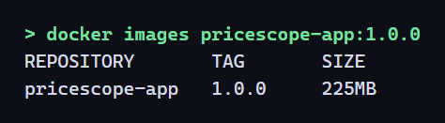
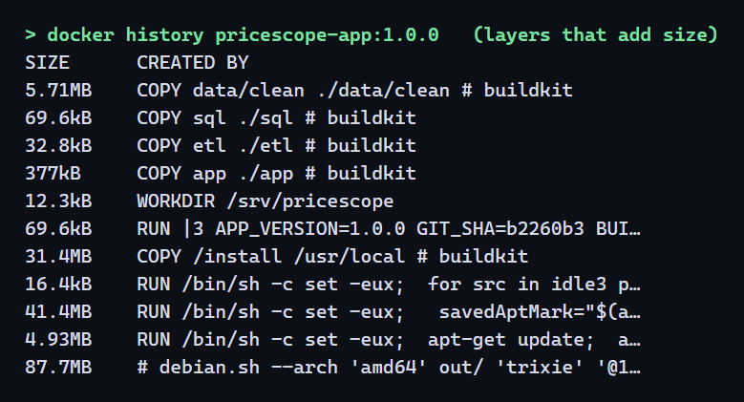
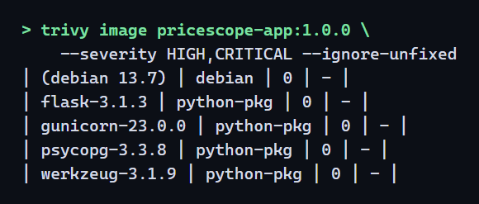
Our Docker Image
Real output from our machine: small, layered and clean.
225 MB
0
final image size
high or critical issues
Trivy security scan of the image
Docker reuses unchanged layers, so a small code edit rebuilds in seconds.
Notes:
These are real terminal outputs. Docker images shows our image is 225 MB. Docker history shows the layers: only about 6 MB is our data, 31 MB is Python libraries, and the rest is the base Python and Debian system. Layers are reused, so a rebuild after a small code change takes seconds. On the right is the Trivy security scan: zero high or critical problems with a known fix, across Debian and all Python packages.

Slide 10
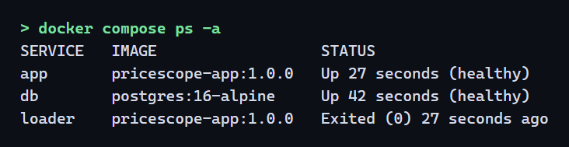
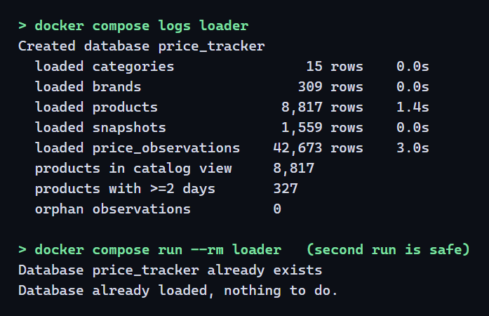
Step 3: Docker Compose
One command starts all three containers, in the right order.
docker compose up --build
1. db
2. loader
3. app
waits until healthy
loads data, then exits
serves port 5000
6 → 1
15 s
manual steps to one command
start with image already built
First run including image build: 68 seconds
Notes:
Compose describes the full application in one file. It solves the start-order problem: the database starts first, Compose waits until it is healthy, then the loader creates tables and loads 42,673 rows and exits, and only then does the app start. Six manual steps became one command. The database has no published port, so only the app can reach it. Point out on the log that running the loader a second time safely does nothing.

Slide 11
Step 4: Kubernetes in Plain English
Docker runs a container. Kubernetes keeps a whole application running.
Pod
Deployment
Service
StatefulSet + Volume
Our app running
The manager
The receptionist
The filing cabinet
The smallest unit: one running container.
Keeps 2 app pods alive and updates them safely.
One address that shares visitors between pods.
Runs the database and keeps its data safe.
Job
ConfigMap
Secret
RBAC
A one-off task
The settings sheet
The locked drawer
The ID badge
Loads the data once, then finishes.
Normal settings, kept outside the image.
Holds the password, separate from the code.
The app may read pods and scale itself, nothing else.
Notes:
Do not read all eight. Explain the idea: we tell Kubernetes what we want, for example two copies of the app, and it continuously makes that true. Use the analogy column. Then point at the ones we rely on most: Deployment, Service and StatefulSet.

Slide 12
Our Kubernetes Architecture
Everything lives in one namespace, defined by the YAML files in k8s/.
Namespace: pricescope
App pod 1
Deployment
Browser
Service
postgres
postgres-0
:8081
LoadBalancer
headless Service
StatefulSet
App pod 2
Deployment
ServiceAccount
ConfigMap + Secret
db-loader
1 Gi Volume
+ Role (RBAC)
settings, password
Job, runs once
PersistentVolumeClaim
Notes:
Follow the arrows from the left. The browser reaches the LoadBalancer Service on port 8081. It shares traffic between the two app pods. They reach the database through a Service called postgres, and the database stores its data on a persistent volume. The Job loads the data once. ConfigMap and Secret give the pods their settings. The service account is what allows the DevOps page to show live pods. This runs on a single-node Docker Desktop cluster, but the same files would work on a larger cluster.

Slide 13
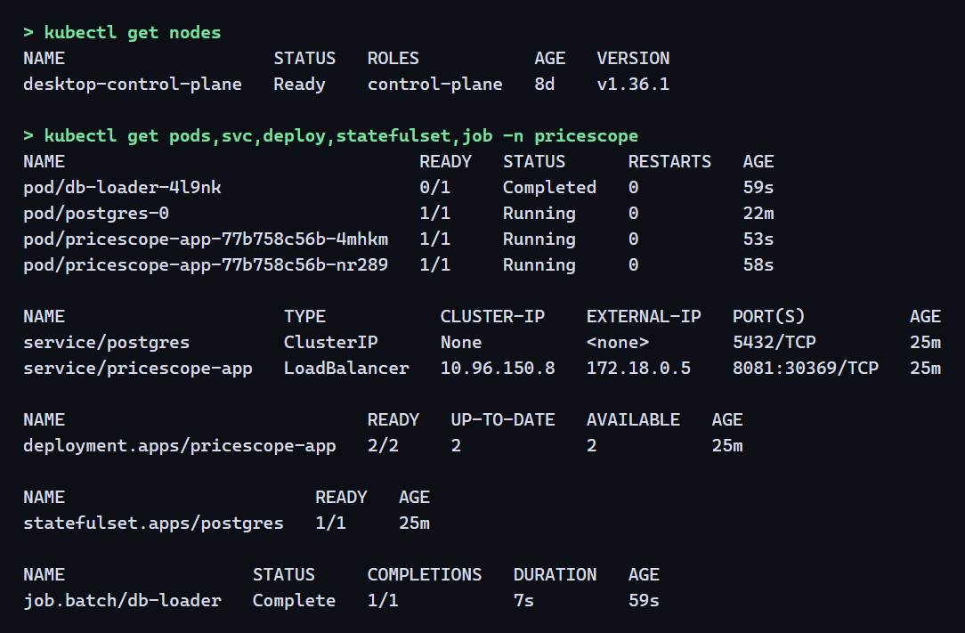
Running on Our Cluster
Real output of kubectl: every part is up and healthy.
1
2 app pods, 1/1 ready
Two copies share all the traffic.
2
postgres-0 running
The database, with a permanent name.
3
db-loader Completed
A Job finishes on purpose after loading.
One script deploys it all
scripts\deploy-k8s.ps1
Build, secret, manifests, wait
Notes:
This is a real screenshot of our deployment. Point out the two app pods at 1 of 1 ready, postgres-0 running, the db-loader Job showing Completed, which is correct because it runs once, and the LoadBalancer Service on port 8081. One script, deploy-k8s.ps1, does all of this: builds the image, creates a random password, applies the files and waits until everything is ready.

Slide 14
Step 5: CI/CD Pipeline
Every push to GitHub runs these checks automatically, with no one watching.
Job 1: Lint and test
Job 3: Build, scan and publish
Starts a real PostgreSQL
Checks code style with ruff
Runs 37 tests with pytest
Runs only if Jobs 1 and 2 both pass
1
Build the Docker image
git push
2
Scan it with Trivy
to main branch
3
Smoke test: start it, call /healthz
Job 2: Validate Kubernetes
4
Log in to GitHub Container Registry
kubeconform checks each YAML
Bad manifests are caught before they reach a cluster
5
Push, tagged by commit and latest
Notes:
CI means Continuous Integration: every change is automatically checked. CD means Continuous Delivery: a good build is automatically packaged and published. The file is .github/workflows/ci-cd.yml. Two jobs run first, and the build job only runs if both pass. So broken code can never become a published image. Pull requests get all the checks but do not publish.

Slide 15
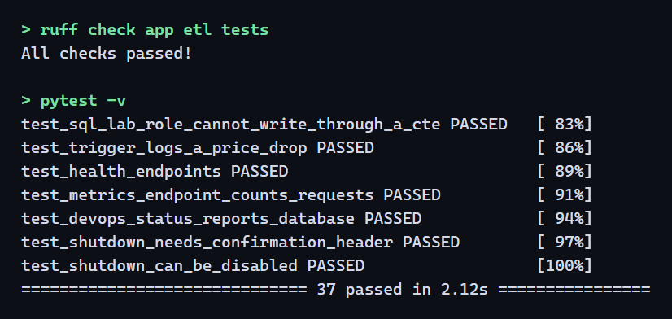
Automated Testing
Real results from the same commands the pipeline runs.
37 / 37
11 / 11
tests passed
K8s resources valid
WHAT THE TESTS COVER
Every analysis query runs without error
Data counts match: 8,817 products
SQL Lab blocks DELETE and DROP
Database trigger logs a price drop
Health, metrics and shutdown safety
Notes:
These are real results. 37 tests pass, and they run against a real PostgreSQL database, not a fake one. Every analysis query is executed, SQL Lab is checked to reject writes, the database trigger is tested, and so are the health endpoints and the shutdown safety checks. All 11 Kubernetes resources pass schema validation.

Slide 16
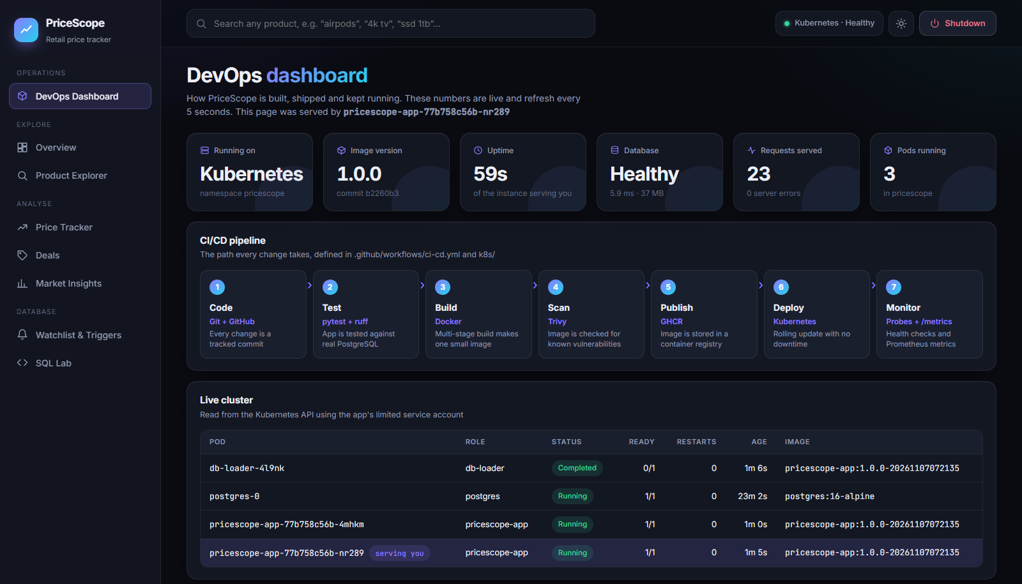
The DevOps Dashboard
A dedicated page makes DevOps visible in the UI itself.
1
Live numbers
Environment, version, uptime, database health, traffic.
2
Pipeline view
The seven stages each change goes through.
3
Live cluster table
Real pods, with the one serving you highlighted.
4
Status and team
Every page shows where it runs and who built it.
Notes:
This is a page in the application, and this is a real screenshot from Kubernetes. The numbers at the top are live and refresh every five seconds. The table reads directly from the Kubernetes API, and the highlighted row shows which pod is serving you. Refresh it and that can change, which demonstrates load balancing. Also point out the status pill at the top right, and the team names in the sidebar.

Slide 17
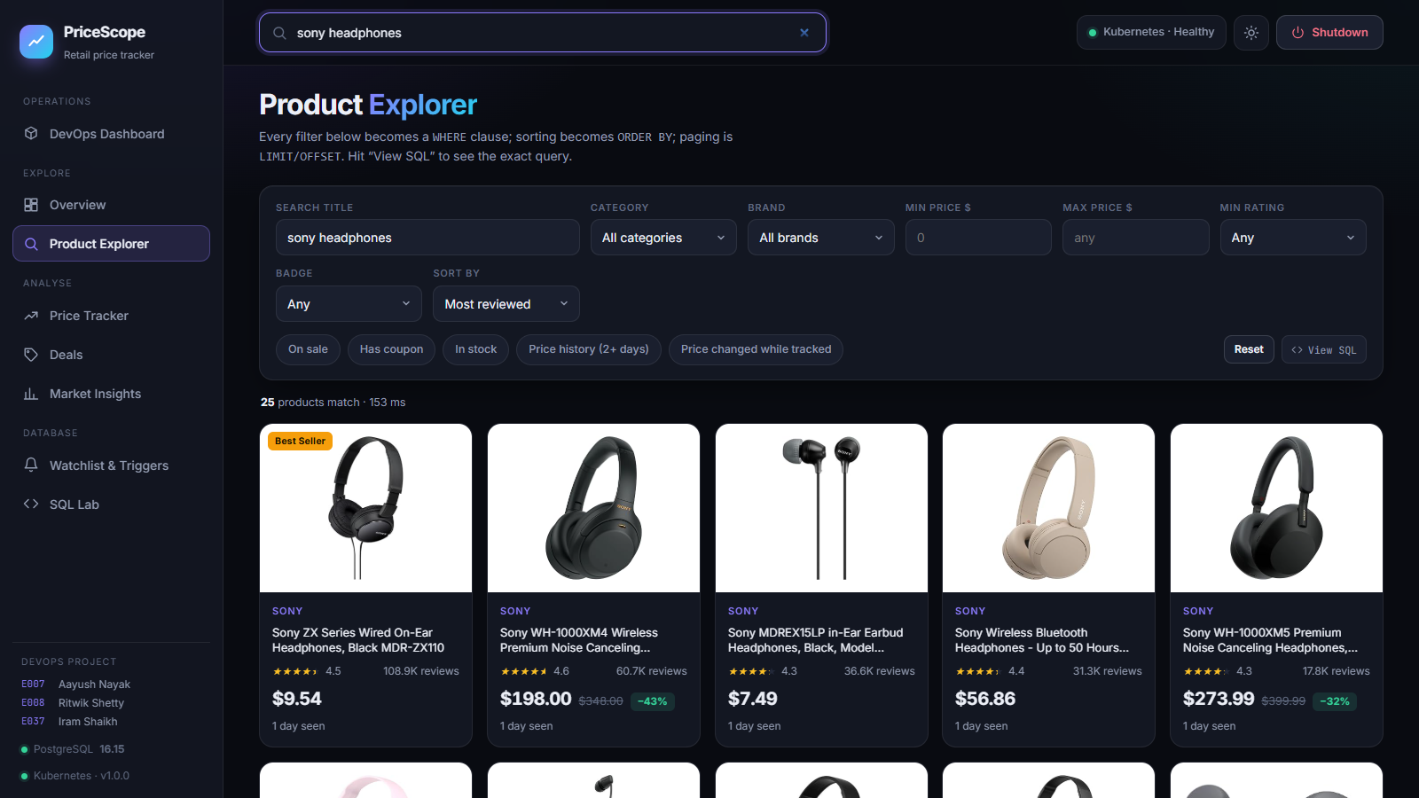
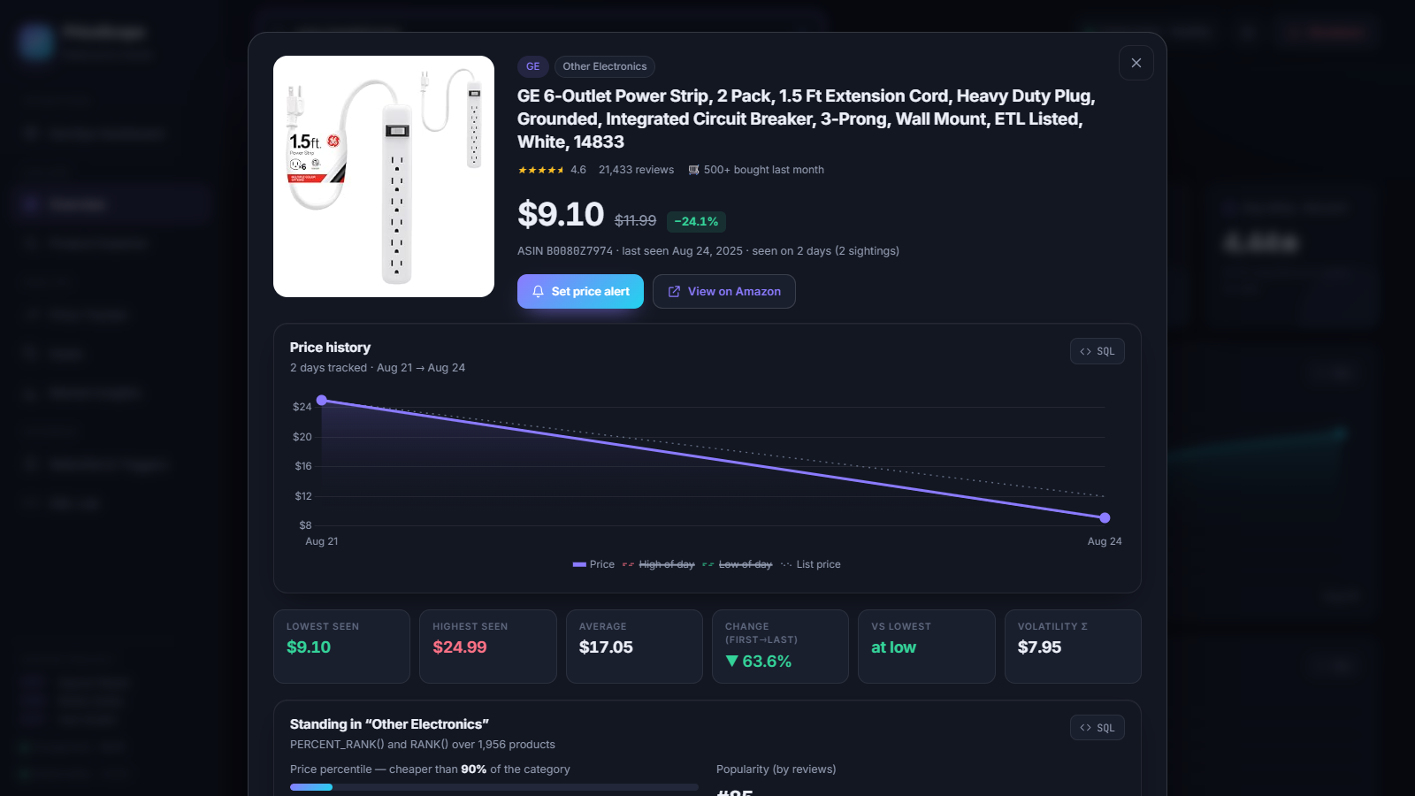
The Application on Kubernetes
Every feature runs inside the cluster, served by our pods.
Product Explorer
Product details
Search and filter across 8,817 products
Price history, category rank and alerts
Notes:
These screens are the live app running on Kubernetes: analytics, search, price tracking, alerts and SQL Lab all work through the pods. Notice the top right of each screen shows Kubernetes, Healthy and the Shutdown button.

Slide 18
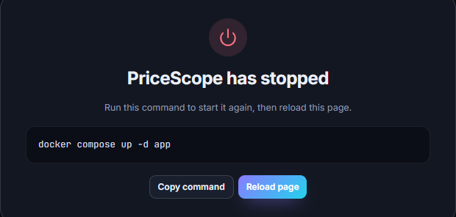
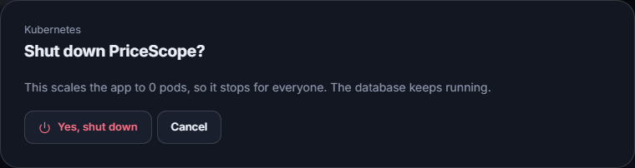

Shutdown Button
Stops the app from the UI, whichever way it is running.
1 Click, top right
2 Confirm
3 App stopped
Why not just exit?
Kubernetes would restart a stopped pod, so we ask it for 0 copies instead.
Running on | What the button does | Command to start again
Kubernetes | Scales the Deployment to 0 pods | kubectl scale deployment pricescope-app -n pricescope --replicas=2
Docker Compose | Exits cleanly; restart: on-failure keeps it stopped | docker compose up -d app
Local Python | Ends the server process | python app/server.py
Tested on Compose by clicking the button in a browser, and on Kubernetes by sending the same request. Each time the app stopped and the command brought it back.
Notes:
The Shutdown button is at the top right of every page. It first asks for confirmation, then shows the exact command to start again. The interesting part is that the method differs. On Kubernetes, if a pod simply exits, Kubernetes restarts it, which is its self-healing doing its job. So the button instead asks Kubernetes for zero copies. On Compose we set the restart policy so a clean exit stays stopped. The database keeps running in all cases, so no data is lost. For safety the request needs a special header, which stops other websites from triggering it, and it can be switched off with one setting.

Slide 19
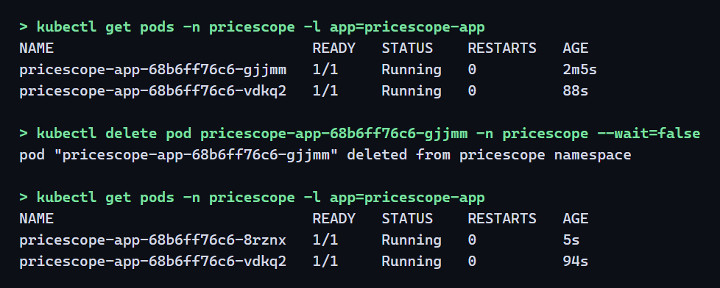
Self-Healing
We deleted a running pod on purpose. Users never noticed.
4 to 8 s
for the replacement pod to become ready
0 failed
of 1,648 requests, across 3 test runs
How it was measured
A pod dies
K8s sees 1 of 2
Starts a new pod
Back to 2
4 parallel clients sent steady traffic while the pod was deleted.
Notes:
This was a real test. We kept sending traffic constantly and deleted a pod. Kubernetes noticed that only one copy was left and started a replacement. The replacement was ready in four to eight seconds. Meanwhile the second pod and the Service kept serving, so across three measured runs, 1,648 requests were sent and none failed. Compare the pod names before and after in the screenshot: gjjmm is gone, and 8rznx has replaced it.

Slide 20
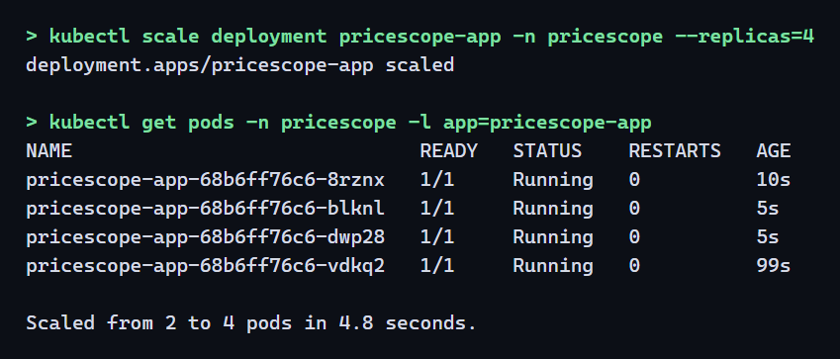
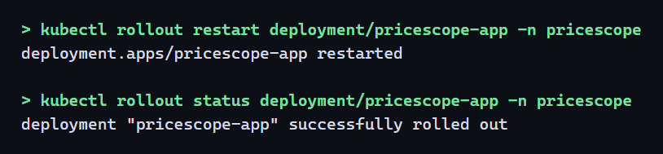
Scaling and Zero-Downtime Updates
More copies on demand, and new versions with no outage.
Scaling up
Rolling update
New pod
Ready?
Old pod off
4.8 s
≈ 8 s
0 failed
to go from 2 to 4 running pods
for a full update
of 1,838 requests, 3 runs
Notes:
Left: scaling. One command took us from 2 pods to 4 in under five seconds. Right: rolling update. Kubernetes starts a new pod, waits until it is ready, and only then removes an old one. Our first test actually failed one request. The cause was a pod shutting down before traffic had stopped going to it. We added a short preStop delay and re-tested, and across three runs 1,838 requests had no failures. This is exactly why you test.

Slide 21
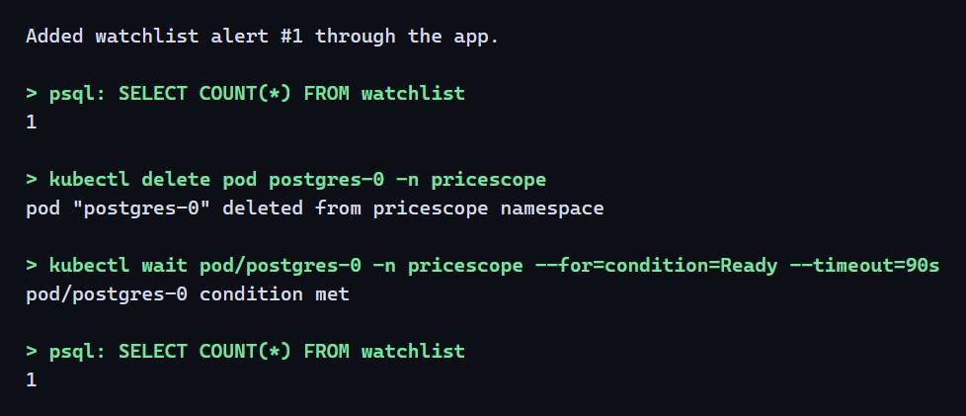
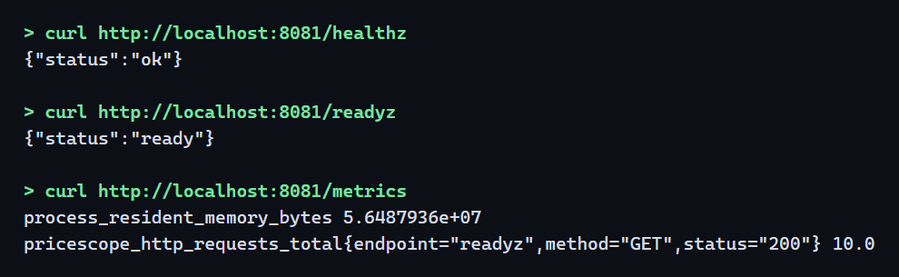
Data Safety and Monitoring
The data survives, and the app reports its own health.
Data survives a database crash
The app reports its health
/healthz
Alive? If not, restart it.
Same count before and after the pod was deleted. The app reconnected by itself within 7 seconds.
/readyz
Ready? If not, send no traffic.
/metrics
Numbers for Prometheus.
Notes:
Left: we saved an alert, deleted the database pod completely, and the alert was still there when it came back, because the data lives on a persistent volume outside the pod. Right: the health checks. Liveness asks whether the app is alive; Kubernetes restarts it if not. Readiness asks whether it can serve users; if not, it gets no traffic. The metrics address gives numbers in the format used by Prometheus, the standard monitoring tool.

Slide 22
Challenges We Hit
Real problems from our testing, and how we fixed them.
One request failed during an update
Kubernetes undid the shutdown
Pods were shutting down before traffic had moved away.
It restarts any pod that exits. That is its job.
FIX
Added a 5-second preStop delay. 0 failures in 3 re-tests.
FIX
The button scales to 0 pods instead of exiting.
Restarts could wipe the data
Redeploys kept running old code
The load script always rebuilt the database from scratch.
The cluster reused its cached image because the tag never changed.
FIX
Added --if-empty, so a loaded database is left alone.
FIX
Every deploy now gets a unique image tag.
Notes:
These all genuinely happened. The dropped request is the best story: we only found it because we tested under steady traffic, and the first measurement was too light to reveal it. The shutdown button needed thought because Kubernetes is designed to undo a stopped app. Be open about these, because examiners value real problem solving.

Slide 23
What DevOps Gives Us
The manual way compared with ours, in numbers we measured ourselves.
 | Without DevOps | With DevOps
Setting up | 6 manual steps | 1 command
Starting | Depends on the person doing it | 15 s, or 68 s with first build
If the server crashes | Stays down until someone restarts it | New pod ready in 4 to 8 s, 0 failed requests
Handling more users | 1 process, cannot grow | 2 to 4 pods in 4.8 s
Releasing an update | Stop the app, then start it again | Rolling update, 0 failed requests
Testing | By hand | 37 automated tests
Security checks | None | Image scan: 0 high or critical; non-root user
Database password | In a file on the laptop | Kubernetes Secret, random, never in Git
Notes:
This slide summarises the whole project. Read two or three rows that stand out: six manual steps become one command, a crash heals itself in seconds instead of staying down, and testing is 37 automated tests instead of manual checks. All the numbers in the right column were measured on our own laptop's single-node cluster.

Slide 24
Conclusion & Future Scope
A working DevOps pipeline, and a clear path to take it further.
WHAT WE DELIVERED
FUTURE SCOPE
A 225 MB, non-root Docker image
One-command start with Docker Compose
Kubernetes deployment that heals and scales
CI/CD pipeline with tests and security scan
Health checks, metrics and a live dashboard
Shutdown control built into the UI
Deploy to a cloud cluster (AWS EKS or Google GKE)
Prometheus and Grafana dashboards
Autoscaling based on real load
Automatic deployment after each pipeline run
Package the manifests as a Helm chart
Notes:
Summarise in one breath: we took a data-heavy web app, packaged it with Docker, ran it on Kubernetes, automated checks with GitHub Actions, and made its health visible. Future scope: the cluster runs on one laptop today, so a cloud cluster is the natural next step, along with dashboards and autoscaling.

Slide 25
Thank you
Questions?
E007
Aayush Nayak
E008
Ritwik Shetty
E037
Iram Shaikh
BTI DS · Semester 11 · DevOps Project
SVKM’s NMIMS
Mukesh Patel School of Technology Management and Engineering, Vile Parle, Mumbai- 400056
Department of Data Science
Notes:
Thank the audience and invite questions. Ritwik takes questions on DevOps concepts and the problem, Aayush takes Docker, Kubernetes and pipeline questions, Iram takes results and testing questions.

