Slide 1
Category review: Chips
June 2020
Retail Analytics
Brand note: If client logo is not required, use alternate title page layout right click slide thumbnail > Layout > Title

Slide 2
Executive summary
01
Task 1
To dive deep into customer segments and understand the consumer drive.
Customer Segment | Life stage
Budget | Older families
Mainstream | Young singles/couples
Premium | Older singles/couples
02
Task 2
To examine the performance of trial and control stores to make recommendations.
Trial store no 77 and 88 had a better performance for sales revenue and total number of customers in at least two out of three trial months. However, trial store 86 didn’t show any significant improvement in sales or total customers for the trial duration.

Slide 3
01
Category

Slide 4
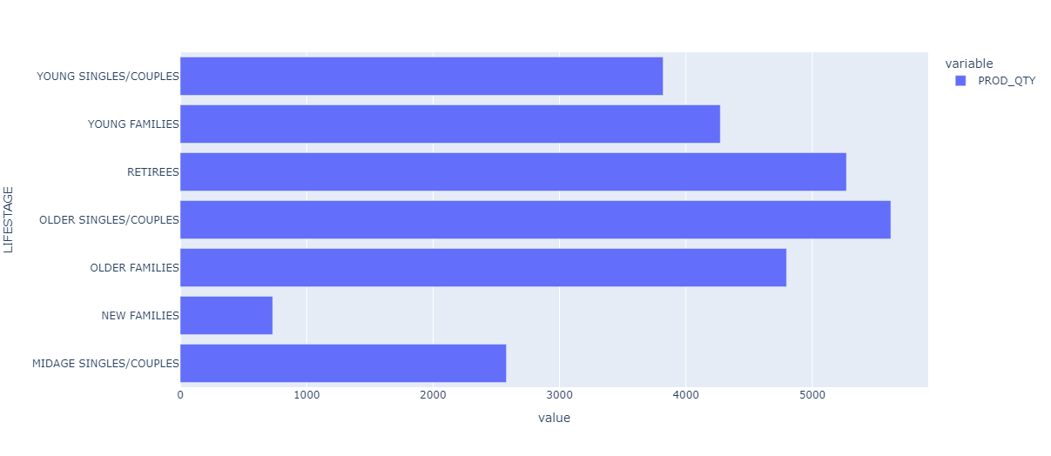
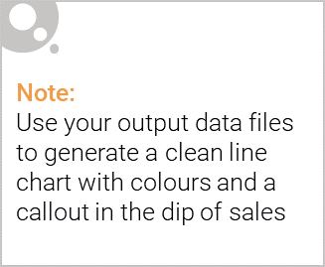
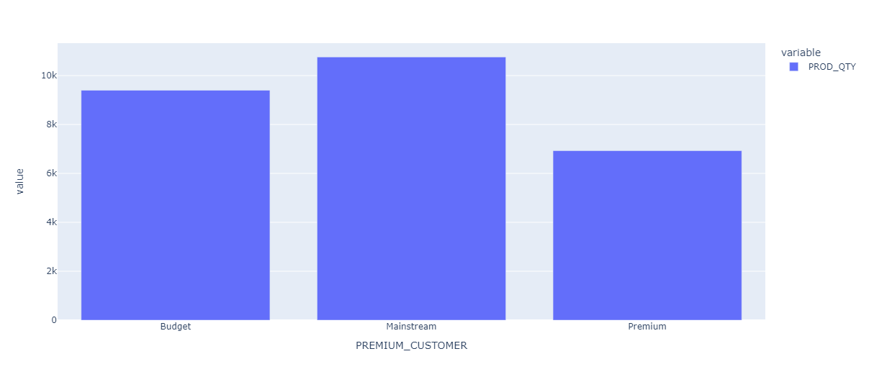
Graph: Distribution of customers who brought
chips according to the life stage.
Graph: Distribution of customers who brought
chips based on their premium.

Slide 5

Following observations can be made:
In total, older couples/singles spent more on the chips as compared to the remaining customer segment.
Mainstream customer spent more on chips as compared to budget and premium customers.
On further analysis, we can see the following trends among various customer segment who make up the major share of chips customers
budget customer segment | older families
mainstream customer segment | young singles/couples
premium customer segment | older singles/couples

Slide 6
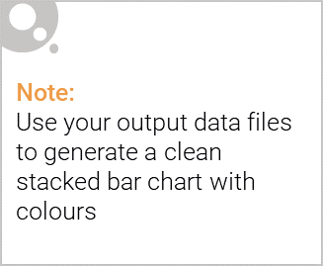
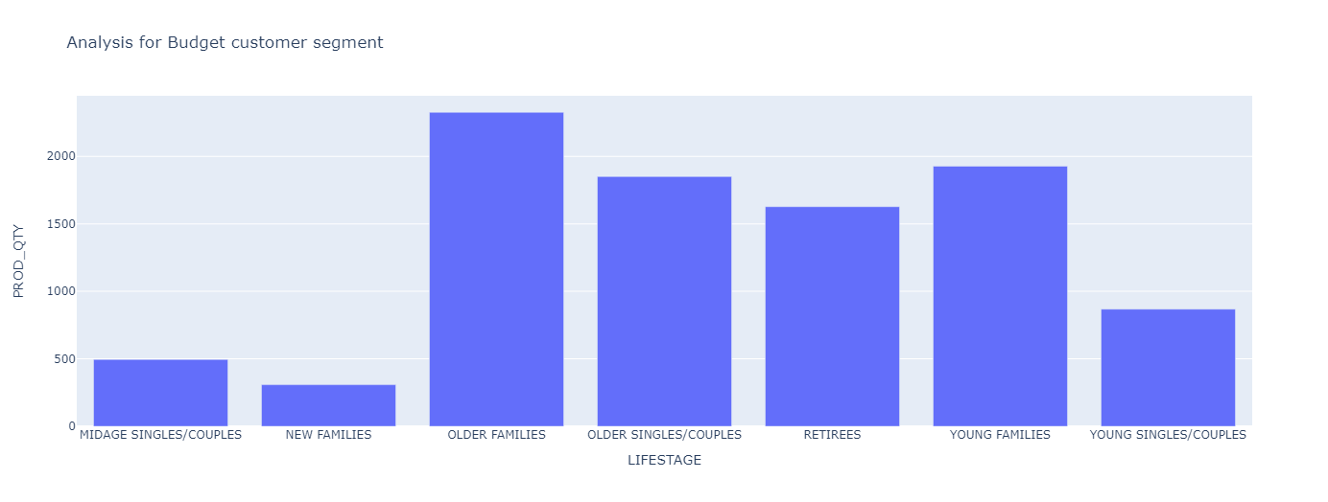
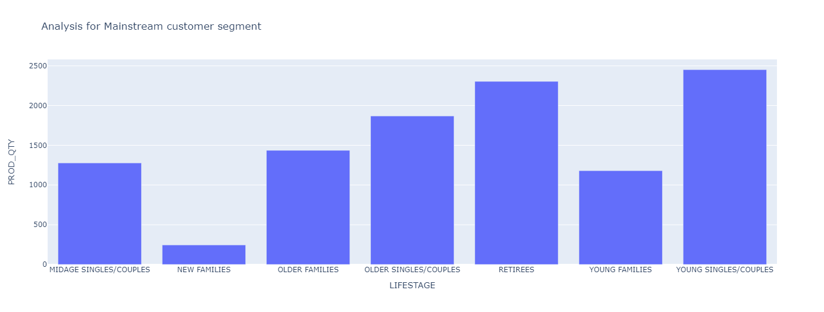
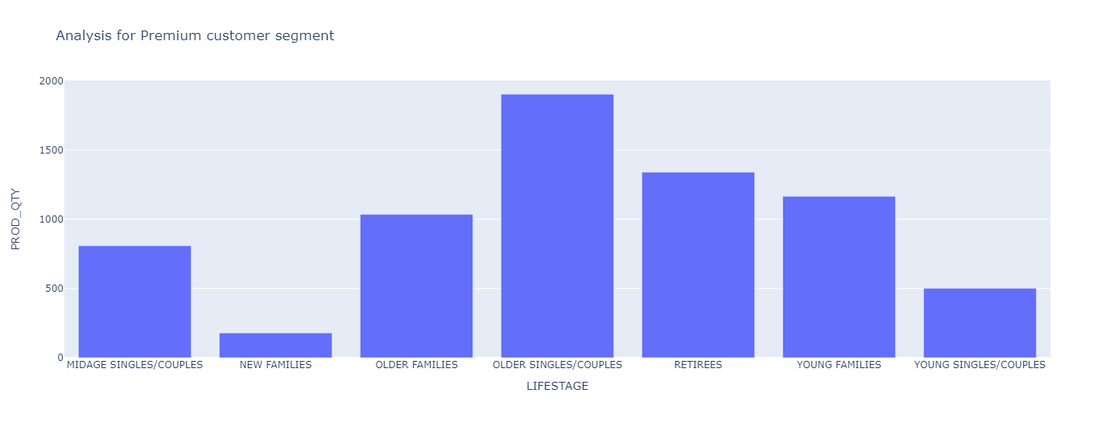
Editable (delete this)

Slide 7
02
Trial store performance

Slide 8
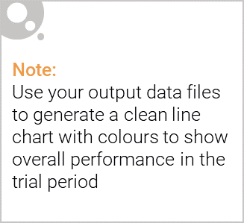
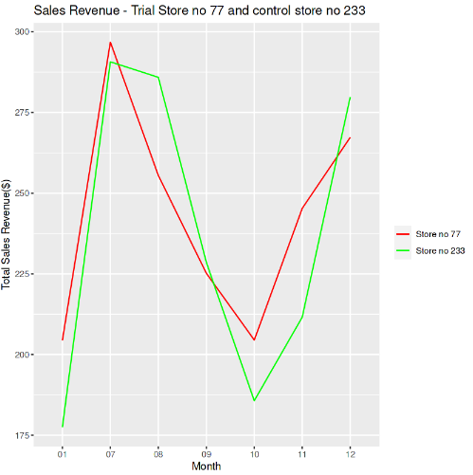
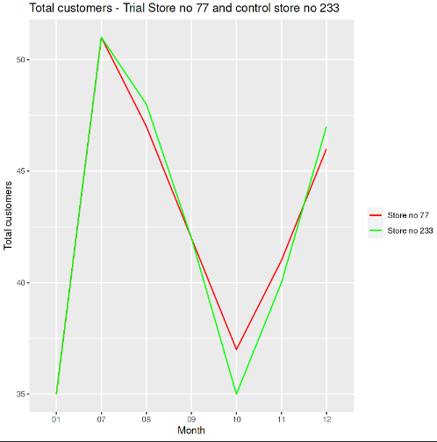
Explanation of the control store vs other stores

Slide 9
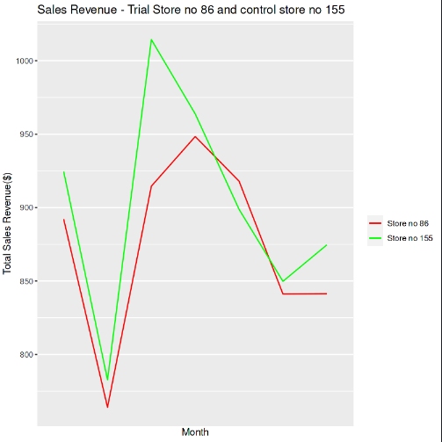
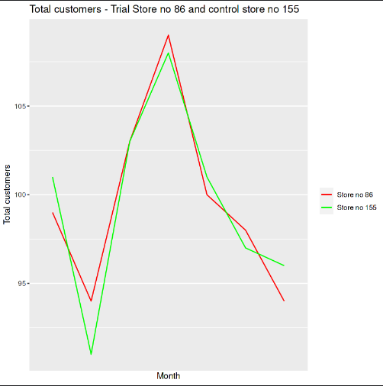
Explanation of the control store vs other stores

Slide 10
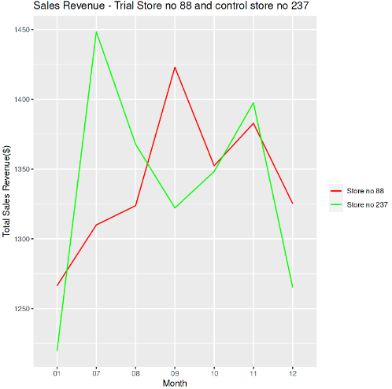
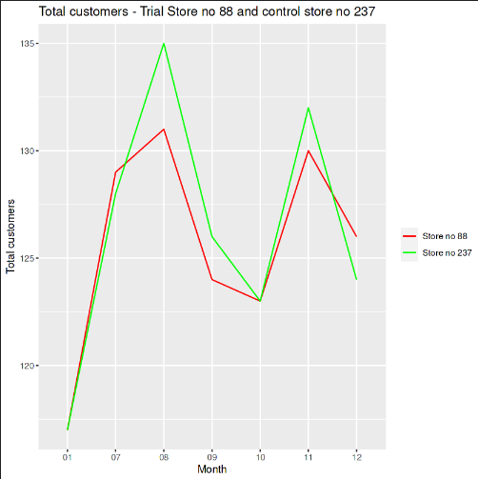
Explanation of the control store vs other stores

Slide 11
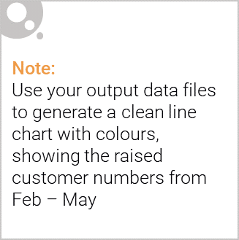
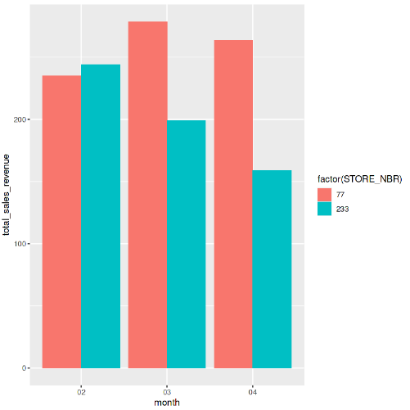
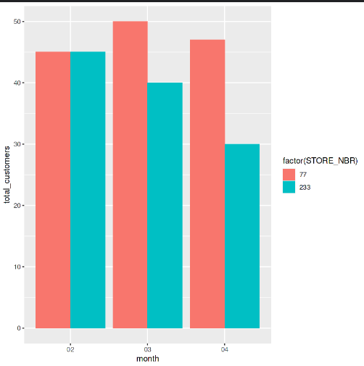
Call out of the performance in the trial store, determining if it was successful

Slide 12
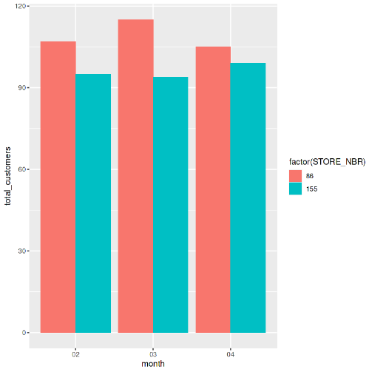
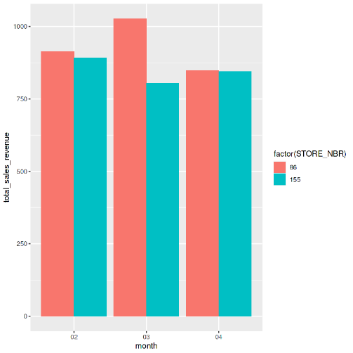
Call out of the performance in the trial store, determining if it was successful

Slide 13
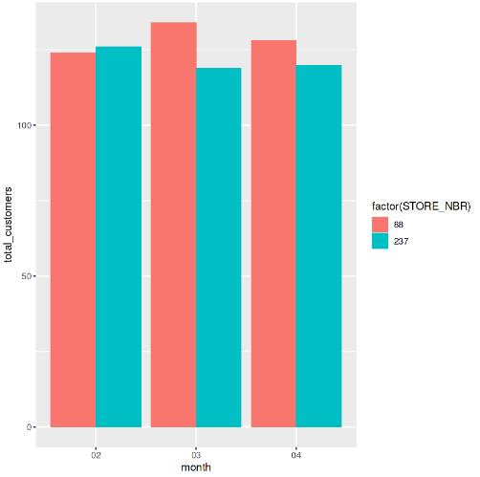
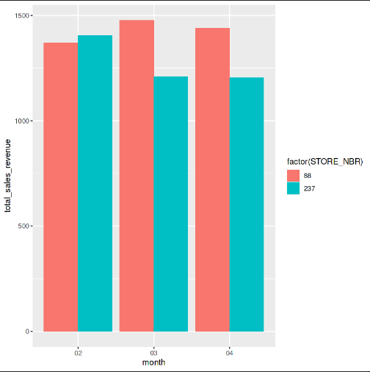
Call out of the performance in the trial store, determining if it was successful

