Slide 1

TOOL PATH PLANNING FOR FACE MILLING OF 3-D SURFACE
Presented by: Aayushi Verma
Roll No. : 18ME02034
Guided by: Dr. Gaurav Bartarya
School of Mechanical Sciences,
IIT Bhubaneswar

Slide 2
Tessellated representation
To fabricate any design, the 3-D model (surface or solid) has to be transferred to STL (Standard Tessellation Language) format.
The STL file format is generated using a tessellation process, which generates triangles to represent the CAD model.
The STL model is mathematically sliced by intersecting it with horizontal planes. Each slice represents a cross-section data for the part.

Slide 3
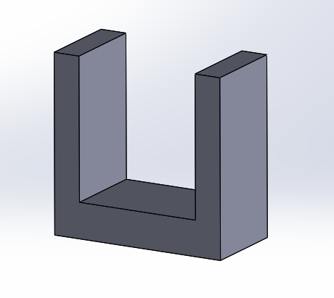
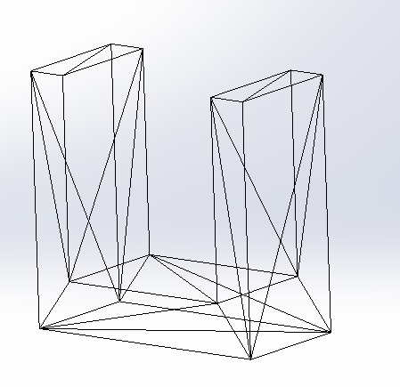
Figure 1: An object and its tessellated representation

Slide 4
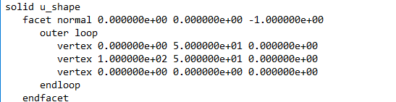
These triangles are described by a set of X, Y and Z coordinates for each of
three vertices, and a unit normal vector to indicate which side of the
triangle contains the mass.
STL file can be in ASCII or in binary format.
Fig 2- : STL File and description of ASCII representation format

Slide 5
OBJECTIVE
To develop a tool path plan using STL format of 3D object by slicing the model.

Slide 6
Reading STL file
START
Open STL file using
fopen
Reading first line from STL
file using fgetl and save it to
‘a1’
Set values to ‘fn’ and ‘v’ as
‘Facet Normal’ and ‘Vertex’
While loop Checking that is there a character in ‘a1’
if
Finding whether
stored ‘fn’ value
is in ‘a1’ or Not
A

Slide 7
A
Saving the integer values from line to
a variable ‘a’ which is further stack up
in ‘normal’ array
elseif
Finding whether
stored ‘v’ value
is in ‘a1’ or Not
Saving the integer values from line to
a variable ‘a’ which is further stack up
in ‘vertex’ array
Reading next line from STL
file using fgets and save it to
‘a1’
Close the file using fclose(FileID)
END

Slide 8
Slicing the model
Find the Cutting Plan (Zc)
The program scans STL file, picks the Z-coordinate of all the triangle, compare, and find the top, the bottom of the geometric (Zmin, Zmax ), add the slice thickness to Zmin.
Zc = Zmin + slice thickness
Find the Facets that intersect with the Cutting Plan
The program scans STL file to pick one triangle at a time, the Z-coordinate of its three vertices compared with the Z-height of the current plane,
Zmin <= Zc <= Zmax , Zmin, Zmax are in one triangle

Slide 9
START
Zc=Zmin
B
If Zc>Zmax
Yes
End of program
No
For i=1:m
No
If mod(i,3)==0
Yes
Saving three consecutive co-ordinate having row index as i-2,i-1,i and repeating first
co-ordinate and save it to array ‘a’
For j=1:size(a)-1
Find u using following equation :-
u = (Zc-Zj)/(Z(j+1)-Zj)
A

Slide 10
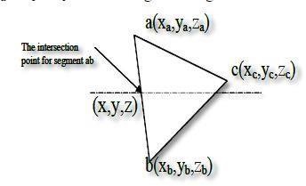
A
No
If u>=0 && u<=1
Yes
Find x_inter, y_inter which are intersection points, using following equation:-
x_inter = Xi+u*(X(i+1)-Xi)
y_inter = Yi+u*(Y(i+1)-Yi)
Save all x-y intersection ‘points ‘ variable and continue to find intersection points for next triangle
Fig. 3- Three vertices of one triangle and the
intersection points
B
Zc=Zc + slice_thickness
END

Slide 11
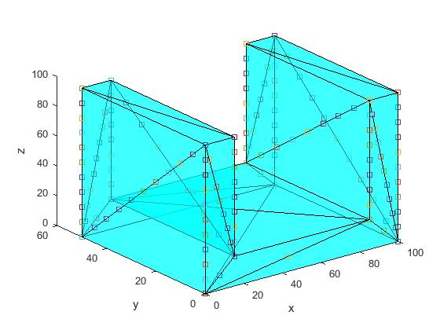
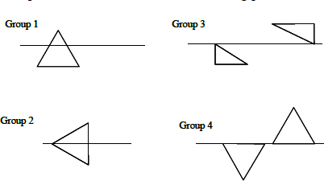
Fig. 3- The possible cases for triangle-plane slicing
Fig. 4- Intersection points

Slide 12
Tool Path Algorithm
Let <L1{(X0,Y0),(X1,Y1)},L2{(X0,Y0),(X1,Y1)} ………..Lm{(X0,Y0),(X1,Y1)}> be array of
intersecting line segments.
START
Yi=Ymin
If Yi>Ymax
Yes
B
End of program
No
For i=1:m
Find u using following equation :-
u = (Yi-Y0)/(Y1-Y0)
If u>=0 && u<=1
Yes
Compute: - x= X0+u*(X1-X0)
And store x value in ‘p’ array
A

Slide 13
A
Sort array ‘p’ and remove duplicate points
Append xmin at front and xmax at last of the array ‘p’
For j=1:size(p)
If mod(j,2)==0
No
Tool cutting ON/Start
Yes
Tool cutting OFF/Stop
B
Yi=Yi + stepsize

Slide 14
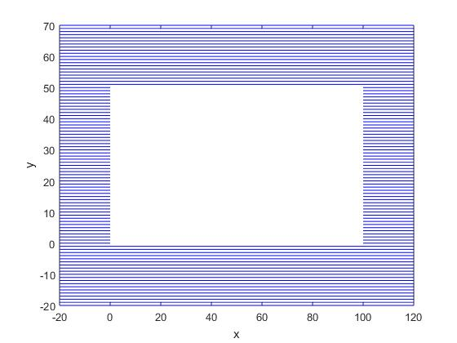
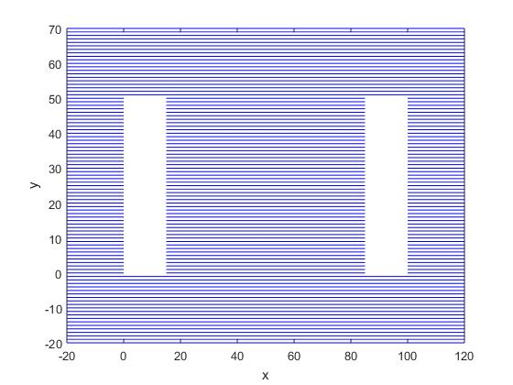
Fig..5- Zc=zmin
Fig..6- Zc=zmax

Slide 15
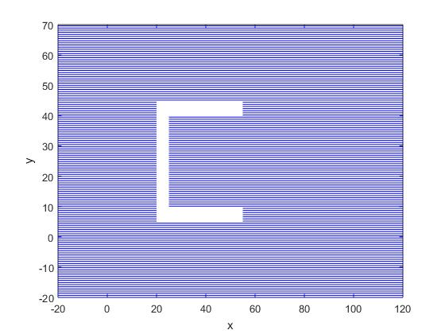
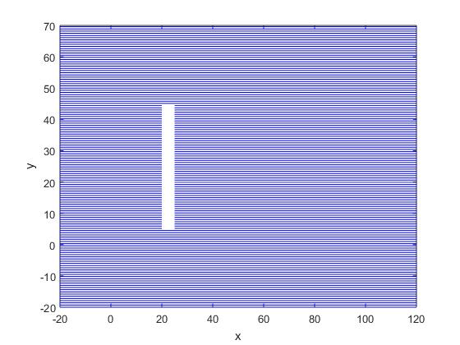
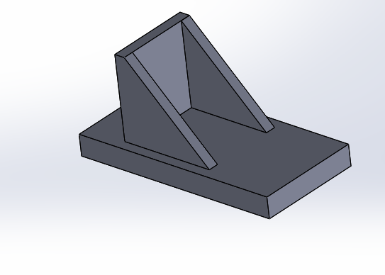
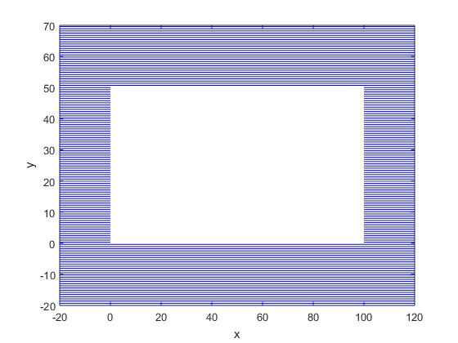
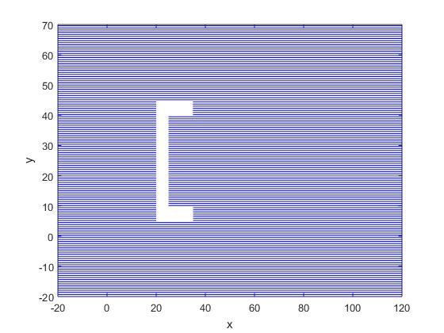
b) Zc=maxz
d) Zc=maxz-30
Fig.7 a) 3D model of bracket
c) Zc=maxz-10
e) Zc=maxz-50

Slide 16
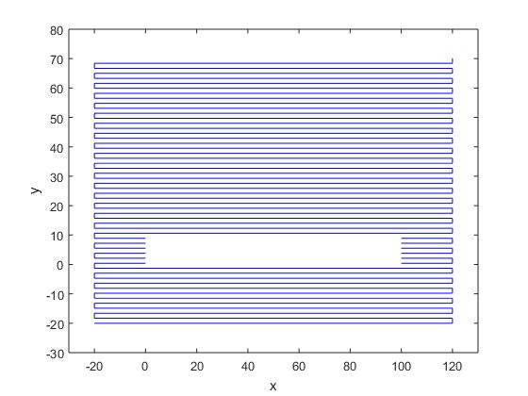
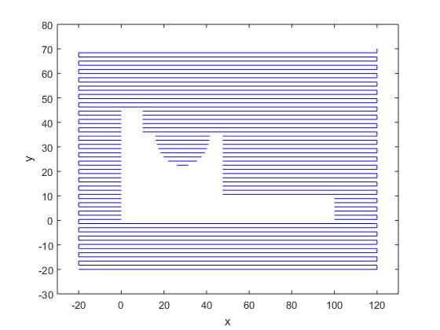
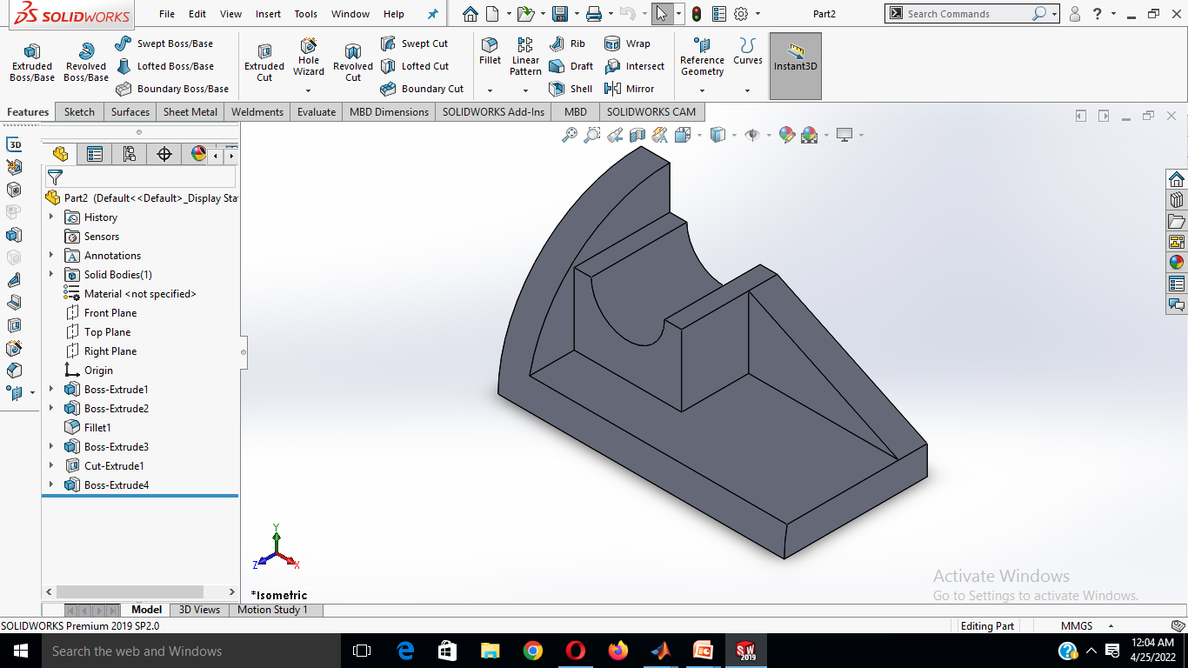
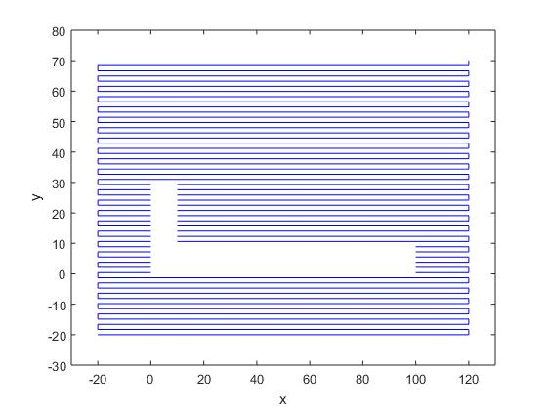
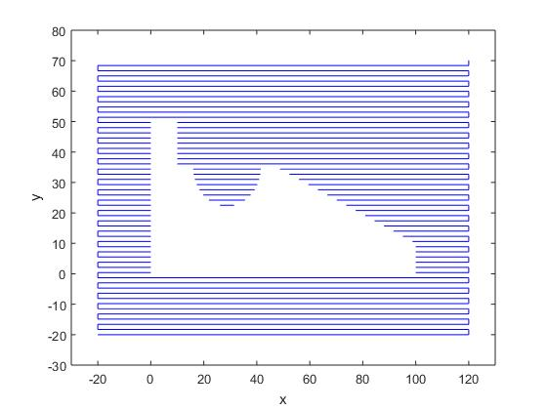
b) Zc=maxz
d) Zc=maxz-30
Fig. 8 a) 3D model of bracket
c) Zc=maxz-10
e) Zc=maxz-50

Slide 17
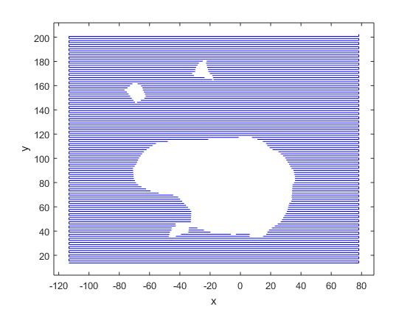
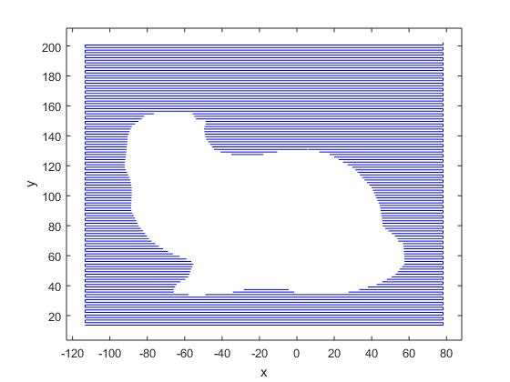
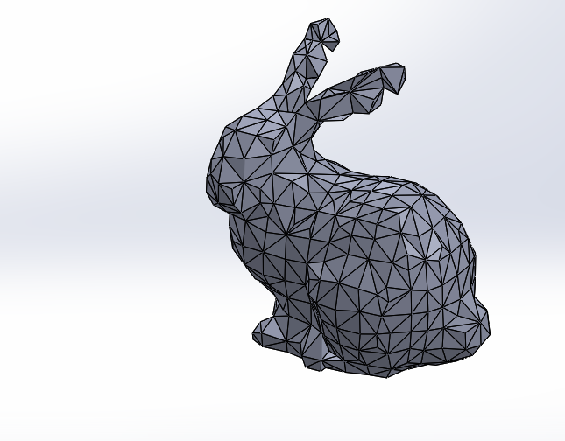
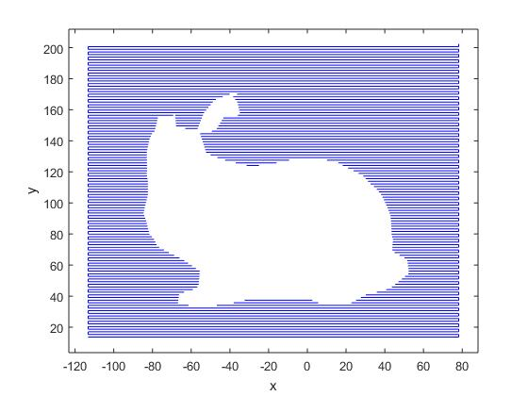
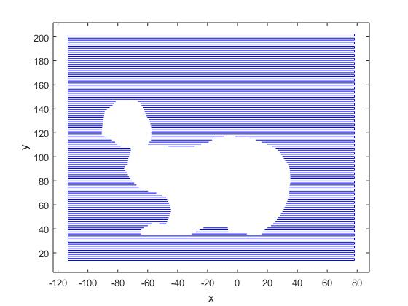
d) Zc=minz+70
b) Zc=minz+40
Fig. 9 a) 3D model of bunny
c) Zc=minz+55
e) Zc=minz+95

Slide 18
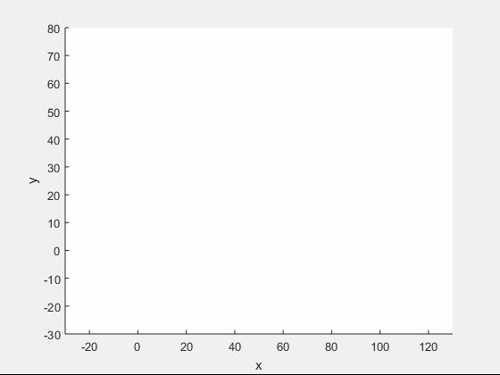
Fig. 11:- Animation of tool path trajectory

Slide 19
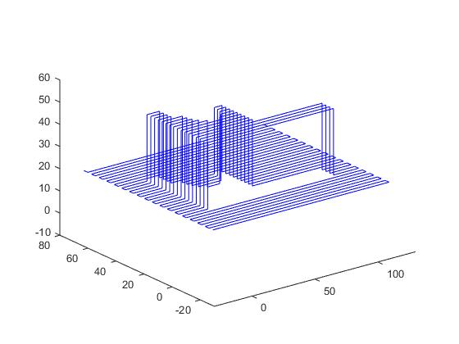
Fig. 10:- 3D representation of tool path lines

Slide 20
FUTURE WORK
Optimization of an algorithm for slicing of STL file of the 3D object by reducing time-complexity.
Development of a method to represent the contour formation of each slice with the help of intersection points and normal vector information.

Slide 21
THANK YOU

