Slide 1

MUTUAL FUND ANALYTICS CAPSTONE PROJECT
Bluestock Fintech
Summer Internship 2026
Aayushi Adhikari

Slide 2
PROJECT OVERVIEW
Problem Statement
This project analyzes mutual fund performance, investor behavior and investment risk using data analytics and visualization techniques.
Mutual fund data is large and complex.
Investors require data-driven decision making.
Performance and risk evaluation are critical.
Objectives
Analyze industry trends.
Evaluate fund performance.
Measure investment risks.
Study investor demographics.
Develop Power BI dashboards.

Slide 3
TECHNOLOGY STACK
Python
Pandas
SQLite
Power BI
Jupyter
End-to-end mutual fund analytics pipeline using Python, SQLite and Power BI.

Slide 4
PROJECT ARCHITECTURE
Raw Data
Data Cleaning
SQLite Database
Automated ETL pipeline transforms raw mutual fund data into interactive dashboards and analytical insights.
Analytics & KPIs
Power BI Dashboard

Slide 5
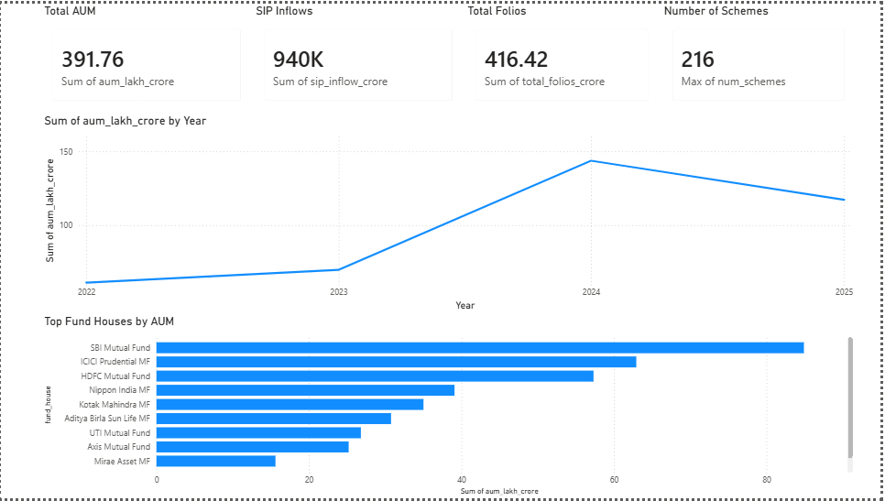
EDA HIGHLIGHTS – INDUSTRY OVERVIEW
Key Insights
Total AUM reached 391.76 lakh crore.
SIP inflows reached approximately 940K.
Total folios crossed 416 crore.
SBI Mutual Fund led the industry by AUM.

Slide 6
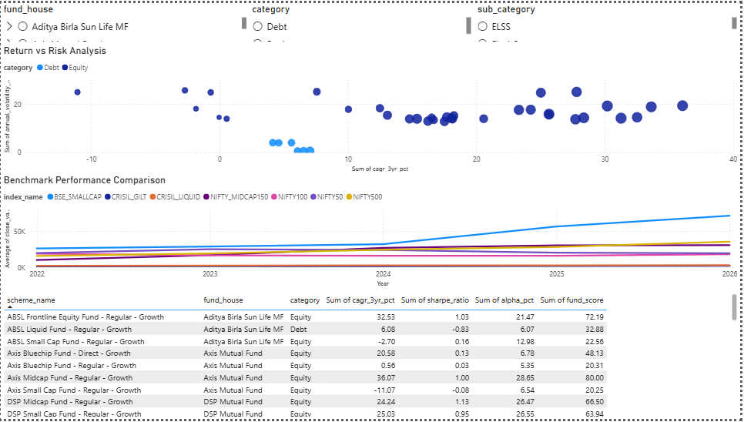
FUND PERFORMANCE ANALYSIS
Key Insights
✓ Top equity funds delivered CAGR above 30%.
✓ Risk-adjusted returns varied across categories.
✓ Sharpe ratio helped identify efficient funds.
✓ Top-performing funds achieved strong fund scores.

Slide 7
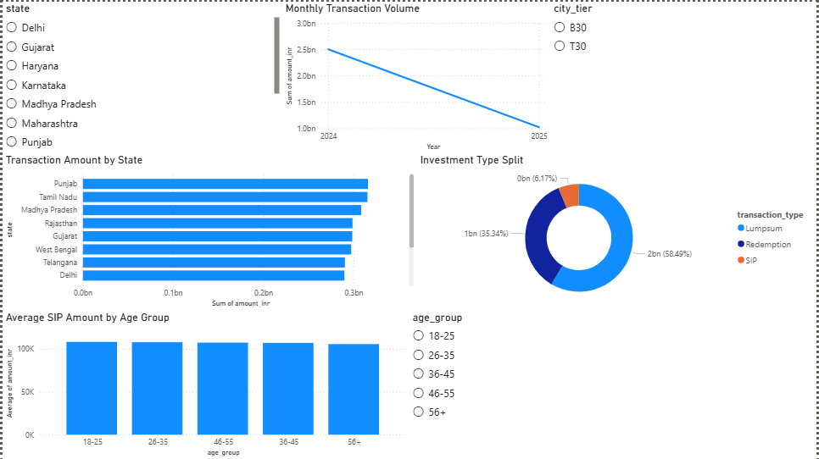
INVESTOR ANALYTICS
Key Insights
Majority of investors belonged to the 26–35 age group.
T30 cities accounted for the largest investor share.
Transaction volumes were concentrated in major states.
Investors showed strong participation across investment types.

Slide 8
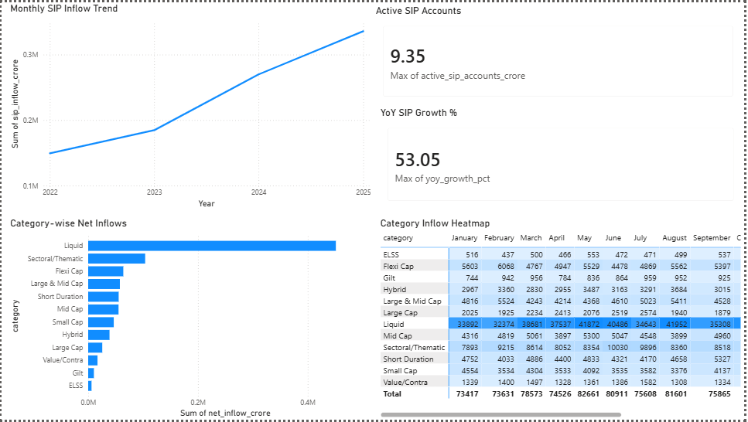
SIP & MARKET TRENDS
Key Insights
Active SIP accounts reached 9.35 crore.
YoY SIP growth exceeded 53%.
Long-term investing generated better outcomes.
SIP remained a preferred investment strategy.

Slide 9
KEY FINDINGS
Total AUM reached 391.76 lakh crore.
SIP inflows showed continuous growth.
SBI Mutual Fund held the highest AUM.
Several equity funds delivered CAGR above 30%.
Investors aged 26–35 formed the largest segment.
Tier-30 cities contributed significantly to transactions.

Slide 10
RECOMMENDATIONS
Encourage long-term SIP investments.
Diversify across multiple fund categories.
Use risk-adjusted metrics before investing.
Monitor fund performance regularly.
Leverage analytics dashboards for decision-making.

Slide 11
PROJECT OUTCOMES
Built complete ETL pipeline.
Created SQLite analytical database.
Developed interactive Power BI dashboard.
Performed industry, performance and investor analysis.
Generated actionable investment insights.

Slide 12
THANK YOU
Questions & Discussion
Project Repository:
https://github.com/aayushiadhikari/bluestock_mf_capstone

