Slide 1
Introduction to Machine Learning
Presented by MISA

Slide 2
Table of Contents
1 | What is Machine Learning?
2 | Data Cleaning
3 | Splitting the Dataset
4 | Linear Regression
5 | Model Evaluation
6 | Feature Selection & ENgineering
Notes:
What is ml
Data Cleaning
Imputation and one-hot encoding
Splitting the Dataset
Train and test
Overfitting with graph visualization
Linear Regression
Simple & Multiple
Better algorithms – you’ll see on the demo & better algorithms next week
Model Evaluation
Four categories
Feature Selection
Wrapper and filter method
Interactions

Slide 3

01
What is ML?
Find historical relationships using data-driven analytics for future predictions..
Notes:
Can someone tell me any example of machine learning?

Slide 4


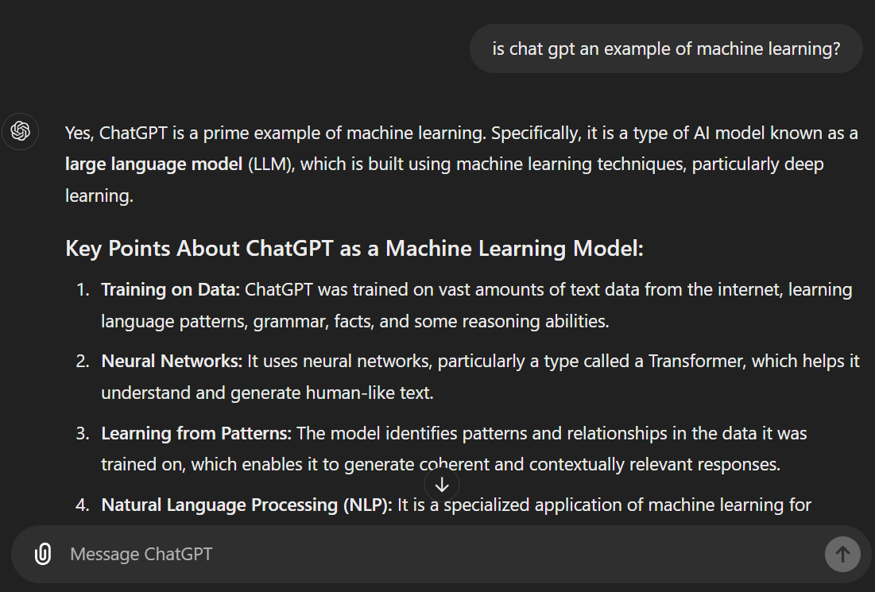

Slide 5
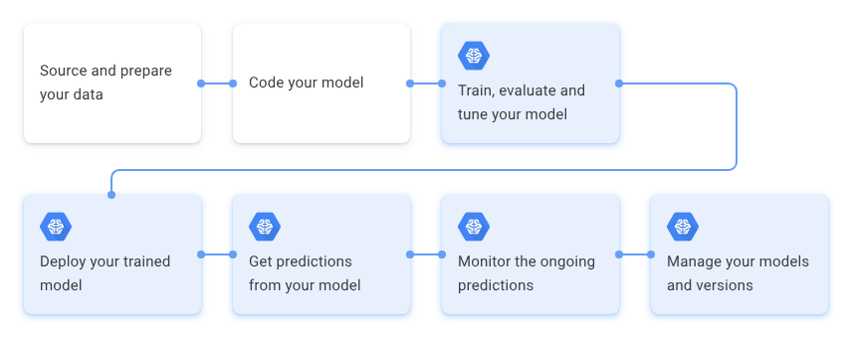
Machine Learning Workflow

Slide 6
Predictive Models: a Type of ML
Identify patterns that illustrate the connection between independent variables (aka FEATURES or PREDICTORS) and the dependent variable (aka TARGET) targeted for prediction.
Linear Prediction
Rule-Based Prediction
Essentially Linear Regression.
Essentially If-Then Statements.

Slide 7
02
Data Cleaning
Pre-processing to clean and engineer the dataset.

Slide 8
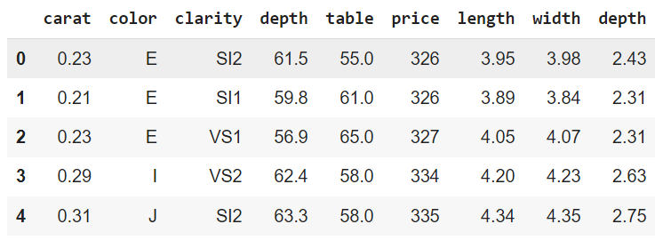
Dataset Deep Dive: diamonds.csv
target
features/predictors
null

Slide 9
Feature Engineering
Extract and transform raw data variables into optimized features to enable improved ML model performance and predictive power.
Data Imputation
One-Hot Encoding
Fill in missing (null) values and standardize data,
Convert categorical variables into numerical variables.

Slide 10
02
Splitting the Dataset
Train model on majority of the dataset.
Test model on the remaining data.

Slide 11
Split Training vs. Testing Data
Training Data: ~80%
Algorithms predict patterns in train data and output a predictive model.
Use majority of the dataset is train (aka induce or fit) the model.
Dataset
Testing Data: ~20%
Used to see how the predictive model will perform on new, unseen data.
Hold out some of the dataset to test the induced model.

Slide 12
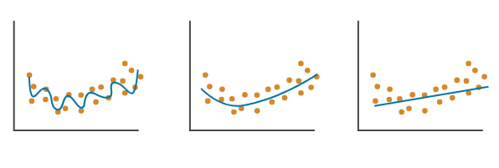
Overfitting
Machine learning models “learn” OLD data to make predictions on NEW data –
if you learn the old, training data too well, it will not generalize to new, testing data.
Overfit
Right Fit
Underfit

Slide 13
03
Linear Regression
Straight-line predictions on unknown numerical data values using known numerical data.

Slide 14
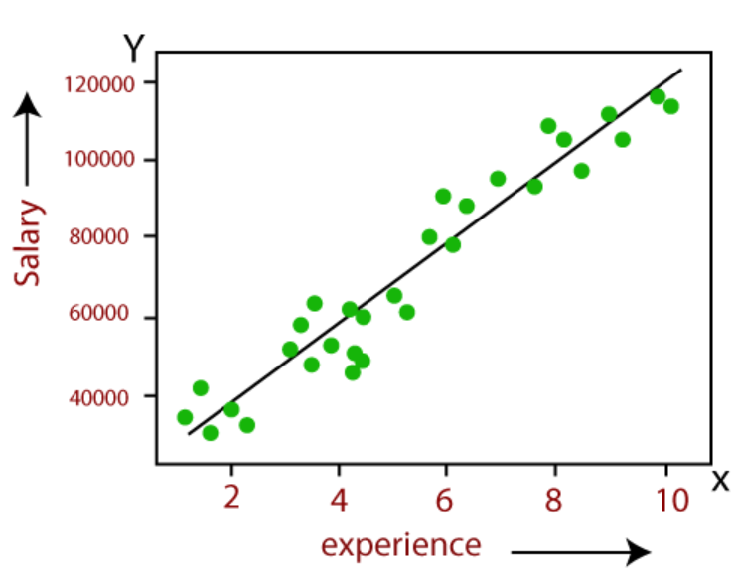
Simple Linear Regression:
y = mx + b
y = TARGET
m = Slope
x = PREDICTOR
b = y-intercept

Slide 15
Simple Linear Regression:
y = mx + b
X and Y Correlation:
Direction: + or -
Strength: how close data aligns with regression line
Notes:
What is the direction?
What is the strength?

Slide 16
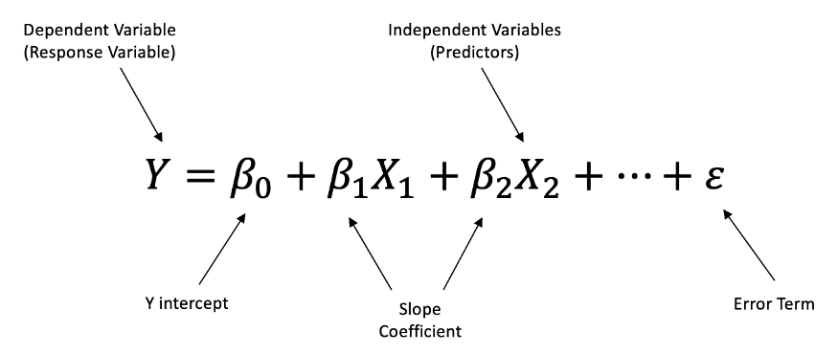
Multiple Linear Regression:
Use multiple independent variables to predict the dependent variable for better model accuracy on unseen data.
Notes:
Normally, linear regressions are not so simple - there can be multiple features than interact together to create an even better prediction.
Think about car prices – you could just use year it was made to predict it, but combining the year and the person’s average income could potentially create even better predictions.

Slide 17
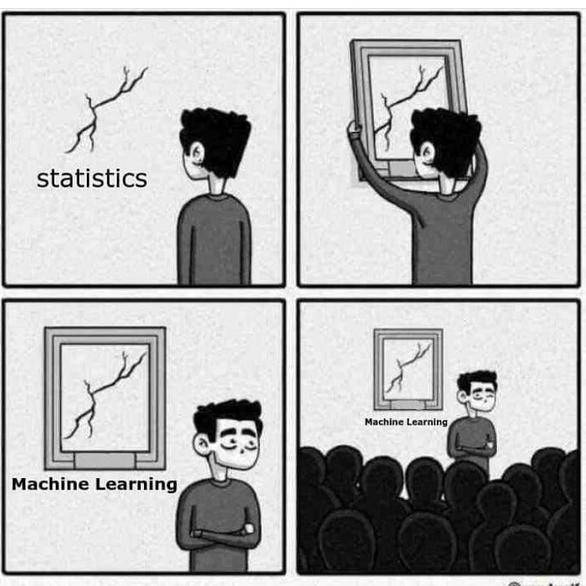
Better Algorithms
Random Forest – averaging a bunch of tree-like models.
Bagging – predict using models built on random subsets of the data.
Boosting – combine a bunch of underfitted trees to “boost” prediction.
Come to Machine Learning Part 2 next Tuesday to try out these algorithms!

Slide 18
04
Model Evaluation
Measure classification accuracy on unseen test data to evaluate model performance.

Slide 19
Measures of Model Accuracy
R^2 (between 0 & 1):
higher the better
Mean Absolute Error: lower the better
% of variance in the target output that can be explained by the predictors.
Like MSE, but in units of target variable. Large errors have lower impact.
Mean Squared Error: lower the better
Root Mean Squared Error: lower the better
How “wrong” the model’s predictions are from reality, on average.
Like MSE, but in units of target variable. Large errors have greater impact.
BEWARE OF OVERFITTING THE MODEL =
Great Accuracy on Train Data, BAD ACCURACY on Test Data.
Notes:
Let’s say you’re predicting house prices based on features like square footage, number of bedrooms, and location.
If your R2=0.8, it means 80% of the variation in house prices is explained by these features. The other 20% is unexplained, possibly due to other factors not included in your model.

Slide 20
05
Feature Selection
Choose the best predictors and create new ones for greater model accuracy.

Slide 21
Feature Selection
Features
Carat
Cut
Color
Clarity
Length
Width
Depth
Filter Method
Wrapper Method
Uses statistical measure (like information gain) to rank importance of features to the model and select optimal feature subset.
Less computationally expensive (good for large datasets), less accurate.
Use model performance and repeated model training based on new feature combinations to find optimal feature subset.
More accurate predictions, more computationally expensive.
What feature might be the best predictor of price? Second best?
What features combos might best predict price together?
Notes:
Put actual examples here
Talk about diamond features
- ask – what are some features that that might work together to to show wrapper method
- ask – what is the one feature that you think are gonna be the best predictors

Slide 22
Competition Time!
You will be using the “penguins” dataset. Whoever can build the best predictive model wins!

