Slide 1

Placement Preparation Session
Organized By,
Training and Placement Cell

Slide 2

Software
CTC
Peer Pressure
Ample amount of opportunities
Interest
My take
Where do you see yourself in the next few years? Does software align with that?

Slide 3
Communication and overall personality
Just one statistics:
6-7/10 companies suggest us to have communication and personality development sessions.
Can’t stress more. High time, start working on it. Consult seniors, attend workshops, get a bit serious.

Slide 4
Resume
Must Do
At least 1 project related to the field of computer science.
Preferred to have an intern in software domain./ A project in the institute would do, in case you don’t land up an intern.
Preferred
At least 2 projects. Fields may be:
Machine Learning, Course Projects (Net Sec)
DS/Algorithms, OS, DBMS, Networks
An intern in development or Machine Learning.

Slide 5
To sum up resume
Should speak that you are a complete package for the software profile
Only ML/AI projects make you look like a Data Science guy, think before making your resume
POR’s don’t matter much, may be in the HR interview. Nothing more.
Give the resume preparation ample amount of time
Make sure you finish your projects by the end of this semester, anyhow.
Start early, be smart.

Slide 6
Test Preparation
If you know the basics:
Read STL( Standard Template Library) from Hackerrank/ Rachit Jain (YouTube)/ TopCoder articles.
Start coding on Codeforces (At least A and B level questions, higher level problems if comfortable.)
If you want to brush up your fundamentals, try GFG.

Slide 7
Order of prep:
Array and String
Linked List
Stack and Queue
Binary Tree, BST and Heap
Hashing
Analysis of algorithms
Searching and sorting
Greedy (Not from GFG, practice of Codeforces)
DP/ Graph (choice is yours)
Once you have done this much, consult your seniors.
Keep solving on Codeforces and give all contests.

Slide 8

How do we know that we are on the right track?
Aiming high?
If by the end of summers, you are able to solve 50% of the C level problems on Codeforces (Div. 2).
For the mid-range firms
If you are comfortable with implementation level problems and can do generic questions.
Plan till summer done

Slide 9


Interviews

Slide 10
After Summers
Code on:
InterviewBit/ Leetcode
Keep giving contests on Codeforces/ Leetcode
Read OOP from GFG (Must)
Study SQL and practice all questions on Hackerrank
If possible, just see the placement doc on fb for the questions asked in the previous years. Just see the type of problems.

Slide 11
Last but important
See this slide only when you are comfortable with the coding front.
Priority Order for CS Theoretical portions:
Operating System
If you want to read the book (Galvin is the one, start reading right away)
Video Lectures (Can see early next sem (finish by August) : Gate Smashers/ Knowledge Gate

Slide 12
DBMS (Study in case you are aiming high else upon you)
A drive link will be shared in some days.
Video Lectures : Knowledge Gate/ Gate Smashers
Some topics that are very company specific (do in case you get a shortlist or you have enough time):
System Design (For Nutanix, Zauba etc.)
Computer Networks (For Cisco)

Slide 13
Last piece of advice
Start preparing for the interviews from mid-October
Give as many mock interviews as possible

Slide 14
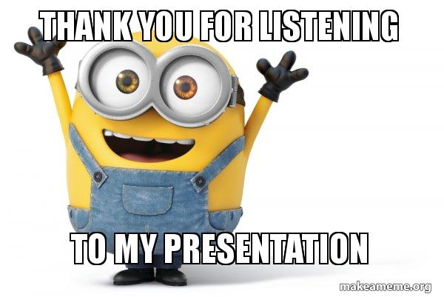
Do well and all the best!

