Slide 1

Project Title - Seasonal Agriculture Performance Analysis
Student Name: Aayushi Engineer
College Name: Silver Oak College of Engineering and Technology
AICTE STU ID : (STU6a6c75e6bbc031785492966 )

Slide 2

PROBLEM STATEMENT
Problem Statement: Weather fluctuations, farming practices, and input utilization create inconsistent seasonal agricultural yield and financial performance.
Core Objectives:
Identify seasonal patterns in environmental conditions, soil health, and resource consumption.
Evaluate crop yield and economic outcomes (costs, revenues, profits) across cropping seasons.
Deliver evidence-based recommendations for resource management, risk reduction, and profit maximization.

Slide 3
Project Description:
The Seasonal Agriculture Performance Analysis project is a comprehensive data analytics initiative examining 4,000 farm-level observation records across 8 Indian states and 10 districts. By synthesizing environmental metrics (rainfall, temperature, humidity, sunlight), soil health factors (pH, moisture, NPK), farm input choices (irrigation methods, seed quality, fertilizers, pesticides), and production outputs, the project evaluates crop yield and financial viability across the Kharif, Rabi, and Zaid cropping cycles. The primary focus is to identify key drivers of agricultural profitability, model operational risk (such as disease and pest outbreaks), and optimize resource efficiency—particularly water and nutrient application—to promote sustainable and profitable farming practices.

Slide 4

WHO ARE THE END USERS?
Farmers & Farm Managers: Benefit from actionable insights on optimal seasonal crop selection, precision input usage, and efficient irrigation techniques (e.g., Drip vs. Flood) to lower input costs and boost net profitability.
Agricultural Extension Officers: Rely on localized statistical findings regarding soil parameters, pest risks, and resource consumption to deliver targeted, evidence-based recommendations to farming communities.
AgTech & Agri-Finance Organizations: Utilize profit, revenue, and yield metrics to design tailored agricultural technology tools, perform data-backed credit risk assessments, and structure crop insurance products.
Policy Makers & Regional Planners: Leverage state and district-level comparative data to guide resource allocation, inform agricultural subsidy programs, and design effective water and soil management initiatives.

Slide 5

Technology Used
  Python
  Matplotlib
  Seaborn
  Pandas
  numpy
  google colab

Slide 6
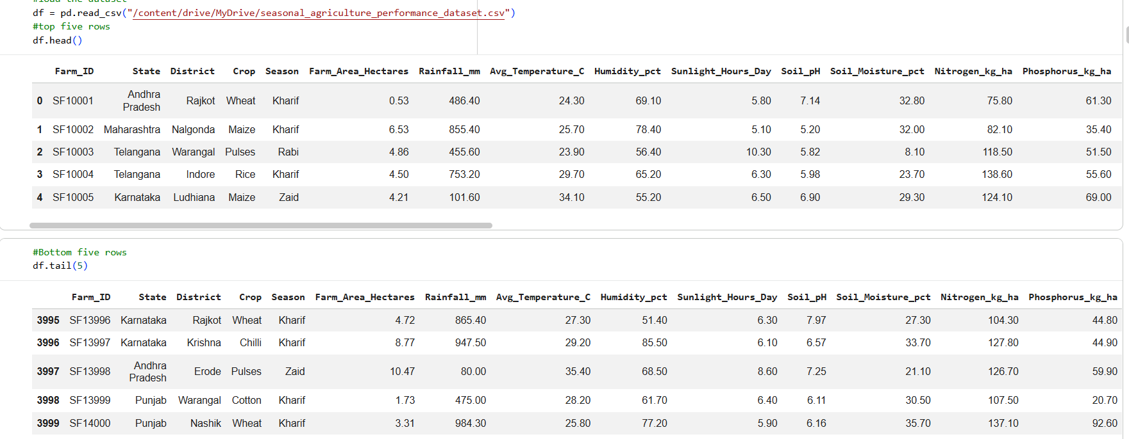
RESULTS

Slide 7
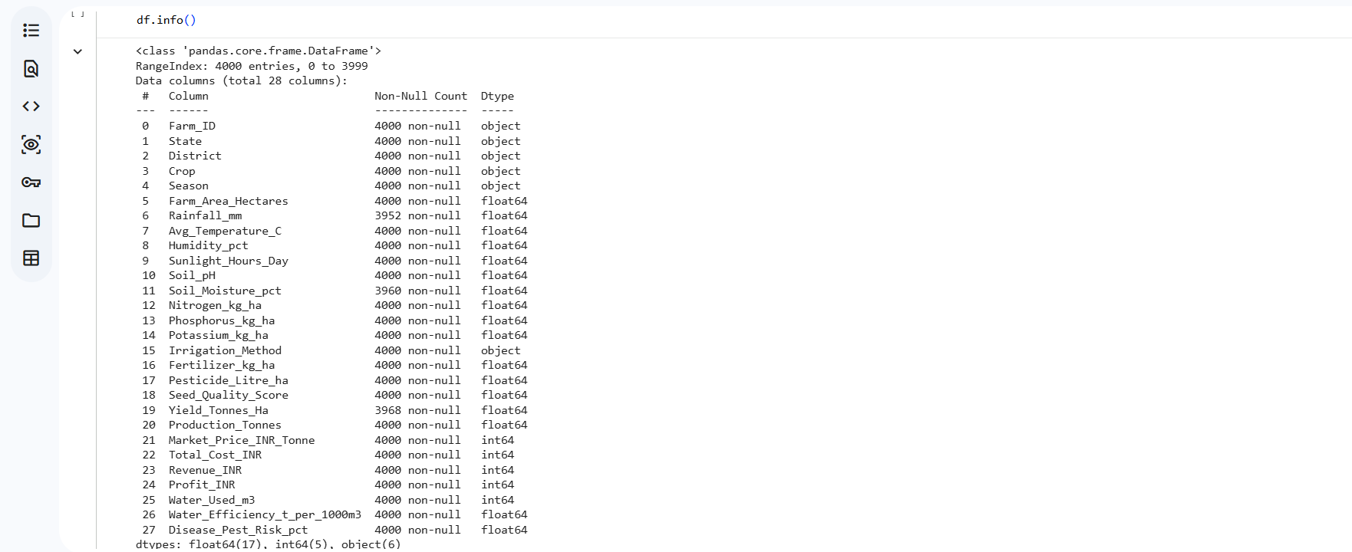
RESULTS

Slide 8
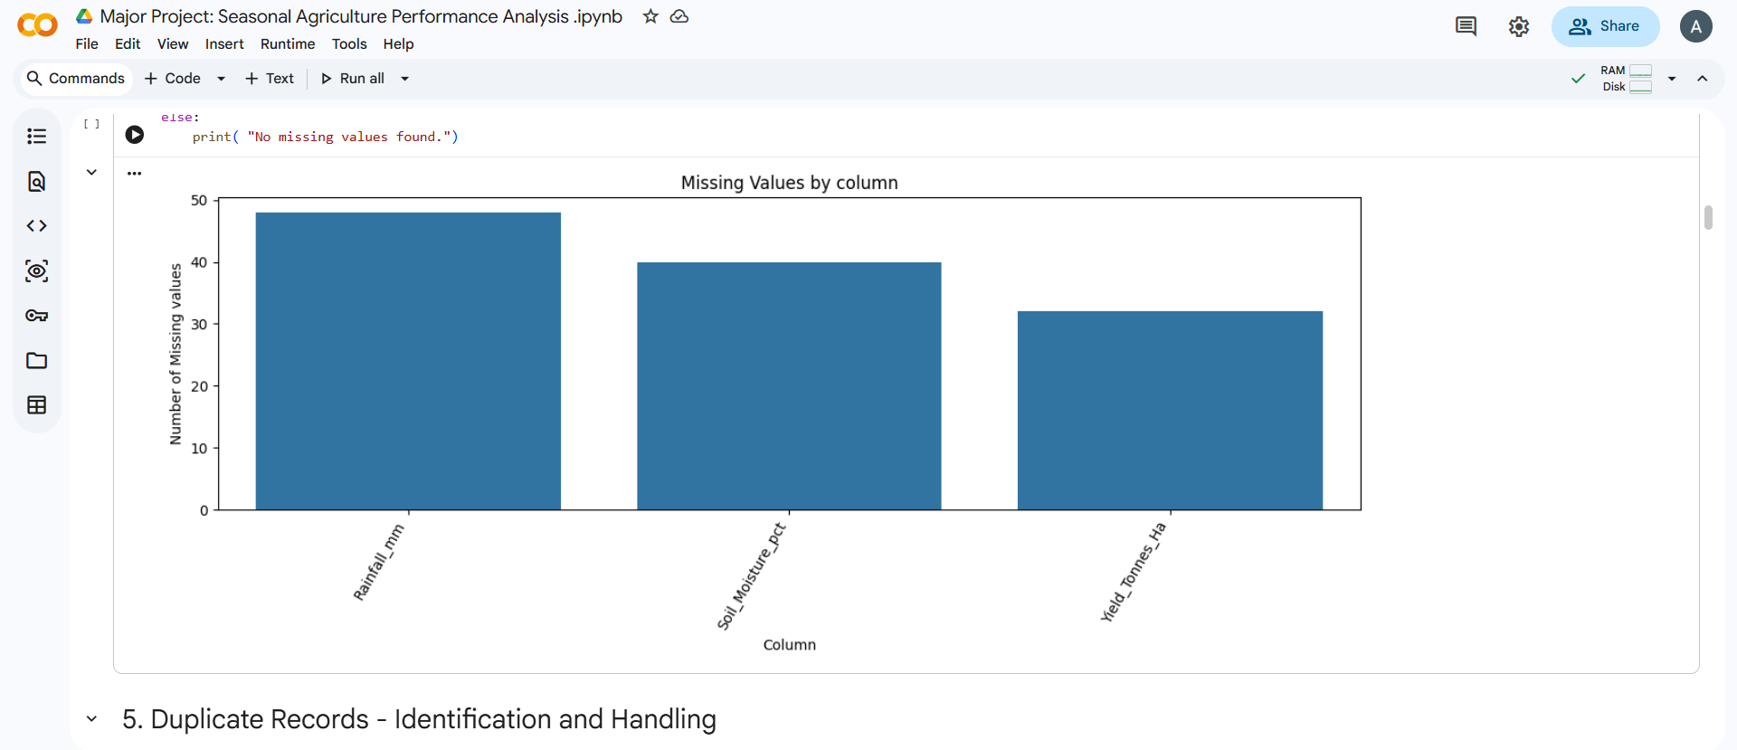
RESULTS
[Add screen shots of your code ]

Slide 9
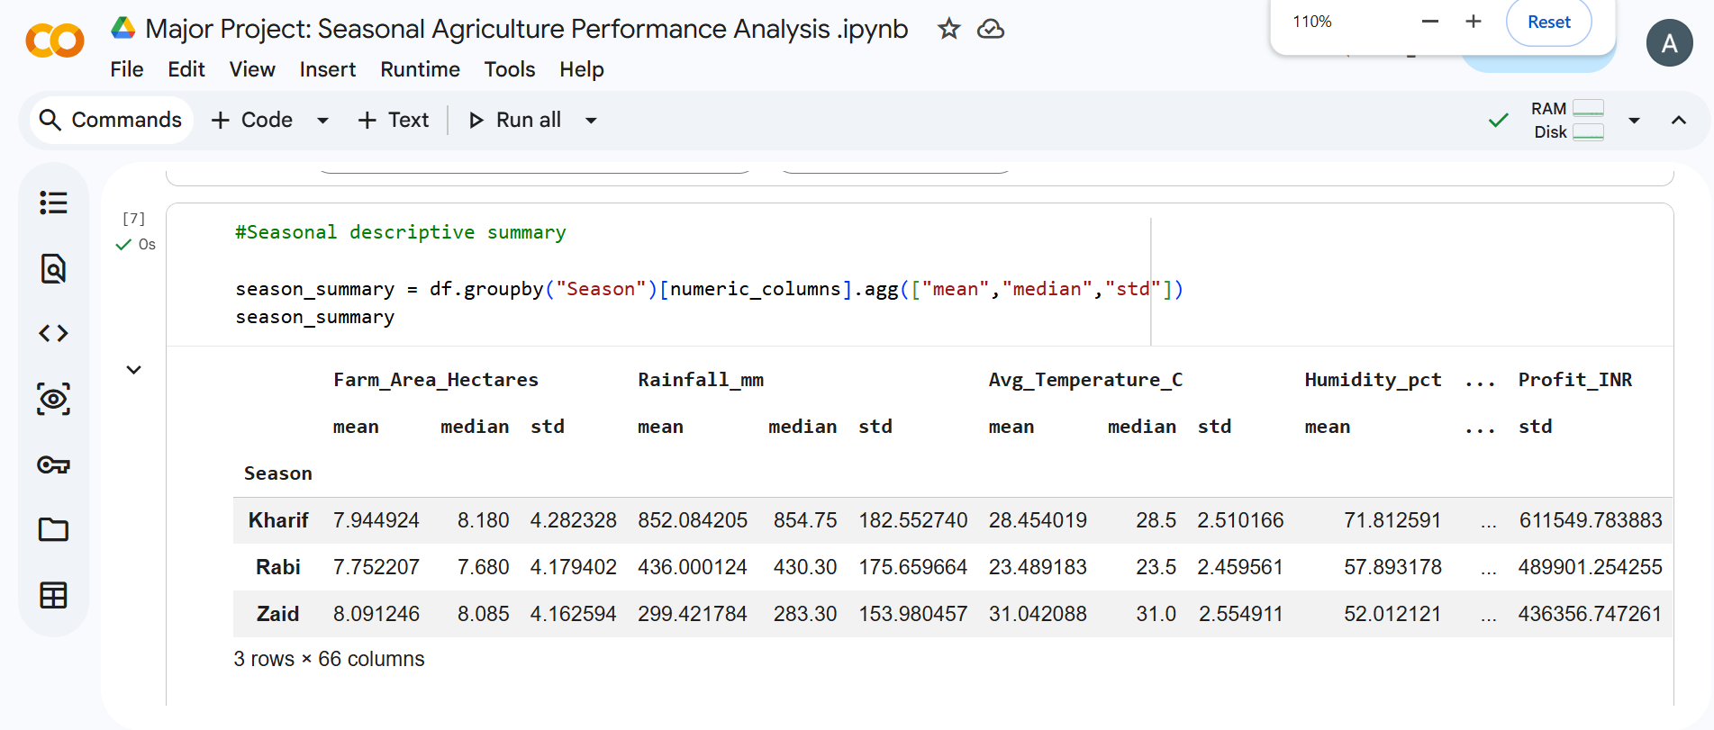
RESULTS

Slide 10
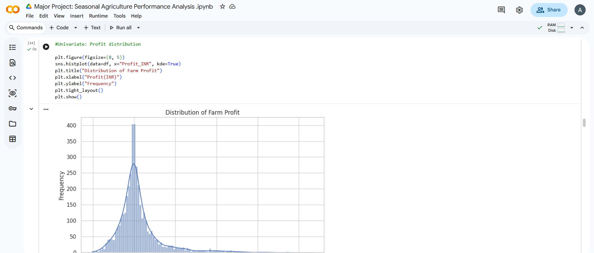
RESULTS

Slide 11
Future scope
1. Predictive Analytics & Machine Learning
2. Real-Time IoT & Smart Farming Integration
3. Geospatial & Remote Sensing Intelligence
4. Financial & Market Intelligence
5. Accessible Decision Support Systems

Slide 12
GitHub Link
https://github.com/aayushiror/VOIS-Major-Project

Slide 13
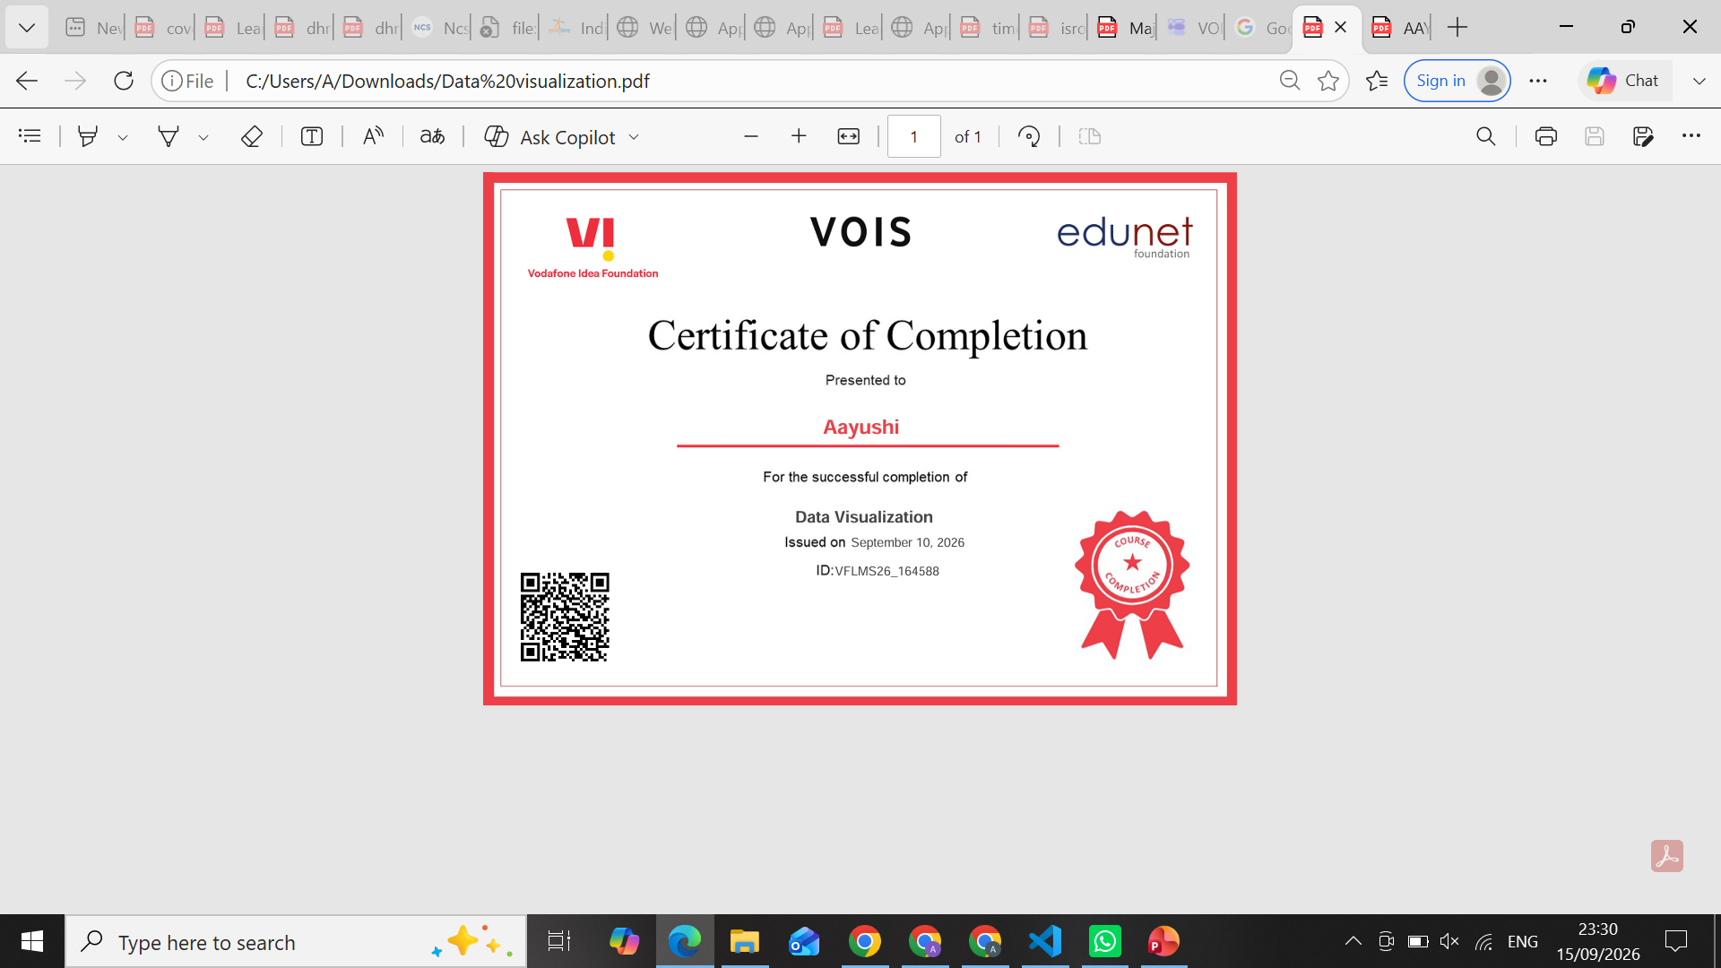
VOIS Course completion certificate -
Course name- Data Visualization

Slide 14
Thank you
.
.

