Slide 1

Notes:
Hi Everyone,
Good Morning
Before we start with the presentation today, I would like to share a small recital.
We have been a part of Publicis Sapient for almost 3months now, and there is this fact that everyone of us would agree upon.
We all started as fresh graduates, underwent 5weeks or so of rigorous training followed by what…5 weeks now of a Hands On project, and what has transpired in these days is a fact that we all are really proud of. A transformation from someone who could code, to someone who can not only code, but add value to everything he does.
So have we succeeded at becoming a Product engineer?
Hi, I am Rajat, a small part of our big team here.
I am here with my colleagues Aman and Chinmay and we are here to give you a walkthrough of our Transformation, our Journey and the project we have been working for sometime now.

Slide 2
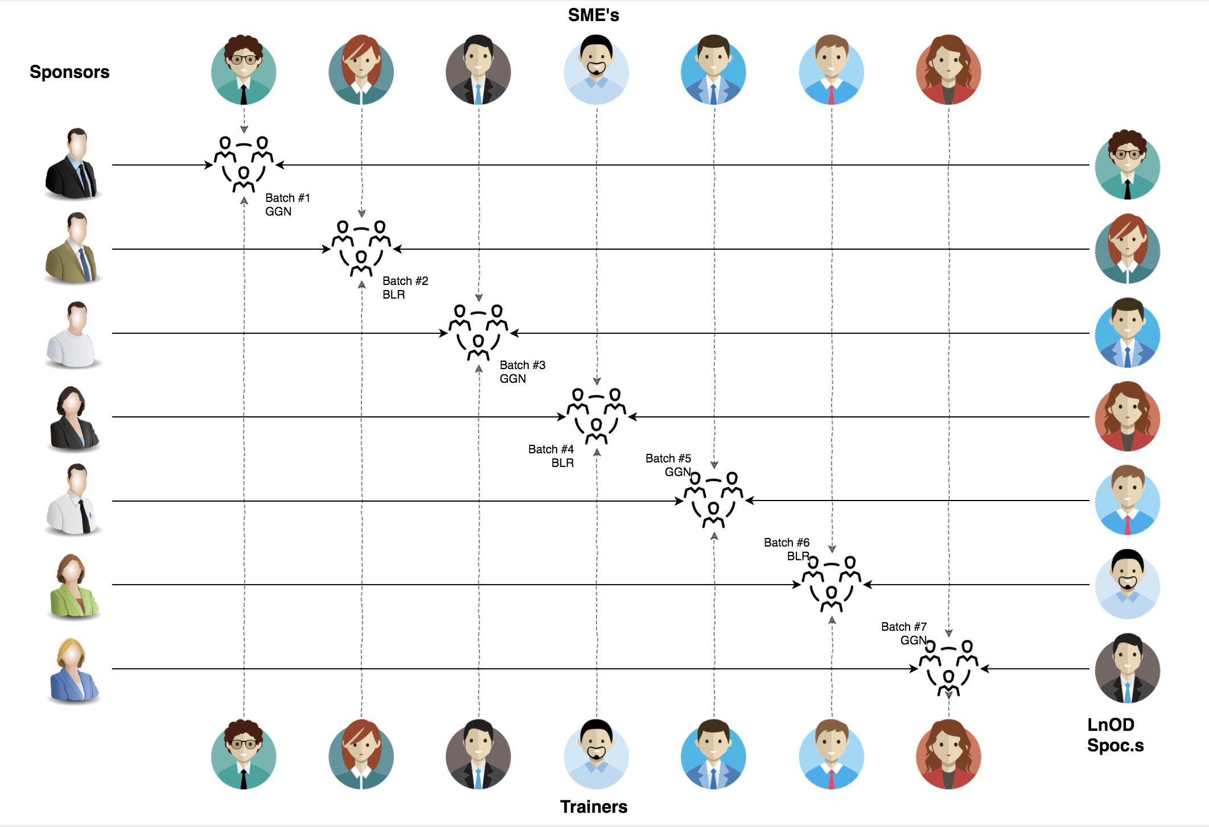
Stakeholders
Sponsors
Flipkart
SME’s
Amit Balyan
Trainer
Amit Balyan
Coordinator
Deepika Gajraj

Slide 3

Our Team
Notes:
Time – 2 mins

Slide 4
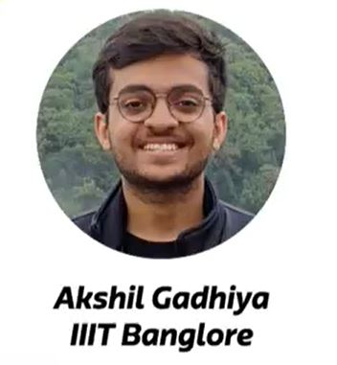
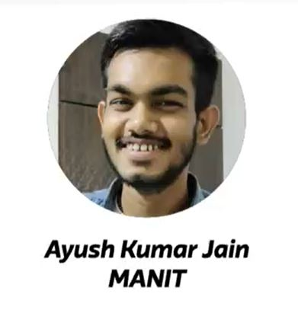
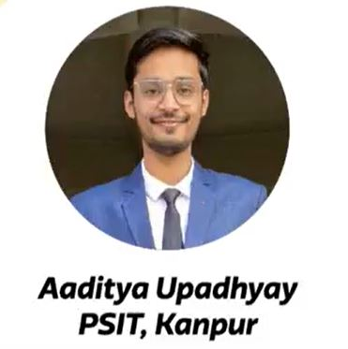
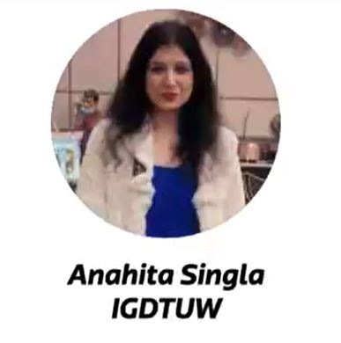
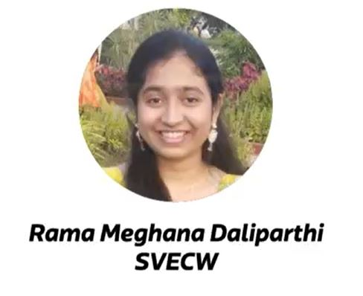


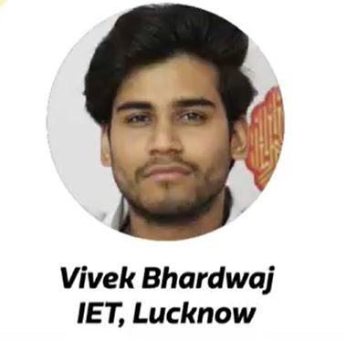

Slide 5
Just a group of college students, with a taste of development
Mostly worked on projects of small scale and priority
Either alone or in small groups of 2-3 members.
New to the Software design patterns and the planning process using diagrammatic tools.
Indifferent to deployment of the end product.
The Ask – Where we started?
…..

Slide 6
Framework for 2 Weeks
2 weeks plan
Every day discussion about topics / Technologies / doubt clearance .
Every day with SME/Trainer discussion of Project progress and transformation based on UML and Technologies

Slide 7
Our next starts
NOW
Notes:
Time – 1 min
Swati

Slide 8
2.5 WEEKS OF TRAINING + PROJECT DEMO
13 DAYS
156 HOURS
9360 MINUTES
561600 SECONDS
LIMITLESS KNOWLEDGE

Slide 9

Agenda
01
Our Journey
02
Project Goals
03
UML Diagrams
04
Engineering Practices
05
Tech Stack
06
Development
07
Challenges & Learnings
08
Demo
09
Questions
Notes:
Time – 1 min

Slide 10

Our Journey
Notes:
Time - 2 mins

Slide 11
Timeline | Modules | Description
17th Jan – 20th Jan | Unix commands Git commands SDLC UML Diagrams | Environment Setup Understanding Unix and Git commands Requirement analysis and modelling
21st Jan – 27th Jan | Java 8 SQL | Developing a POS Application using Java and MySQL. Understanding Java 8 features and collections
28th Jan – 3rd feb | Rest Jersey DropWizard | Developing REST API using Jersey and DropWizard framework

Slide 12
Converting into Dropwizard Application
Procss
5
4
Adding Rest functionality using jersey
Comprehend
3
Creating Terminal based POS Application
2
Designing UML Diagrams
1
Understanding Project Goals

Slide 13
Name | Responsibility
Ramisetty Naga Sudhakar | Implemented Professor, User functionalities Use Case Diagrams
Ayush Jain
Aaditya Upadhyay
Vivek Bhardwaj | Implemented Student, User functionalities Sequence Diagrams
Rama Meghana Daliparthi
Utkarsh Chauhan | Implemented Admin functionalities Class Diagrams
Akshil Gadhiya
Anahita Singla

Slide 14

Project Goals
Notes:
Time – 3 mins

Slide 15




Problem Statement
To develop a POS application and REST API for Course Registration System using JAVA where the student can register, add/drop course, professors can view courses, enrolled students while admin can manage users, add/drop courses to catalog
1
2
Quality
Security
3
4
Interactivity
Speed
Notes:
User satisfaction and brand value

Slide 16
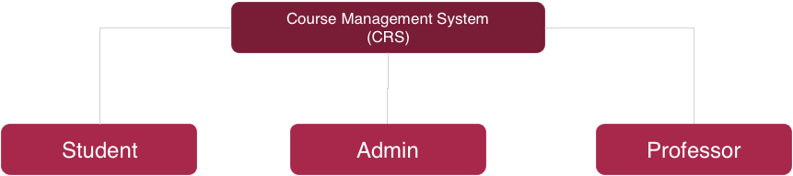
Register Courses
Add/Drop Course
Register themselves
View Registered Courses
Pay Fee
View Course Catalog
View Report Card
Add Professor
Assign Course to Professor
Approve Student Registration
Add/Delete Courses
View Pending Admissions
Update Catalog
Generate Report Card
Grade Students
View Courses to Teach
View Registered Students
View Professor Details
View Professor Courses
‹#›

Slide 17

Engineering Practices
Notes:
Time – 5 mins

Slide 18
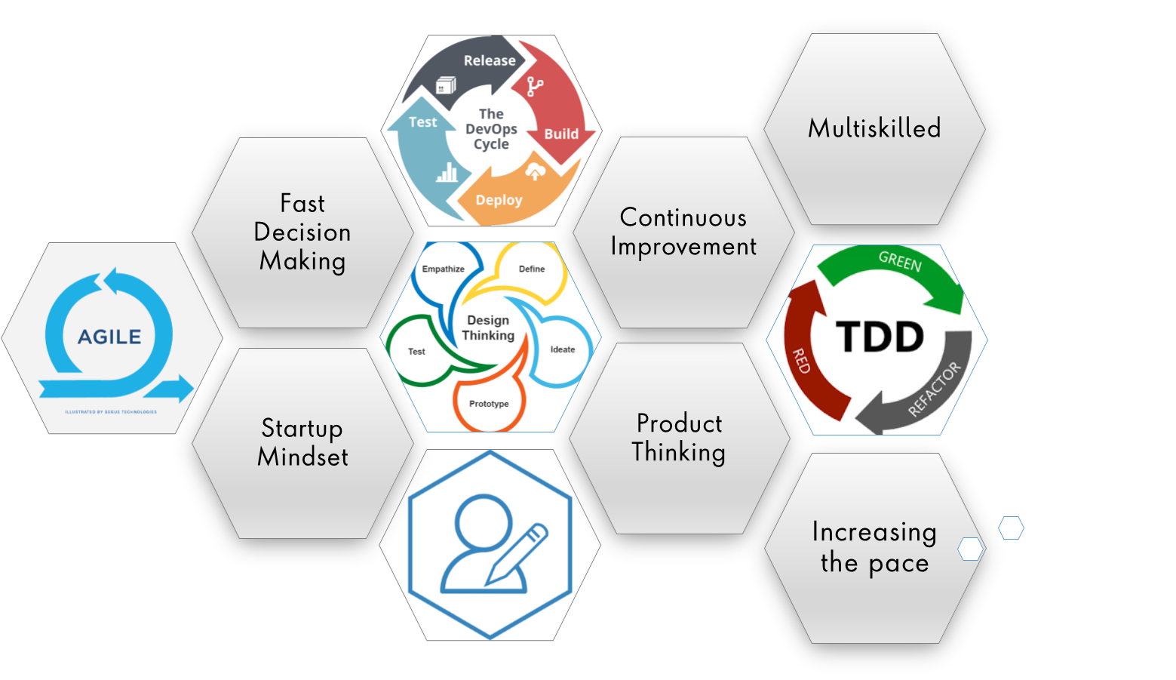
Notes:
Product Thinking (Design Thinking, Requirement Analysis, )
Multi Skilled (Frontend, Backend, DevOps)
Fast Decision Making (Agile)
Increasing the Pace (Automation CI/CD)
Startup Mindset (Agile)
Continuous Improvement (Retros)

Slide 19
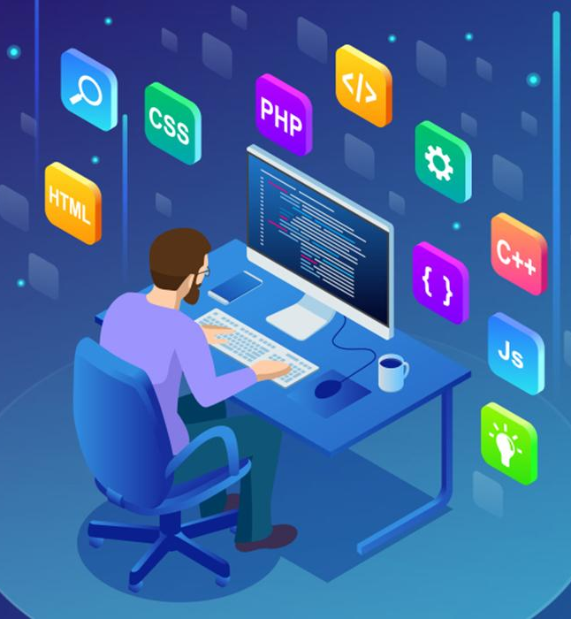
Tech Stack
Notes:
Time – 2 mins

Slide 20
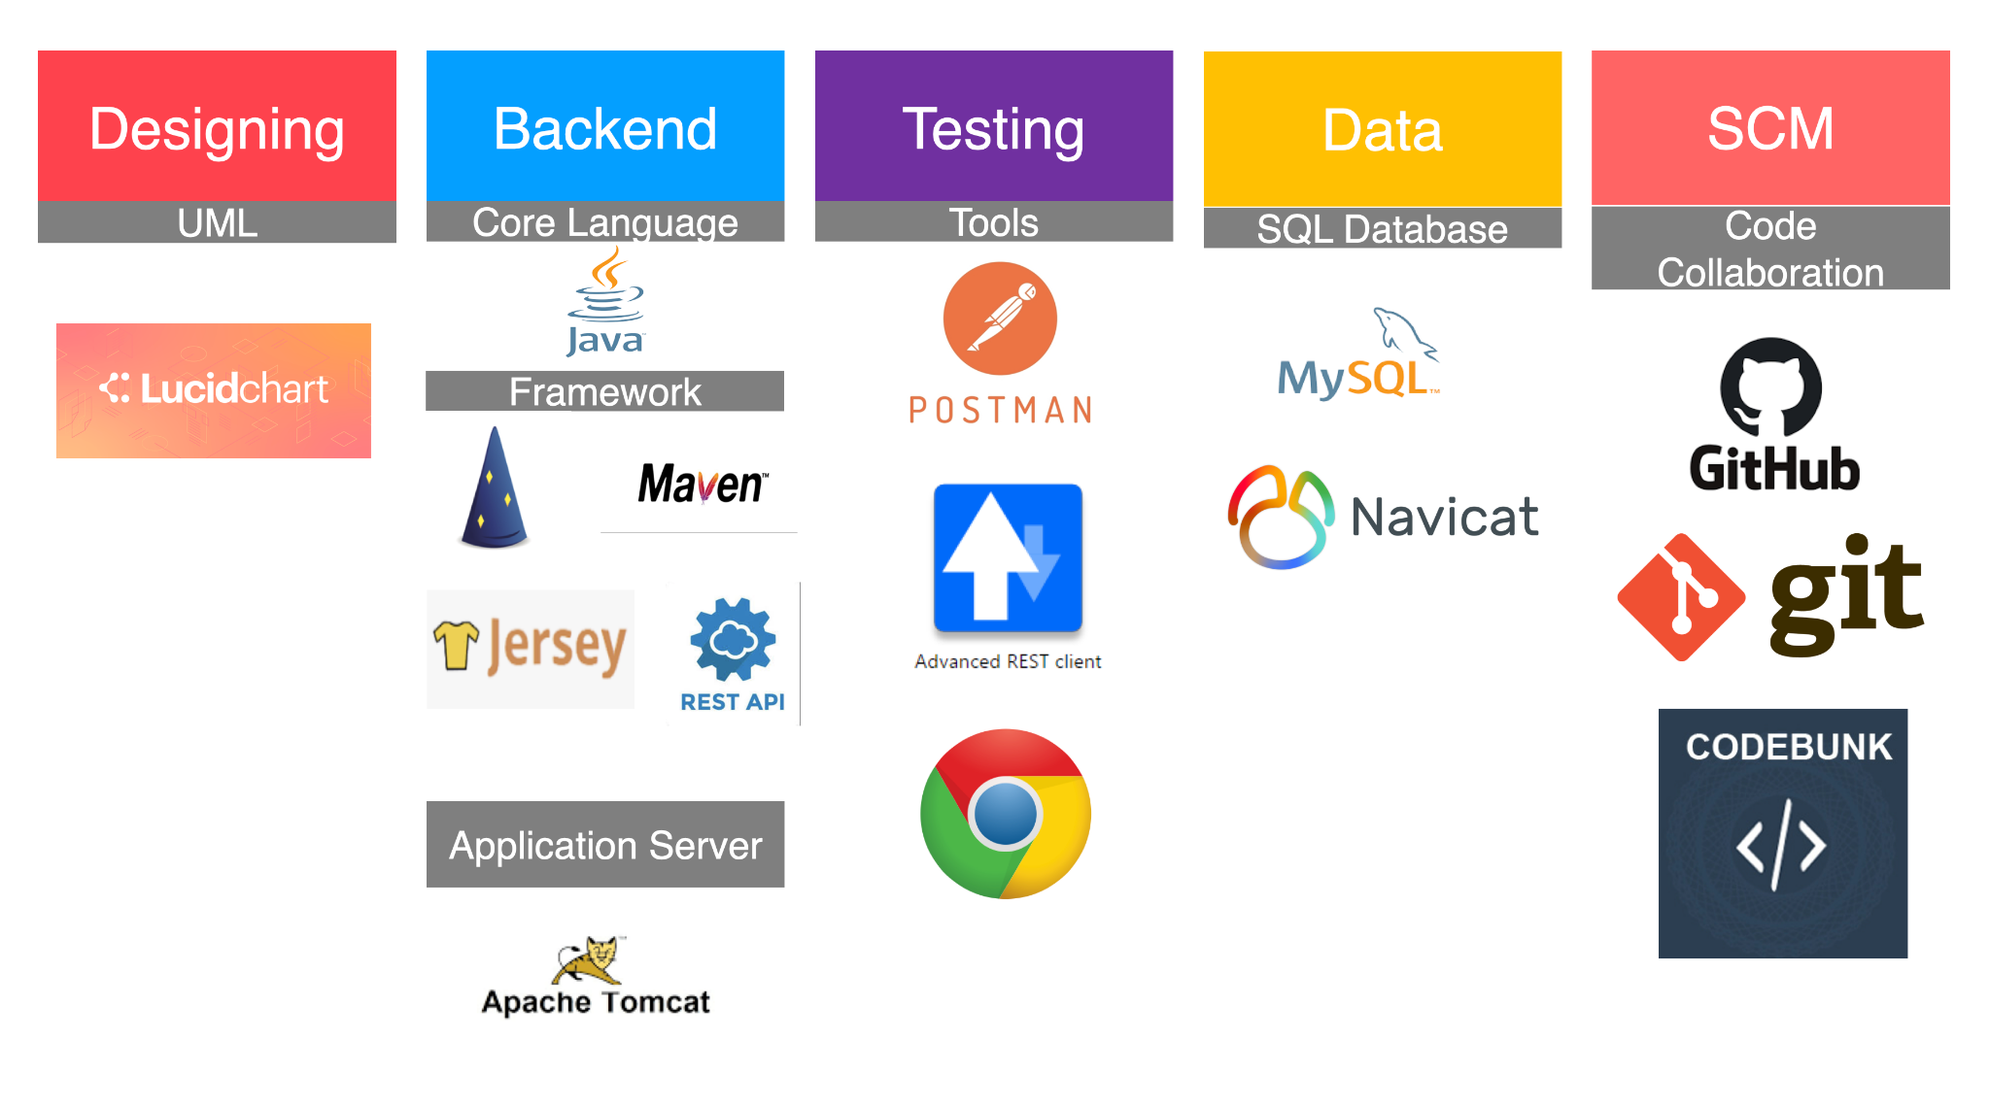

Slide 21

Development
Notes:
Time – 1 min

Slide 22
Planning
Understanding problem Statement
Requirement understanding
Research and analysis
Estimation
Sprint Planning
Spring Grooming
Delivery
Sprint Implementation
LLD
Development
Code Review
Commit
Integrate
Deploy
Test
Notes:
Time – 1 min

Slide 23

Demo
Notes:
Time –
POS- Student -5 min
REST - Professor - 3 min
DropWizard- 3 min

Slide 24

Challenges & Learnings
Notes:
Time – 2 mins
Challenges-
Installing the Tomcat server and running application on it.
Learnings-
Got to learn new technologies.
Learnt working together in teams.(collaboration)
Learnt how to write code which is accepted by the industry.
Learnt how to make UML diagrams for the given problem.

Slide 25
 | Challenges | Learning
Week 1 | Understanding the problem statement Collaboration issues such as merge conflicts in Git UML diagram conventions | UNIX Ubuntu Git commands UML Diagrams
Week 2 | Installation softwares on multiple environments POS application development using layered architecture | Java 8 Exception Handling SQL
Week 3 | Resolving jar and version dependencies Jersey validation Running Apache TomCat server | REST API development using Jersey and DropWizard Maven DropWizard

Slide 26

Questions
Notes:
Time - ?

Slide 27

Thank you
Notes:
Time – After this show the testimonial video. 1 min

