Slide 1
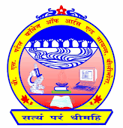
: SUBJECT :
(604) SEMINAR
V.S.PATEL COLLAGE OF ARTS & SCIENCE,BILIMORA
BCA DEPARTMENT
Ty-BCA
SHREYA UMESHBHAI PATEL
Roll no : 78

Slide 2
CONTENTS
INTRODUCTION
FEATURES
CONSTRUCTION
WORKING
CURRENT PRODUCTS
ADVANTAGES
DISADVANGTAGES
CONCLUSION

Slide 3
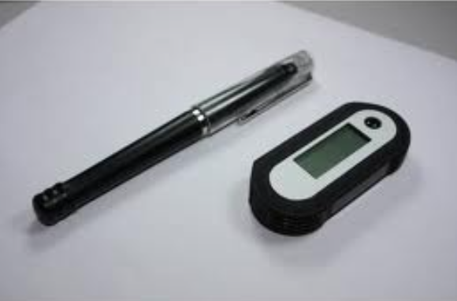
Smart Note Taker

Slide 4
INTRODUCTION
Smart Note Taker is a very useful product that could satisfy the need of people in today’s technological and fast life. Smart Note Taker is a pen that provides taking fast and easy notes to people who are busy one’s self with something.with the help of SNT people will be able to make notes in air, while being busy with their work. The written notes will be stored in memory chip of the pen and will be able to read in digital medium after the job is done.it is made by KAWELL industry of HONGKONG.this will save time and facillite life.it also include voice recorder.

Slide 5
FEATURES:
With the help of smart note taker handwritten notes can be instantly converted into editable text.
It can recognize upto 22 Languages such as English,Canada,germam,simplified Chinese,Korean,Spanish,French and many more.
Recognize handwritten notes – simply write your text using the provided ink pen.your handwritten notes will be instantly converted into editable text.

Slide 6
WORKING
Using the smart note taker we can write in air and it is stored in the internal memory.
The sensed shape that is drawn in the air will be recognized and the desired character can be written with the help of the software program and later printed in the word document.
If the application program is a paint related program, then The most similar shape will be chosen by the program and then will be displayed on screen.
It converts your handwriting into text. Any handwriting is recognized 99.9% accurately. Write in cursive or print, even a combination!

Slide 7
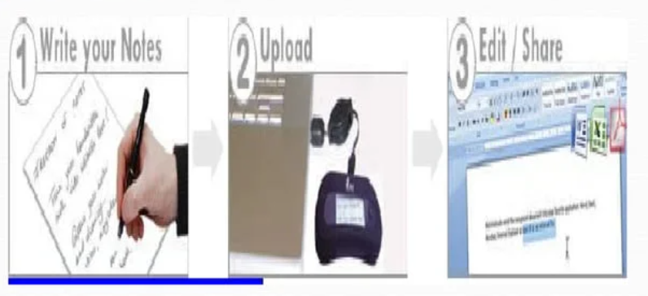
Simply write your notes when you are back to edit your notes in with the provided your computer ,simply favorite standard ink pen. Upload your notes software.

Slide 8
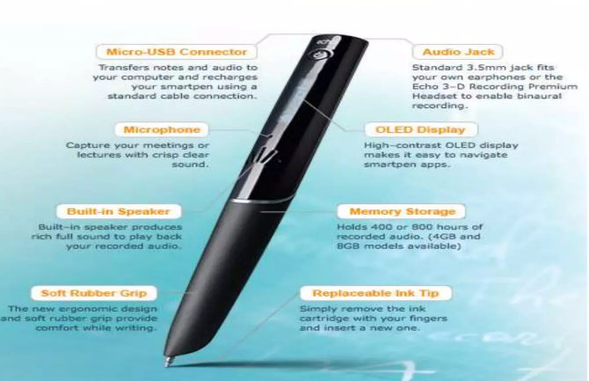
CONSTRUCTION(external)

Slide 9
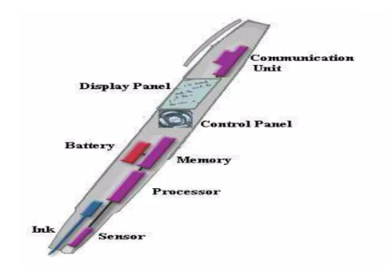
CONSTRUCTION(Internal)

Slide 10
TECHNICAL REQUREMENTS
Operating system(LINUX OR WINDOWS)
Software program to convert data into text or string format.
Displacment sensor.
Parallel cable.
Analog to digital converter.
switch,.
Rechargeable battery.

Slide 11
OPPORTUNITIES IN MARKET
In the current market there are many similar products that can convert handwritten documents into digital type documents. In these products optical sensors are being widely used to perceive the motion. ink is also used in these products to be functioned as an ordinary pen . there are optical sensors on the pen. However ,they have some lacks and imperfection such as being wired , limited in work space, non –practical and limited in 2D.

Slide 12
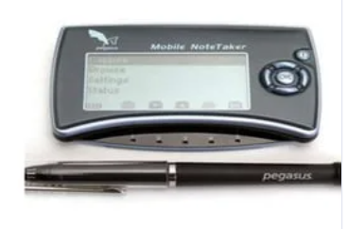
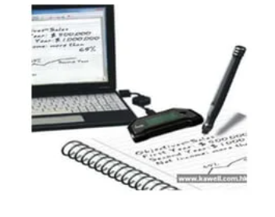
CURRENT PRODUCTS:
MOBILE NOTE TAKER PC NOTE TAKER

Slide 13
Advantage
Smart note taker is realible and powerful.
It is useful for blinds that think and write freely.
Easy to use wireless connection.
It is time saving.
Smart note taker is used for instructors in presentation.
Light weighted

Slide 14
Disadvantage:
Cost of the pen is very high(50-90$ for 2D pen,2000$ 3D pen).
Only high class people can affords this type of note takers.

Slide 15
Conclusion
Hence , we can conclude that our product has many advantages over digital pen , since the smart note taker is a device that can store visual recordings and thus can be used widely.

Slide 16
References
[online] Available: http://www.anoto.com.
S. Jaeger, S. Manke, J. Reichert and A. Waibel, "Online Handwriting Recognition: the Npen++ Recognizer", International Journal on Document Analysis and Recognition 3:169–180, 2001.
https://www.youtube.com/watch?v=N6skSKMYEao

Slide 17
Thank youu

