Slide 1

AquaCoach
Your ultimate hydration companion

Slide 2
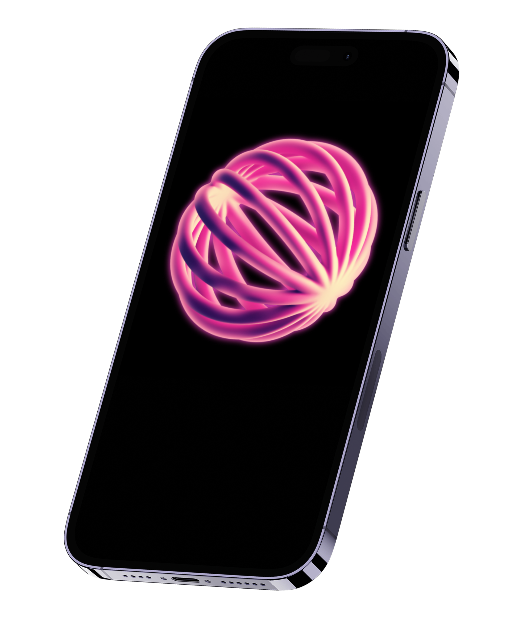
Introduction
About
Team
User Stories
Constraints
Progress

Slide 3

Introduction

Slide 4



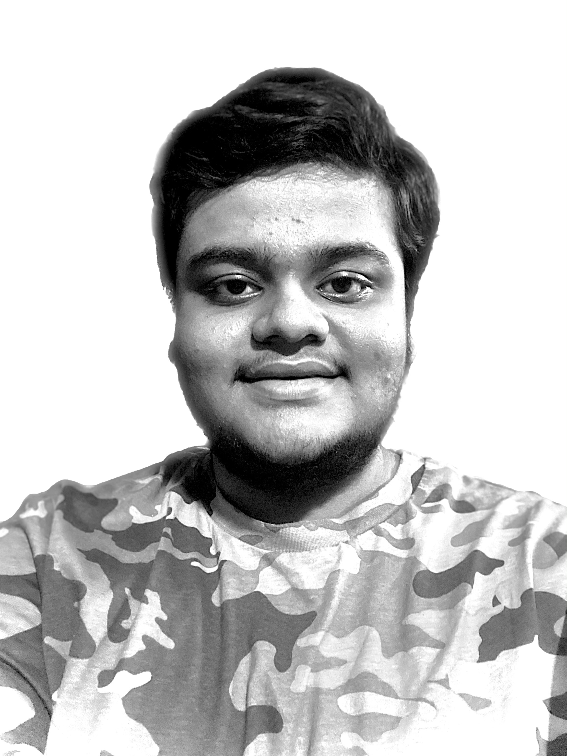
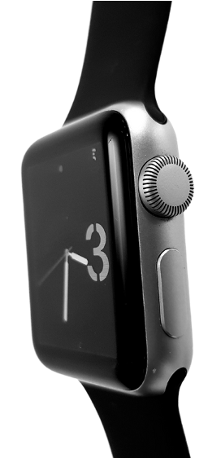




Data-driven insights
Intelligent analytics
Personalized daily goals
Location aware
Welcome
Apple HealthKit enabled
I’m Aayush, and I'll be sharing with you my idea for what AquaCoach is. Follow me at @aayushkeshari on GitHub to learn more.
AquaCoach is a smart hydration tracking application designed to encourage healthy water-intake habits through real-time analytics and adaptive reminders.
Workout Companion
Student-made
40+
beverages
Health and Food Conscious
Environmentally Aware

Slide 5

What AquaCoach is

Slide 6
AquaCoach is to help users monitor, optimize, and personalize daily fluid intake using intelligent analytics and adaptive reminders. We aim to promote healthier hydration habits through intuitive design, predictive goal setting, and data-driven insights.

Slide 7
Team

Slide 8
Team Member: Aayush (solo developer)
Email: kesharah@mail.uc.edu
GitHub Repo: github.com/aayushkeshari/AquaCoach
Advisor: Aishwarya Keshari (Amazon), Shivani Gupta (Amazon)

Slide 9

Goals and Background

Slide 10
Problem Background
- Many hydration apps rely on static daily water goals that ignore lifestyle and environmental variation.
- Users often abandon hydration apps due to notification fatigue or lack of personalization.
- Dehydration contributes to fatigue, cognitive decline, and reduced physical performance.
Project Goals
- Develop a personalized hydration system that adapts to user behavior, activity, and environment.
- Use intelligent reminders to reinforce healthy habits without overwhelming users.
- Design an intuitive interface accessible to diverse age groups and lifestyles.
- Promote sustainable long-term behavioral change through data-driven feedback.

Slide 11
User Stories

Slide 12
The AquaCoach app is designed with diverse users in mind. For example, a health-conscious individual wants to log their daily water intake to consistently track progress toward personalized hydration goals. A busy student seeks timely reminders throughout the day to ensure they stay properly hydrated despite a hectic schedule. Meanwhile, an athlete desires an intelligent system that dynamically adjusts hydration targets based on factors such as weather conditions and physical activity levels. Together, these perspectives illustrate AquaCoach’s commitment to accessibility, adaptability, and user-centered design that supports healthy hydration habits for every lifestyle.

Slide 13
Intellectual Merits

Slide 14
Intellectual Contributions
- Designed a modular hydration goal algorithm integrating weight, activity level, and weather variables.
- Engineered a context-aware reminder engine that adapts notification timing based on user progress.
- Structured system architecture separating Intake Manager, Goal Calculator, Reminder Engine, and Data Layer for scalability.
- Integrated Apple HealthKit using secure, permission-based data exchange.
Methodological Strength
- Applied iterative human-centered design.
- Conducted usability-driven design decisions.
- Built architecture aligned with software engineering best practices.

Slide 15
Broader Impacts

Slide 16
Health & Well-Being
Encourages sustainable hydration habits.
Supports cognitive and physical performance improvements.
Accessibility & Inclusivity
Simple, clean UI for all ages.
Adjustable reminder frequency and customizable beverage tracking.
Designed to function across climates and diverse hydration needs.
Social Impact
Promotes preventative health behavior.
Reduces reliance on sugar-based beverages.
Enhances everyday user well-being through subtle behavioral reinforcement.
Scalability Potential
Expandable to wearable integration.
Potential application in athletic training and workplace wellness programs.

Slide 17
Design Specifications

Slide 18
System Overview
- iOS-based mobile application.
- Modular system architecture (D0–D2).
- Local SQLite storage with optional secure cloud synchronization.
- Weather API integration for environmental adjustments.
Functional Requirements
- Log 40+ beverage types.
- Calculate personalized hydration goals.
- Provide real-time dashboard analytics.
- Deliver adaptive OS-level reminders.
Non-Functional Requirements
- Secure local data encryption.
- Response time under 2 seconds.
- Battery-efficient reminder scheduling.
- HealthKit privacy compliance.

Slide 19
Design Diagrams

Slide 20
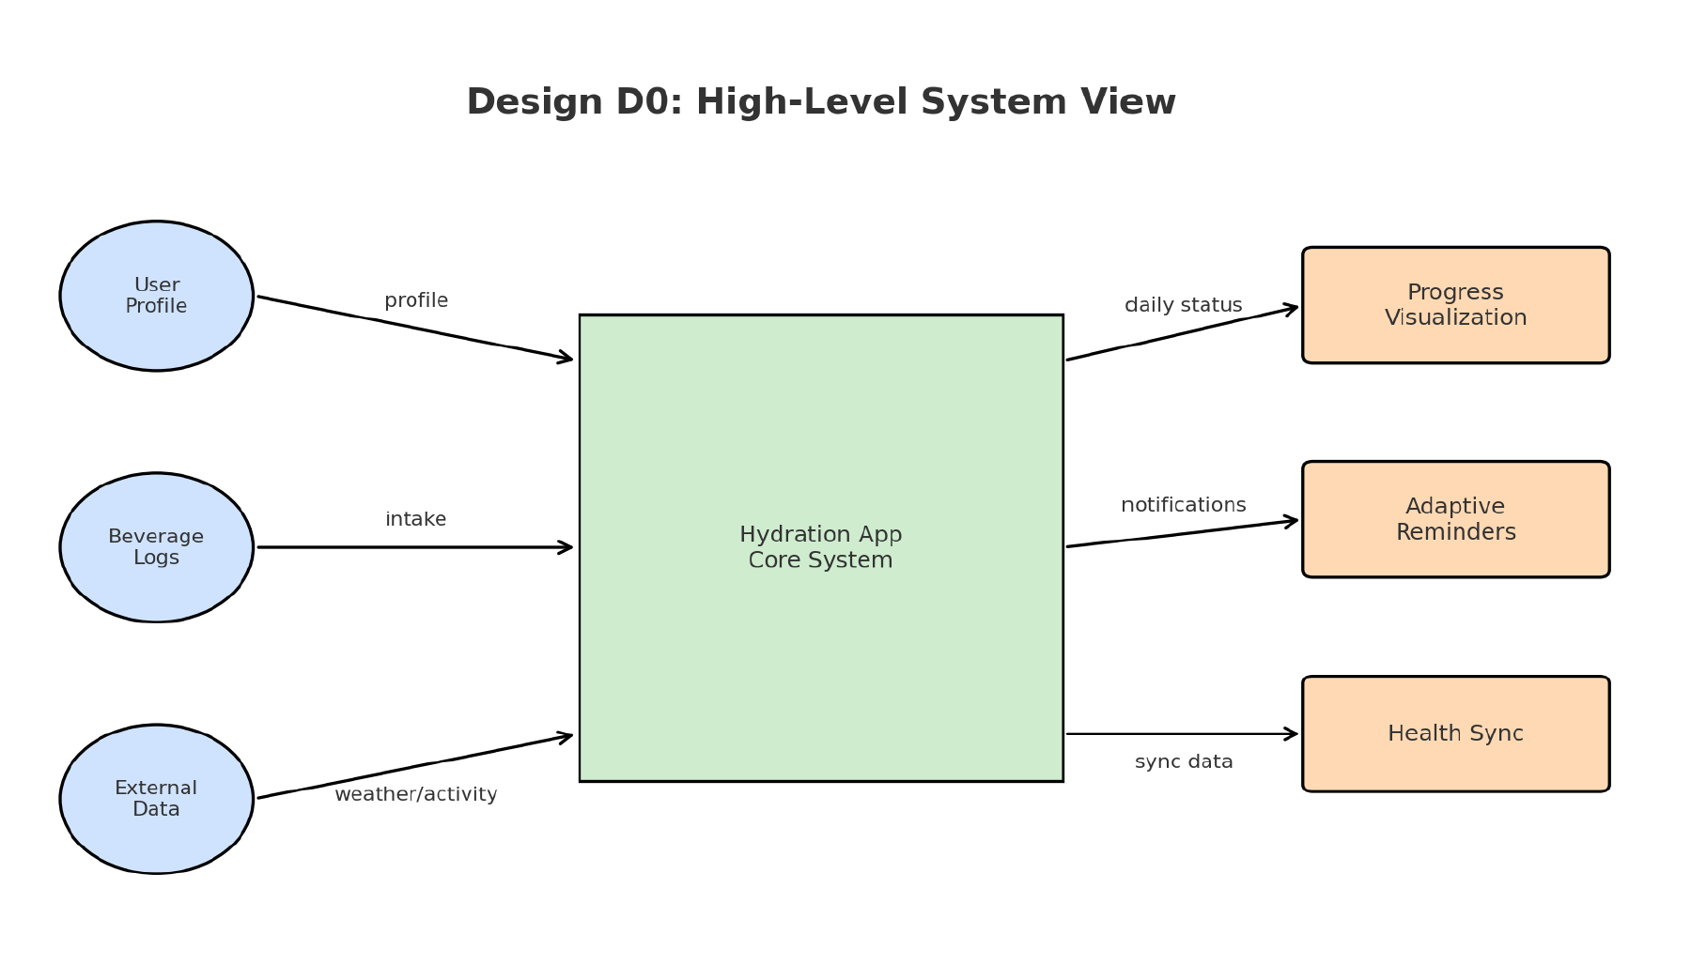
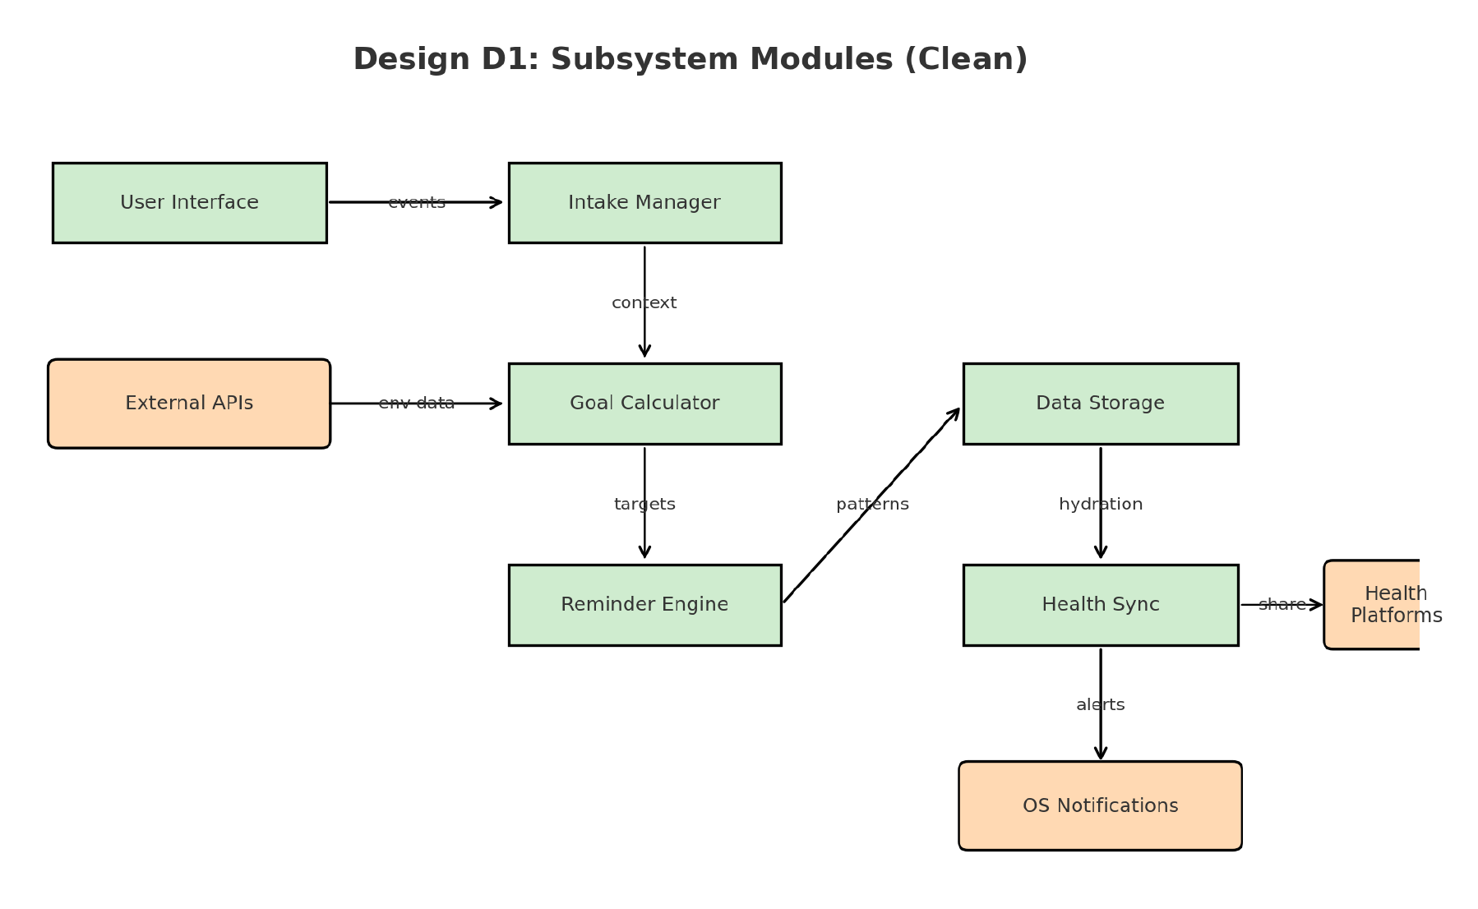
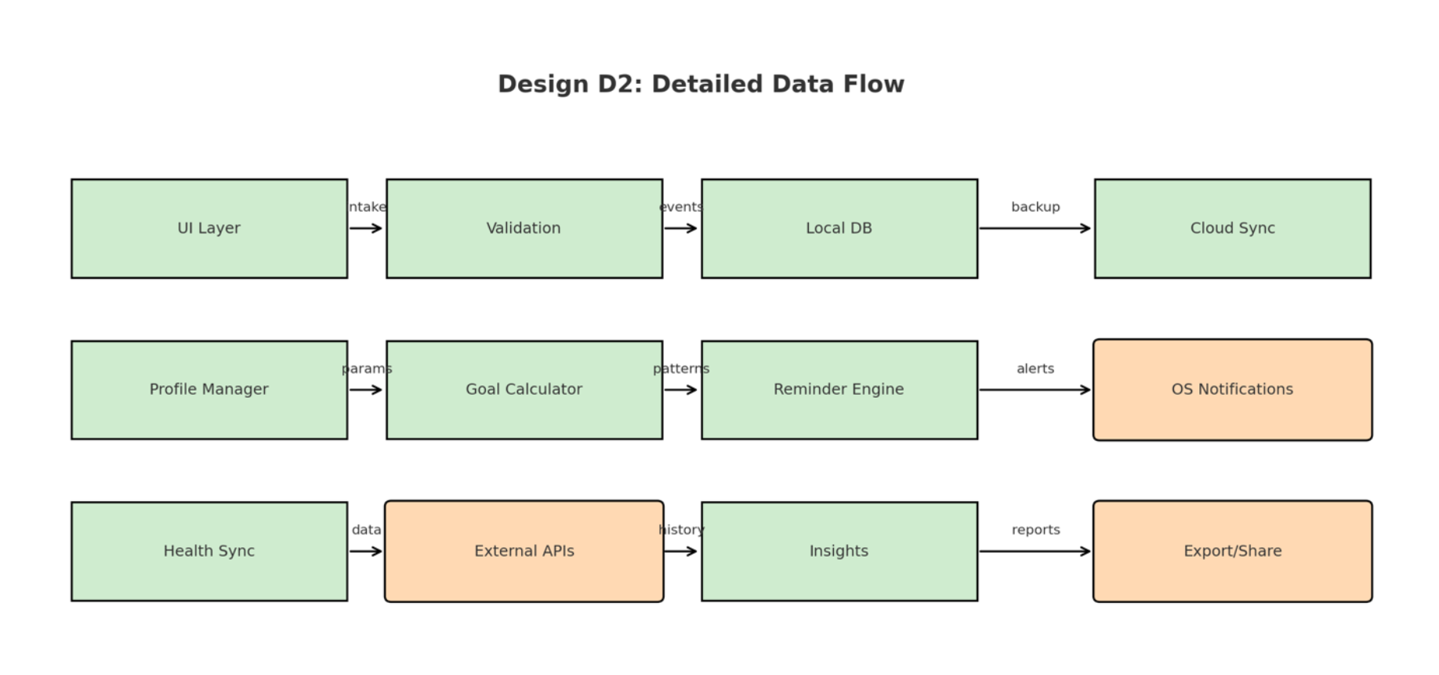

Slide 21
Technologies

Slide 22
Development Stack
- Swift & SwiftUI for iOS application.
- Apple HealthKit Framework.
- SQLite / CoreData for persistent storage.
UserNotifications Framework for reminders.
External Integrations
- Weather API for environmental context awareness.
- iCloud Sync for secure backup.
Engineering Tools
- Xcode Development Environment.
- GitHub for version control and documentation.
- Figma for user-centered UI prototyping.
Security Implementation
- Encrypted local storage.
- Permission-based HealthKit data read and write access.
Secure authentication handling.

Slide 23

Constraints

Slide 24
AquaCoach operates under several real-world constraints:
Economic: Uses free APIs, SQLite, and open-source frameworks due to no external funding.
Ethical: Protects user privacy by encrypting local data and minimizing personal identifiers.
Security: Follows secure data-sharing standards with Apple HealthKit and iCloud backup encryption.
Diversity & Cultural Impact: Inclusive UI supports varied languages, climates, and hydration patterns.
These factors shape design decisions and prioritize responsibility alongside functionality.

Slide 25

Progress

Slide 26
Current Status:
Completed:
✅ Completed requirements and architecture designs
✅ Defined the workflow of the project
✅ Created UI/UX wireframes and early prototype screens
✅ Established GitHub repo with structured documentation and deliverables

Slide 27
Current Status:
In works:
🔄 Module development for different tasks
Intake Manager
Beverage Manager
Goal Calculator
Reminder Engine

Slide 28
A Snapshot
Completed
- Fully structured system architecture.
- Functional intake logging workflow.
- Database schema implementation.
- Reminder scheduling logic framework.
Preliminary Validation
- Successful data persistence across sessions.
- Reminder trigger reliability >95% in simulation testing.
- HealthKit permission workflow validated.
Remaining Tasks
- Full integration testing.
- UI refinement based on usability feedback.
- Performance optimization.
- Finalized test plan execution.

Slide 29
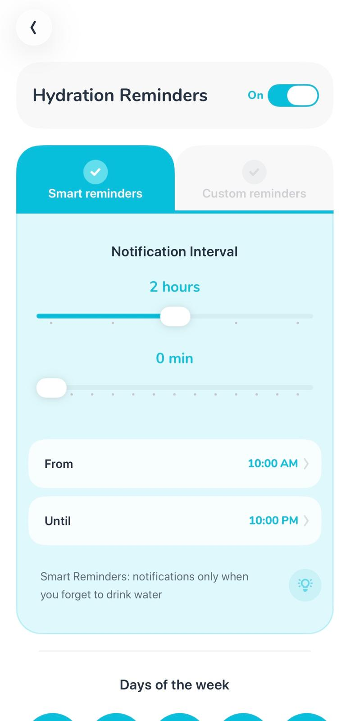
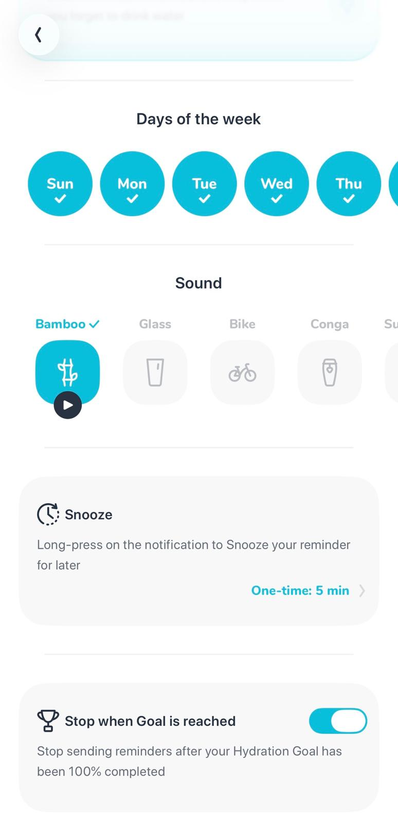
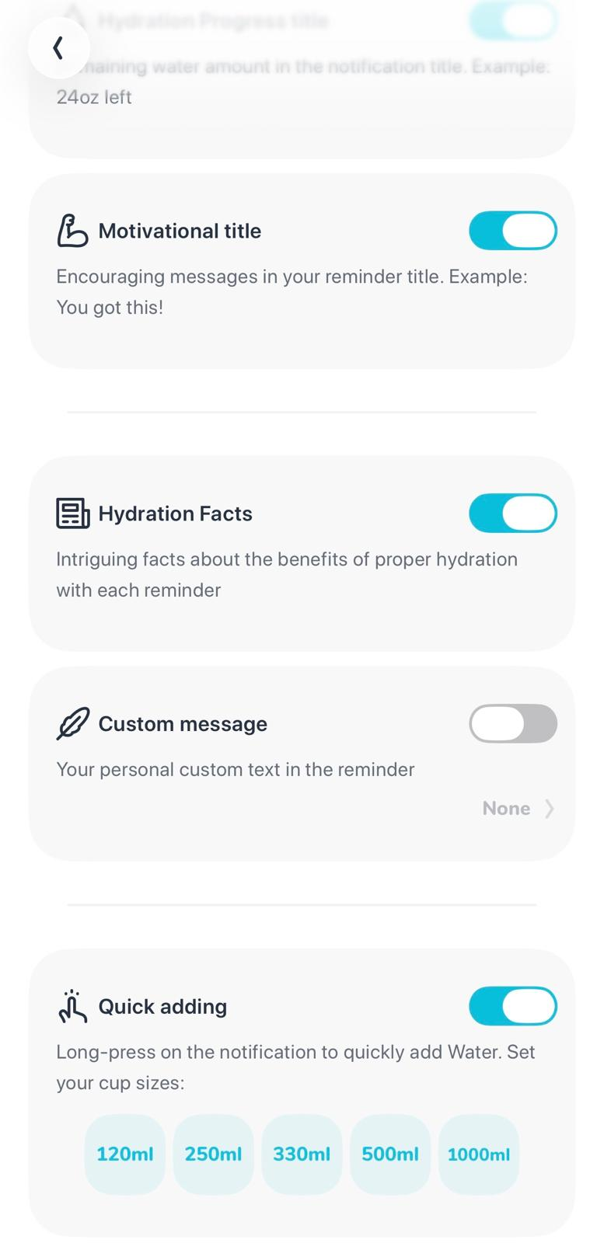
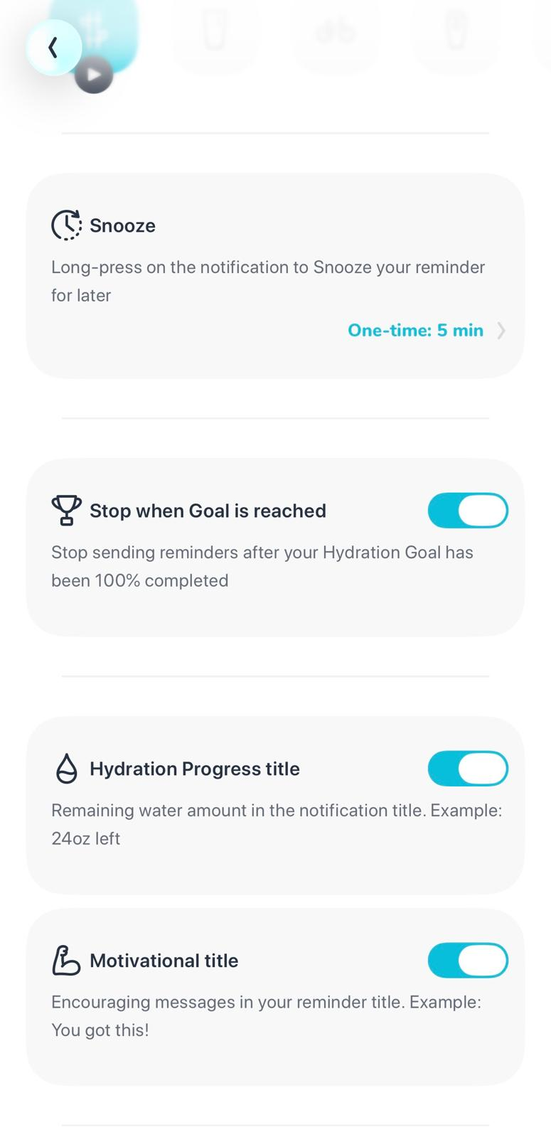
Reminder Engine

Slide 30
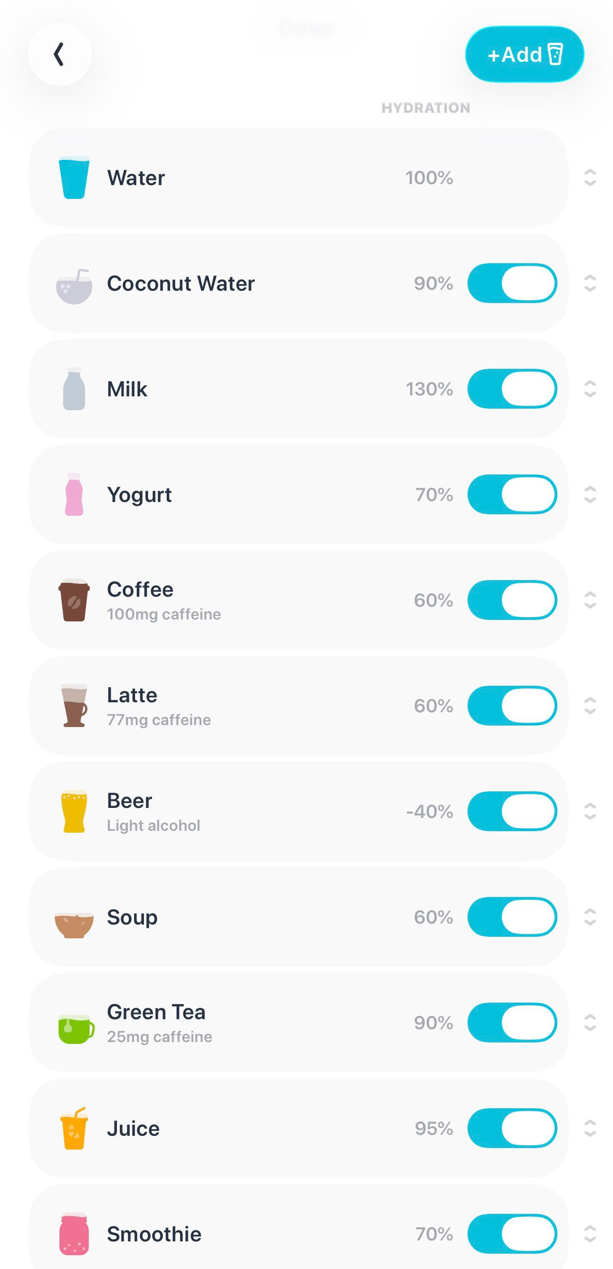
Beverage Manager

Slide 31

Expected Accomplishments

Slide 32
➡️ Complete designing and fine-tuning UI.
➡️ Complete each of the modules.
➡️ Complete testing.

Slide 33
Challenges and Solutions

Slide 34
Challenge: Balancing Simplicity with Accuracy
Solution: Designed modular hydration formula for scalability.
Challenge: Notification Fatigue
Solution: Adaptive reminder logic and customizable intervals.
Challenge: Privacy & Data Security
Solution: Encrypted local storage and strict HealthKit compliance.
Challenge: Solo Development
Solution: Structured milestone planning and disciplined documentation process.

Slide 35

Effort Allocation

Slide 36
Since the project is individual, I am responsible for all phases of development.
Key Roles:
System Architecture & Design (10%)
UI & Prototype Development (15%)
Module Implementation (Intake, Goal, Reminder, Storage, Apple HealthKit) (50%)
Integration & Testing (15%)
Documentation & Presentation (10%)

Slide 37
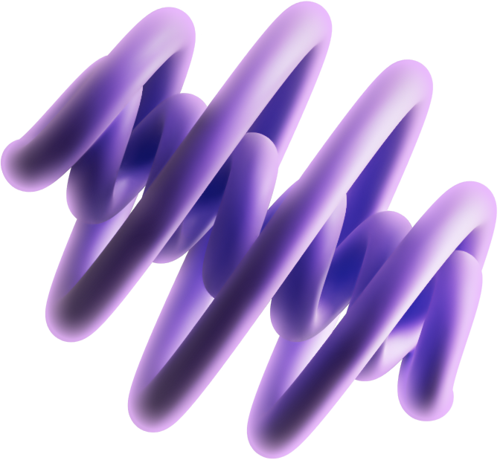
Demo

Slide 38
Planned CEAS Expo Demo:
➡️ Live demonstration of hydration logging and goal calculation.
➡️ Real-time hydration insights based on activity and weather.
➡️ Interactive reminder system with OS-level notifications.
➡️ Dashboard display with visual progress and trend charts.
Deliverables Showcased:
➡️ Working app prototype, poster presentation, and technical documentation.

Slide 39
Flow of events at Expo (planned):
Live Demonstration Flow
- User profile sign-up and setup.
- Personalized hydration goal generation.
- Beverage intake logging.
- Real-time progress dashboard update.
- Adaptive reminder trigger simulation.
- HealthKit synchronization preview.
Demo Objectives
- Demonstrate human-centered usability.
- Showcase intelligent adaptation.
- Highlight secure and scalable system architecture.

Slide 40
Contact me!
350 Straight St, Cincinnati, OH-45219
kesharah@mail.uc.edu
@aayushkeshari (GitHub)

Slide 41
“I skate to where the puck is going to be, not where it has been.”
- Wayne Gretzky

Slide 42
Thanks!

