Slide 1
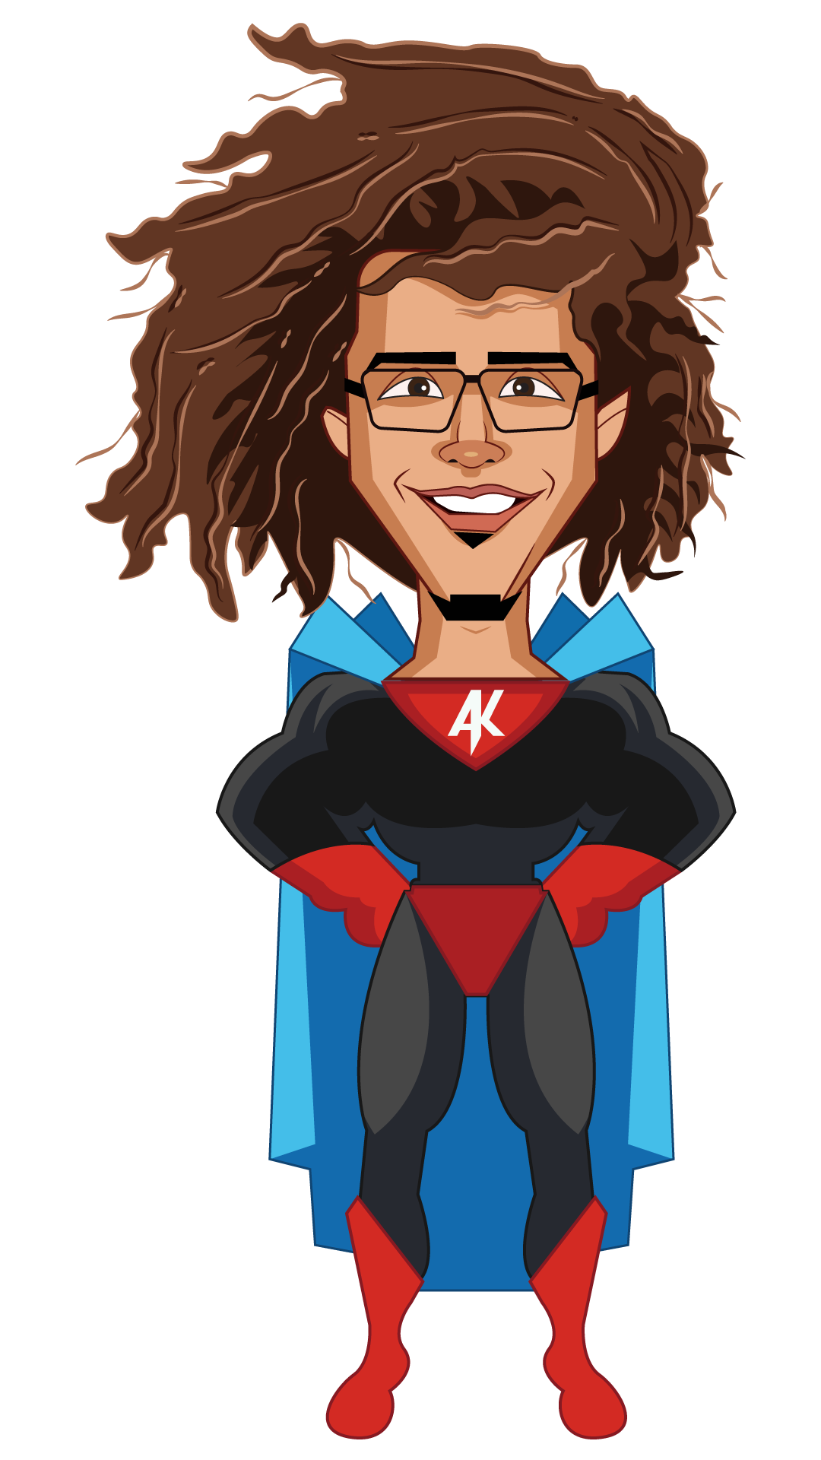

Title
Frontend Developer
Department
Tech Team
guide
Aayush’s
Connect with me on
user
Read my story @
Aayushkhanna.me
My schedule
Best way to reach me
Usually 9:30 am – 5:30pm pst
In-person/google/ meets >> Slack, email
Top three things to know while working with me
I am a Visual learner - For example, I prefer learning about something through a video over reading an article.
I tend to not follow conventional rules and like to create/build something unique.
I am unopinionated on stuff that I do not know much about, and very passionate about things I like doing.
Collaboration and communication preferences
General communication tips
I love direct and open communication
In most cases, I Prefer to be given direction rather than leading.
If you need me to work faster/ be more effective, please do let me know !
recognition
Even though it is completely unnecessary, you are always welcome to stroke my ego, and flatter me with compliments.
I am terrible at taking compliments and often turn into a red tomato.
Feedback
Both positive and negative feedback help me stay motivated in doing my work.
I am always vying to become better personally and professionally. I usually take feedback very positively.
Every sort of feedback is appreciated, The more the better. Especially if it’s related to the product.
miscellaneous
I am An awkward cookie who is Non-confrontational by nature. I Have a hard time saying ‘no’.
I love when there are clear and concise tasks/goals.
If I’m not able to complete a task I’ll always try to be straight forward about it.
If I’m blocking you on anything, please do let me know asap and i will prioritize my work accordingly.
My work style
I like to spread out my work into chunks of a few hours throughout the day, hence You may find me eating nachos and pushing code at 1 am.
I often listen to music while working. Feel free to interrupt me from my daily dose of despacito.
i take about 12 mins to frame one sentence. Hence I prefer a quick video/phone call over slack/email.
I am a reflective thinker and not an impromptu thinker - most of my best ideas are from instances of me reflecting in the shower.
Strengths
I have a Decent eye for visually creative things. Some examples are web animation, logo design, user interface design, visual arts, character drawing and videography.
thinking visually in terms of data - data visualization.
Attention to detail.
I’m a reflective thinker, and Might not often have an opinion in the moment.
I have a hard time Reading documentation.
Procrastination.
I find it hard setting time estimates on tasks/goals at first glance.
weaknesses
I take time to grasp heavy concepts. running me through some examples is always helpful.
I am a Visual learner. Explaining stuff to me with the help of some visual examples is immensely helpful.
My learning style
Other things that help me do my best work
A Change of scenery.
A good combination of working on code and design.
Anything where I can maximize my impact and learn something new along the way.
Projects that excite me
personal pointers
I’m a geek. I Love dogs. ENFJ. Hufflepuff/ravenclaw.
All-time favorite movie - the Shawshank redemption
All-time favorite song - now we are free by Lisa Gerrard
All-time favorite album - tree of life by audiomachine
It takes me longer to open up to people. I like movies, anime, tv shows, football(soccer), video games and deep intellectual conversations (on human nature, society, emotions, psychology).
~~The End~~

