Slide 1


DeePicarMicro: Applying TinyML to Autonomous CPS
Authors - Michael Bechtel, QiTao Weng, Heechul Yun
Affiliated Institute - University of Kansas, USA
Published - arXiv Preprint, 23rd August 22
Presented by - Aayush Jannumahanti

Slide 2
Table of Contents
‹#›
Introduction
Background
DeepPicarMicro
NAS
Evaluation
Related Work
UMBC VLSI-SOC GROUP

Slide 3
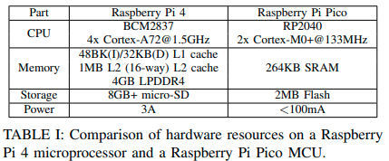
Introduction
‹#›
DeepPicarMicro, a low-cost autonomous car testbed to study the feasibility of AI enabled CPS on tiny MCUs. DeepPicarMicro employs an end-to-end deep learning approach, which utilizes a convolutional neural network (CNN) to directly control the physical plant from the camera based sensory input
https://developer.nvidia.com/blog/deep-learning-self-driving-cars/
UMBC VLSI-SOC GROUP

Slide 4
Motivation
‹#›
Using DeepPicarMicro, we want to answer the following questions:
(1) Can we run a full-sized PilotNet on a microcontroller?
(2) How can we find optimized neural network architectures for a target micro-controller?
(3) What are the relationships between accuracy, latency, and control performance of an end-to-end DNN model in controlling CPS?
UMBC VLSI-SOC GROUP

Slide 5
Can they run a full size PilotNet on an MCU
‹#›
The full sized PilotNet can run on a Pico MCU using a specialized ML framework, namely Tensorflow-lite micro (TFLM) https://www.tensorflow.org/lite/microcontrollers
https://github.com/tensorflow/tflite-micro
Standard optimization techniques such as 8-bit quantization
However, the unmodified (except quantization) PilotNet model’s latency was more than 3 seconds, which is not acceptable for real-time control of CPS. Clearly, there is a strong need to further optimize the network to be able to run on a tiny MCU.
UMBC VLSI-SOC GROUP

Slide 6
Background (Existing Work Con..)
‹#›
They employ Neural Architecture Search to find smaller variants of the PilotNet in terms of input resolution, depth, width of full model
They also employ depthwise separable convolutions in place of 2D convolutions to further reduce the latency of the models
As a result PilotNet variants meet the real time constraints of CPS
It is observed that DNNs with less accuracy and less latency perform better than ones with high accuracy and high latency
This suggests that in a CPS system, not only a network’s accuracy but also its latency must be taken into account to predict the model’s true performance. Therefore, the standard NAS approach that treats latency as a constraint may not be ideal to find best performing models.
UMBC VLSI-SOC GROUP

Slide 7
Proposed Work
‹#›
Recently, there are increasing interests and effort to enable ML applications in MCUs, which is collectively known as Tiny Machine Learning or TinyML
In TinyML, a major goal is to execute machine learning algorithms, such as DNN models, locally on an MCU, instead of relying on communications with larger PC or cloud that requires high energy consumption and suffers long latency.
Lately, major MCU vendors as well as big tech companies such as Google have developed machine learning frameworks specially tailored for MCUs.
UMBC VLSI-SOC GROUP

Slide 8
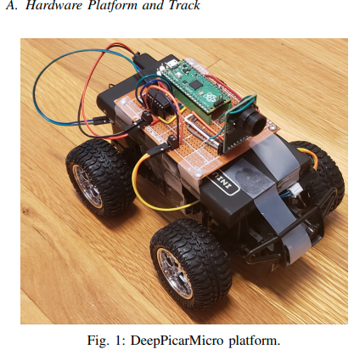
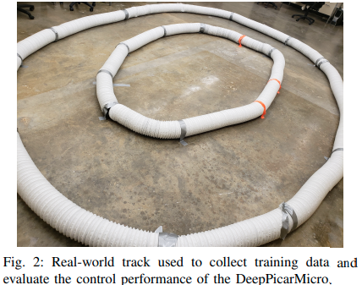
Experimental Setup
‹#›
Deep Picar is a small scale replication of a real self-driving car called DAVE-2 by NVIDIA. Using Deep Picar, we analyze the Raspberry Pi computing capabilities to support end-to-end deep learning based real-time control of autonomous vehicles.
The main difference compared to all other prior works is that they realized this CNN based end-to-end control system on a tiny MCU
https://www.instructables.com/Deep-Picar/
https://towardsdatascience.com/deeppicar-part-1-102e03c83f2c
UMBC VLSI-SOC GROUP

Slide 9
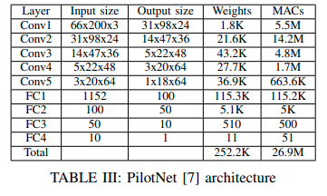
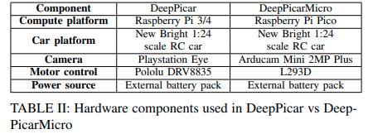
Results and Discussion
‹#›
UMBC VLSI-SOC GROUP

Slide 10
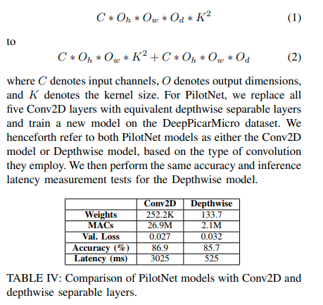
Proposed Contutation
‹#›
On the basis of PilotNet’s temporal performance there are chances of achieving good control performance, It can run on Pico with high accuracy
Still it would face issues in reacting to external stimuli before system fails (eg car crashes)
To address this they replace the Conv2D layer with Depthwise Separable layers to reduce the total multiply-accumulate (MAC) operations
Depthwise separable layers significantly reduce MACs by separating conv2D into 2 different operations
1. Depthwise Convolution
2. Pointwise Convolution
UMBC VLSI-SOC GROUP

Slide 11
NAS
‹#›
However, they still find the Depthwise model’s performance to be unsatisfactory.
Even with fewer MACs, it still takes the Depthwise model >500 ms to process a single frame, which is greater than the target 133 ms control period.
Due to this, we next explore the potential for reducing PilotNet’s size without overly sacrificing accuracy. For this, they perform a Neural Architecture Search (NAS).
For the NAS, our goal is to find the model with the highest accuracy while also satisfying the different physical and temporal constraints required by the DeepPicarMicro.
In particular, we hold that the model must be small enough to fit in the Pico MCU’s SRAM and Flash and that its inference latency be <133 ms, the DeepPicarMicro’s control period.
Importantly, due to the performance gains seen in earlier table, we perform our NAS on the PilotNet model with depthwise separable layers
UMBC VLSI-SOC GROUP

Slide 12
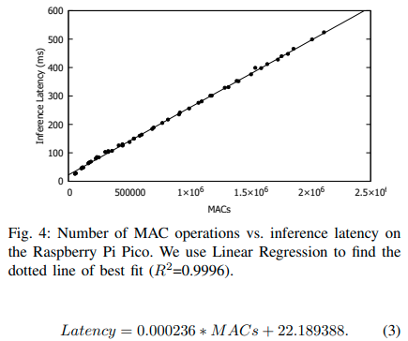
NAS improved Latency Predictions
Prior studies have shown that model’s MAC operations correspond to its interface latency, to find this relationship for PicoMCU they run 50 CNN models with MAC operations ranging from ~54.4K to ~2.1M and measure their inference latencies

Slide 13
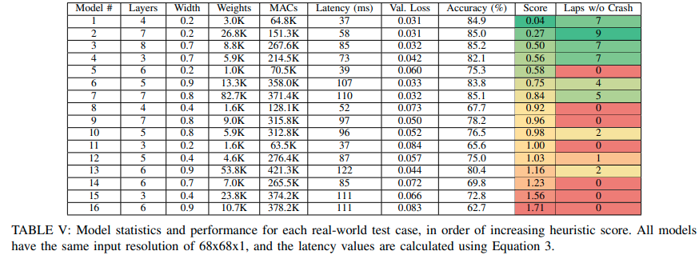
NAS
In process for an optimal TinyML model most SOTA NAS approaches will search on an performance based metric like accuracy
A heuristic score to each model that is calculated is

Slide 14
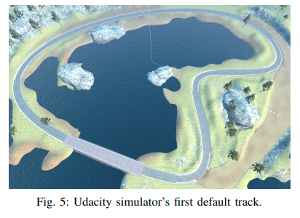
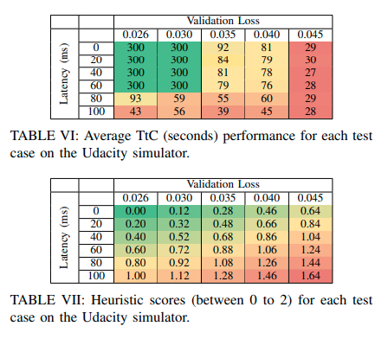
NAS Evaluation
Performance is measured on Real Track and Udacity Simulator

Slide 15
Related work
‹#›
There are several RC-car based autonomous car testbeds. MIT’s RaceCar and the F1Tenth car are both based on a Traxxas 1/10 scale RC car.
DonkeyCar also runs on a CNN based loop on embedded Raspberry PI https://www.donkeycar.com/
UMBC VLSI-SOC GROUP

Slide 16
Thank you
‹#›
Questions?
UMBC VLSI-SOC GROUP

