Slide 1


PyRCN: A toolbox for exploration and application of Reservoir Computing Networks
Published by: Peter Steinera, Azarakhsh Jalalvandb, Simon Stoneax, Peter Birkholza
Published at: Engineering Applications of Artificial Intelligence (Vol 113)
Presented by: Aayush Jannumahanti

Slide 2
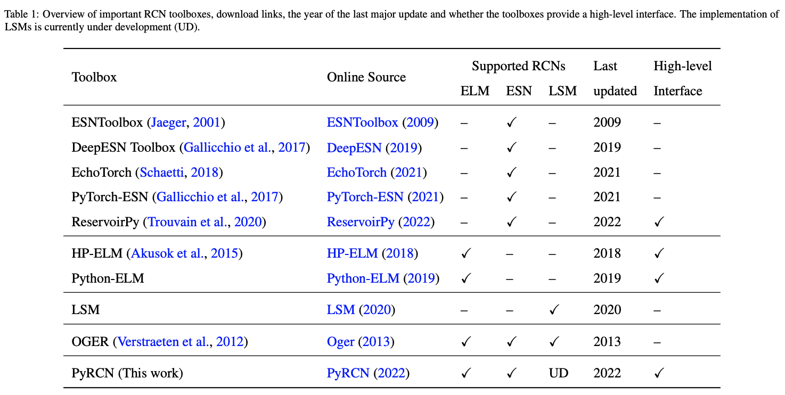
‹#›
Introduction
PyRCN is a toolbox for Reservoir Computing Networks (RCNs), which belong to a group of machine learning techniques that project the input space non-linearly into a high-dimensional feature space
In this paper, Author demonstrates how to uniformly describe RCNs with small and clearly defined building blocks, and introduces the Python toolbox PyRCN (Python Reservoir Computing Networks) for optimizing, training and analyzing RCNs on arbitrarily large datasets
PyRCN is around ten times faster than reference toolboxes on a benchmark task while requiring substantially less boilerplate code
UMBC VLSI-SOC GROUP

Slide 3
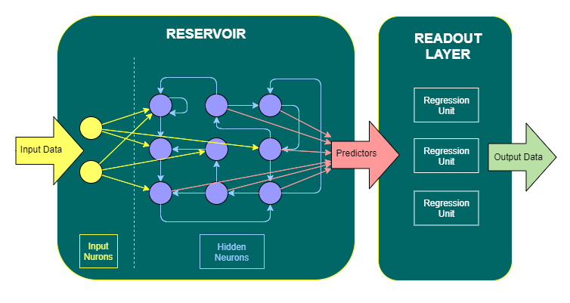
‹#›
Reservoir Computing (Training Recurrent Neural Networks)
Reservoir computing is a framework for recurrent neural network training. Conventionally to train RNN’s we use back propagation through time method and tune all the weights inside the network. But, in reservoir computing we don’t do that, we only adjust the readout part and we prepare huge amount of non-linear computational nodes coupled randomly
In the middle this part is called reservoir and it forms high dimensional non-linear dynamic system and we don’t tune the weights usually, inside this reservoir part We only adjust the readout part
UMBC VLSI-SOC GROUP
Notes:
“Reservoir” means network can store past inputs: also called “liquid state machines” (Maass et al 2002) and “echo state networks” (Jaeger & Haas 2004)
Reservoir is rich enough to do all different types of computation on temporal data, data that change in time
Liquid state machines responds in way that if we have a certain liquid that responds in a complicated way it can actually do different types of computation Ex dropping pebbles in to water at different time stamps, you can learn something about where and when those pebbles were thrown into the water
Echo states machines are similar to sound waves, from echos interfering with one and another in a similar way where multiple inputs interfere with one and another and also their past instantiations with one and another

Slide 4
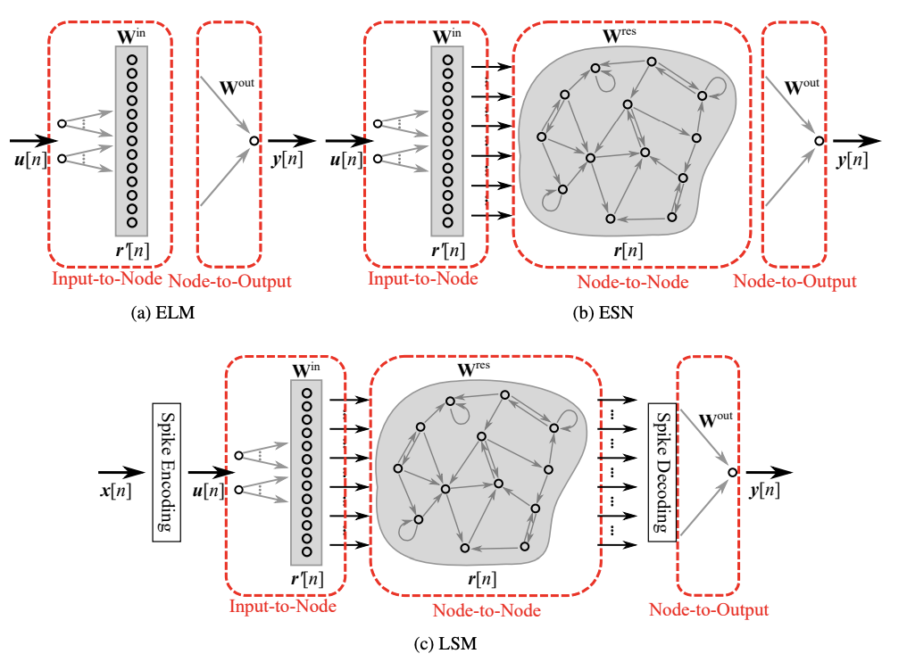
‹#›
Building blocks of Reservoir Computing
A conventional Reservoir Computing Network (RCN) consists of various weight matrices that describe how input data is transported in and processed by a hidden layer, which is typically a pool of non-linear neurons
“Input-to-Node” that describes a combination of input weights and a non-linear input activation function
“Node-To-Node” that describes recurrent reservoir weights and a non-linear reservoir activation function
“Node-to-Output” that describes the trainable output weights and is often referred to as linear model
UMBC VLSI-SOC GROUP
Notes:
Spiking neural networks aim to bridge the gap between neuroscience and machine learning, using biologically realistic models of neurons to carry out the computation.

Slide 5
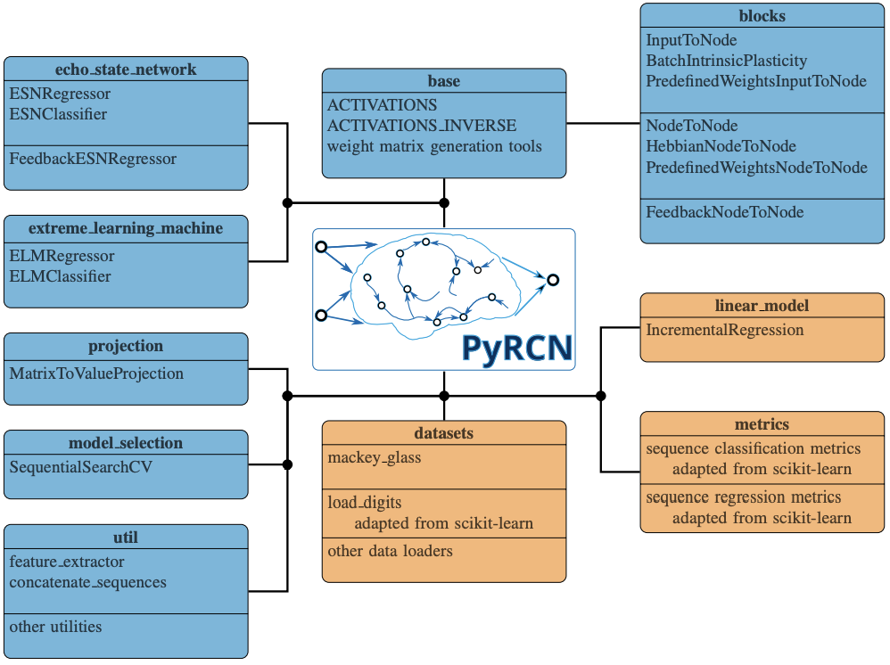
‹#›
Overview of PyRCN
PyRCN offer two vital features Simplicity and Interoperability
Simplicity: it needs only four lines of code to load the Mackey-Glass dataset that is part of PyRCN and only two lines to fit the different RCN models, respectively. Interoperability with scikit-learn
UMBC VLSI-SOC GROUP
Notes:
Overview of the most important modules included in PyRCN. The blue modules include modules that are entirely new, whereas the orange modules can be treated as an extension of scikit-learn’s built-in modules

Slide 6
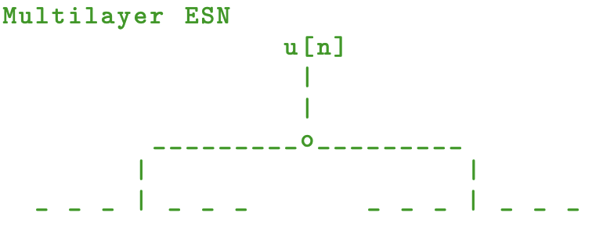
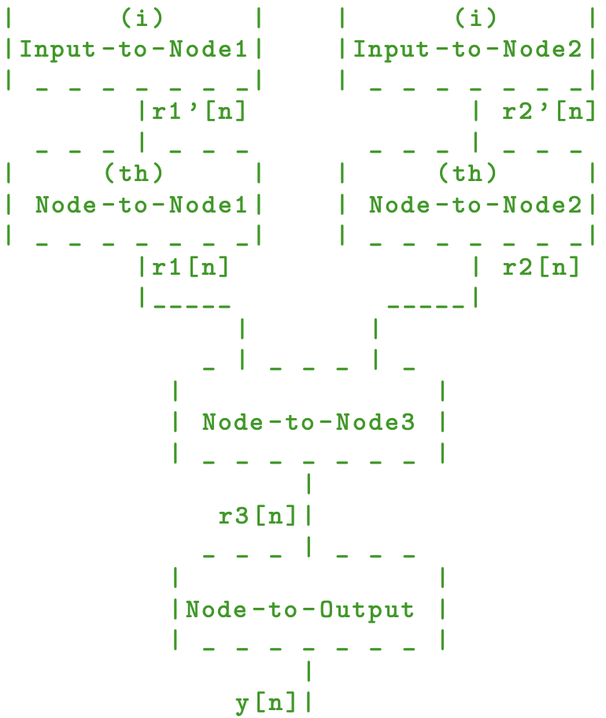
‹#›
Building Reservoir Computing Network with PyRCN
ELM: The vanilla ELM as a single-layer feedforward network consists of an “Input-to-Node” and a “Node-to-Output” module
ESN: The Context Reverberation Network is a very early
variant of Reservoir Computing that was later generalized
to the ESN. CRNs and ESNs, as variants of RNNs,
consequently consist of an “Input-to-Node”,
a “Node-to-Node” and a “Node-to-Output” module
and are trained in three steps.
Deep ESN: Building different variants of deep ESNs and
many more customized variants, where we have a layer that
mimicks the Modular Deep ESN in the first layer.
On top of that, we have stacked a second reservoir that
receives the output of the first layer as input.
LSM: Basic Liquid State Machines (LSMs) can be built in a
similar way as ESNs. The main difference is that u[n] is a
spike train sequence, hence, we need spiking neuronal
models
UMBC VLSI-SOC GROUP

Slide 7
‹#›
Applications
https://pyrcn.readthedocs.io/en/latest/?badge=latest PyRCN Docs
PyRCN has successfully been used for several tasks:
Music Information Retrieval (MIR), Multipitch tracking, f0 Onset detection analysis of spoken language, GCI detection in raw audio signals
Time Series Prediction - Mackey-Glass benchmark test, Stock price prediction
Ongoing research tasks: Beat tracking in music signals, Pattern recognition in sensor data, Phoneme recognition, Unsupervised pre-training of RCNs and optimization of ESNs
UMBC VLSI-SOC GROUP

Slide 8
‹#›
Conclusion and Outlook
A current limitation is that PyRCN does not provide an interface to other established machine learning frameworks, e.g., PyTorch or Keras
Next Task is the implementation of of PyRCN Modules in Scikit-learn
UMBC VLSI-SOC GROUP

Slide 9
Thank you
‹#›
Questions?
UMBC VLSI-SOC GROUP

