Slide 1
SAMSUNG PRISM Y2026 • GENAI HACKATHON
STREAMING
LIVE RAG
A live, session-aware RAG system that retrieves early,
handles multiple intents, and refines answers as context arrives.
THEME 04
LIVE RETRIEVAL
GROUNDED AI
ONE UTTERANCE → MANY SIGNALS
TEAM
Aayush Makkar • 1MS24CS004
Bhoomie Bhasin • 1MS24CS050
WAIT
RETRIEVE
REFINE
01 / 06

Slide 2
01 • WHY THIS EXISTS
The problem: live requests are not static queries
Streaming conversation creates uncertainty, multiple intents, and late-arriving context.
A USER DOESN'T SPEAK IN PERFECT SEARCH QUERIES
01
WHEN TO RETRIEVE
Don't wait for the perfect final sentence.
“Tell me about…”
INCOMPLETE
02
WHAT TO RETRIEVE
“…FAISS and multi-intent decomposition.”
ENOUGH TO RETRIEVE
One utterance can hide several distinct questions.
“Actually, explain the RAG part too.”
REFINEMENT
03
HOW TO RESPOND
New detail should sharpen the current answer.
02 / 06

Slide 3
02 • SYSTEM DESIGN
From transcript stream to grounded answer
A compact pipeline keeps control, retrieval, synthesis, and session state explicit.
TRANSCRIPT
CONTROLLER
DECOMPOSER
FAISS
FUSION
GROQ
Live chunks
WAIT / RETRIEVE
/ SUPPRESS
Split intents
Retrieve
per query
Merge evidence
Grounded
answer
SESSION MEMORY
Previous answer + intents + details → reused when new context arrives
TELEMETRY
controller • decomposition • retrieval latency • evidence • answer version
03 / 06

Slide 4
03 • LIVE DEMO
Three controller states. One continuous experience.
The prototype turns the hackathon behavior into an observable UI flow.
W
WAIT
R
RETRIEVE
S
SUPPRESS
INPUT
INPUT
INPUT
Tell me about
Explain FAISS + multi-intent decomposition
Thanks
The request is incomplete.
No retrieval is triggered.
Two retrieval queries are generated.
Evidence is fused into one grounded answer.
Conversational input.
No unnecessary retrieval or generation.
OBSERVABLE IN STREAMLIT
OBSERVABLE IN STREAMLIT
OBSERVABLE IN STREAMLIT
The system decides first — then spends retrieval + generation compute only when useful.
04 / 06

Slide 5
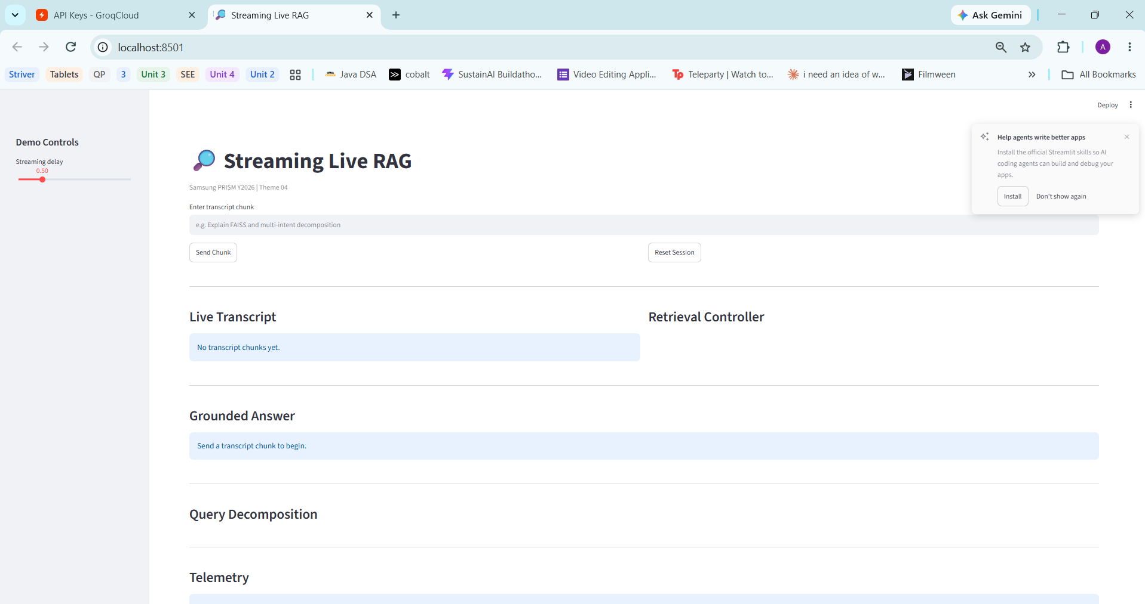
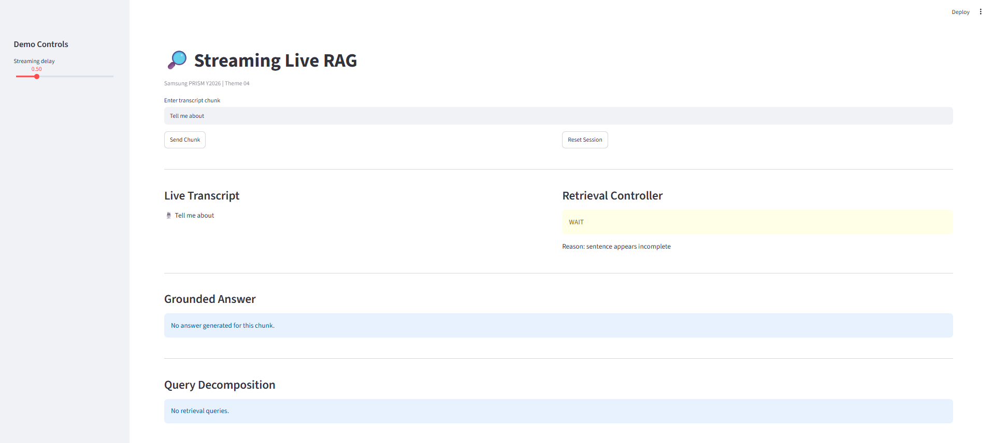
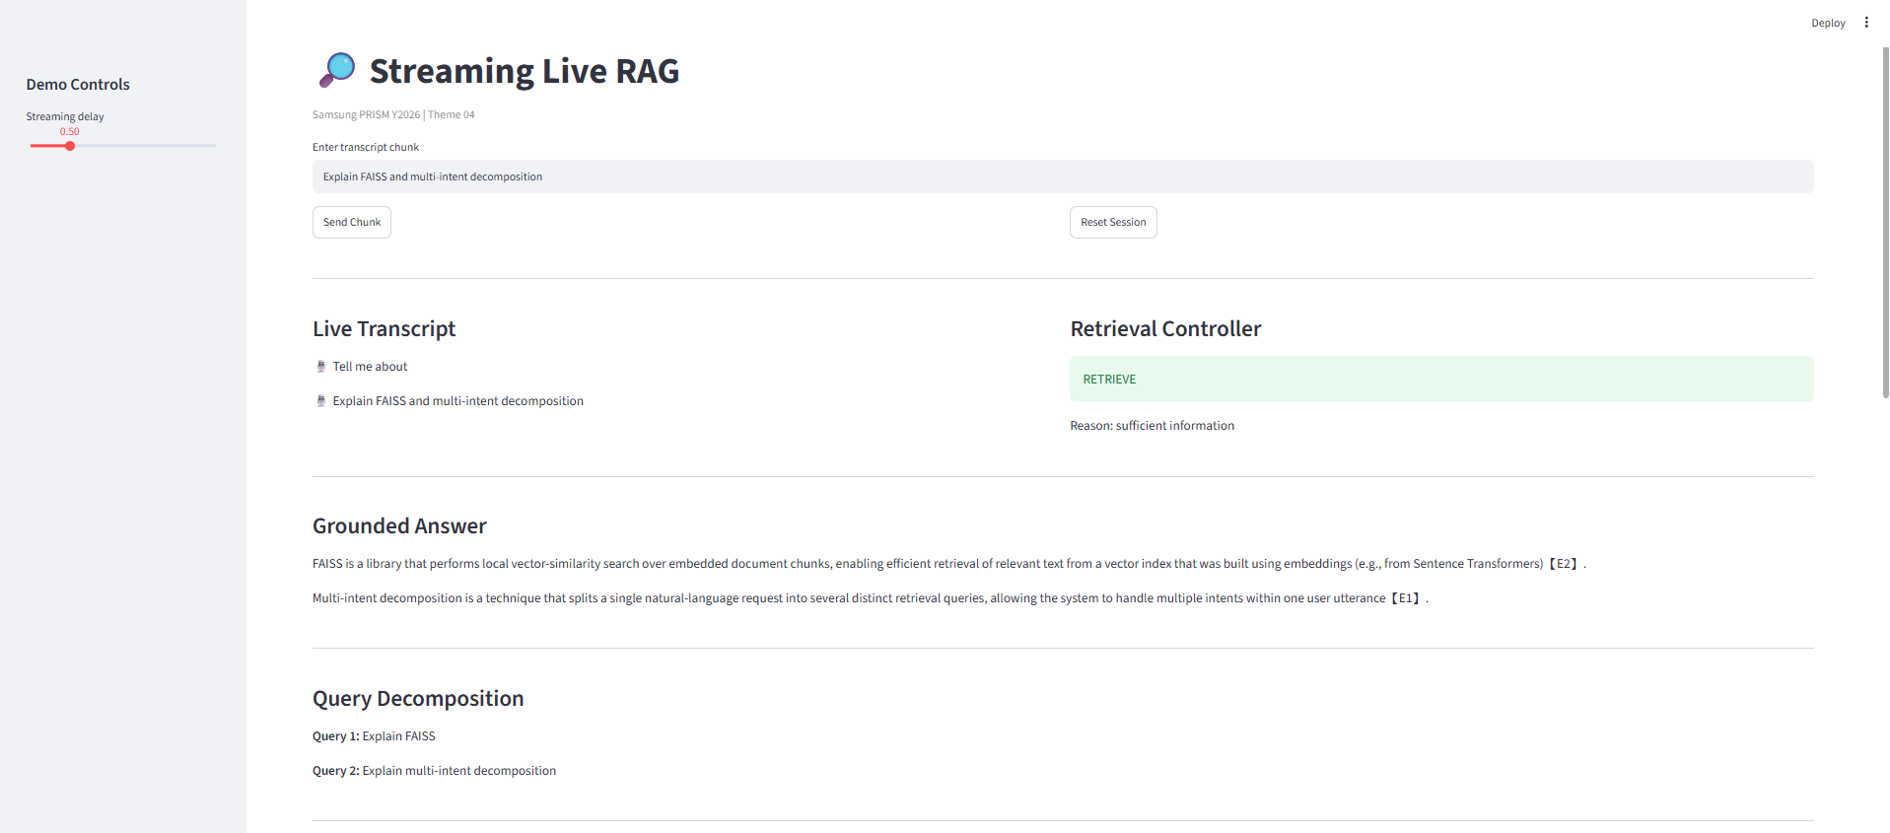
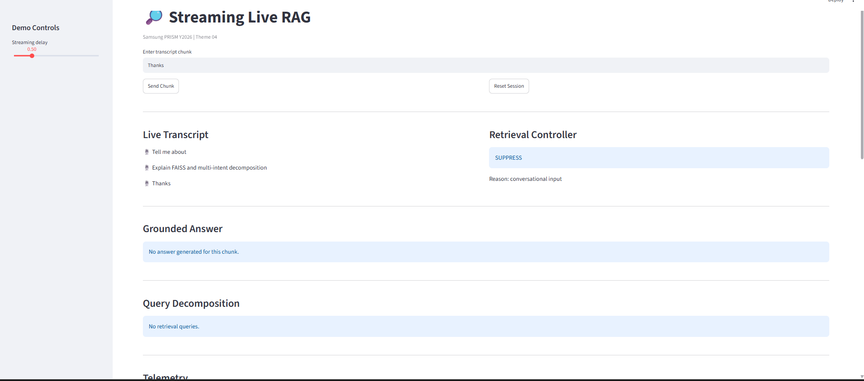

Slide 6
04 • THE INTELLIGENCE
Multi-intent fusion + session refinement
The answer improves because the system remembers the current session, not because it restarts the conversation.
ONE NATURAL REQUEST
SESSION-AWARE REFINEMENT
“Explain FAISS and
multi-intent decomposition”
Answer v1
FAISS = vector similarity engine
QUERY 1
Explain FAISS
New detail arrives
“Explain how it is used in RAG”
QUERY 2
Explain multi-intent decomposition
Answer v2
FAISS results → deduplicate → rank → fuse
Same session → sharper RAG-specific answer
05 / 06

Slide 7
05 • VALIDATION & SUBMISSION
What works now — and what remains
The prototype is locally runnable, demonstrable, and packaged for the hackathon workflow.
LOCAL VALIDATION
BEFORE FINAL SUBMISSION
✓
WAIT / RETRIEVE / SUPPRESS
• Replace temporary demo corpus with the official corpus
• Rebuild FAISS index
• Run benchmark on the official corpus
• Record ≤5 min demo video
✓
Multi-intent decomposition
✓
FAISS retrieval + evidence fusion
✓
Grounded [E#] citations
SUBMISSION PACKAGE
✓
Session-aware follow-up
README.md • requirements.txt
Source code • PPT • Demo video
AI disclosure • Git tag
✓
JSONL telemetry
PRISM_GENAI_HACKATHON_Y2026
RETRIEVE EARLY • DECOMPOSE SMARTLY • ANSWER WITH EVIDENCE • REFINE IN SESSION
06 / 06

