Slide 1
Supply Chain Analytics Dashboard : Insights & Recommendations
Visualizing data to optimize supply chain performance
Name- Ayushman Dutta
Name- Jayavelu D

Slide 2
Introduction
Supply chain analysis project developed using Power BI.
Focuses on operational performance evaluation of GlowCare Pvt Ltd.
Analyzes supplier performance, transportation costs, manufacturing efficiency, revenue generation, and defect rates.
Uses business intelligence dashboards and visualization techniques for decision-making.

Slide 3
Company Overview
GlowCare Pvt Ltd is a cosmetics and personal care company selected for this project analysis.
The company specializes in skincare, haircare, and cosmetic products distributed across multiple supply chain channels.
The organization depends heavily on supplier coordination, transportation efficiency, manufacturing operations, inventory planning, and quality management systems.
Due to increasing market competition, the company aims to improve operational efficiency using business intelligence and data analytics solutions.
Power BI dashboards were developed to evaluate revenue generation, supplier performance, transportation expenses, manufacturing efficiency, defect rates, and customer purchasing behavior.

Slide 4
Project Objective
The primary objective of this project is to analyze supply chain operations using Power BI dashboards and business intelligence techniques.
The project helps management monitor operational efficiency, supplier performance, transportation costs, manufacturing activities, and inventory planning.
The dashboard supports identification of operational bottlenecks, logistics inefficiencies, and quality management issues.
The analysis also focuses on understanding customer purchasing behavior and revenue generation across different product categories.
The project demonstrates the importance of data analytics in improving supply chain visibility and operational transparency.

Slide 5
Dataset Overview
Dataset Includes:
Product Type and SKU Information
Revenue Generated and Product Pricing
Manufacturing Costs and Production Volumes
Supplier Details and Lead Times
Transportation Modes and Shipping Costs
Inventory Levels and Order Quantities
Defect Rates and Inspection Results
Customer Demographics and Product Demand
Tools and Technologies Used:
Power BI for Dashboard Development
DAX Measures for KPI Calculations
Data Cleaning and Transformation Techniques
Interactive Business Intelligence Visualizations
Purpose of Dataset:
Evaluate supply chain performance.
Monitor logistics efficiency.
Analyze operational costs and quality management.
Support strategic planning and business decision-making.

Slide 6
Data Cleaning & Preprocessing
Data Cleaning & Preprocessing
Removed unnecessary rows from CSV dataset.
Promoted proper column headers.
Converted columns into correct data types.
Removed duplicate and blank values.
Created DAX measures for KPI calculations.
Improved dataset consistency and accuracy.

Slide 7
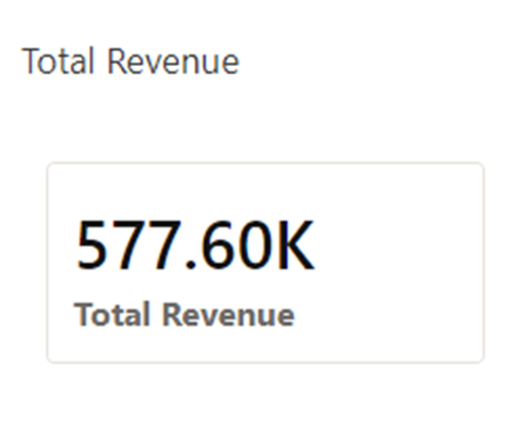
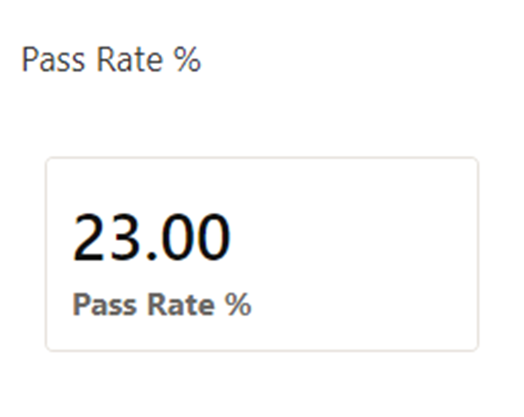
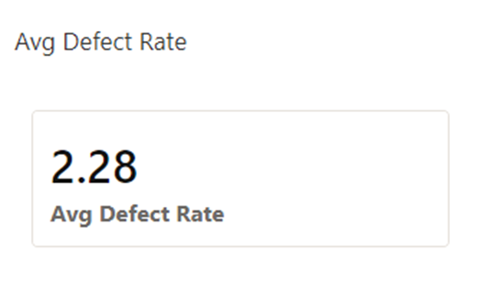
Executive KPI Dashboard
KPIs Included:
Total Revenue
Average Defect Rate
Pass Rate Percentage
Key Insights:
Revenue KPI reflects overall business performance.
Defect Rate KPI helps monitor operational quality.
Pass Rate Percentage indicates product inspection efficiency.

Slide 8
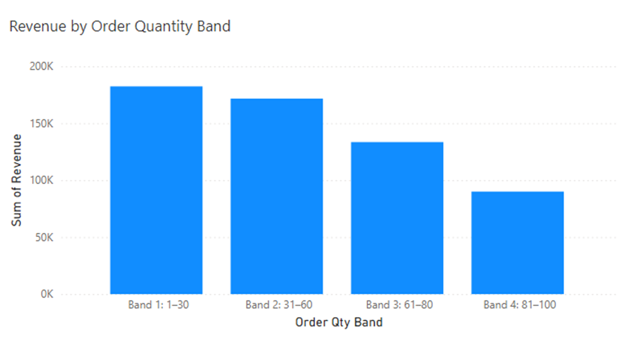
Revenue by Order Quantity
Bulk Orders Revenue Impact
Smaller orders (Band 1: 1–30 units) generate ~₹170K — matching Band 2 (31–60 units) at ~₹170K. This challenges the assumption that bulk orders drive most revenue.
Smaller Orders Importance
Revenue declines sharply for larger bands: Band 3 (61–80 units) drops to ~₹120K, and Band 4 (81–100 units) falls to ~₹85K — a 50% decline from the smallest order band.
Fulfillment Strategy Insights
The data suggests small and mid-size orders (Bands 1–2) are the revenue backbone at ~₹340K combined. Fulfillment efficiency for these bands directly impacts 60%+ of order revenue.
Notes:
--- This slide references information from the following file: https://buckmanconnect-my.sharepoint.com/personal/jdurai_buckman_com/_layouts/15/Doc.aspx?sourcedoc=%7B772A33A7-F2EB-49DD-AF21-CC460A7BBB98%7D&file=Supply%20chain%20dashboard%20images.pptx&action=edit&mobileredirect=true This slide analyzes revenue contribution across different order quantity bands. Bulk orders often generate a significant portion of revenue, highlighting the importance of key wholesale or large-volume customers. Smaller orders, while more numerous, may contribute less individually but can still be important for market reach. This insight supports differentiated fulfillment strategies, such as prioritizing service levels for large orders while optimizing cost for smaller ones. Understanding order patterns also helps in capacity planning and transportation optimization. The chart shows how revenue scales with order size.

Slide 9
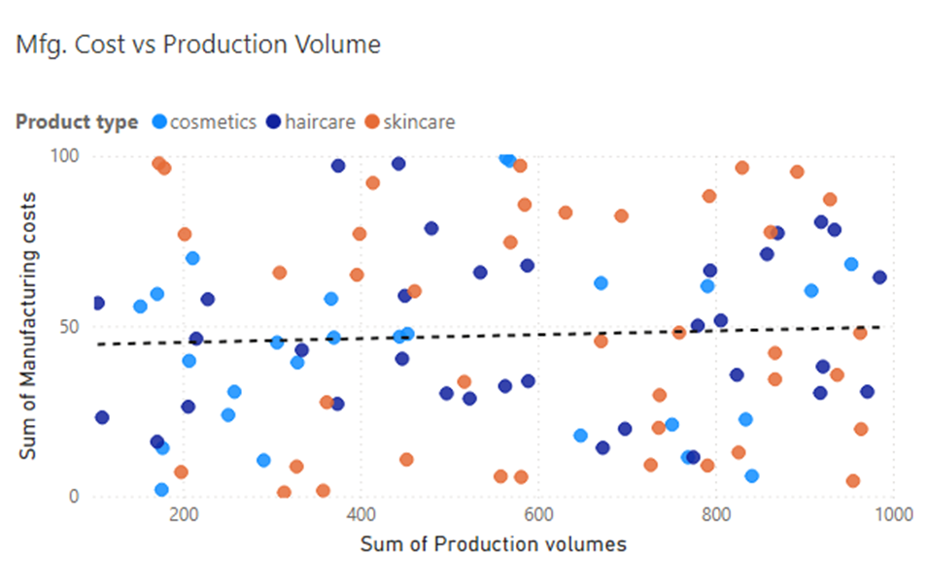

Manufacturing Cost vs Production Volume
Economies of Scale
The trend line at ~₹45 average cost shows limited economies of scale — costs remain flat even as production volume increases from 200 to 800 units, suggesting fixed-cost dominance.
Cost Inefficiencies
Skincare (orange) shows the widest cost variation, ranging from ₹10 to ₹100 per unit. Multiple outliers above ₹80 at low volumes indicate high setup costs for small production runs.
Process Optimization
Haircare (dark blue) clusters tightly around ₹40–80 regardless of volume, while cosmetics (light blue) shows a few high-cost outliers that warrant process review.
Notes:
--- This slide references information from the following file: https://buckmanconnect-my.sharepoint.com/personal/jdurai_buckman_com/_layouts/15/Doc.aspx?sourcedoc=%7B772A33A7-F2EB-49DD-AF21-CC460A7BBB98%7D&file=Supply%20chain%20dashboard%20images.pptx&action=edit&mobileredirect=true This slide compares manufacturing costs against production volumes to assess economies of scale. In many cases, higher production volumes correlate with lower unit costs, indicating efficient utilization of manufacturing capacity. However, deviations from this trend may point to inefficiencies, outdated processes, or high setup costs. Understanding this relationship helps operations teams decide where to consolidate production or invest in process improvements. Optimizing production volumes can reduce per-unit costs and improve margin performance. The visual demonstrates how cost behavior changes with production scale.

Slide 10
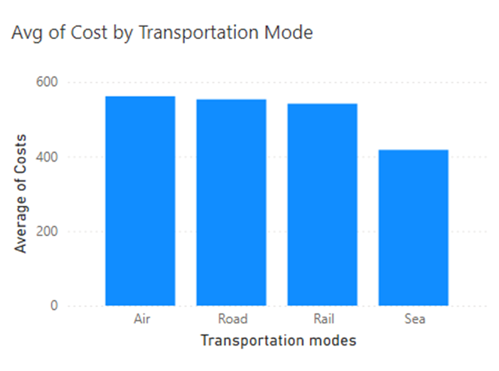
Transportation Cost Analysis
Air Transport Costs and Speed
Air transport costs ~₹550 per shipment on average — highest among all modes but only marginally above road (~₹530) and rail (~₹530), suggesting limited cost differentiation.
Road and Rail Cost Efficiency
Road and rail costs are nearly identical at ~₹530 each. With similar pricing, the choice between them should be driven by delivery speed, route coverage, and shipment volume.
Sea Transport for Bulk Goods
Sea transport at ~₹380 is the clear cost leader — 31% cheaper than air. For non-urgent bulk shipments, shifting to sea could deliver significant logistics savings.
Notes:
--- This slide references information from the following file: https://buckmanconnect-my.sharepoint.com/personal/jdurai_buckman_com/_layouts/15/Doc.aspx?sourcedoc=%7B772A33A7-F2EB-49DD-AF21-CC460A7BBB98%7D&file=Supply%20chain%20dashboard%20images.pptx&action=edit&mobileredirect=true This slide examines average transportation cost by mode, such as air, road, rail, and sea. Air transport typically shows the highest cost but offers speed, while road and rail provide cost-effective alternatives for less time-sensitive shipments. Sea transport may be economical for bulk movements but involves longer lead times. The insight here is the importance of matching transportation mode to product value, urgency, and demand variability. Overuse of premium modes like air can inflate logistics costs unnecessarily, while excessive reliance on slower modes may hurt service levels. A balanced, segmented transportation strategy can optimize both cost and responsiveness. The chart compares cost efficiency across transport modes.

Slide 11
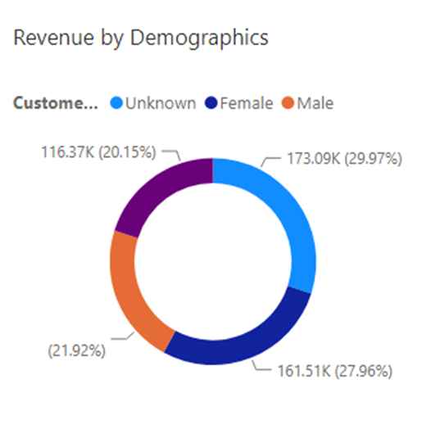

Revenue by Customer Demographics
Key Findings:
Unknown demographic category generated highest revenue share.
Female customers contributed significantly to revenue.
Better CRM systems can improve customer profiling.
Notes:
--- This slide references information from the following file: https://buckmanconnect-my.sharepoint.com/personal/jdurai_buckman_com/_layouts/15/Doc.aspx?sourcedoc=%7B772A33A7-F2EB-49DD-AF21-CC460A7BBB98%7D&file=Supply%20chain%20dashboard%20images.pptx&action=edit&mobileredirect=true This slide explores revenue distribution across customer demographic segments, such as gender or other classifications. The results indicate diversified demand across multiple segments rather than dependence on a single customer group. This diversity reduces demand risk and supports stable revenue streams. From a supply chain perspective, understanding demographic-driven demand helps in tailoring product assortments, packaging, and distribution strategies. It also supports more accurate demand forecasting when demographic trends shift. This insight highlights the value of integrating customer analytics with supply chain planning. The visual illustrates how revenue is split across demographic groups.

Slide 12
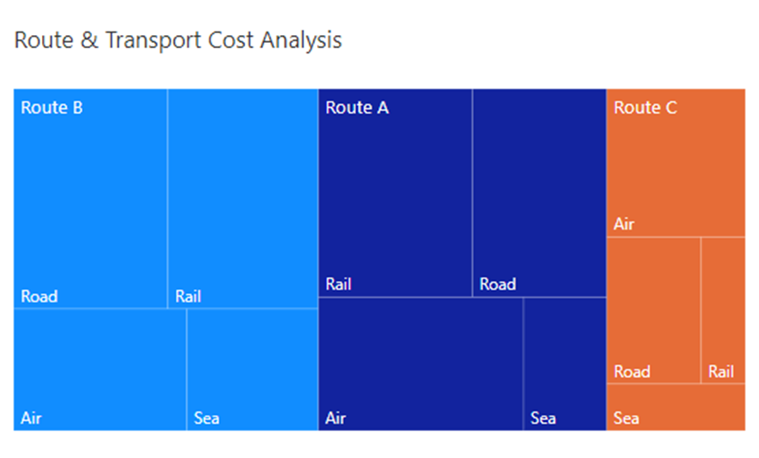
Route and Transport Cost Analysis
Key Findings:
Route B recorded highest transportation expenditure.
Route C showed comparatively lower operational cost.
Air and road transportation contributed heavily to logistics expenses.
Transportation planning optimization can improve efficiency.
Notes:
--- This slide references information from the following file: https://buckmanconnect-my.sharepoint.com/personal/jdurai_buckman_com/_layouts/15/Doc.aspx?sourcedoc=%7B772A33A7-F2EB-49DD-AF21-CC460A7BBB98%7D&file=Supply%20chain%20dashboard%20images.pptx&action=edit&mobileredirect=true This slide evaluates logistics routes in combination with transportation costs. Certain routes consistently incur higher costs, possibly due to distance, infrastructure limitations, or inefficient carrier selection. Identifying high-cost routes allows logistics teams to explore alternatives such as route consolidation, carrier renegotiation, or mode shifts. Over time, route optimization can deliver significant cost savings and improve delivery reliability. This analysis supports strategic network design decisions and continuous logistics improvement initiatives. The chart highlights cost differences across routes and transport combinations.

Slide 13
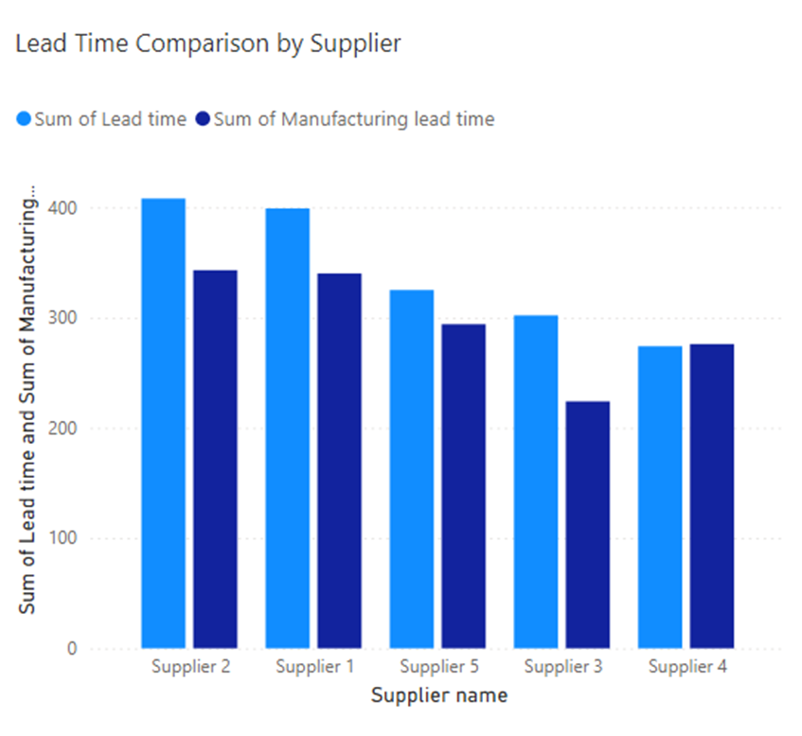
Lead Time Comparison by Supplier
Lead Time Variability Impact
Supplier 2 has the highest combined lead time (~730 days total across orders), while Suppliers 3 and 4 average ~490 days — a 49% gap that directly impacts planning reliability.
Supplier Performance Differences
Supplier 1 shows a notable gap between manufacturing lead time (~400) and total lead time (~320), suggesting delays occur in logistics rather than production.
Strategic Supplier Management
Suppliers 3 and 4 consistently deliver shorter lead times and should be prioritized for time-sensitive orders, while Suppliers 1 and 2 require renegotiated SLAs.
Notes:
--- This slide references information from the following file: https://buckmanconnect-my.sharepoint.com/personal/jdurai_buckman_com/_layouts/15/Doc.aspx?sourcedoc=%7B772A33A7-F2EB-49DD-AF21-CC460A7BBB98%7D&file=Supply%20chain%20dashboard%20images.pptx&action=edit&mobileredirect=true This slide focuses on lead time variability across suppliers, which is a critical determinant of supply chain reliability and inventory planning. The comparison reveals noticeable differences in average lead times between suppliers, indicating inconsistent fulfillment performance. Suppliers with longer or highly variable lead times introduce uncertainty into production planning, increase safety stock requirements, and elevate the risk of stockouts or delayed customer deliveries. On the other hand, suppliers with shorter and more stable lead times contribute positively to responsiveness and cost efficiency. The insight here is that lead time performance should be treated as a key supplier evaluation metric, alongside cost and quality. By identifying suppliers with consistently higher lead times, procurement and operations teams can initiate corrective actions such as renegotiating service-level agreements, improving forecast sharing, or developing alternate sourcing strategies. Additionally, understanding lead time dispersion helps in segmenting suppliers into strategic, preferred, or transactional categories. Over time, reducing lead time variability can significantly improve customer service levels, reduce working capital tied up in inventory, and enhance overall supply chain resilience. The chart visually compares supplier lead times, making variability and outliers immediately visible.

Slide 14
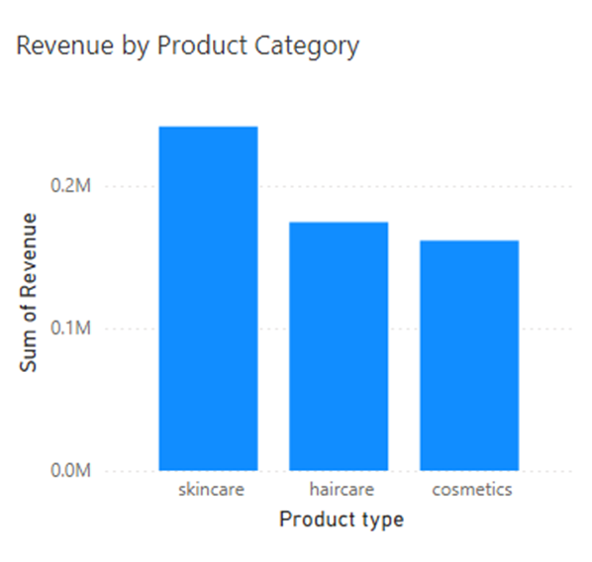
Revenue by Product Category
Skincare Revenue Leadership
Skincare dominates with ~₹230K revenue (approximately 40% of total), making it the single most critical category for supply chain protection and inventory prioritization.
Growth Opportunities in Haircare and Cosmetics
Haircare contributes ~₹170K and cosmetics ~₹150K. Combined, these two categories represent 55% of revenue and offer growth opportunities through targeted promotions and premium SKUs.
Supply Chain Strategic Focus
Any disruption to skincare supply could impact 40% of total revenue. Dual sourcing and higher safety stock levels are recommended for the top-performing category.
Notes:
--- This slide references information from the following file: https://buckmanconnect-my.sharepoint.com/personal/jdurai_buckman_com/_layouts/15/Doc.aspx?sourcedoc=%7B772A33A7-F2EB-49DD-AF21-CC460A7BBB98%7D&file=Supply%20chain%20dashboard%20images.pptx&action=edit&mobileredirect=true This slide highlights revenue contribution by product category, revealing that skincare products generate the highest share of total revenue, followed by haircare and cosmetics. This distribution indicates where customer demand is strongest and where the business derives most of its financial value. Skincare’s dominant position suggests that investments in this category—such as improved supplier partnerships, higher service levels, and targeted inventory planning—are likely to deliver the greatest returns. Haircare and cosmetics, while slightly lower in revenue, still represent significant portions of the portfolio and may offer growth opportunities through product differentiation or promotional strategies. From a supply chain perspective, category-level revenue insights should directly inform capacity planning, supplier prioritization, and risk management. Any disruption in the skincare supply chain would have a disproportionately large impact on overall business performance. Therefore, this slide supports the recommendation to treat high-revenue categories as strategic segments requiring tighter control, higher visibility, and stronger contingency planning. The visual clearly compares revenue contribution across categories, emphasizing skincare leadership.

Slide 15
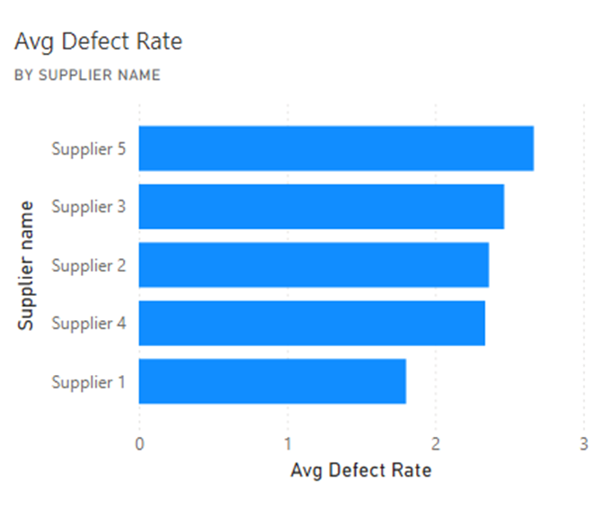
Average Defect Rate by Supplier
Supplier Defect Rate Variation
Supplier 5 leads with the highest defect rate (~2.7%), closely followed by Supplier 3 (~2.5%). The spread between best and worst performers is nearly 1.2 percentage points.
Impact of High Defect Rates
Supplier 1 stands out as the quality benchmark at ~1.5% defect rate — nearly half that of Supplier 5, translating to significantly lower rework and return costs.
Quality Management Strategies
Suppliers 2 and 4 cluster around 2.1–2.3%, sitting close to the overall average. Targeted corrective action plans for these mid-tier suppliers could yield quick quality wins.
Notes:
--- This slide references information from the following file: https://buckmanconnect-my.sharepoint.com/personal/jdurai_buckman_com/_layouts/15/Doc.aspx?sourcedoc=%7B772A33A7-F2EB-49DD-AF21-CC460A7BBB98%7D&file=Supply%20chain%20dashboard%20images.pptx&action=edit&mobileredirect=true This slide analyzes supplier quality performance by comparing average defect rates. While the overall defect rate is moderate, the supplier-level breakdown shows meaningful differences, indicating that quality issues are not evenly distributed. Certain suppliers consistently exhibit higher defect rates, which can lead to increased inspection costs, rework, returns, and customer dissatisfaction. This insight highlights the importance of supplier quality management programs, including regular audits, root-cause analysis, and corrective action plans. Suppliers with low defect rates can be considered benchmarks or preferred partners, while high-defect suppliers require immediate attention. Over time, linking defect performance with commercial decisions such as order allocation or contract renewal can drive continuous improvement across the supplier base. This slide reinforces that quality is a shared responsibility and must be actively managed to protect brand reputation and operational efficiency. The chart makes it easy to identify suppliers with above-average defect rates.

Slide 16
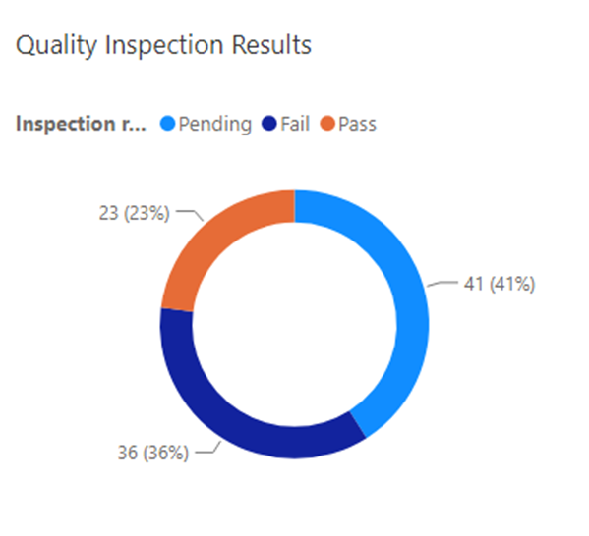
Inspection Results Distribution
Inspection Outcome Categories
Only 41% of inspections pass, while 36% fail and 23% remain pending. Less than half of products clear quality checks on the first attempt.
Impact of Failed and Pending Inspections
The combined fail + pending rate of 59% means more than half of all inspected items require rework, re-inspection, or are stuck in queue — directly inflating lead times.
Strategies for Improvement
The 23% pending rate suggests capacity constraints in the inspection process. Automating routine checks and implementing supplier self-certification could halve this backlog.
Notes:
--- This slide references information from the following file: https://buckmanconnect-my.sharepoint.com/personal/jdurai_buckman_com/_layouts/15/Doc.aspx?sourcedoc=%7B772A33A7-F2EB-49DD-AF21-CC460A7BBB98%7D&file=Supply%20chain%20dashboard%20images.pptx&action=edit&mobileredirect=true This slide presents the distribution of quality inspection outcomes, typically categorized as pass, fail, or pending. A significant share of failed or pending inspections indicates potential bottlenecks in quality assurance processes or upstream manufacturing issues. High pending rates may also suggest inspection capacity constraints or delays in decision-making. From a supply chain perspective, unresolved inspection results increase lead times and inventory uncertainty, as products cannot be released for sale or distribution. This insight underscores the need to streamline inspection workflows, improve first-pass quality, and ensure adequate inspection resources. Implementing statistical process control, automated quality checks, or supplier self-certification programs for reliable partners could reduce inspection delays. Ultimately, improving inspection outcomes contributes to faster throughput, lower costs, and higher customer satisfaction. The visual highlights the balance between passed, failed, and pending inspections.

Slide 17
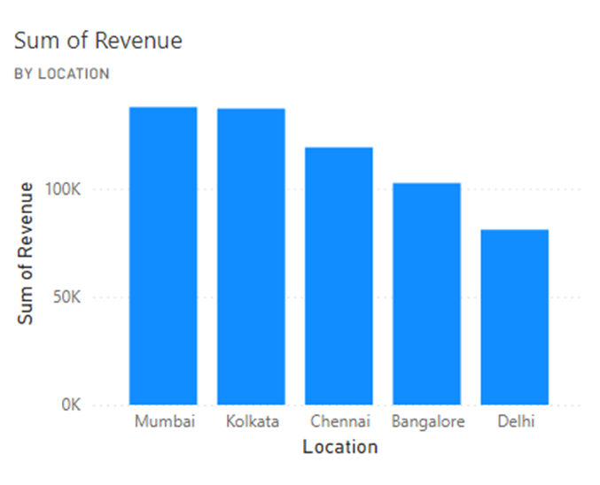

Revenue by Location
Revenue Variability Across Regions
Mumbai leads with ~₹130K revenue, followed closely by Kolkata (~₹125K) and Chennai (~₹115K). Delhi generates the least at ~₹75K — a 42% gap from the top city.
Factors Influencing Performance
The top three cities (Mumbai, Kolkata, Chennai) contribute over 65% of total location-based revenue, indicating strong concentration in western and eastern India.
Strategic Implications
Bangalore (~₹100K) and Delhi (~₹75K) underperform relative to their market size, suggesting opportunities for improved distribution coverage or targeted marketing.
Notes:
--- This slide references information from the following file: https://buckmanconnect-my.sharepoint.com/personal/jdurai_buckman_com/_layouts/15/Doc.aspx?sourcedoc=%7B772A33A7-F2EB-49DD-AF21-CC460A7BBB98%7D&file=Supply%20chain%20dashboard%20images.pptx&action=edit&mobileredirect=true This slide analyzes revenue contribution by geographic location, revealing uneven performance across cities or regions. Certain locations generate significantly higher revenue, likely due to stronger demand, better distribution coverage, or proximity to key markets. Conversely, lower-performing regions may suffer from weaker demand, higher logistics costs, or service-level challenges. These insights can guide decisions on regional inventory positioning, warehouse placement, and distribution network design. High-revenue locations may justify higher service levels or faster replenishment, while underperforming regions may require targeted marketing or cost rationalization. Understanding geographic revenue patterns also helps in risk planning, as disruptions in high-performing regions would have a larger financial impact. The map or chart visually emphasizes regional revenue concentration.

Slide 18
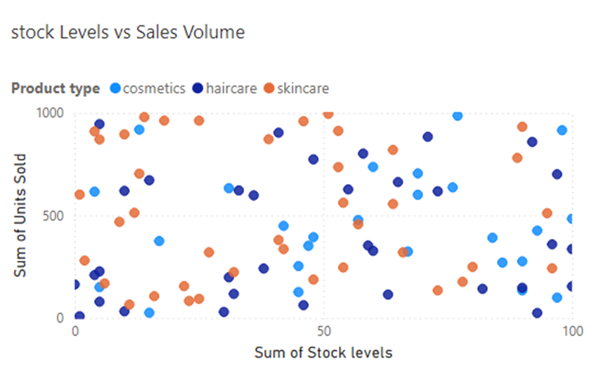
Stock Levels vs Sales Volume
Inventory and Sales Mismatch
The scatter plot reveals cosmetics consistently achieving ~1,000 units sold across all stock levels, while skincare ranges widely from 200–600 units — indicating demand volatility.
Financial Impact of Stock Levels
Several skincare data points show high stock (50–100 units) but low sales (~200 units), while cosmetics at similar stock levels sell 3–5x more, indicating possible skincare overstocking.
Demand Forecasting and Optimization
Haircare shows the most consistent stock-to-sales ratio, clustering in the 500–800 units sold range. This category's predictable demand makes it ideal for automated replenishment.
Data-Driven Inventory Techniques
Applying ABC segmentation: cosmetics (high volume, stable) as A-class for lean inventory; skincare (volatile) as B-class requiring buffer stock; haircare (predictable) for just-in-time.
Notes:
--- This slide references information from the following file: https://buckmanconnect-my.sharepoint.com/personal/jdurai_buckman_com/_layouts/15/Doc.aspx?sourcedoc=%7B772A33A7-F2EB-49DD-AF21-CC460A7BBB98%7D&file=Supply%20chain%20dashboard%20images.pptx&action=edit&mobileredirect=true This slide compares stock levels against sales volume to assess inventory effectiveness. Mismatches between inventory and demand indicate either overstocking or understocking risks. High stock with low sales ties up working capital and increases holding costs, while low stock with high sales raises the risk of lost revenue and customer dissatisfaction. The analysis suggests the need for more accurate demand forecasting and dynamic replenishment policies. Aligning inventory levels with actual sales patterns can significantly improve cash flow and service levels. This insight encourages the use of data-driven inventory optimization techniques such as ABC analysis, safety stock optimization, and demand segmentation. The scatter or comparison chart highlights inventory-sales alignment issues.

Slide 19

Strategic Recommendations
Improve supplier performance monitoring.
Reduce dependency on high-defect suppliers.
Increase use of sea and rail transportation.
Strengthen quality inspection procedures.
Improve customer demographic data collection.
Implement real-time Power BI dashboards.
Standardize manufacturing operations.
Notes:
--- This slide references information from the following file: https://buckmanconnect-my.sharepoint.com/personal/jdurai_buckman_com/_layouts/15/Doc.aspx?sourcedoc=%7B772A33A7-F2EB-49DD-AF21-CC460A7BBB98%7D&file=Supply%20chain%20dashboard%20images.pptx&action=edit&mobileredirect=true The final slide summarizes actionable recommendations derived from the dashboard insights. Key priorities include strengthening supplier performance management by focusing on lead time reliability and defect reduction, optimizing inventory through better demand forecasting and stock alignment, and reducing logistics costs via mode and route optimization. Additionally, high-revenue categories such as skincare should receive strategic focus to protect and grow business value. Implementing supplier scorecards, improving inspection processes, and leveraging the dashboard as a continuous monitoring tool will help drive sustained supply chain improvement. These actions collectively aim to enhance resilience, efficiency, and customer satisfaction while supporting long-term profitability.

Slide 20
Business Intelligence Benefits
Provides real-time operational visibility.
Improves reporting accuracy and transparency.
Helps identify operational bottlenecks.
Supports faster data-driven decision-making.
Improves logistics efficiency and customer satisfaction.

Slide 21
Conclusion
The project successfully analyzed supply chain operations using Power BI.
Dashboard visualizations provided insights into supplier performance, logistics efficiency, manufacturing activities, and revenue generation.
Data-driven decision-making can improve operational efficiency and reduce business costs.
Business intelligence dashboards strengthen supply chain management and strategic planning.

