Slide 1
Rock Paper Scissor Classification

Slide 2
Presented by:
Aayush Maru – 1813102
Akshit Tayade – 1813106
Hiral Lineswala – 1923001
Shreya Pawar – 1923006
Ashwini Patel - 1923009

Slide 3
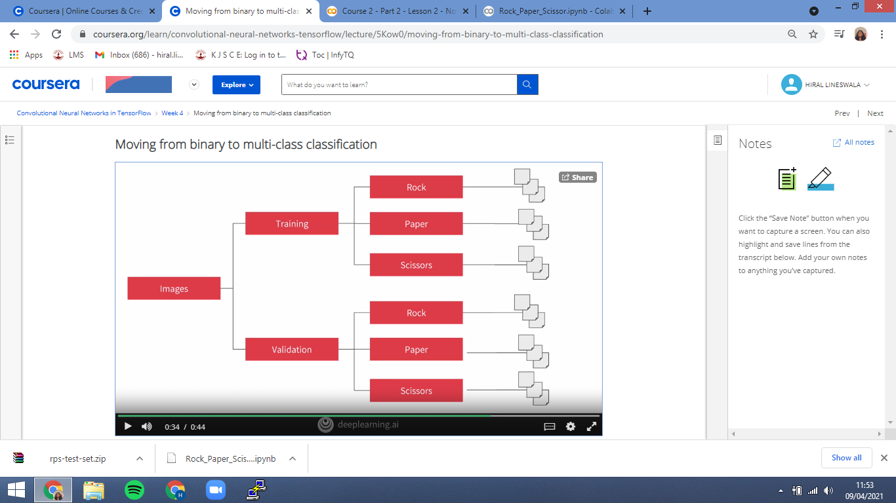
Overview
Here our images get automatically labelled based on the directories that they are in.
For example: Here we have three sub-directories of rock, paper and scissors with the images in them, and we will see the working of image data generator in mutli-class mode.
Here Training and validation have three subdirectories. In these we can put training and validation images of rock, paper and scissors.

Slide 4
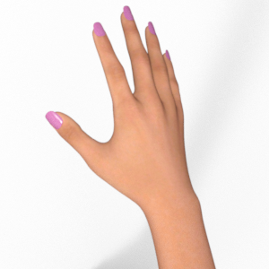
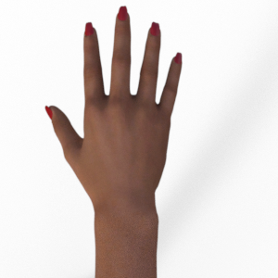
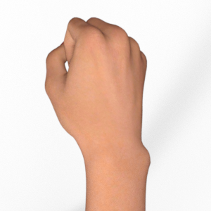
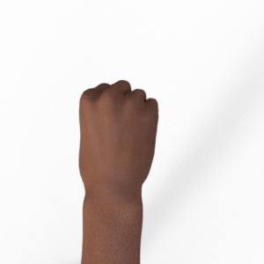


Dataset used
http://www.laurencemoroney.com/rock-paper-scissors-dataset/
This dataset of rock paper and scissor consist of 2892 images of diverse hand in rock/paper/scissor poses. These images have all been generated using CGI techniques as an experiment in determining if a CGI-based dataset can be used for classification against real images.

Slide 5
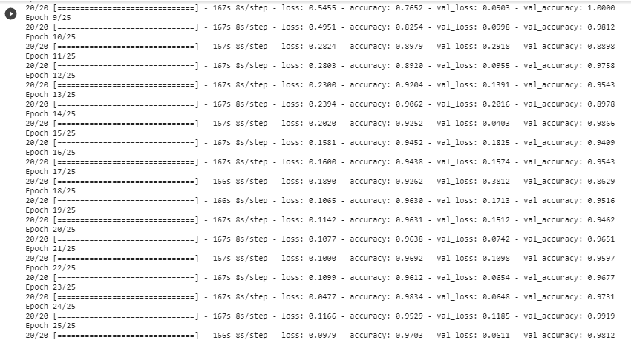
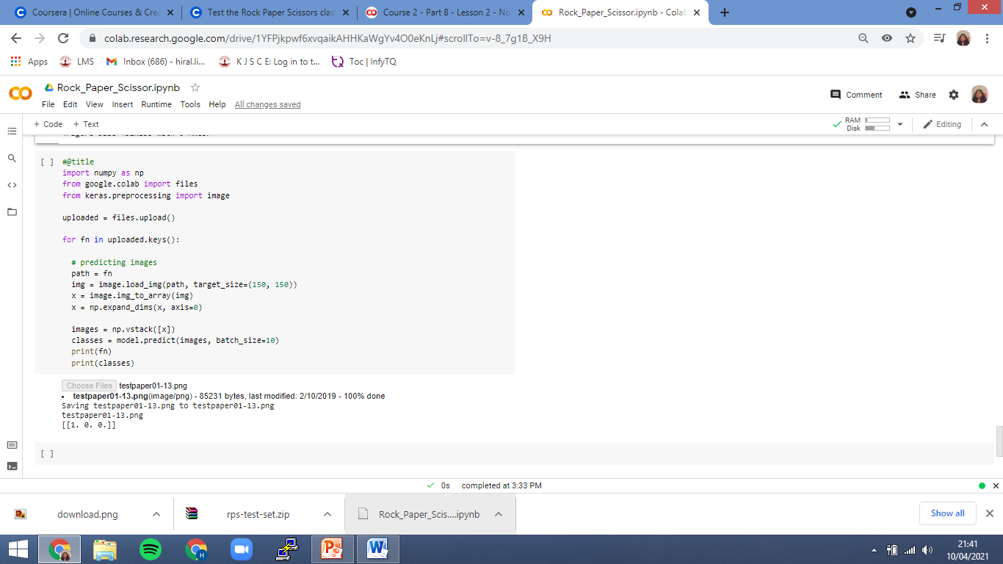
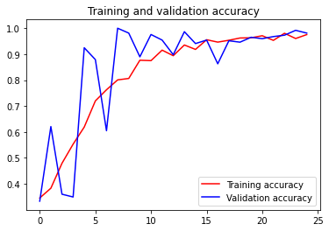
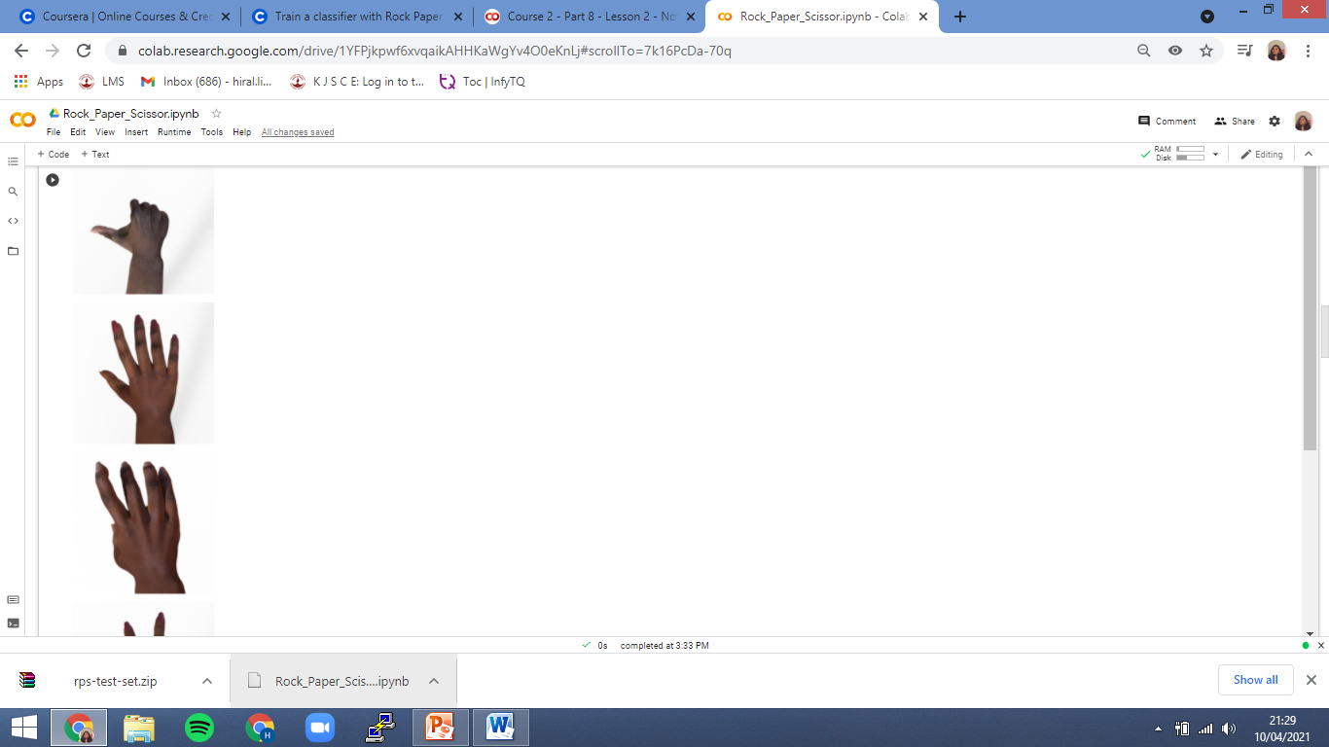
Demonstration:
Get a data.
Unzipping the data in temp directory.
Plotting few files from sub-directory.
Building a model.
Checking the accuracy of training data.
Plotting the accuracy.
Now testing with some images that were not in previous plot.

Slide 6
TRAINING CODE
After plotting the data we can see there are different images of hands with different skin colors, male and female.
Now we will set the image generator for giving different variance.
After that we will print the model and inspect it for training.
Here we are training for 25 epochs and it will give accuracy and validation for all.
Lastly will we plot the accuracy.

Slide 7
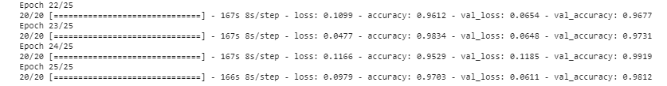
Output of training code
Training and validation accuracy plot

Slide 8
TESTING CODE
Here we will upload the image which were not use in training and validation set.
After uploading we will get a classification.
It will show the output.
Because we are using image generator the classes comes from directories and its in alphabetical order.
So the first value is for paper second is for rock and third is for scissor.

Slide 9
Output for testing code.

Slide 10
Conclusion
In this project we have successfully done the classification of rock paper scissor dataset by training data and testing.

Slide 11
Thank you.

