Slide 1
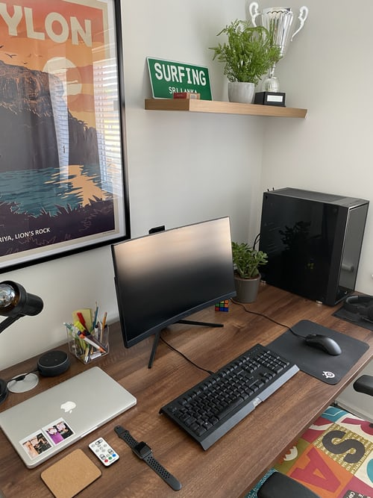
Image Classification
Electronic items

Slide 2
What is DEEP LEARNING?
Deep Learning is a subfield of machine learning concerned with algorithms inspired by the structure and function of the brain called artificial neural networks.

Slide 3
Artificial Intelligence:
Artificial intelligence refers to the simulation of human intelligence in machines that are programmed to think like humans and mimic their actions. The term may also be applied to any machine that exhibits traits associated with a human mind such as learning and problem-solving

Slide 4
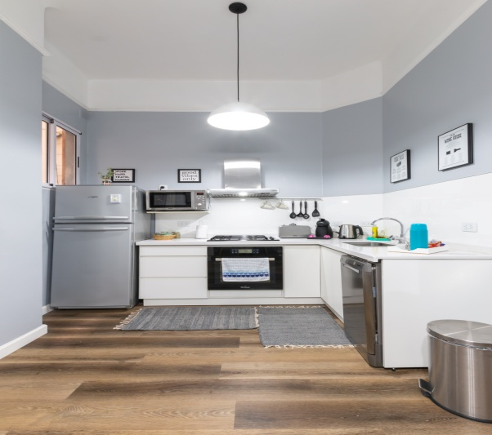
OBJECTIVE:
THE PROJECT CLASSIFIES 5 CATOGRIES OF ELECTRONIC ITEMS:
LAPTOP
REFRIGERATOR
GEYSER
JUICER
FAN

Slide 5
APPLICATION:
BANKING:
AI in banking is growing faster than you thought! A lot of banks have already adopted AI-based systems to provide customer support, detect anomalies and credit card frauds. An example of this is HDFC Bank.
_{AGRICULTURE:}
Organizations are using automation and robotics to help farmers find more efficient ways to protect their crops from weeds.
Autonomous Vehicles:
For the longest time, self-driving cars have been a buzzword in the AI industry. The development of autonomous vehicles will definitely revolutionaries the transport system.

Slide 6
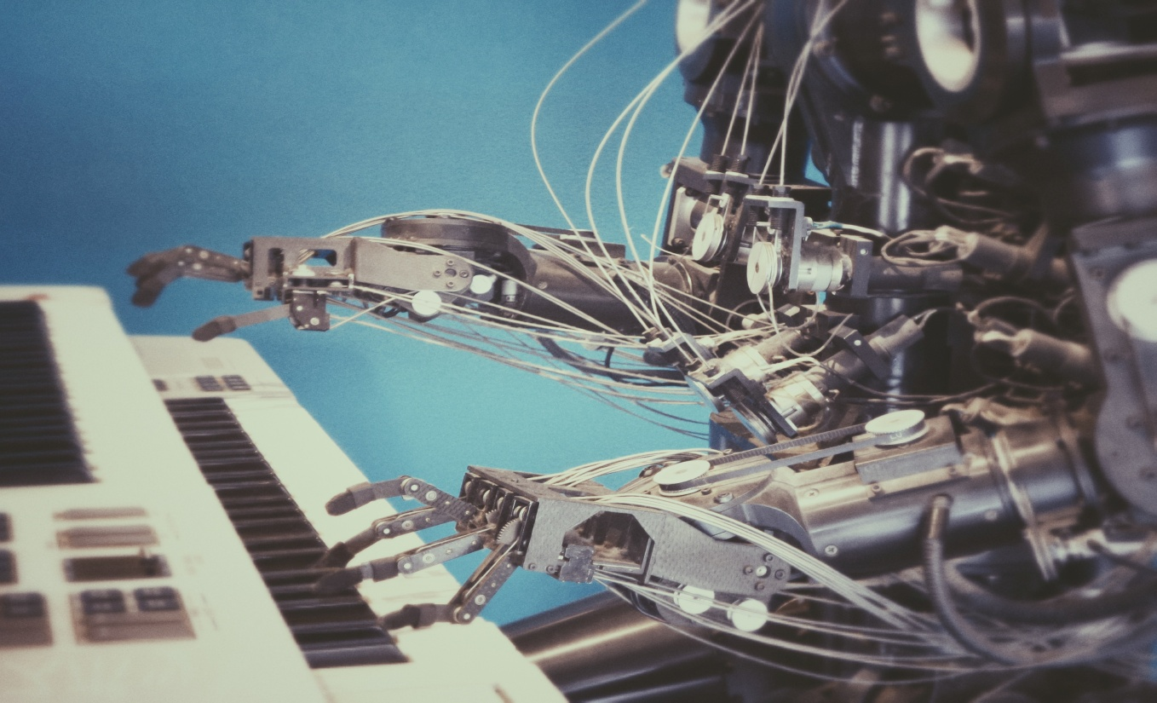
PROJECT
DESCRIPTION
I
NOTEBOOK1
NOTEBOOK2
NOTEBOOK3

Slide 7
NOTEBOOK 1:
Downlaoding and updating
Dataset on kaggle
Dataset is prepared by web scrapping .
Dataset is uploaded on kaggle
Data is then downloaded into our notebook by using the api commands.
Data has been made public by Me. Try it ->
Download it by using the API command->
kaggle datasets download -d rahulkashyap14298/electronic-items

Slide 8
NOTEBOOK 2:
.TRAINING OF MODEL:-
Data set is downlaoded and unzipped.
For training ,here resnet 50:50 layers deep convolutional neural network is used.
Data is trained upto 3 epochs first and then unfreeze and then train for 2 epochs .
2.
Trained model is saved as stage-1 and stage.pth and export.pkl file is generated which contains all the information of model.
Only the saved model is now needed for prediction

Slide 9
NOTEBOOK 3:
Contains the data for test purposes
A video is generated for the test data sample
A function for user also provided to custom check the output of the model by providing the url of the image.

Slide 10
A Heart full thanks to the geeksman AI squad who made it possible for completion of the above project.
ACKNOWLEDGEMENT

