Slide 1
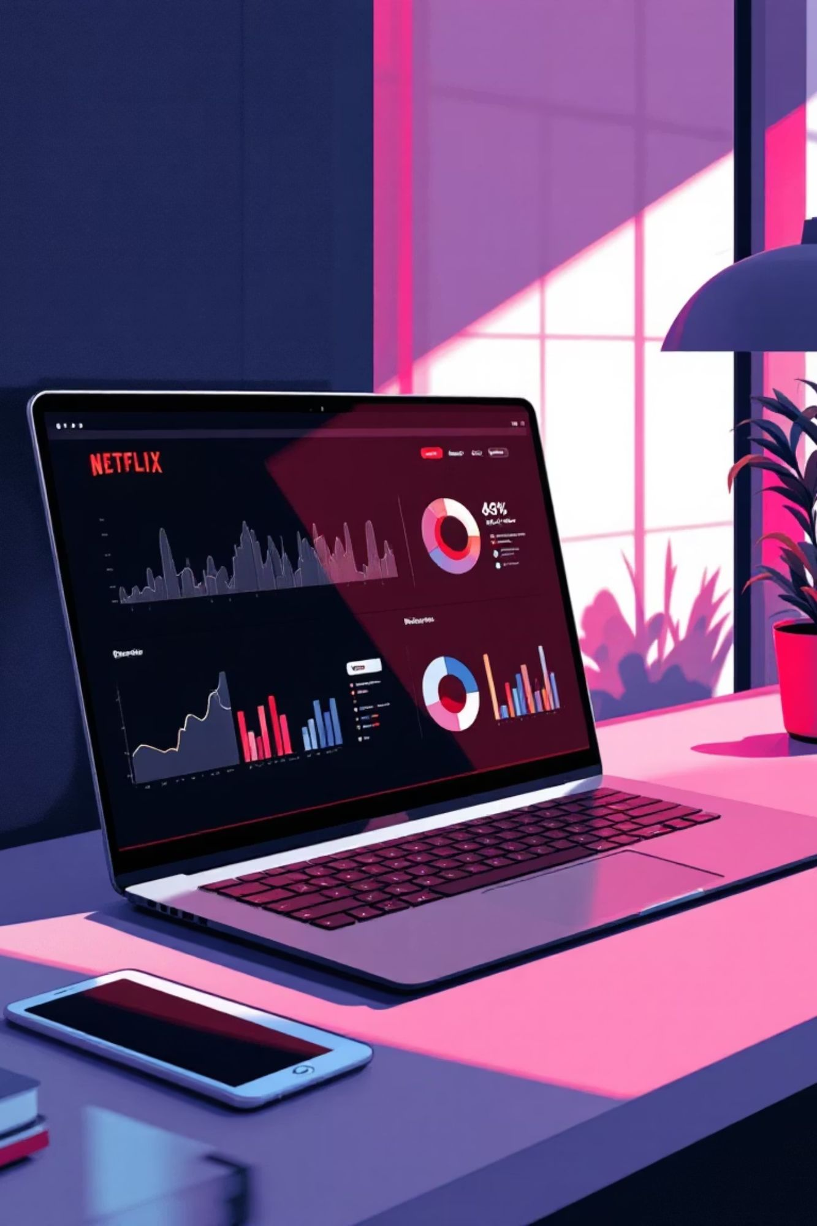

DATA ANALYTICS
Netflix Content Analytics
Insights on Audience Trends, Content Strategy, and Platform Growth Using SQL

Slide 2

Project Overview
Dataset
Focus Areas
~8,800 Netflix titles analyzed using SQL to extract strategic insights
Content types, ratings, genres, regional trends, and growth patterns
Outcome
Transform raw data into actionable business intelligence for strategic decisions

Slide 3
The Business Challenge
How can content metadata be used to understand viewer preferences, content trends, and strategic growth opportunities?
01
02
Investment Decisions
Regional Strategy
Determine which content types deserve budget allocation
Identify high-contributing markets for expansion
03
04
Audience Targeting
Content Acquisition
Optimize content for specific viewer demographics
Guide production and licensing strategies

Slide 4
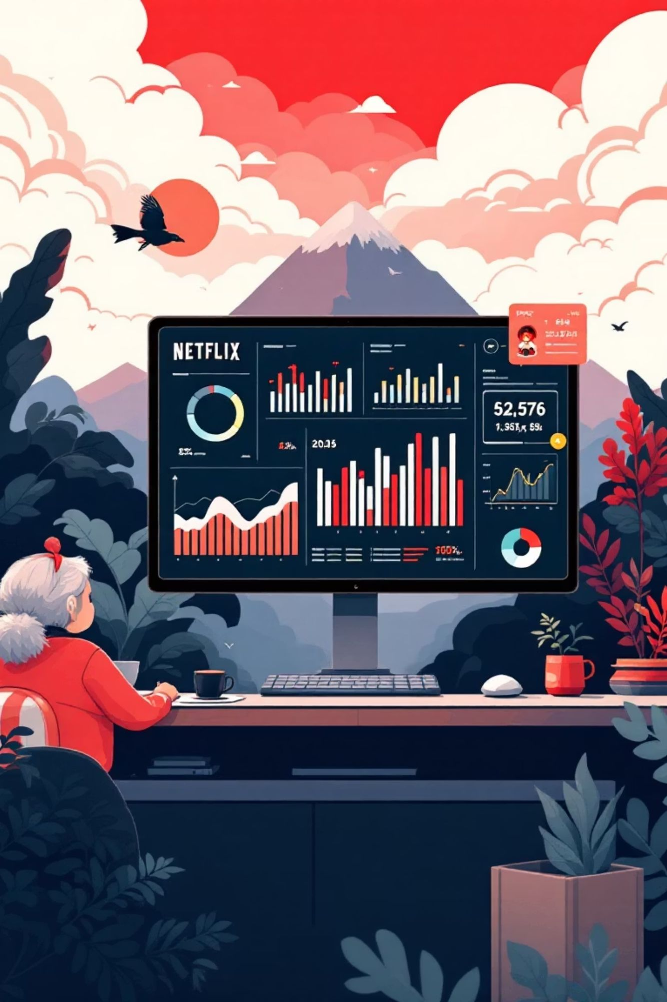
Analytical Objectives
Content Distribution
Strategic Insights
Movies vs TV Shows breakdown
Regional content contribution
Rating categories analysis
Growth trends over time
Genre popularity patterns
Key talent identification

Slide 5
Key Insights Discovered
Movies Dominate
Recent Expansion
Regional Leaders
Movies form the majority of Netflix's catalog, indicating clear content preference
Most content released after 2015, showing rapid platform growth
U.S. and India are top content-producing countries on the platform

Slide 6

Content Patterns & Trends
TV-MA
90-120
2
Top Rating
Optimal Duration
Leading Genres
Most common rating, indicating strong focus on mature audiences
Most movies fall within this minute range
Drama and International content appear most frequently

Slide 7



Technical Approach
SQL Techniques
Data Processing
Analysis Methods
CTEs, window functions, subqueries, and string manipulation
Text analysis, time-based filtering, and classification logic
Aggregation, ranking, segmentation, and trend identification

Slide 8
Strategic Recommendations
Prioritize Movies
Invest in Key Markets
Continue focusing on movie production and acquisition as they dominate the catalog
Strengthen investments in U.S. and Indian markets for maximum content contribution
Genre Strategy
Optimize Duration
Focus future content around Drama and International genres for audience alignment
Maintain 90-120 minute range for movies, aligning with dominant trends

Slide 9

Tools & Technologies
PostgreSQL
GitHub
Core analysis engine for querying and data transformations
Project documentation and version control management

Slide 10

Project Impact
This Netflix content analysis demonstrates how data analytics drives strategic business decisions in the streaming industry. By combining technical SQL expertise with business intelligence, the project reveals actionable insights for content planning, market focus, and audience targeting.
Technical Excellence
Business Value
Insights that directly support organizational strategy
Advanced SQL techniques applied to real-world dataset
Practical Application
Simulates actual data analyst responsibilities

