Slide 1

A Mini Project Presentation on Group Face Emotion Recognition With Deep Learning
Submitted to:
Mr. Ankit Gupta
Assistant Professor, GEU Submitted by:
Ayush Pundir
2018748

Slide 2
Introduction and Problem Statement
Emotion detection using convolutional neural networks (CNN) is a modern technique for detecting and classifying human emotions based on various features related to facial expression, voice tone, and text content. Using the power of deep analysis, CNNs have revolutionized the discipline with a useful resource that can systematically study hard emotional patterns from raw information, enabling greater accuracy and sophistication in emotion recognition. The modern generation finds various programs in the areas of facial ability assessment, human-computer interaction, market research and emotional assessment. Despite its great potential, the use of CNNs for emotion detection faces concerns about individual and cross-cultural differences in emotion expression, as well as ethical concerns about privacy and responsible use. However, by applying rigorous techniques including information preprocessing, version learning, and ethical assurance, CNN-based comprehensive sentiment detection is expected to provide valuable insights into human behaviours and better reshape various industries.
The practical problem is to extend sophisticated emotion detection machines to extent sophisticated emotion

Slide 3
Contd...
machines to include the use of convolutional neural networks (CNNs), which must be able to reliably understand human emotion from a variety of methods, including facial expressions, tone, and text. content Traditional emotion detection strategies have limitations in capturing the complexities and nuances of human emotions, which hinders their effectiveness in real-world applications. The reason is to harness the power of deep domain and CNNs to overcome the limitations of traditional emotion detection techniques and provide valuable information about people's emotional states.
The main purpose of this note is:
Emotional Reputation Accuracy: A CNN-based version is designed for emotion detection, which achieves extremely high accuracy in identifying a wide range of strong emotions.
Real-time applications: Improves benchmark performance for real-time package deployment and reduces inference time while maintaining greater accuracy.

Slide 4
Methodology
Dataset Preparation: Gather a diverse dataset of labelled facial expressions encompassing a wide range of emotions from the Kaggle largest data science community with powerful tools and resources to help you achieve your data science goals, entitled as FER-2013.Preprocess the facial images by resizing them to a consistent resolution and normalizing pixel values to improve data consistency.
CNN Model Architecture: We have designed a deep learning-based CNN architecture which is then optimized significantly for group facial expression analysis which is the purpose of the project. The architecture includes Fully Connected Layers as an essential component, which are in great use for recognising and classifying images for computer vision successfully. To introduce non-linearity and to introduce feature representation use activation functions like ReLU.
Data Augmentation: Various transformations, such as rotations, flips, and translations are used to augment the dataset.. This step enhances the model's ability to generalize to different facial orientations and expressions.

Slide 5
Contd...
Training and Optimization: Split the dataset into training and validation sets. Use the training set for model parameter optimization and the validation set for hyperparameter tuning. Implement backpropagation and stochastic gradient descent for model training. Experiment with different learning rates, weight initialization, and regularization techniques (e.g., dropout) to optimize the model's performance.
Performance Evaluation: Evaluate the trained CNN model on a separate testing dataset to measure its accuracy in emotion recognition. The model’s performance to recognise emotion among group of people is comprehensively assessed using different metrices such as accuracy, precision, recall and F1 score are calculated.
Comparison with Traditional Methods: Compare the performance of the CNN-based emotion recognition model with traditional methods, such as Support Vector Machines (SVM) or handcrafted feature-based classifiers, to showcase the superiority of deep learning techniques.

Slide 6
Contd...
Real-World Application: Apply the trained CNN model to real-world scenarios, such as human-computer interaction or affective computing, to demonstrate its practicality and effectiveness.
Interpretability: Explore techniques to interpret the CNN model's decisions and visualize learned features to gain insights into which facial regions contribute most to emotion recognition. This approach can be further adapted and extended to other modalities, such as audio and text, to enable multimodal emotion recognition systems and enhance the understanding of human emotions in various applications.

Slide 7
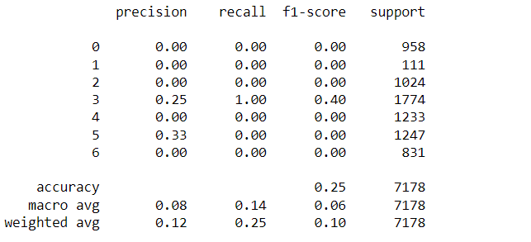
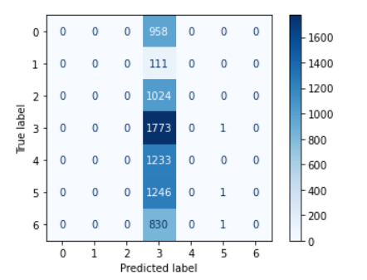
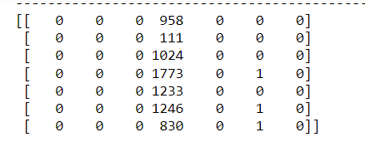
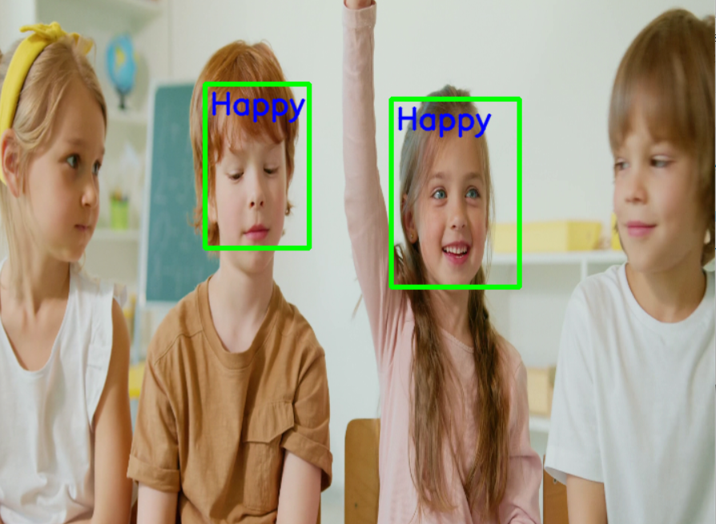
Contd...

Slide 8
Results and Discussion
The results and discussion based on the above data show that emotion recognition using convolutional neural networks (CNNs) has emerged as a powerful and effective approach to identify and classify human emotions from various sources such as facial expressions, tone of voice, and text content. The adoption of deep learning techniques, particularly CNNs, has revolutionized emotion recognition, enabling the automatic learning of complex emotional patterns from raw data, leading to more accurate and sophisticated results.
The technology's applications have extended to diverse domains, including facial feature analysis, human-computer interaction, market research, and sentiment analysis, showcasing its versatility and potential impact across industries.
Despite its promising potential, CNN-based emotion detection does face challenges related to individual variability and cross-cultural variations in emotional expressions, as well as ethical concerns regarding data privacy and responsible use. However, these challenges can be addressed through a systematic approach

Slide 9
Contd...
approach encompassing data preprocessing, model training, and ethical safeguards.
Overall, the results and discussions highlight the significant promise of CNN-based emotion detection in providing valuable insights into human behaviours and transforming various industries for the better. It holds the potential to foster empathetic interactions, enhance user experiences, and contribute to fields like mental health monitoring, education, marketing, and beyond.

Slide 10
Conclusion and Future Work
The goal of the present project is to predict the category of emotions processed from the CNN algorithms and Keras model. The project is set up in such a way that the device fetches the type of emotions of the humans displayed in the pre-loaded video clips. The prediction results from the Deep Learning algorithm (CNN) were satisfactory and correct to some extent. A prediction accuracy probability of 0.82448 is concluded by it.
In upcoming future works, the field of emotion detection using CNNs can advance further, unlocking new possibilities for understanding human emotions, enhancing user experiences, and making meaningful contributions to various domains and industries.
There are several exciting avenues for future research and improvement in emotion detection using CNNs, which are mentioned: 1.Multimodal Emotion Detection, 2.Transfer Learning, 3.Cross-Cultural Emotion Analysis, 4.Interpretability, 5.Real-Time Applications, etc.

