Slide 1
E WASTE CLASSIFICATION
Srita Shukla
Kanishka Goyal
Aayush Rai

Slide 2
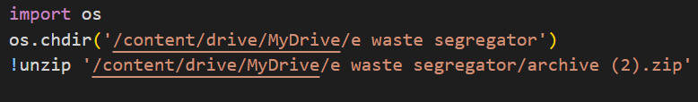
Dataset
- Dataset Name: ewaste segregator
- Number of Classes: 10
- Classes: The dataset comprises various classes representing electronic waste items such as mouse, keyboard, and others.
- Training Dataset Size: 2400 samples
- Testing Dataset Size:300 samples
- Data Split: The dataset is split into a training set containing 2400 samples and a testing set containing 300 samples.
- Task Type: The dataset is suitable for classification tasks where the goal is to classify input images into one of the 10 predefined classes representing different electronic waste items.
Evaluation Metric: Evaluation metric for this task include accuracy.

Slide 3
Image preprocessing
- Preprocessing: Before using the images for training or testing, they are preprocessed in the following steps:
- Converted to Tensor: The images are converted into tensor format, which is a multi-dimensional array representation suitable for deep learning frameworks like PyTorch.
- Resized: The images are resized to a standardized size of 224x224 pixels. This step ensures that all images have the same dimensions, which is often required for feeding them into deep learning models.
- Normalized: The pixel values of the images are normalized using the mean and standard deviation values commonly used for the ImageNet dataset. These normalization values are `[0.485, 0.456, 0.406]` for mean and `[0.229, 0.224, 0.225]` for standard deviation. Normalization helps in stabilizing and accelerating the training process of deep neural networks.
- Dataset Loading: The dataset is imported using `ImageFolder`, a utility provided by PyTorch, for loading datasets from subdirectories. This utility automatically handles the loading of images from subfolders and assigns labels based on the directory structure. This approach simplifies the process of loading and organizing image datasets for training deep learning models.

Slide 4
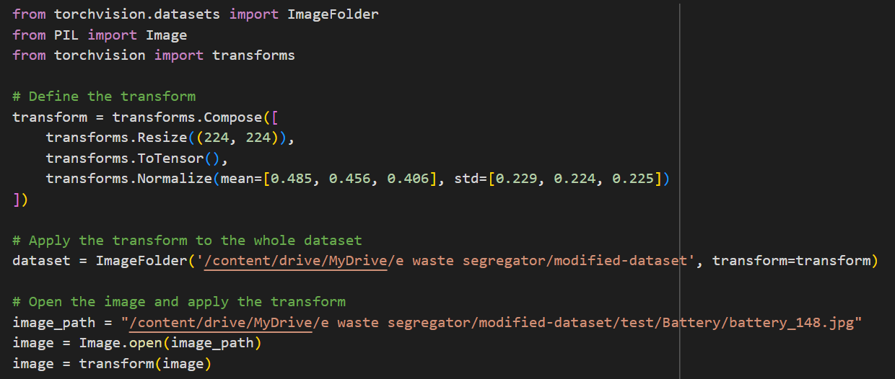

Slide 5
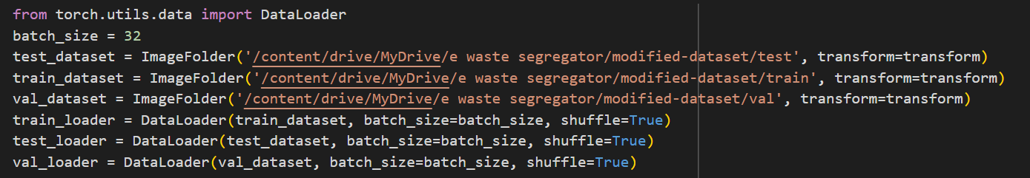
Data loader
- Data Loader Import: The data loader functionality is imported from a deep learning framework, such as PyTorch . Data loaders are utilities that facilitate the processing of datasets in batches during model training and evaluation.
- Transformations: Before loading the data into the model, transformations are applied to the input images. These transformations typically include resizing, converting to tensor format, and normalization.
- Batch Size: During dataset loading, the data loader splits the dataset into batches of a specified size. Batch processing allows the model to process multiple images simultaneously, which can improve training efficiency and utilize parallel computing resources effectively.

Slide 6
Why pretrained?
1. Transfer Learning: Pre-trained models, such as ResNet-50, VGG16, and YOLOv9, have been trained on large-scale datasets (e.g., ImageNet) for tasks like image classification, object detection, or semantic segmentation. These models have learned rich and generalizable features from vast amounts of data.
2. Feature Extraction: Pre-trained models act as feature extractors, where the early layers of the network learn low-level features like edges, textures, and colors, while deeper layers learn high-level features like object shapes and semantic information. By using a pre-trained model, we can extract meaningful features from our dataset without the need to train the entire network from scratch. This can significantly reduce the computational resources and time required for training.
3. Fine-Tuning: In addition to feature extraction, pre-trained models can be fine-tuned on our specific dataset to adapt the learned features to our task. Fine-tuning involves unfreezing some of the layers in the pre-trained model and retraining them on our dataset while keeping the rest of the network parameters fixed. Fine-tuning allows the model to learn task-specific nuances from our data while still benefiting from the general features learned during pre-training.

Slide 7
Why VGG16
1. It has a uniform architecture, simplifying design and implementation.
2. Its depth allows for hierarchical feature extraction.
3. It achieves competitive performance on image classification tasks.
4. Pre-trained models are available for transfer learning, making it accessible and practical for various applications.

Slide 8
Model hyperparameters
Number of epochs = 10
Learning rate = 0.01
Optimiser = SGD
Loss = Cross entropy loss

Slide 9
Why Resnet50
ResNet-50, short for Residual Network with 50 layers, is a deep convolutional neural network architecture that addresses the vanishing gradient problem commonly encountered in training deep neural networks. It achieves this by introducing skip connections, also known as shortcut connections or residual connections, which allow the gradients to flow more easily during training.
1. Skip Connections: ResNet-50 incorporates skip connections that bypass one or more layers in the network. These skip connections enable the network to learn residual mappings, which are the differences between the desired output and the current output of a layer. By learning these residual mappings, the network can focus on refining the learned features, making it easier to train deeper architectures.
2. Depth: ResNet-50 consists of 50 layers, making it a deep neural network. The depth of the network allows it to learn hierarchical representations of data, capturing increasingly abstract and complex features as information propagates through the layers. This depth is essential for handling complex tasks and datasets with high levels of variability.
3. Transfer Learning: Transfer learning is utilized with ResNet-50 by leveraging the pre-training done on the ImageNet dataset. ImageNet is a large-scale dataset with millions of images across thousands of categories. By pre-training on ImageNet, ResNet-50 has already learned to extract rich and generalizable features from images, making it highly effective for various computer vision tasks. Transfer learning with ResNet-50 involves fine-tuning the network on a specific task or dataset, allowing it to adapt its learned features to the new domain while retaining the knowledge gained from ImageNet.

Slide 10
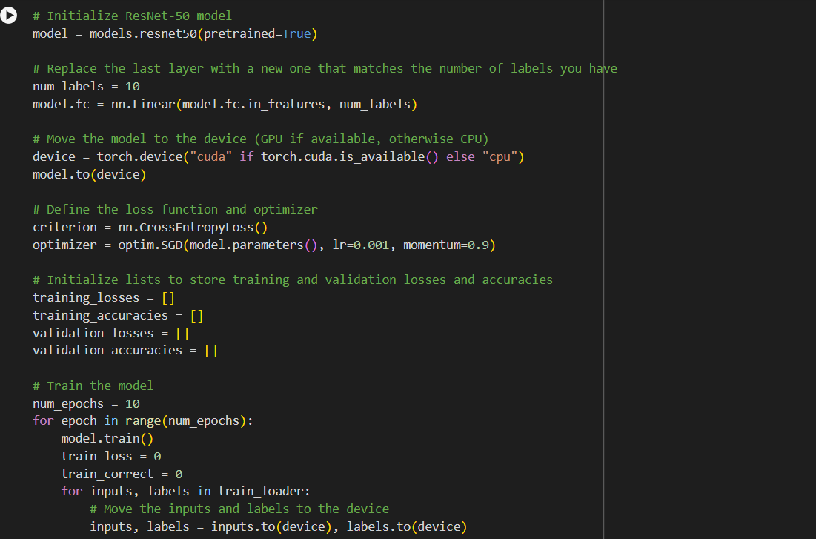

Slide 11
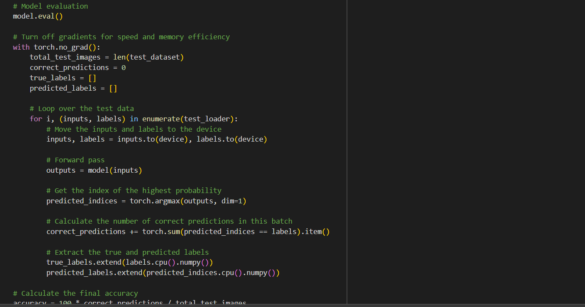
Testing model

Slide 12
Model hyperparameters
The given parameters are for the best accuracy .
Number of epochs = 10
Learning rate = 0.001
Optimiser = SGD
Loss = Cross entropy loss

Slide 13

Accuracy, confusion matrix , comparison
Number of epochs = 25
Learning rate = 0.001
Optimiser = SGD
Loss = Cross entropy loss
Accuracy=98%
Number of epochs = 15
Learning rate = 0.001
Optimiser = SGD
Loss = Cross entropy loss
Accuracy=96.67%
Number of epochs = 10
Learning rate = 0.001
Optimiser = SGD
Loss = Cross entropy loss
Accuracy=96.33%

Slide 14
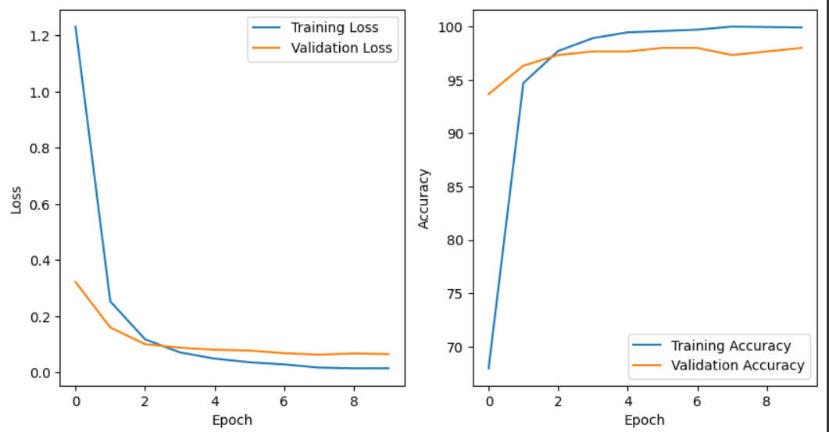
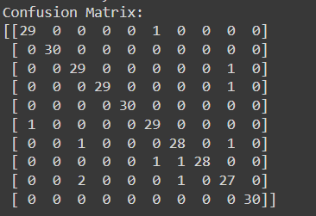
We have performed training for number of epochs= 10 where we have plotted confusion matrix and curve for train and test against epochs.

Slide 15
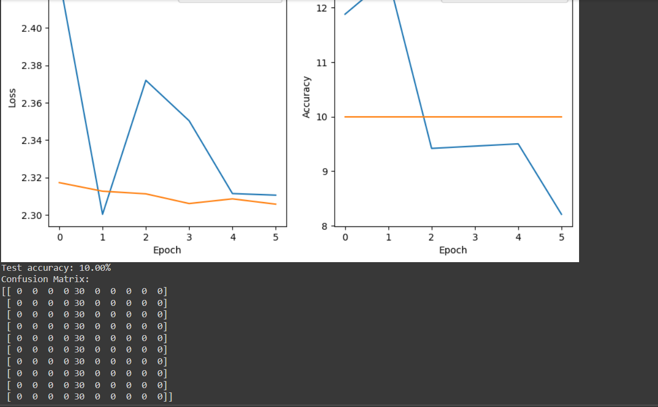
For vgg16
first we tried with 5 epochs in vgg16 then we tried with 10 epochs.These are the results for 5 epochs.

Slide 16
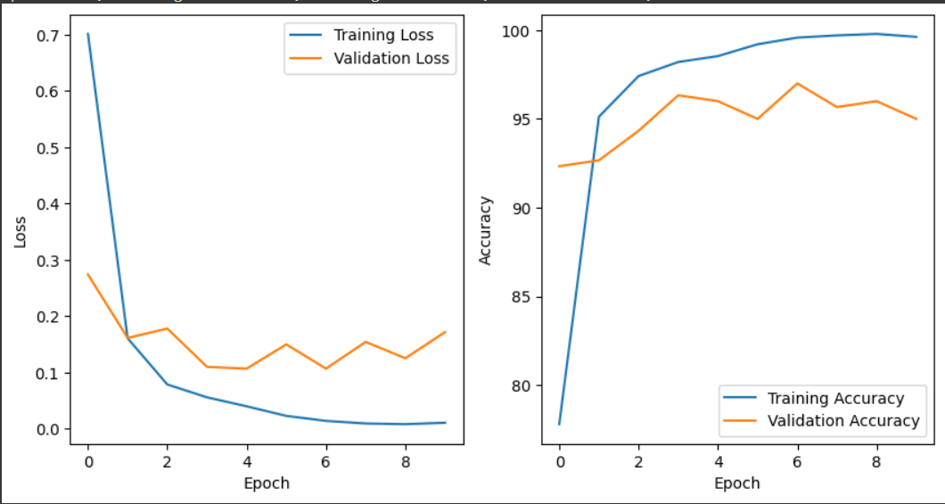
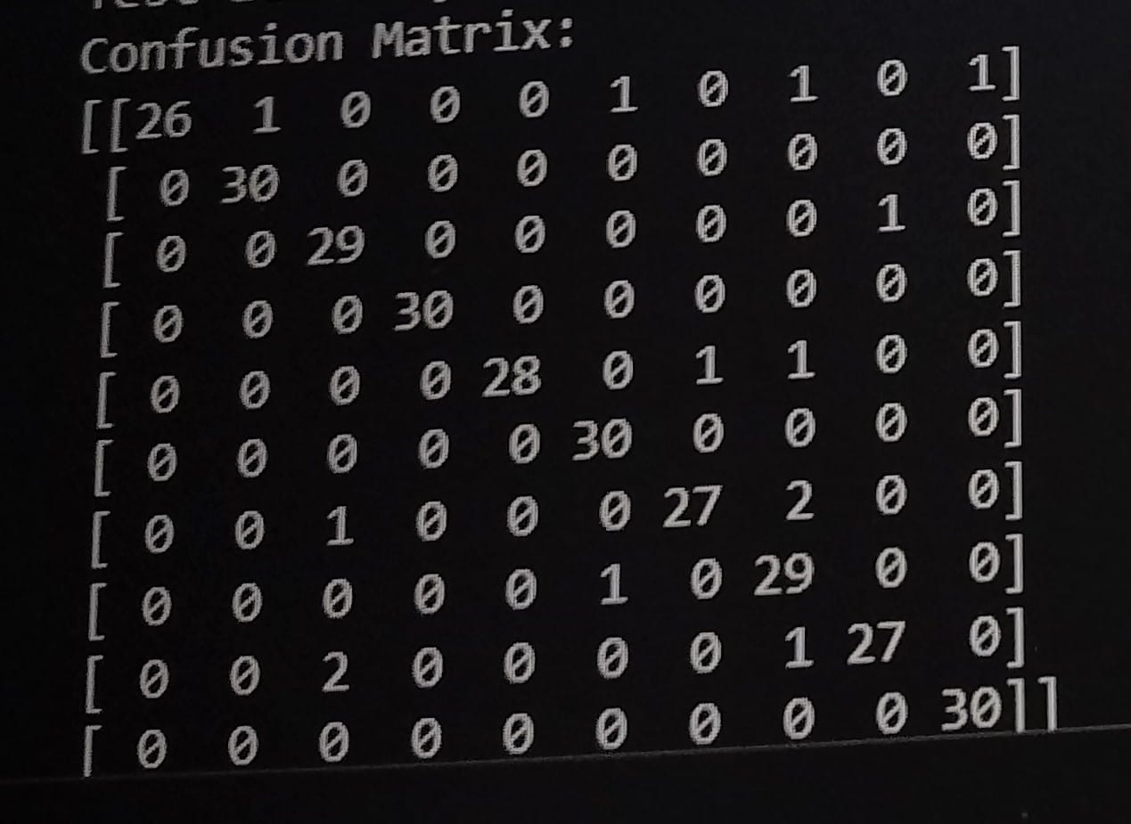
For vgg 16 Number of epochs = 10 Learning rate = 0.01 Optimiser = SGD Loss = Cross entropy loss Accuracy= 95.33

Slide 17
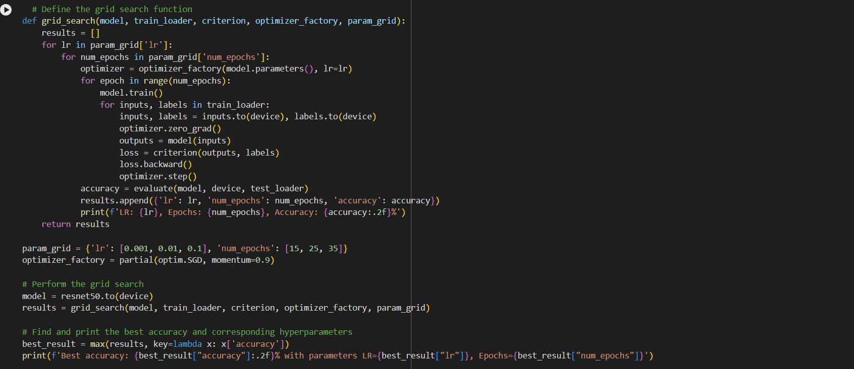
Challenges faced
1. Grid search
We encountered challenges while attempting to use grid search to find the optimal parameters for our ResNet-50 model, especially when training for more than 25 epochs. Unfortunately, we faced runtime errors in Google Colab notebooks, which hindered our progress

Slide 18
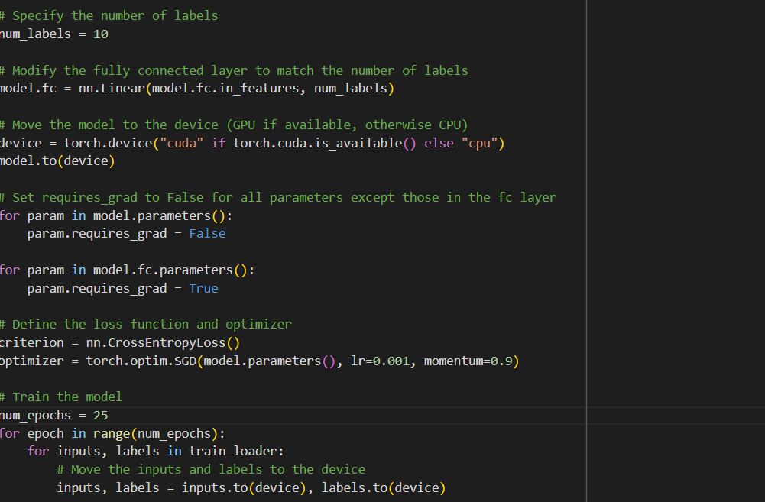
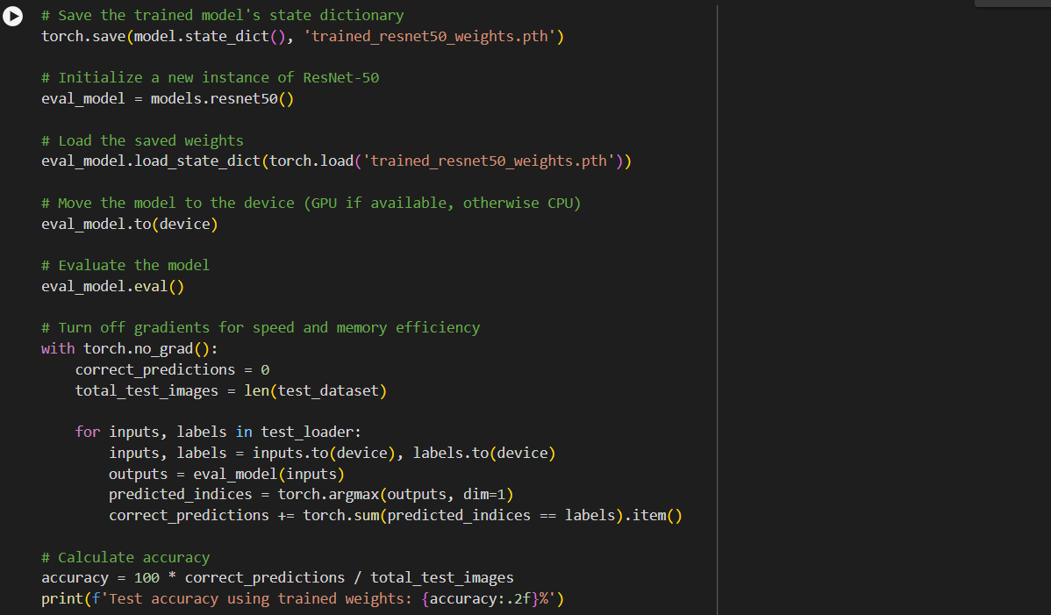
2.We have tried fine tuning our renet50 by updating the weights of all the fully connected layer and freezing the rest . However this code also showed runtime exceeded for 25 epochs .

Slide 19
Furthermore, we encountered shape errors during matrix multiplication operations. These errors occurred when attempting to multiply matrices with incompatible dimensions, preventing successful computation.

Slide 20
YOLOv9 : Introduction
YOLOv9 is the latest installment in the YOLO (You Only Look Once) series, released in February 2024. It is probably the most accurate model right now in object detection with proper dataset of it’s kind.
Existing methods ignore a fact that when input data undergoes layer-by-layer feature extraction and spatial transformation, large amount of information will be lost(Information bottleneck).
It uses the concept of programmable gradient information (PGI) to cope with the various changes required by deep networks to achieve multiple objectives and, a new lightweight network architecture – Generalized Efficient Layer Aggregation Network (GELAN).

Slide 21
Comparison with other models
The basic difference between YOLOv9 and Resnet50,VGG16 is the use of a complex architecture with innovations like Programmable Gradient Information (PGI) and Generalized Efficient Layer Aggregation Network (GELAN) to achieve high accuracy and efficiency.
While resnet Relies on residual connections, a technique that addresses vanishing gradients in deep neural networks, allowing for better training and performance. YOLOv9 has introduced the use of GELAN which is more concerned with Information bottleneck as clear from the figure below

Slide 22
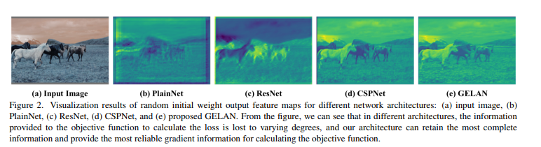
Comparison (contd.)
Source: YOLOv9 official paper
With these fascinating features in mind we decided to train our dataset with YOLOv9.

Slide 23
Training model
The first task was to annotate our dataset according to YOLO labels. For This we used Autodistill (grounding dino +SAM) for automated labelling of 2400 train images and 400 validation and test images each with 10 ontologies.
Probably using Labelimg tool for this task would have provided with more proper annotation but considering size of dataset we decided not to do it manually.

Slide 24
Parameters and Hyperparameters
Optimizer: SGD (Stochastic Gradient Descent)
learning rate : 0.01.
Batch Size: 32
Image Size: 256*256 px.
Epochs: 10 and 50.
Layers in architecture : 930.

Slide 25
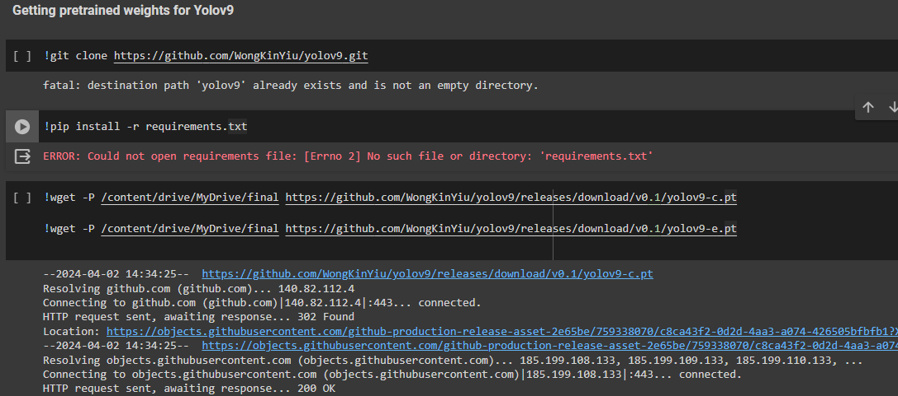

Slide 26
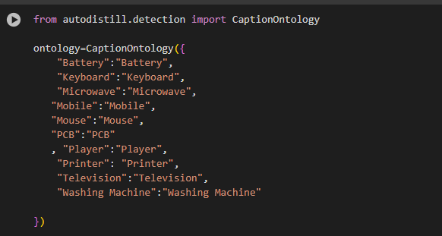
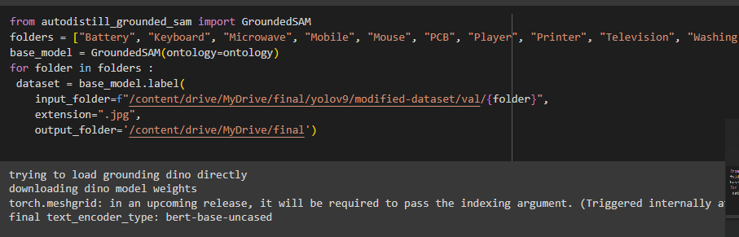

Slide 27
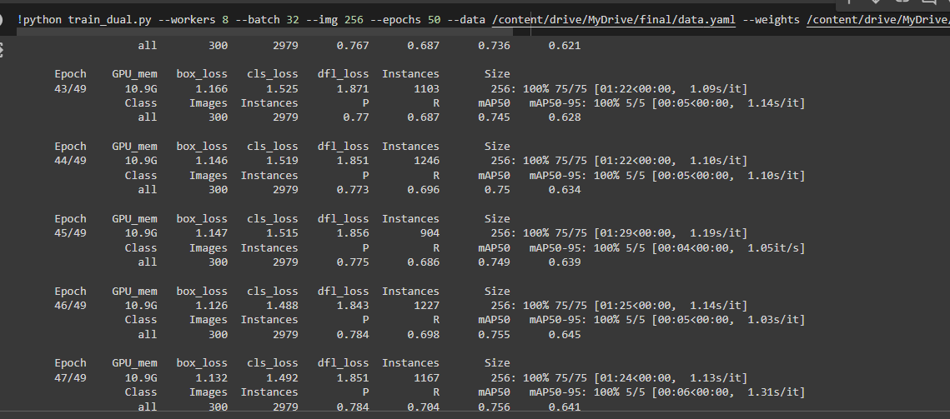

Slide 28
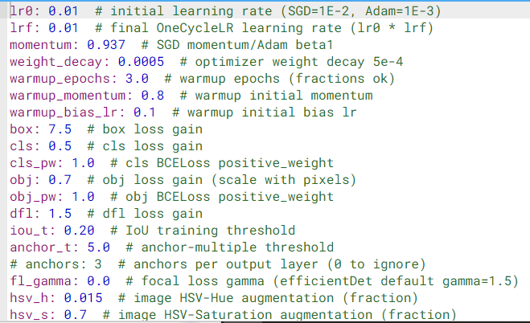

Slide 29
Results of the Training
After training the dataset with the parameters as shown above we got max mAP-50 of around 0.75
Although the results were not so precise in actual predictions
The results are summarized in the coming slides.
These Results as summarized from above ones suggest that with our dataset the classification task of E waste Seggregator is well performed by Resnet 50 model.

Slide 30
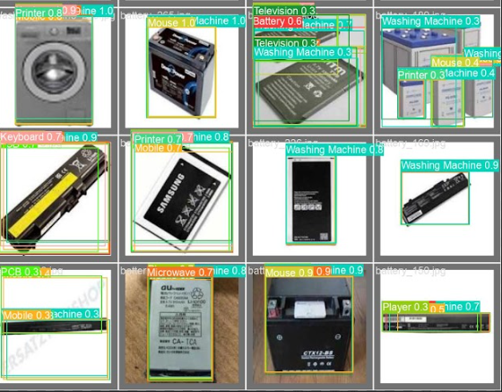
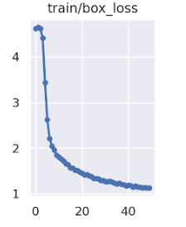
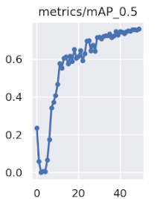
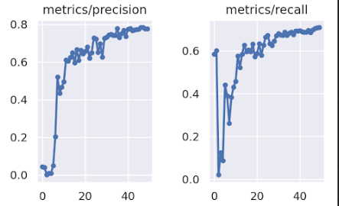
A sample of the validation images prediction after training.

Slide 31
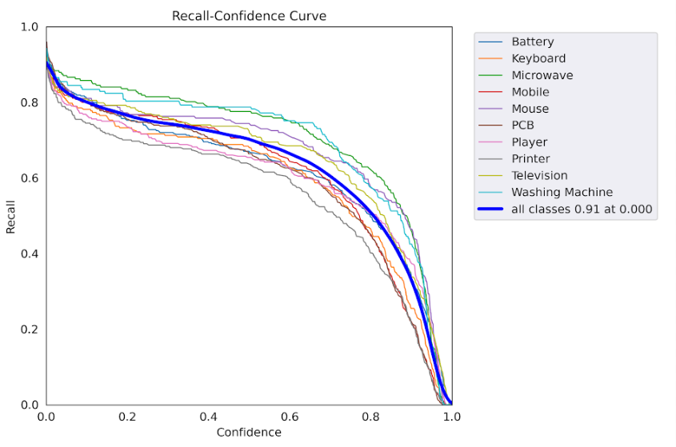
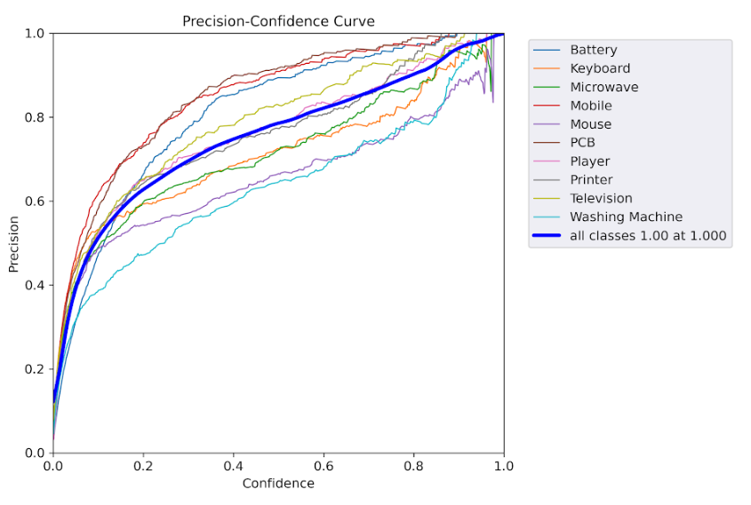

Slide 32
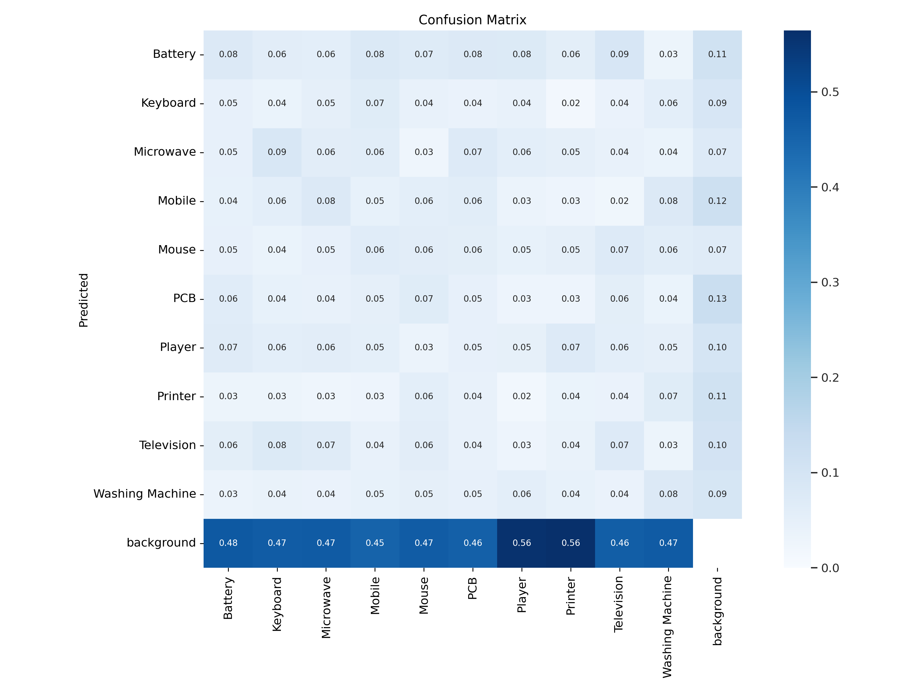
Confusion matrix : As clear it didn’t give much appreciating results

Slide 33
Challenges Faced
We encountered several challenges while implementing the YOLOv9 model on the dataset
One of the challenges which we found most difficult was automated data annotation in accordance with YOLO We used autodistrill but it didn’t turned out to be that good due to some missing keyword in ontology and other reasons.

