Slide 1
FIDS –Flight information Display
Slide - 1

Slide 2
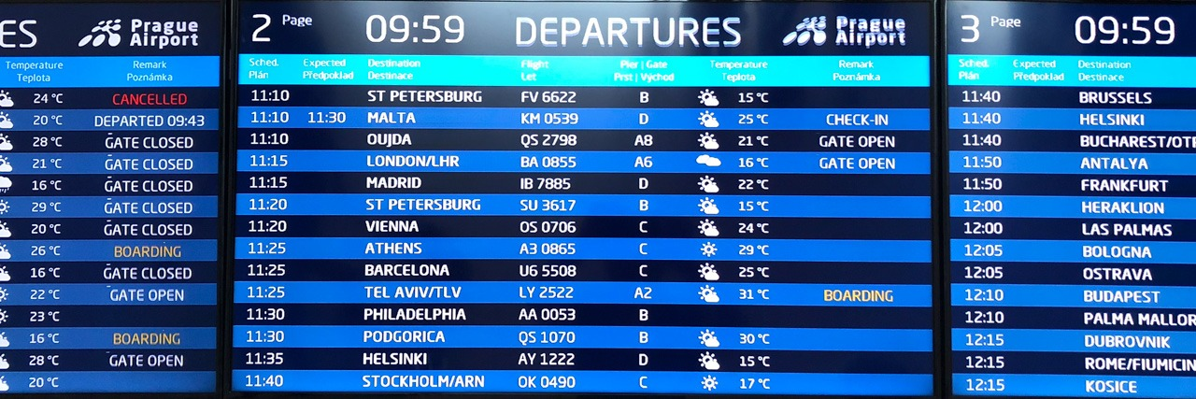
INTRODUCTION
SLIDE -2
A flight information display system (FIDS) is a computer system used in airports to display flight information to passengers, in which a computer system controls mechanical or electronic display boards or TV screens to display arrivals and departures flight information in real-time. The displays are located inside or around an airport terminal.

Slide 3
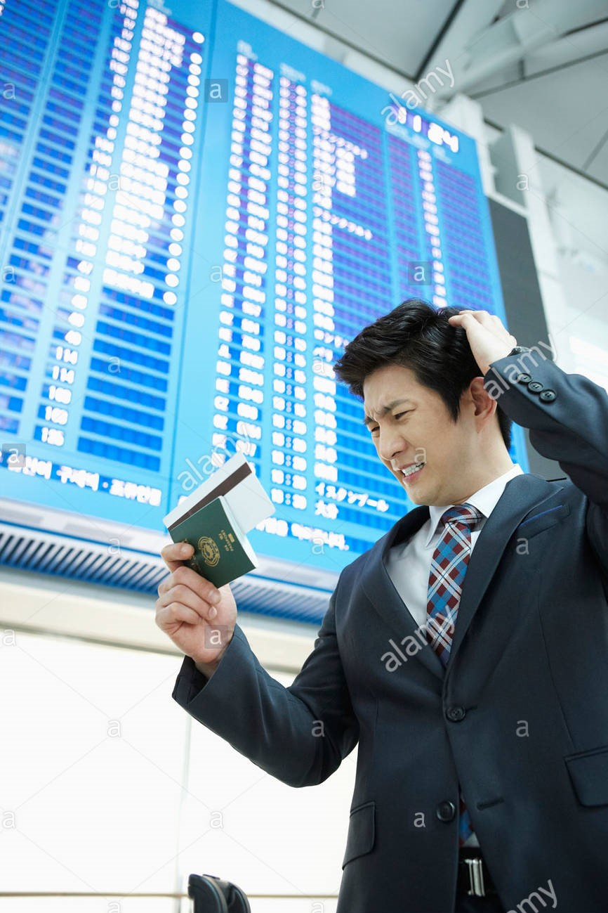
EXISTING WORK AND LIMITATION
01
02
03
04
SLIDE -3
The airport can be a taxing place, but what a lot of travelers don’t realize is that it can be even more stressful for the employees. All content IS static and numbers were never updated in real-time.
This often left travelers lost and upset—which subsequently affected the stress levels of employees.
Additionally, the entertainment and marketing aspects of airport signage are limitless.
As society continues to rely on digital forms of communication, FIDs, BIDs, GIDs wayfinding stations and other types of airport digital signage solutions will become even more prevalent than they already are.

Slide 4
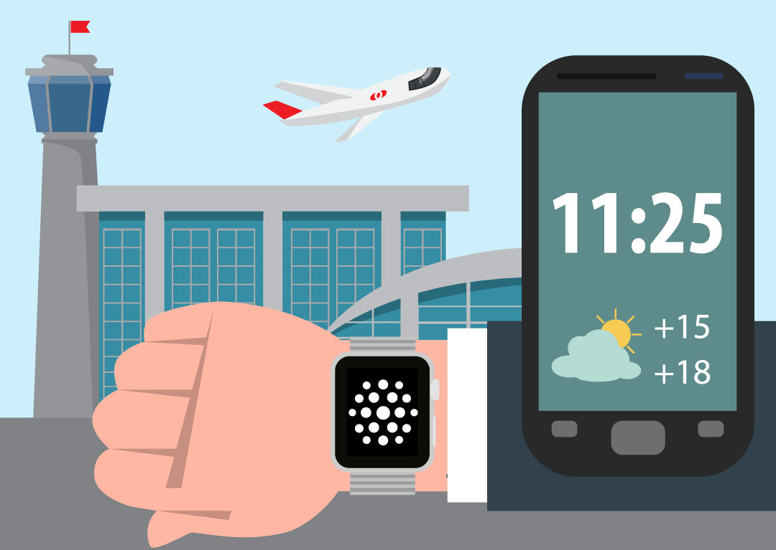
PROPOSED WORK AND METHODOLOGY
SLIDE - 4
Majority population doesn’t prefer air travel due to complexity and economy issues.
Passengers need easy and personalized system at airport.
So a application can be built that once connected to airport network can display all information.

Slide 5
Novelty of the Project
SLIDE - 5
This system can display all details and updates as it will be directly connected to the FIDS system .
Passengers can search for their travel details by entering the unique Airplane identity or details of departing plane and will also have an option to display all details.
The direct question to this application can be that all the details are mentioned in our ticket so why do we need this app , but then also nearly 15% passenger miss their flight as we are aware of the Dynamism of airport.
Many times the plane arriving time , departure time , terminal number , check-in time , boarding time and sometimes in rare case the aircraft changes.
This app can ensure that you can catch up with all the changes and effortlessly board your flight.

Slide 6
Hardware and Software Requirement
SLIDE - 6
The programming language used in this type application will be c++
The data structure that will be using in code will be stack
Module split up
CONSIDERING THE PROBLEM
DEVELOPING A BASIC SOLUTION
DESIGNING ALGORITHM
WRITING THE CODE

Slide 7
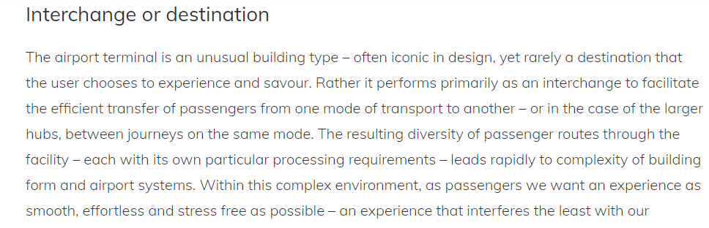
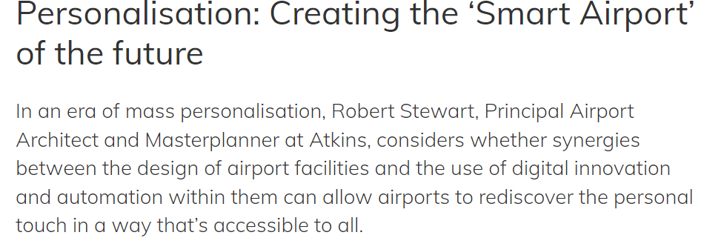
Literature review and Prior work
SLIDE - 7
By Robert Stewart
https://www.internationalairportreview.com/article/25929/personalisation-smart-airport/

Slide 8
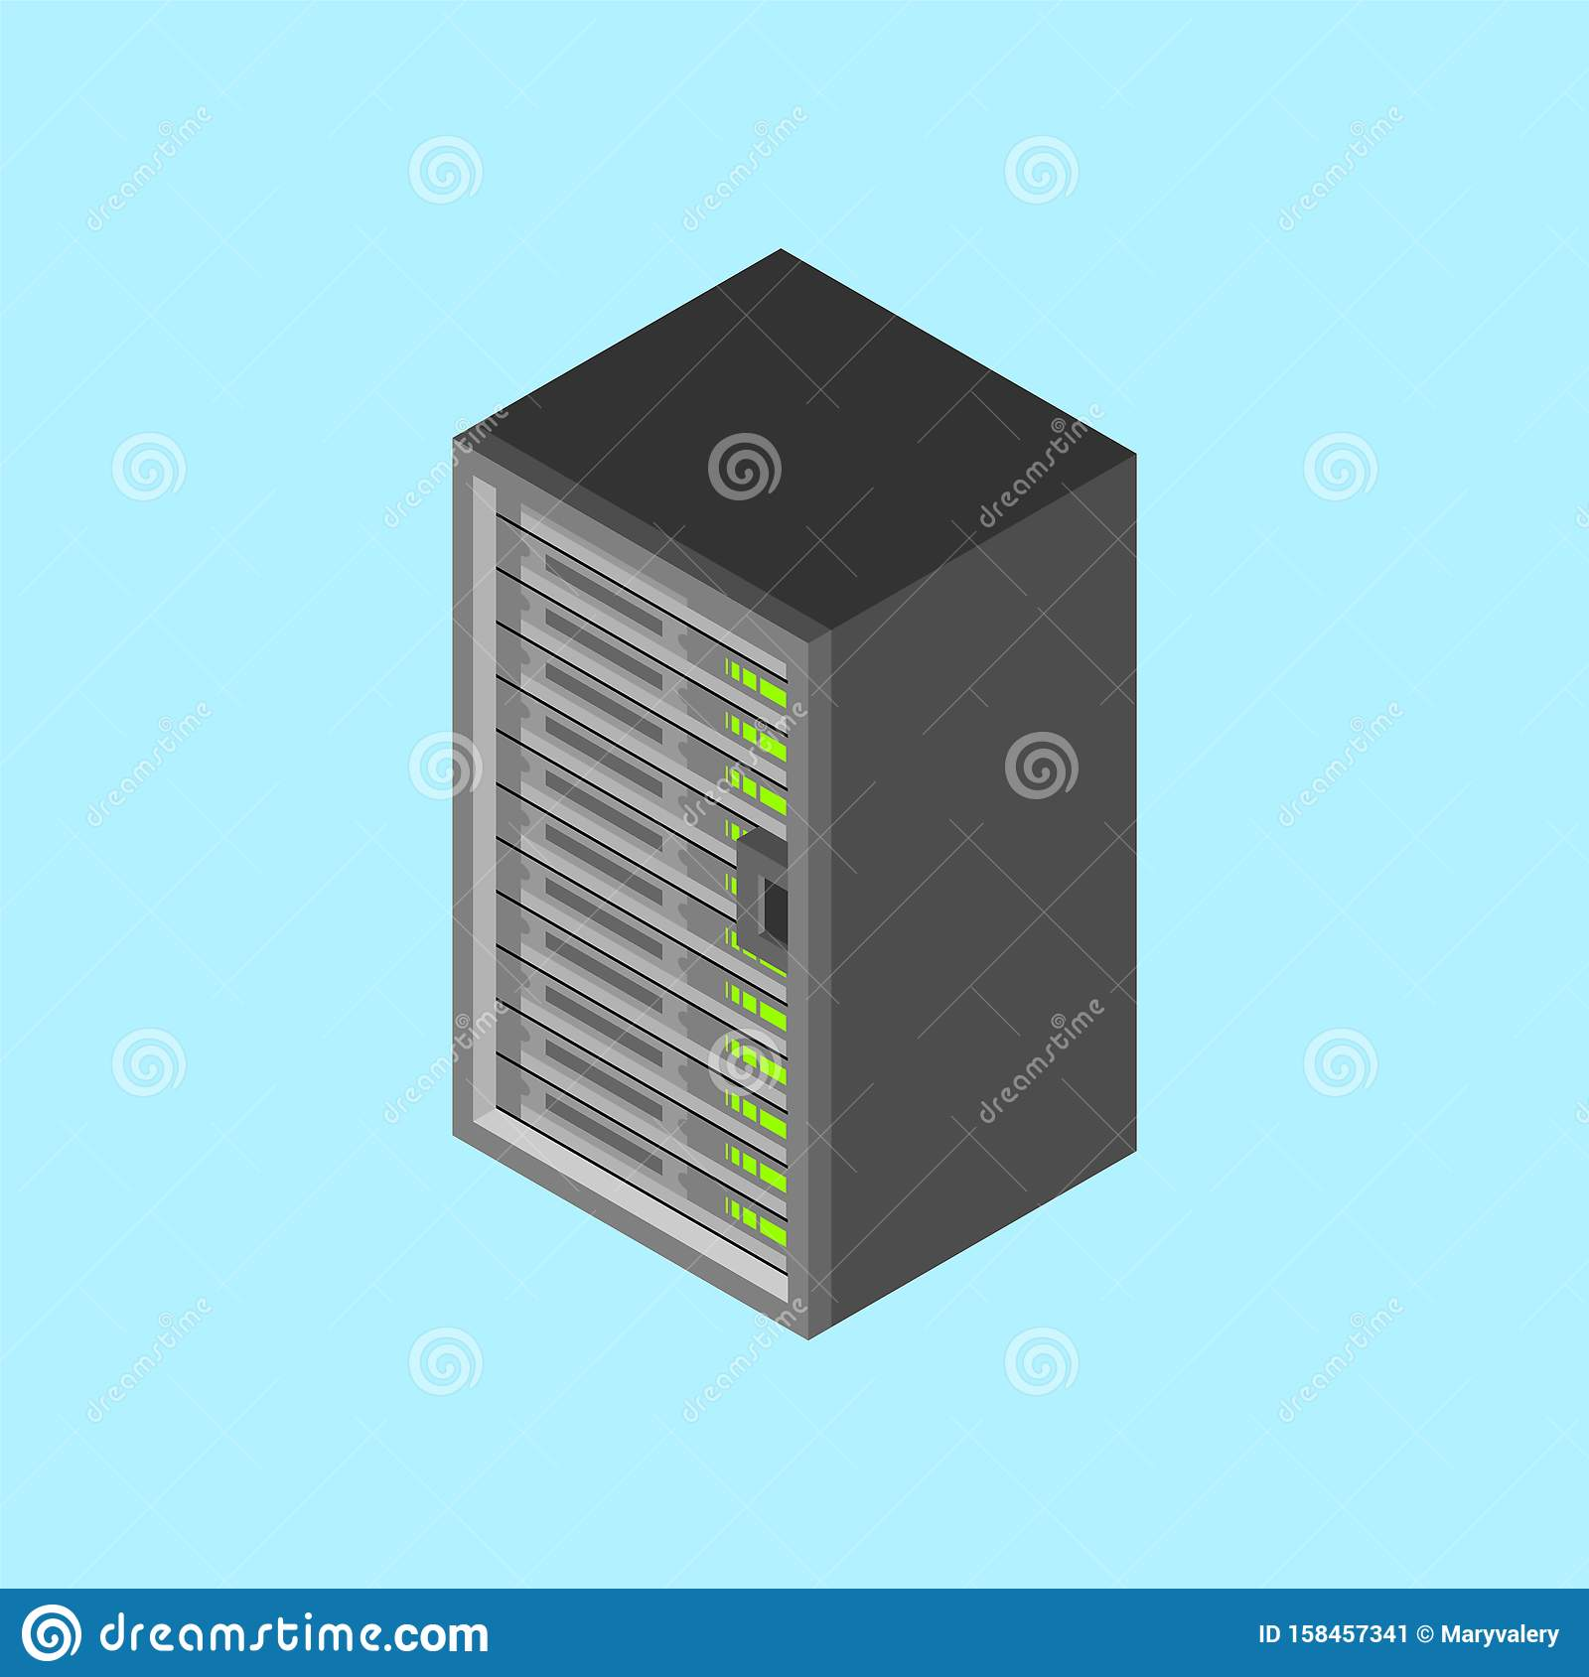
Overall Architecture diagram
SLIDE - 8
ATS
Airport network
AIRPORT MANAGEMENT SYSTEM
DISTRESS SIGNAL
COMMUNICATION SERVER
HANDLERS
AWS
USER

Slide 9
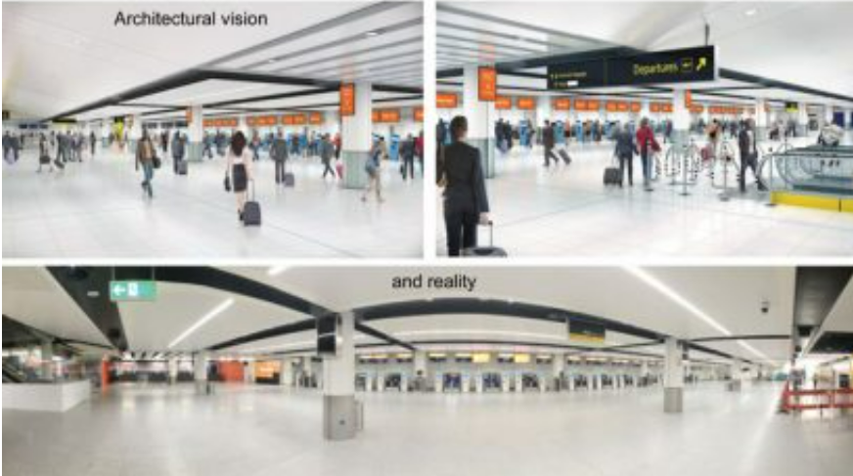
Examples
SLIDE - 9
The adoption of new processes and technologies to automate the journey, such as the self-service bag drop recently deployed for easyJet at Gatwick North Terminal, already means that departing passengers spend less time landside, with the focus of passenger experience shifting towards the airside departures lounge.
As processes such as security screening become more efficient and less time consuming, we can expect more passengers to reach airside lounges sooner, creating new opportunities for service and experience
This increased automation of processes combined with new capabilities in digital technologies also enables true personalization of the passenger journey.

Slide 10
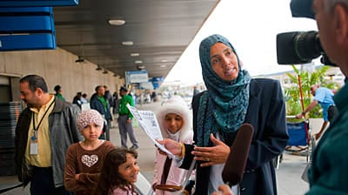
Examples
SLIDE - 10
Atkins’ joint design and IT team worked together on King Abdelaziz International Airport in Jeddah, Saudi Arabia, to integrate design and IT to meet passenger expectations. The development is now at the advanced stage of construction.

Slide 11
Code
Slide -11
#include <iostream>
#include<stack>
#include<string>
#include<cstdio>
#include<conio.h>
using namespace std;
struct Aeroplane{
string name;
string destination;
string arrival;
int departureTime,arrivalTime,checkInTime;
string flightId;
};
void deleteInMiddle(stack<Aeroplane> &st,string ae)
{
if(!st.empty())
{
Aeroplane a,b;
a.flightId="";
b=st.top();
if(b.flightId != ae)
{
a=st.top();
st.pop();
deleteInMiddle(st,ae);
}
else
{st.pop();
}

Slide 12
Slide -12
if(a.flightId!="")
{
st.push(a);
}
}
}
void displayTheAeroplaneTop(Aeroplane aee){
cout<<"The place from where flight has to be boarded: ";
cout<<aee.arrival<<endl;
cout<<"The arrival time of the flight: ";
cout<<aee.arrivalTime<<endl;
cout<<"The name of the airline: ";
cout<<aee.name<<endl;
cout<<"The airplane ID: ";
cout<<aee.flightId<<endl;
cout<<"The departure time of the flight: ";
cout<<aee.departureTime<<endl;
cout<<"The Check IN for the passengers: ";
cout<<aee.checkInTime<<endl;
cout<<"The destination of the flight: ";
cout<<aee.destination<<endl;
}
void searchInMiddle(stack<Aeroplane> st,string ae)
{
if(!st.empty())
{
Aeroplane a,b;
a.flightId="";
b=st.top();
if(b.flightId != ae)
{
a=st.top();
st.pop();
}

Slide 13
Slide -13
else
{
Aeroplane aee=st.top();
displayTheAeroplaneTop(aee);
return;
}
if(a.flightId!="")
{
st.push(a);
}
}
}
void displayTheAeroplane(stack<Aeroplane> aeroplane)
{
while(!aeroplane.empty())
{
Aeroplane ae=aeroplane.top();
cout<<"The place from where flight has to be boarded: ";
cout<<ae.arrival<<endl;
cout<<"The arrival time of the flight: ";
cout<<ae.arrivalTime<<endl;
cout<<"The name of the airline: ";
cout<<ae.name<<endl;
cout<<"The airplane ID: ";
cout<<ae.flightId<<endl;
cout<<"The departure time of the flight: ";
cout<<ae.departureTime<<endl;
cout<<"The Check IN for the passengers: ";
cout<<ae.checkInTime<<endl;
cout<<"The destination of the flight: ";
cout<<ae.destination<<endl<<endl;
aeroplane.pop();
}
}

Slide 14
Slide -14
void insertNewAeroplane(stack<Aeroplane> &aeroplane){
Aeroplane ae;
cout<<"Enter the place from where flight has to be boarded \n \b";
cin>>ae.arrival;
cout<<"Enter the arrival time of the flight \n \b";
cin>>ae.arrivalTime;
cout<<"Enter the name of the airline \n \b";
cin>>ae.name;
cout<<"Enter the airplane ID \n \b"; cin>>ae.flightId;
cout<<"Enter the departure time of the flight \n \b";
cin>>ae.departureTime;
cout<<"Enter the Check IN for the passengers \n \b"; cin>>ae.checkInTime;
cout<<"Enter the destination of the flight \n \b";
cin>>ae.destination;
aeroplane.push(ae);
}
int main()
{
stack<Aeroplane> aeroplane;
char c='y';
while(c=='y'){
cout<<"\n\nSanjana Prasad \nBrijesh Kumar\n\n";
cout<<"********************************WELCOME***********************************\n";
cout<<"\n1.==>Insert new Aeroplane Details\n2.==>Search any Aeroplane with its unique Aeroplane ID\n3.==>Enter details of Departing Aeroplane\n4.==>Display all Aeroplane\n\n";
int n;
cout<<"Enter your choice...\n";
cin>>n;

Slide 15
Slide -15
switch(n)
{
case 1:{
insertNewAeroplane(aeroplane);
break;
}
case 2:
{cout<<"Enter the flight ID the Aeroplane you want to search\n";
string b;
cin>>b;
searchInMiddle(aeroplane,b);
break;}
case 3:
{
string ae;
cout<<"Enter the airplane ID \n \b";
cin>>ae;
deleteInMiddle(aeroplane,ae);
break;
}
case 4:
{
displayTheAeroplane(aeroplane);
break;
}
default:
cout<<"Choose the number correctly...\n";
}
cout<<"***********************************************************************************\n";
cout<<"Do u want to continue...('y' for YES or 'n' for NO)\n";
cin>>c;
}
getch();
return 0;
}

Slide 16
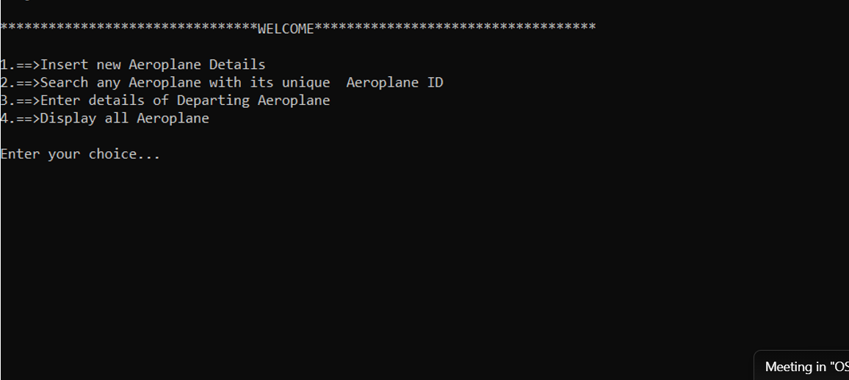

Slide 17
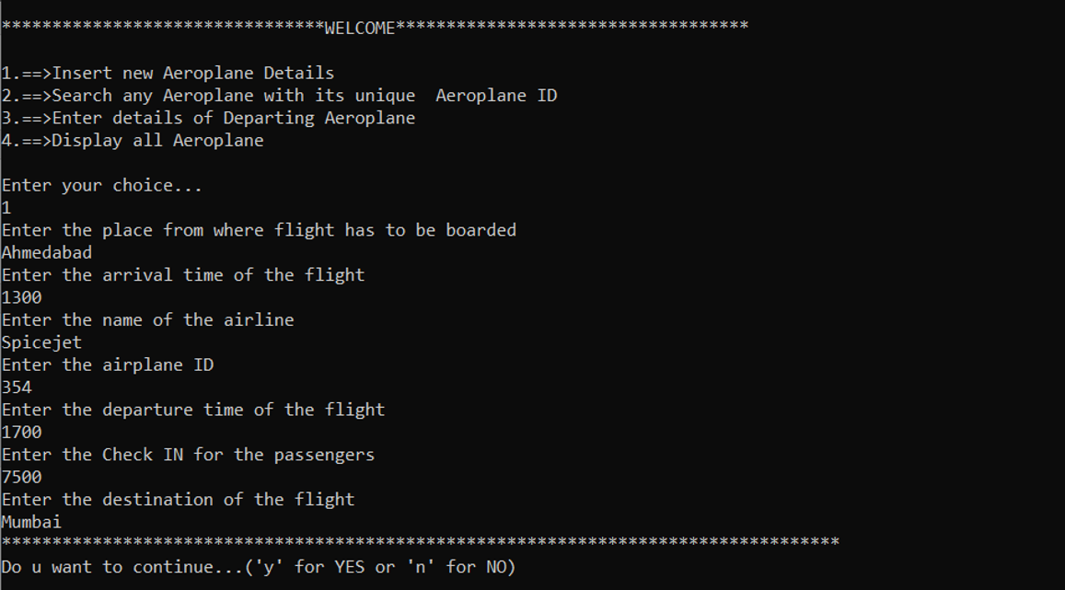

Slide 18
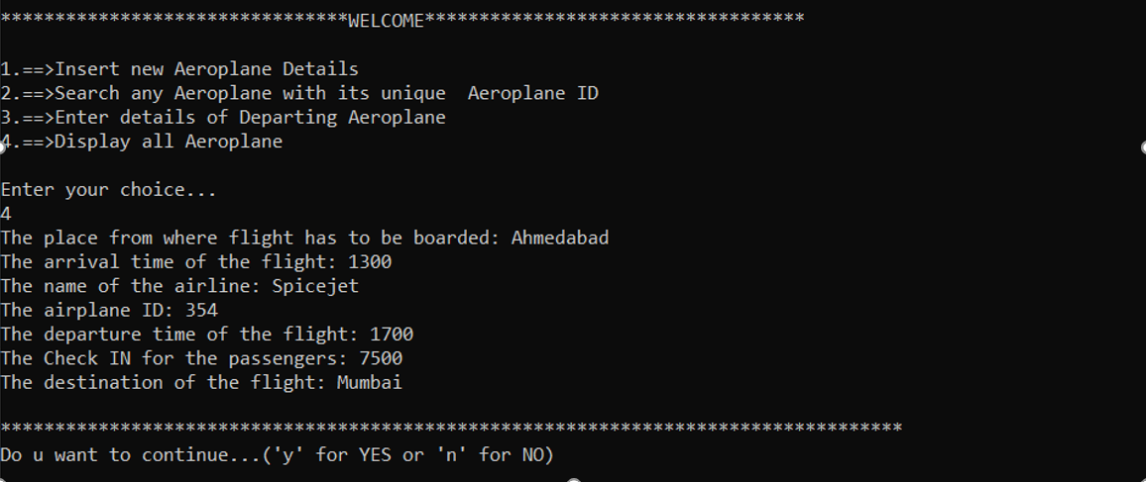

Slide 19
Conclusion
Slide - 20
This project will allow us truly to individualize the passenger journey by recognizing and responding to their particular needs at all points of the journey. Looking at each of the potential benefits in security and convenience that the personalized journey can give us will perhaps help us find the right balance. passengers will be kept moving at the airport. Personalized wayfinding will guide individuals through the terminal, giving accurate timings at each stage. Queuing for security and immigration will be minimized through the use of predictive and real time passenger flow management systems

