Slide 1
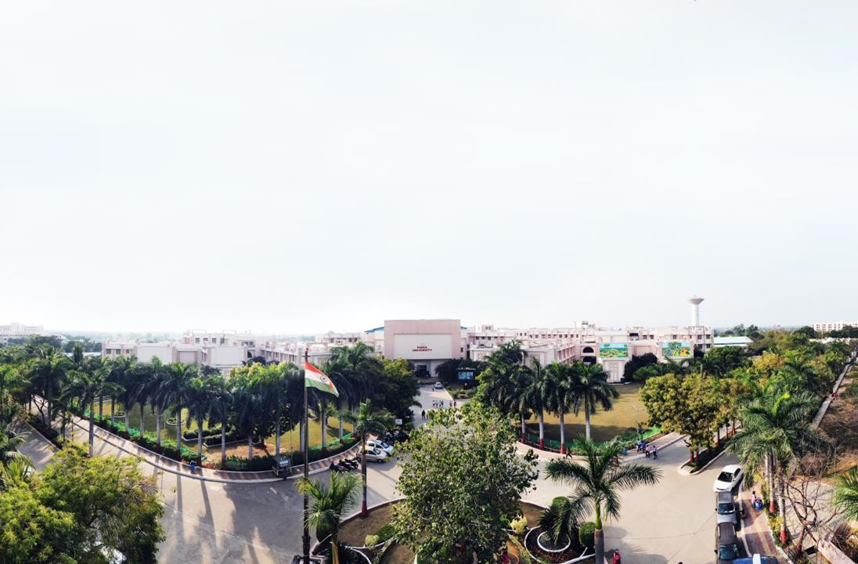

COMPILER DESIGN SUBJECT CODE: 303105349
Ami sachin Shah, Assistant Professor Computer Science & Engineering

Slide 2


CHAPTER-1
Overview of compilation

Slide 3
Contents
The structure of a compiler and applications of compiler technology
Lexical analysis - The role of a lexical analyzer
specification of tokens
recognition of tokens
hand-written lexical analyzers
LEX, examples of LEX programs.

Slide 4
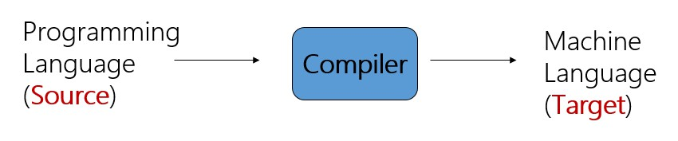
Complier
A compiler acts as a translator, transforming human-oriented programming languages into computer
oriented machine languages.
Ignore machine-dependent details for programmer

Slide 5
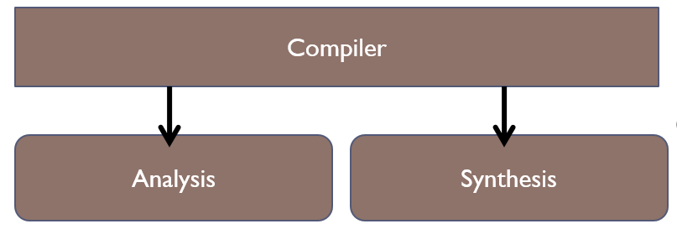
The structure of a compiler
Any compiler must perform two major tasks
Analysis of the source program
Synthesis of a machine-language program

Slide 6
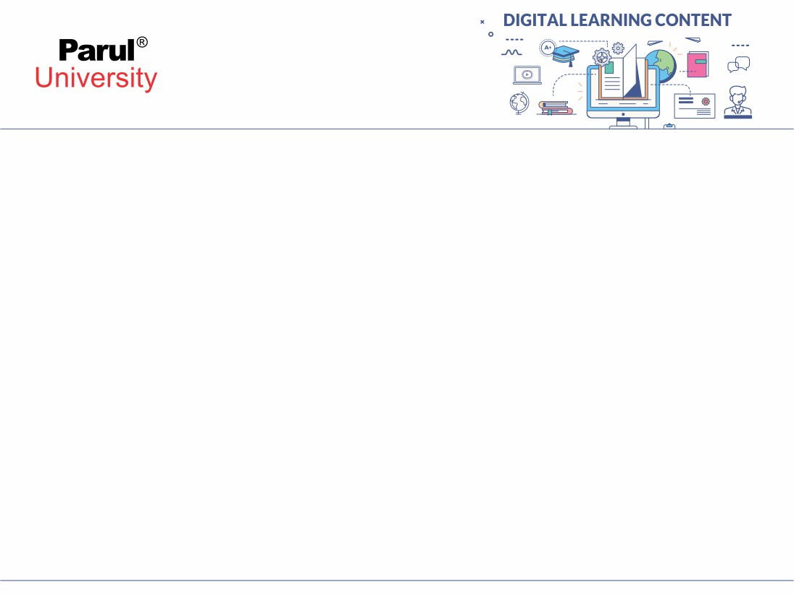
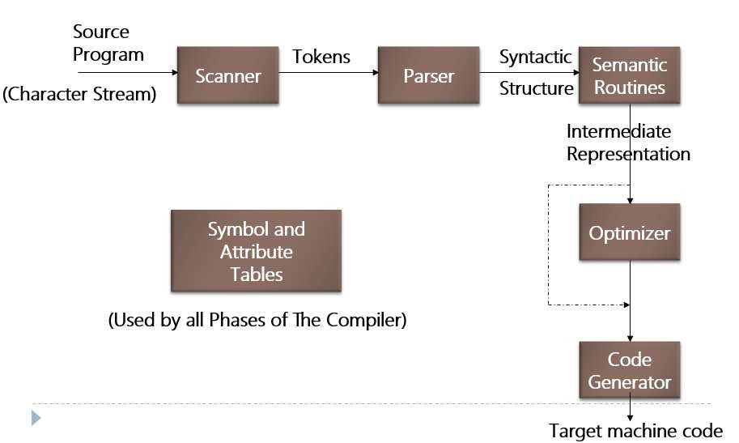
The structure of a compiler

Slide 7
The structure of a compiler
Scanner
The scanner begins the analysis of the source program by reading the input, character by character, and grouping characters into individual words and symbols (tokens)
RE ( Regular expression )
NFA ( Non-deterministic Finite Automata )
DFA ( Deterministic Finite Automata )
LEX

Slide 8
The structure of a compiler
2- Parser
Given a formal syntax specification (typically as a context-free grammar [CFG] ), the parse reads tokens and groups them into units as specified by the productions of the CFG being used.
As syntactic structure is recognized, the parser either calls corresponding semantic routines
directly or builds a syntax tree.
CFG ( Context-Free Grammar )
BNF ( Backus-Naur Form )
GAA ( Grammar Analysis Algorithms )
LL, LR, SLR, LALR Parsers
YACC

Slide 9
The structure of a compiler
3 - Semantic Routines
Perform two functions
Check the static semantics of each construct
Do the actual translation
The heart of a compiler
Syntax Directed Translation
Semantic Processing Techniques
IR (Intermediate Representation)

Slide 10
The structure of a compiler
4 - Optimizer
The IR code generated by the semantic routines is analyzed and transformed into functionally equivalent but improved IR code
This phase can be very complex and slow
Peephole optimization
loop optimization, register allocation, code scheduling
Register and Temporary Management
Peephole Optimization

Slide 11
The structure of a compiler
5 - Code Generator
Interpretive Code Generation
Generating Code from Tree/Dag
Grammar-Based Code Generator

Slide 12
Applications of compiler technology
Compiler technology is more broadly applicable and has been employed in rather unexpected areas.
Text-formatting languages,
like nroff and troff; preprocessor packages like eqn, tbl, pic
Silicon compiler for the creation of VLSI circuits
Command languages of OS
Query languages of Database systems

Slide 13

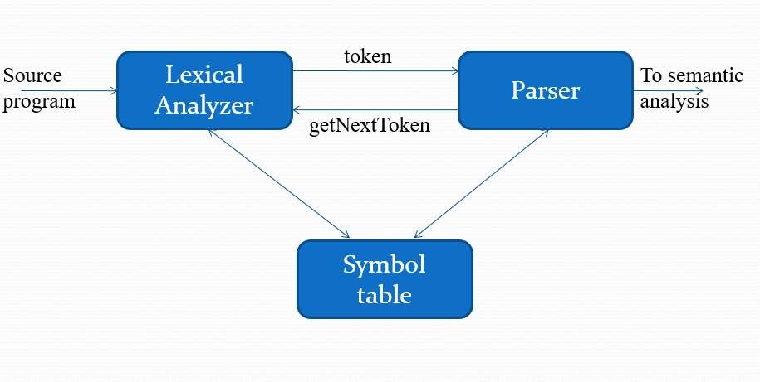
Lexical analysis - The role of a lexical analyzer

Slide 14
Lexical analysis - The role of a lexical analyzer
Lexical analyzer performs below given tasks:
Helps to identify token into the symbol table
Removes white spaces and comments from the source program
Correlates error messages with the source program
Helps you to expands the macros if it is found in the source program
Read input characters from the source program

Slide 15
Lexical analysis - The role of a lexical analyzer
Tokens, Patterns and Lexemes
A token is a pair a token name and an optional token value
A pattern is a description of the form that the lexemes of a token may take
A lexeme is a sequence of characters in the source program that matches the pattern for a token

Slide 16
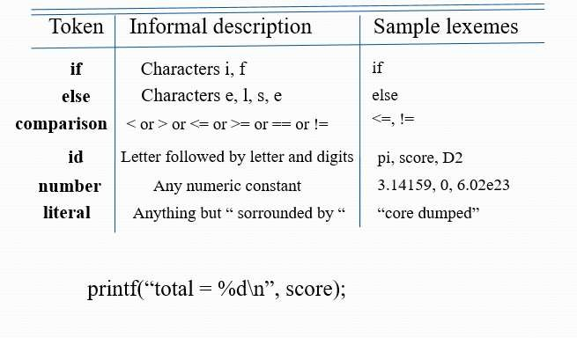
Lexical analysis - The role of a lexical analyzer
Example

Slide 17
Lexical analysis - The role of a lexical analyzer
Attributes for tokens:
E = M * C ** 2
<id, pointer to symbol table entry for E>
<assign-op>
<id, pointer to symbol table entry for M>
<mult-op>
<id, pointer to symbol table entry for C>
<exp-op>
<number, integer value 2>

Slide 18
Lexical analysis - The role of a lexical analyzer
Lexical errors:
A character sequence which is not possible to scan into any valid token is a lexical error. Important facts about the lexical error
Misspelling of identifiers, operators, keyword are considered as lexical errors
Generally, a lexical error is caused by the appearance of some illegal character, mostly at the beginning of a
token.
e.g: int @a1;
Above statement has lexical error because identifier (@a1) can’t start with special character

Slide 19
Lexical analysis - The role of a lexical analyzer
Lexical analysis - The role of a lexical analyzer
Error Recovery in Lexical Analyzer
Removes one character from the remaining input
In the panic mode, the successive characters are always ignored until we reach a well-formed token
By inserting the missing character into the remaining input
Replace a character with another character
Transpose two serial characters

Slide 20
Specification of tokens
In theory of compilation regular expressions are used to formalize the specification of tokens
Regular expressions are means for specifying regular languages Example:
letter_(letter_ | digit)*
Each regular expression is a pattern specifying the form of strings

Slide 21
Recognition of tokens
-> [0-9]
-> digit+
digit
Digits
number -> digit(.digits)? (E[+-]? Digit)?
letter -> [A-Za-z_]
id -> letter (letter|digit)*
If -> if
Then -> then
Else -> else
Relop -> < | > | <= | >= | = | <>

Slide 22
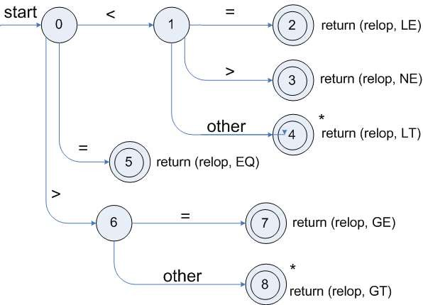
Recognition of tokens
Transition diagram for relop:

Slide 23
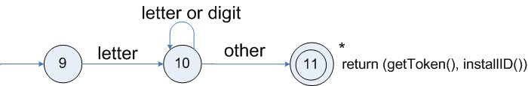
Recognition of tokens
Transition diagram for reserved words and identifiers :

Slide 24
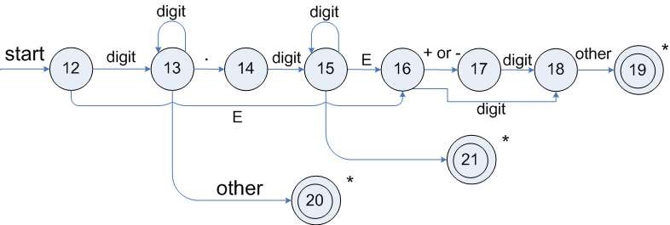
Recognition of tokens
Transition diagram for unsigned numbers :

Slide 25
hand-written lexical analyzers
TOKEN getRelop()
{
TOKEN retToken = new (RELOP)
while (1) { /* repeat character processing until a
return or failure occurs */
switch(state) {
case 0: c= nextchar();
if (c == ‘<‘) state = 1;
else if (c == ‘=‘) state = 5;
else if (c == ‘>’) state = 6;
else fail(); /* lexeme is not a relop */ break;
case 1: …
…
case 8: retract();
retToken.attribute = GT;
return(retToken);
}

Slide 26
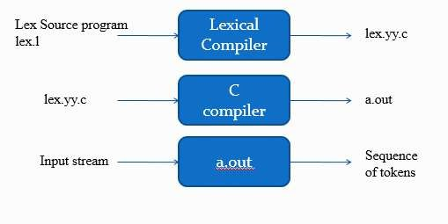
Lexical Analyzer Generator - Lex

Slide 27
Structure of Lex programs
A lex program consists of three parts: the definition section, the rules section, and the user subroutines.
...definition section ...
%%
... rules section...
%%
... user subroutines ...

Slide 28
www.paruluniversity.ac.in

