Slide 1
PROJECT
Our project
ORION
Enterprise Credit Intelligence
& Underwriting
An analyst workbench with explainable models
and recorded human decisions
ORION / Synthetic academic demonstration
01
Notes:
Opening, 35 seconds. ORION is a local academic application for credit decision support. All data and model outcomes in this deck come from synthetic educational data. Source: README.md, docs/ARCHITECTURE.md, docs/KNOWN_LIMITATIONS.md.

Slide 2
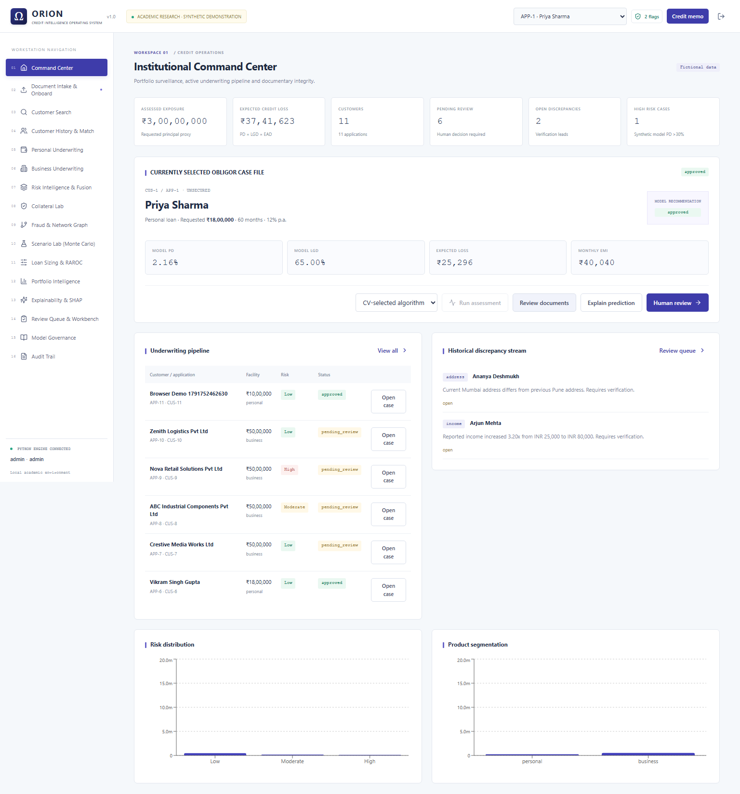
PROJECT
Our project in action
16 workspaces
One persistent case
Intake and documents
Assessment and SHAP
Human review
Credit memo and audit
Local FastAPI application with a React interface and Python analytics
ORION / Synthetic academic demonstration
02
Notes:
45 seconds. Screenshot is the actual ORION Command Center captured during local browser verification. Crop retains the top command-center view. All borrowers and financial values are fictional. Source: docs/screenshots/command-center.png, backend/main.py, frontend source. The sixteen navigation workspaces are preserved from the supplied screenshot reference.

Slide 3
BUSINESS
Business opportunity
Manual credit review
ORION opportunity
Repeated reconciliation
A case joins borrower inputs and reviewed documents
Calculations across spreadsheets
Python applies the same capacity and loss formulas
Decision rationale spread across files
Saved assessments, review reasons and audit history
Pilot measure: analyst minutes per completed case and corrections per case
ORION / Synthetic academic demonstration
03
Notes:
60 seconds. These workflow problems and benefits are product hypotheses inferred from the supplied project scope, not market research. Initial proposed route is an internal analyst pilot. Measure handling time, correction rate and review consistency against an observed manual baseline before commercial adoption. Source: project directive, docs/PRESENTATION_AND_DEMO.md.

Slide 4
BUSINESS
Target audience
01
02
03
Credit analyst
Credit committee
Risk leadership
Prepare a reviewable case
Record a defensible decision
Review portfolio exposure
Review documents and inputs
Assess repayment capacity
Explain the model output
Inspect the original assessment
Approve or override with reasons
Export the credit memorandum
Compare stress scenarios
Inspect expected loss
Track decisions and overrides
ORION / Synthetic academic demonstration
04
Notes:
50 seconds. These are intended user personas, not existing commercial customers. An internal lending team is the proposed initial audience. Analyst begins the case, committee records the final outcome and risk leadership reviews portfolio scenarios. Source: implemented role permissions and docs/PRESENTATION_AND_DEMO.md.

Slide 5
BUSINESS
Financial ROI
200%
Illustrative year-one ROI
1,000 cases / month
30 minutes saved / case
INR 600 / analyst hour
Sensitivity by minutes saved per case · INR lakh
Capacity value, not realized cash savings
Base case: INR 36 lakh value − INR 12 lakh cost = INR 24 lakh net
ORION / Synthetic academic demonstration
05
Notes:
70 seconds. Entire business case is hypothetical, not measured savings or a supplier quote. Assumptions: 1,000 cases/month, INR600 labor value/hour, INR750,000 one-time implementation and INR450,000 first-year operations. Total year-one cost INR1.2m. At 30 minutes saved: 6,000 hours, INR3.6m gross capacity value, INR2.4m net, 200% ROI. Formula: (annual value minus year-one cost)/year-one cost. Ten minutes breaks even. Time released does not automatically create cash savings. Source calculation: scripts/presentation_roi.py and tmp/deck/roi.json.

Slide 6
TECHNICAL
System architecture diagram
React + TypeScript
FastAPI
Case database
Intake, underwriting, portfolio and review
Sessions, roles and input validation
SQLite / SQLAlchemy
Case history and audit
Financial engine
ML service
Document service
EMI, DTI / DSCR, loss and scenarios
Versioned models and real SHAP values
Uploads, text extraction and field review
Local implementation • No live bureau connection • No external LLM
ORION / Synthetic academic demonstration
06
Notes:
80 seconds. Editable diagram of implemented local components. UI sends requests to FastAPI. Session authorization and roles protect operations. Python services handle finance, documents and ML. SQLAlchemy persists records and audit events in SQLite. Trusted local versioned model artifacts feed inference. Extraction supports text PDF/TXT, scanned OCR requires optional Tesseract. No live bureau or external LLM exists. Source: backend/main.py, backend/database.py, backend/finance.py, backend/documents.py, src/model.py, docs/ARCHITECTURE.md.

Slide 7
TECHNICAL
Feature selection logic
Feature | Reason for inclusion | Input interpretation
Credit score | Credit history signal | Reviewed score
Repayment burden | Ability to service debt | Debt service / income or cash flow
Delinquencies | Prior payment difficulty | Count of reported events
Utilization | Use of available credit | Ratio from 0 to 1
Stability years | Employment or business continuity | Non-negative years
Business flag | Borrower-type mapping | Personal = 0, business = 1
Six predefined inputs. No empirical feature-importance or fairness claim.
ORION / Synthetic academic demonstration
07
Notes:
65 seconds. Six features are defined explicitly by the synthetic generator and inference schema. This is domain mapping, not empirical feature selection on real bank outcomes. Personal burden maps monthly obligations and proposed EMI to income. Business burden maps annual debt service to annual cash flow. Score, utilization and delinquency values require reviewed input. No demographic fairness conclusion is supported. Collateral affects LGD, not the PD vector. Sources: src/data.py, src/model.py, backend/finance.py.

Slide 8
TECHNICAL
Model optimization
Candidate | Search space | Selected configuration
Logistic Regression | C: 0.1, 1, 10 | C = 1 with StandardScaler
Random Forest | Depth: 4, 8 Min. leaf: 5, 15 | Depth = 8, min. leaf = 5
XGBoost | Depth: 2, 4 Learning rate: 0.05, 0.1 | Depth = 2, learning rate = 0.05
1,800 synthetic rows
80% training
20% test
Stratified split, seed 42. Five training folds. Test set held aside during tuning.
ORION / Synthetic academic demonstration
08
Notes:
70 seconds. Training uses 1,440 synthetic rows. GridSearchCV evaluates five stratified folds by ROC-AUC. Logistic scaling remains inside each training fold pipeline. C is inverse L2 regularization strength. Tree models use 100 estimators. Winner is selected by mean training CV AUC. Test results are not used to choose the winner. Source: src/model.py and docs/MODEL_EVALUATION.json.

Slide 9
TECHNICAL
Cross-validation results
Selected
Logistic
Regression
0.867 ± 0.013
Highest mean CV AUC
Fold dispersion overlaps
Mean ± fold standard deviation: LR 0.867 ± 0.013 RF 0.854 ± 0.010 XGB 0.855 ± 0.012
ORION / Synthetic academic demonstration
09
Notes:
70 seconds. All values are measured on synthetic training data. Five-fold mean ROC-AUC and one standard deviation: Logistic 0.867473 +/- 0.013360, Random Forest 0.854464 +/- 0.010095, XGBoost 0.855240 +/- 0.011568. These overlapping fold dispersions do not establish statistically significant superiority. Logistic selected by best mean CV AUC. Generator uses an additive logistic outcome mechanism, which may favor Logistic Regression. Source: docs/MODEL_EVALUATION.json and src/data.py.

Slide 10
TECHNICAL
Validation on 360 held-out cases
Model | ROC-AUC | PR-AUC | F1 | Brier ↓
Logistic Regression | 0.860 | 0.837 | 0.751 | 0.152
Random Forest | 0.853 | 0.803 | 0.775 | 0.155
XGBoost | 0.843 | 0.803 | 0.749 | 0.161
Logistic Regression
Random Forest
Best test ranking and lowest Brier among these candidates
Highest F1 at the fixed 0.30 classification threshold
ORION / Synthetic academic demonstration
10
Notes:
60 seconds. Executed synthetic test metrics for tuned candidates. ROC-AUC and PR-AUC are ranking metrics, F1 is threshold-dependent and Brier is squared probability error, lower is better. Threshold 0.30. Logistic is CV-selected, RF achieves higher F1 on this test set. Do not change model selection based on this test comparison. This random synthetic split gives no out-of-time or real lending validation. Source: docs/MODEL_EVALUATION.json.

Slide 11
TECHNICAL
Error analysis
Logistic at 0.30 | Pred. 0 | Pred. 1
Actual 0 | 119 | 77
Actual 1 | 19 | 145
0 = non-default, 1 = default
88.4% recall
65.3% precision
False positives can restrict credit. False negatives can miss defaults.
The threshold remains educational until real outcome costs are available.
ORION / Synthetic academic demonstration
11
Notes:
80 seconds. Threshold 0.30 labels a case as default when model probability is at least 0.30. Selected logistic confusion matrix actual rows non-default/default, predicted columns non-default/default: 119,77;19,145. Test data has 196 non-default and164 default cases. FP77 could burden good applicants, FN19 could miss defaults. LR precision65.3%, recall88.4%. RF has FP73 FN14. Outcome costs and policy constraints are needed for threshold optimization on validation data, followed by a fresh independent test. Source: docs/MODEL_EVALUATION.json.

Slide 12
TECHNICAL
Explainability and human decisions
01
Model assessment
Versioned probability estimate with feature-level SHAP contributions
02
Financial and policy review
Python capacity checks and expected loss using explicit LGD assumptions
03
Human decision
Reviewer records a rationale. The original model assessment remains saved.
Audit history connects the case, model assessment and final decision
ORION / Synthetic academic demonstration
12
Notes:
65 seconds. Actual SHAP contributions explain the stored model output. Logistic and XGBoost use log-odds output, Random Forest probability. Additivity tests exist for all three. Financial decisions separately assess personal DTI/business DSCR and EL=PD*LGD*EAD. Collateral adjusts LGD, not PD. Reviewers can override and must record reasons. Original model assessments remain saved. Mutations create audit events. Sources: src/model.py, backend/finance.py, backend/main.py, tests/test_orion.py.

Slide 13
DEMO
Live demonstration
01
Borrower and documents
Review the fictional borrower
and extracted inputs
02
Underwriting
Compare repayment capacity, PD
and expected loss
03
Explain and decide
Inspect SHAP, then save a
reasoned human decision
04
Memo and scenarios
Open the memo, audit history
and a business stress case
ORION / Synthetic academic demonstration
13
Notes:
90 seconds. Suggested flow: create or open a fictional borrower, review uploaded text-document fields, assess the application, inspect SHAP and finance, record a decision and show audit/credit memo. Pre-stage a business case for the scenario if time allows. Do not claim a live bureau call. Server was stopped on user request and must be started deliberately before presenting. Source: docs/PRESENTATION_AND_DEMO.md.

Slide 14
CLOSING
Next steps and boundaries
Working today
Before a real lending pilot
Persistent case workflow
Three trained model families
SHAP, finance and human review
Memo exports and audit history
Authorized historical outcomes
Validation across time and groups
Threshold and calibration study
Operational security and monitoring
Synthetic results demonstrate the system. Real lending requires independent evidence.
ORION / Synthetic academic demonstration
14
Notes:
45 seconds. All model results use synthetic educational data, no real bank default outcomes. No production lending approval or regulatory certification claimed. Proposed next steps: authorized historical outcomes, out-of-time validation, empirical threshold costs, calibration and fairness analysis, document depth and production operational security. Scanned OCR needs Tesseract. Initial strategy is a supervised internal pilot with handling-time measurements. Source: docs/KNOWN_LIMITATIONS.md, docs/MODEL_EVALUATION.json and docs/TEST_REPORT.md.

