Slide 1
ORION
Enterprise Credit Intelligence
& Underwriting
Python analytics with traceable human credit decisions
12 October 2026
ORION / Academic demonstration with synthetic data
01
Notes:
Course: Data Science for Managers. Executive pitch five minutes, technical deep dive and demonstration ten minutes. Team members should supply their own names. Source: assignment PDF pages 1–3.

Slide 2
Credit analyst workflow
Analysts reconcile borrower identity, documents and repayment capacity.
Credit committees need a recorded rationale for every final decision.
ORION preserves the model result while the reviewer records a decision.
The initial product is a local academic workbench for these users.
ORION / Academic demonstration with synthetic data
02
Notes:
Executive pitch: explain the target persona and current manual reconciliation burden. Opportunity is a product hypothesis, not market research. Source: project directive and implemented workflow.

Slide 3
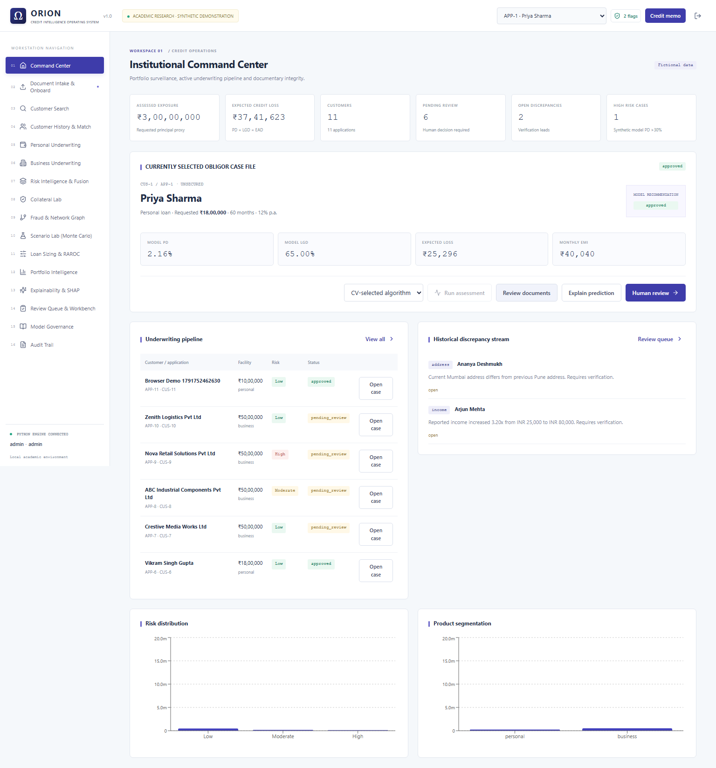
Working application
16 workspaces
Persistent intake and review
Python financial and ML services
Role-based access and audit
ORION / Academic demonstration with synthetic data
03
Notes:
Screenshot source: docs/screenshots/command-center.png from executed local browser test. All displayed customers and values are fictional.

Slide 4
Illustrative business case
Annual labor-efficiency scenario | INR / volume
Cases per month | 1,000
Time saved per case | 30 minutes
Annual gross labor value | 3,600,000
Annual operating cost | 150,000
Annual net benefit | 3,450,000
2,300% assumption-based ROI
Actual savings depend on adoption, review time and operating costs.
ORION / Academic demonstration with synthetic data
04
Notes:
Assumptions only. 1,000 cases/month, 30 minutes saved, INR600/hour, INR150,000 annual operating cost. Annual gross=1,000*12*30/60*600=3,600,000 INR. Net=3,450,000 INR. ROI=net/cost=23, or 2,300%. No realized ROI or default reduction claimed.

Slide 5
Adoption and validation strategy
Start with an internal analyst demonstration and observed usability tasks.
Measure time per case and correction rates against a manual baseline.
Validate with authorized historical outcomes before a controlled pilot.
Public hosting requires stronger operational security and model governance.
ORION / Academic demonstration with synthetic data
05
Notes:
Market strategy is proposed, not externally researched. Team should explain why an internal workbench is the initial target and why authorized real data validation must precede a lending pilot.

Slide 6
Python service architecture
React / TypeScript interface
FastAPI + session authorization
Python finance, documents and models
SQLAlchemy / SQLite + audit events
ORION / Academic demonstration with synthetic data
06
Notes:
Source: backend/main.py, backend/database.py, src/model.py and docs/ARCHITECTURE.md. Editable diagram shows the implemented request path.

Slide 7
Feature and financial conventions
Model input | Meaning
Credit score | Reported, reviewed value
Repayment burden | Proposed debt service relative to capacity
Delinquencies and utilization | Credit conduct indicators
Stability years | Employment or business age
Business flag | Personal / business feature mapping
Monthly personal figures and annual business figures use explicit conversions.
ORION / Academic demonstration with synthetic data
07
Notes:
Source: src/data.py and backend/finance.py. The ML has six inputs. Personal repayment burden is monthly total debt / income. Business burden is annual debt service / cash flow. Collateral affects LGD rather than the PD feature vector.

Slide 8
Training and validation
1440 training rows and 360 held-out test rows from 1,800 synthetic examples
Five stratified training folds select hyperparameters by ROC-AUC.
Logistic scaling fits within the cross-validation pipeline.
The test set measures synthetic generalization after model selection.
ORION / Academic demonstration with synthetic data
08
Notes:
Source: docs/MODEL_EVALUATION.json and src/model.py. Candidate selection uses training CV AUC only. GridSearchCV tests Logistic C .1/1/10, Random Forest depths 4/8 and leaf counts 5/15, XGBoost depths 2/4 and learning rates .05/.1. Fixed 100 trees for tree models.

Slide 9
Measured candidate performance
Model | CV AUC | Test AUC | PR-AUC | F1 | Brier
Logistic Regression | 0.867 | 0.860 | 0.837 | 0.751 | 0.152
Random Forest | 0.854 | 0.853 | 0.803 | 0.775 | 0.155
XGBoost | 0.855 | 0.843 | 0.803 | 0.749 | 0.161
CV-selected candidate: Logistic Regression
Synthetic data limits external validity and time-horizon interpretation.
ORION / Academic demonstration with synthetic data
09
Notes:
Source: docs/MODEL_EVALUATION.json. Metrics are executed held-out synthetic-data results. They do not establish bank performance. Selected candidate: Logistic Regression. Version: 20261011T205522521361

Slide 10
Error analysis at threshold 0.30
Threshold costs need real outcome validation before lending decisions.
ORION / Academic demonstration with synthetic data
10
Notes:
Source: docs/MODEL_EVALUATION.json. Confusion matrices, precision and recall are also available in the app. False positives can restrict credit and false negatives miss defaults. Threshold selection requires empirical business costs before lending.

Slide 11
Explainability and expected loss
SHAP attributes the saved model output to each feature and a base value.
Logistic and XGBoost explain log odds. Random Forest explains probability.
Expected loss equals PD × LGD × EAD using explicit recovery assumptions.
Synthetic PD and illustrative LGD do not represent calibrated regulatory risk.
ORION / Academic demonstration with synthetic data
11
Notes:
Source: src/model.py, backend/finance.py and tests/test_orion.py. SHAP additivity tests execute for Logistic Regression, Random Forest and XGBoost. Positive values raise the model output. Unsecured facilities do not require collateral.

Slide 12
Live demonstration
Create a personal borrower and upload the fictional sample credit report.
Review extracted fields, assess capacity and inspect actual SHAP values.
Record a human decision and inspect the audit event and credit memo.
Show a business downturn scenario and portfolio loss simulation.
ORION / Academic demonstration with synthetic data
12
Notes:
Use docs/PRESENTATION_AND_DEMO.md for detailed fields. Source: executed browser workflows. Pre-stage business case if time is short. Remain within 15 minutes plus Q&A.

Slide 13
Technical defense and limits
Cross-validation chooses models without using test outcomes.
Review and override rows retain the original model recommendation.
Text PDF and TXT extraction work. Scanned pages require Tesseract.
Real data validation, fairness checks and operational hardening remain essential.
ORION / Academic demonstration with synthetic data
13
Notes:
Source: docs/KNOWN_LIMITATIONS.md, docs/ALGORITHM_REGISTRY.md and assignment page3. Each team member should explain model choice, feature mapping, financial formulas and validation. No live bureau, external LLM, bank certification or realized ROI is claimed.

