Slide 1
Super Hero Analysis
A report by Aayush Sinha

Slide 2
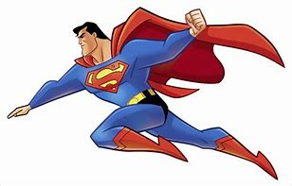
Superheroes : Overview
Superheroes have been in popular culture for a long time and now more than ever
Since its creation, super heroes have not been very diverse, but that is changing rapidly
This dataset for our analysis aims to provide an overview about heroes and their physical as well as power characteristics
Identifying super trends and insights with the given dataset

Slide 3

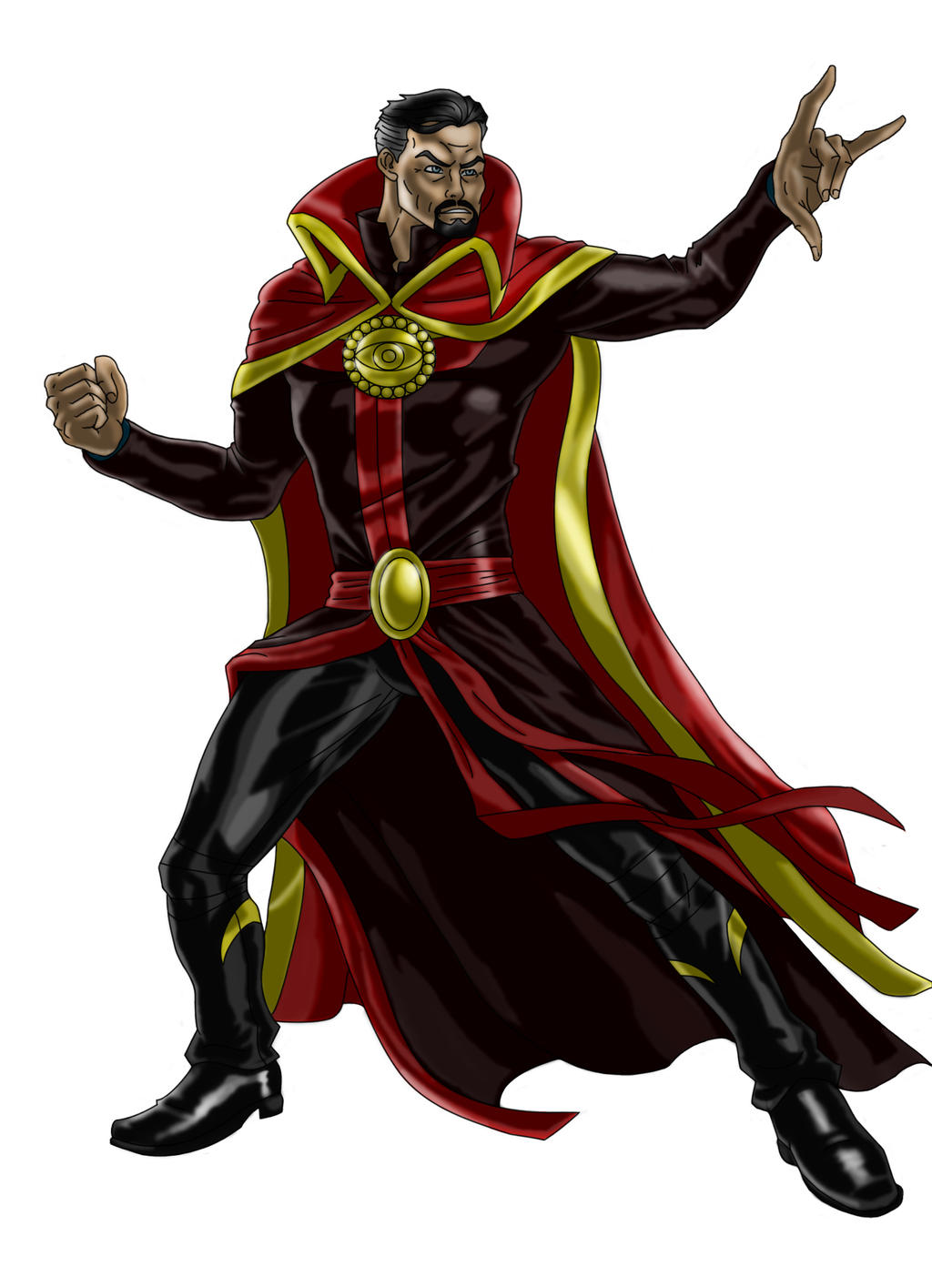
Objective
Problem Statement: To predict if a superhero is a human or not.
Data-Preprocessing Setting up analysis environment, loading libraries, Reading datasets
Exploratory Data Analysis (EDA) Exploring trends, maximize insights,check for data quality and errors, look for relationship between features.
Classification A classification model tries to draw some conclusion from the input values given for training. Evaluate the model Performance -Hypertune features for modelling
Name Generator - A simple Superhero name generator

Slide 4
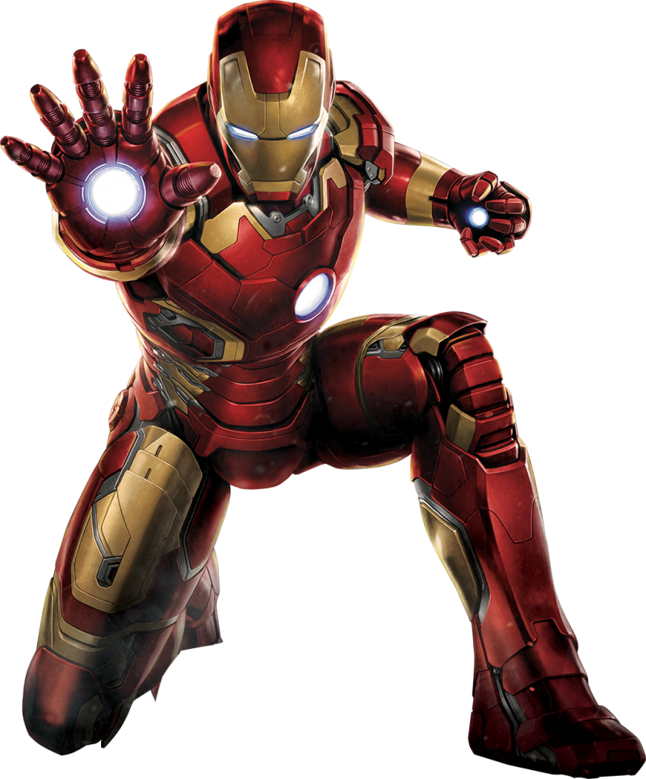
Superheroes : EDA Summary
Heroes-information dataset has - 734 rows, 11 columns
Super-heroes power dataset has - 667 rows, 168 columns
Gender wise distribution - Male 505, Female 200
Most of the Superheroes have blue colored eyes - 225
Most of them belong to the human race
Most of the Superheros are black-colored-hair
Marvel & DC account for maximum superheroes publishers
Most of the Superheroes are ‘Face’ - Good; 496; 207 amongst the superheroes are ‘heel’ , 24 are neutral
Most Common superpowers are - ‘Super Strength’, ‘Stamina’, ‘Durability’, ‘Super Speed’, ‘Agility’
Some of the superheroes have rare strengths - Intuitive aptitude, thirstoklnesis, omnitrix, Banish,Spatial Awareness
Amongst Humans and Mutants there are - 138 human heroes, 47 human villains, 45 Mutant Heroes, 12 Mutant Villains

Slide 5
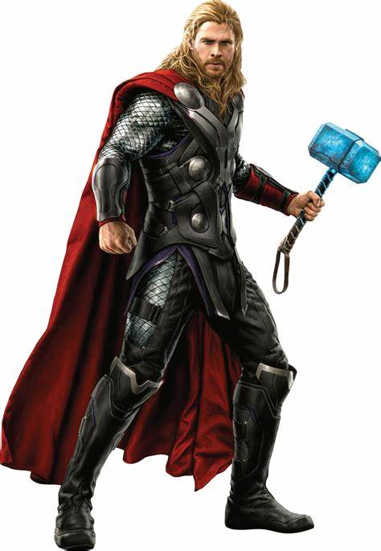
Superheroes : EDA Summary
Most Powerful superhero is : Spectre from DC publishers
The most powerful villain is Amazo and is from DC Comics
The most powerful female hero is Captain Marvel and is from Marvel Comics
The most powerful god is Spectre and is from DC Comics
The most powerful god villain is Mister Mxyzptlk

Slide 6
Classification Model - Overview
Random forest classifier creates a set of decision trees from randomly selected subset of training set
It then aggregates the votes from different decision trees to decide the final class of the test object
Random Forest Classifier being ensembled algorithm tends to give more accurate result
Number of weak estimators when combined forms strong estimator
Steps
Import library - Create model - Train - Predict
Hyperparameter tuning-
n_estimators : Number of trees in forest. Default is 10
criterion: “gini” or “entropy” same as decision tree classifier
min_samples_split: minimum number of working set size at node required to split. Default is 2

Slide 7
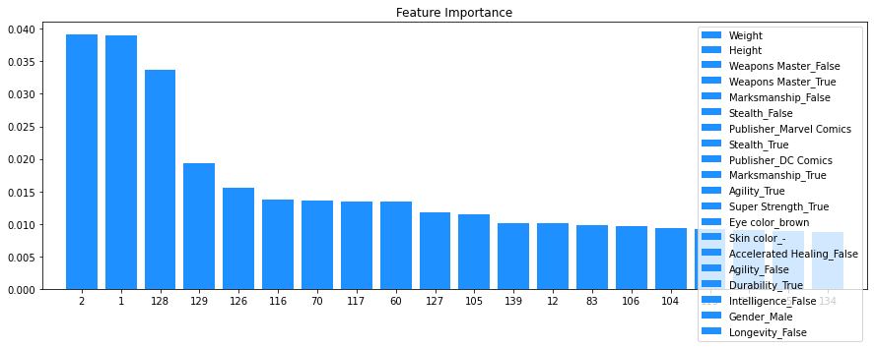
Feature Importance
Feature Selection is important as it reduces overfitting, Improves accuracy, reduces training time
Most Important Features for the classification model - Weight, Height, Weapons Master_False, Weapons_Master_True,Marksmanship_False, Stealth_False

Slide 8

Superheroes : Classification Summary
Cross-validation for the first model gave an accuracy of 75.61%
The best parameter for our model was :-
(max_depth = 5, max_features = 4, min_sample_leaf=3, n-jobs= -1, oob_score = True, random_state = 42)
Max-depth - Larger an individual tree; more chances of overfitting - Random Forest has many individual trees so it handles overfitting issues
Max_features - maximum number of features used for a node split process
Min_sample_leaf - minimum number of data points requirement in the node of decision tree
N-jobs - no of processors used for training
Oob_score - out of bag score to validate Random Forest Split
Random_state = 42, to randomly select similar data points for training
The model gave an accuracy of 79.5%

Slide 9

Superhero Name Generator

Slide 10
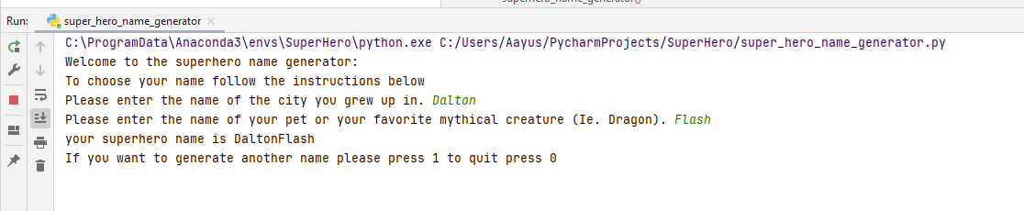


Superhero Name Generator

Slide 11

About me:
Creative Problem Solver Specializing Data Wrangling, Data Visualization, Analytics & Reporting.
I have had a great proclivity towards data science and Artificial Intelligence ever since I was in school. It fascinated me, built my curiosity and fuelled my desire to learn more.
I see this as a bridge between my qualification in computer applications and my interests in machine learning and data science.
My intellectual curiosity also drives me to be a lifelong learner.
https://www.linkedin.com/in/aayush-sinha-97211288/
https://public.tableau.com/app/profile/aayush.sinha
https://github.com/aayushs7ha

Slide 12
THANK YOU

