Slide 1
Table of Contents
EDA
Data pre-processing
Gradient Descent
Stochastic Gradient Descent
Batch Gradient Descent
Analysis
Suggestions for Improvements

Slide 2
EDA
Data Pre-processing
In the data-set there are 2k rows, 15 independent variables and a target variable
There are 3 categorical independent variables, rest are of float data-type
All the variables have missing values ~ 4-5%
The categorical variables are transformed using one-hot encoding
The ordinal variable is simply converted to a single integer variable
Missing values are imputed using mean fill method
The data is standardised between 0 and 1
After this, we have 18 independent variables and a target variable in the dataset

Slide 3
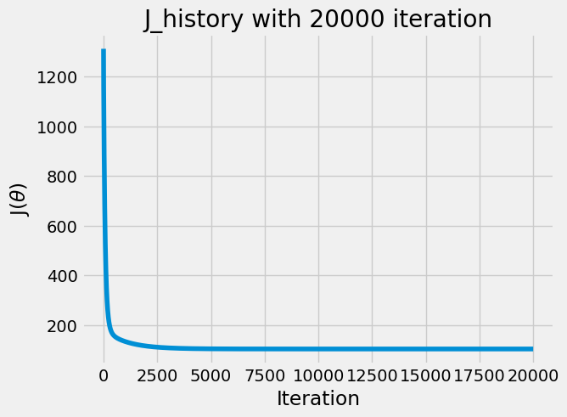
Gradient Descent
Independent and dependent variables are taken out from the dataset as numpy arrays: X and y
A constant term of 1 is added to X as bias. The variable ‘theta’ is initialised to 0
After initializing the learning rate and maximum number of iterations, gradient descent is performed
It took ~17 sec for the algorithm to perform the optimisation process

Slide 4
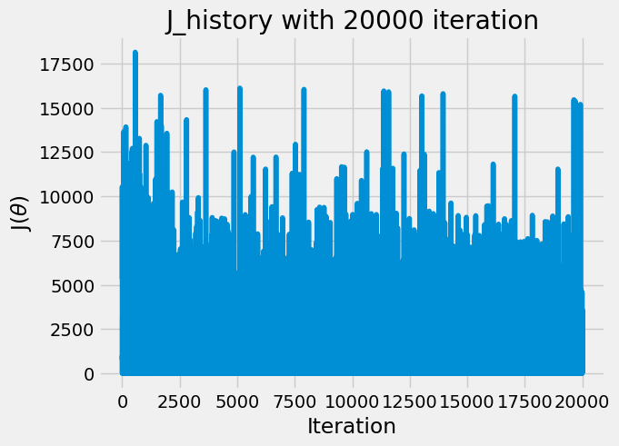
Stochastic Gradient Descent
A single random datapoint is selected from the dataset
The gradients are calculated only wrt this datapoint rather than the complete dataset
It took just ~3.4 sec for the algorithm to perform the finish the iterations
Important point to note here is that the algorithm failed to converge as the losses are not reducing wrt the iteration

Slide 5
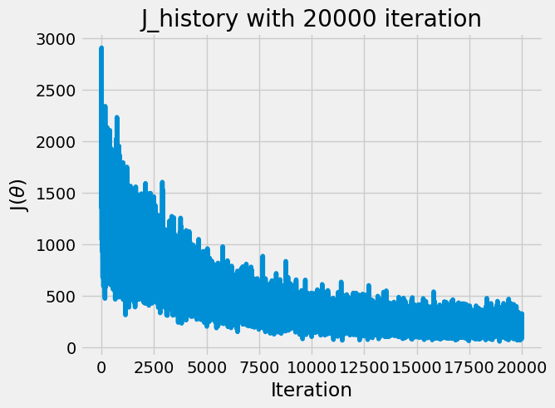
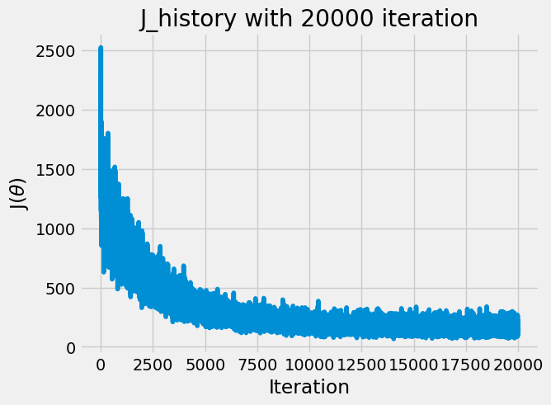
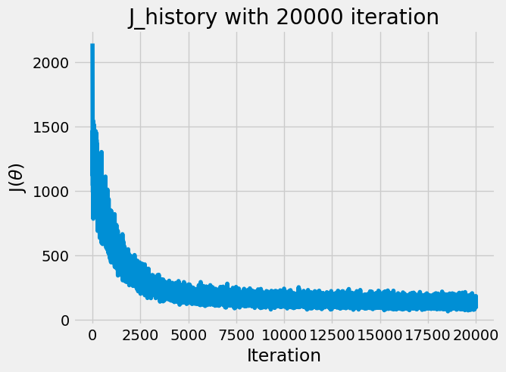
Batch Gradient Descent
In batch gradient descent, rather than a single data-points some fix k data-points are used in order to yield the gradient descent coefficients for linear regression
Batch gradient descent is performed on k = 32, 64, 128
The time taken for these experiments range around 3-4 sec
In all these 3 experiments, the algorithm converged successfully
k = 32
k = 64
k = 128

Slide 6
Analysis
Impact of k?
As the value of k is increased, the optimisation convergence becomes much more likely and the cost function graph gets smoothened, thereby reducing the cost noise
There is also increase in time taken for the same number of iterations as k increases
K = 128; 4.03 sec
K = 64; 3.69 sec
K = 32; 3.56 sec
K = 1; 3.47 sec
Also another point to note is that it takes less number of iterations for the algorithm to converge as the value k increases
When to stop the optimization process?
Optimization process can be stopped when there is no significant decrease in the loss function, for this a tolerance variable can be defined
Effect of L2 regularisation?
With L2 regularisation, the loss function is transformed in such a way that the coefficients have a penalizing effect. So, the coefficients tends to be small and thus overfitting is reduced
Also, when taking the gradient to the update of weight, because of L2 regularisation there will be a term -2*lambda*theta in the partial differentiation of the loss function. Because of this, with L2 the convergence can be fast in some cases

Slide 7
Suggestions for Improvements
We can add random starting points, play with the learning rate in case the algorithm is unable to converge or is getting fixated to a local minima
Momentum based techniques can be applied for faster convergence by taking a fraction of the previous update in the current state of update. Also, exponentially weighted average of the gradients can be used to find the minima faster
There are also some second order methods which take the second derivative of the cost function, which helps in the algorithm convergence
Also algorithms like RMSprop, Adam Optimization can be applied

