Slide 1
Gate-Crashers
Predicting moving gates with a Kalman filter and flying through them with a min-jerk quadrotor planner
Ankita Mehta
B.Tech Robotics & Automation, SIT Pune | Motion Planning & Control (TE7864)
Notes:
Software-only simulation. Everything shown is reproduced by run_all.py.

Slide 2
The problem: fly through gates that move
A quadrotor must pass through a gate that slides sideways like a sine wave (±1 m, 6 s period)
The camera gives only noisy POSITION (5 cm std) - no velocity
Success = at the crossing instant, the drone is within 0.3 m of the gate's true centre
Then repeat for 3 gates in a row
±1 m
gate slide
5 cm
sensor noise
0.3 m
success radius

Slide 3
The pipeline: sense, estimate, plan, control
Sense
Estimate
Plan
Control
Fly
›
›
›
›
noisy gate position
(100 Hz)
Kalman filter:
position + velocity
min-jerk quintic to
predicted gate state
feedforward + PD
on tilt angles
linearised quadrotor
RK4
gate.py
kalman.py
planner.py
controller.py
dynamics.py
pipeline.py wires these together; the run scripts test them

Slide 4
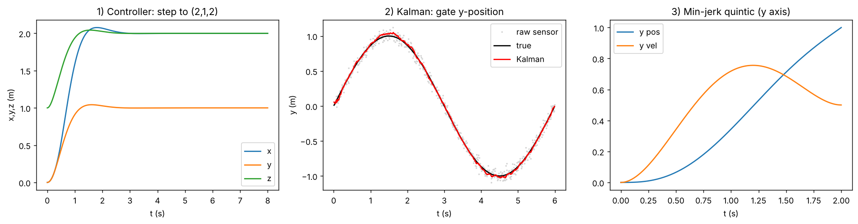
Model and controller
Hover-linearised quadrotor (small angles)
ẍ = g·θ ÿ = −g·φ z̈ = a_z
Feedforward + PD tracking
a = a_ref + Kp(p_ref−p) + Kd(v_ref−v)
Kp = 8, Kd = 4, tilt clipped to ±25°
Notes:
Left panel: controller step response (final error 0.0000 m). Feedforward removes lag on moving references; the clip keeps the linear model valid.

Slide 5
Kalman filter: estimating velocity
Constant-velocity model, 6 states, position-only measurement
Process noise Q = q·[dt³/3 dt²/2; dt²/2 dt] (white-noise acceleration)
Our first diagonal Q gave a velocity error 3.5x worse
Gate is really a sine, so q = 0.1 absorbs the model error
0.018 m
filtered position error (raw sensor 0.051 m)
0.15 m/s
velocity error, with no velocity sensor

Slide 6
Min-jerk trajectory: why a quintic
1
Minimise ∫ (x‴)² dt
Verified
All six boundary conditions match to 1e-9 at t = 0 and t = T
2
Euler-Lagrange gives x⁽⁶⁾(t) = 0
3
So x(t) is a 5th-order polynomial: 6 unknowns
4
6 boundary conditions (pos, vel, acc at t=0 and T)
5
c0, c1, c2 are trivial; c3..c5 come from a 3x3 linear solve

Slide 7
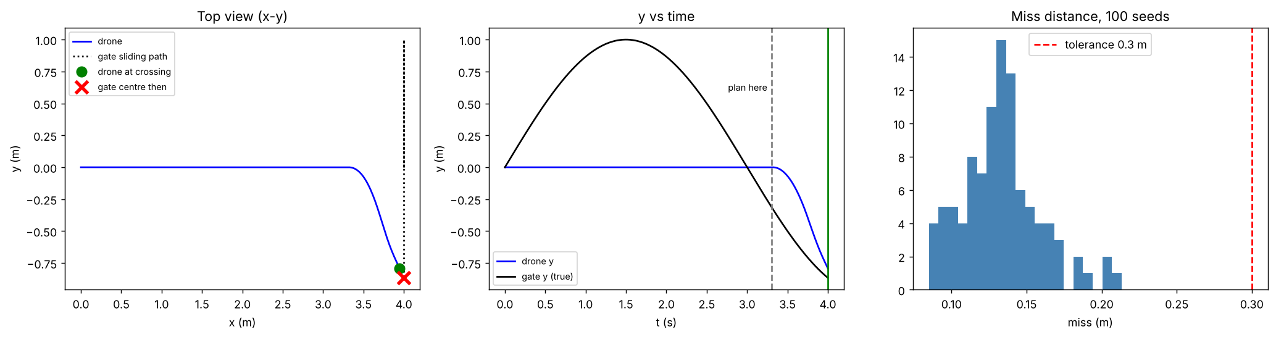
Strategy: cruise, then precision intercept
Cruise at 1 m/s for 3.3 s while the Kalman filter watches the gate
Then plan ONE quintic (0.7 s) to the gate's forecast state
Long-range prediction fails: constant velocity is valid only well under 1/4 of the period (0.7 s is 12%)

Slide 8
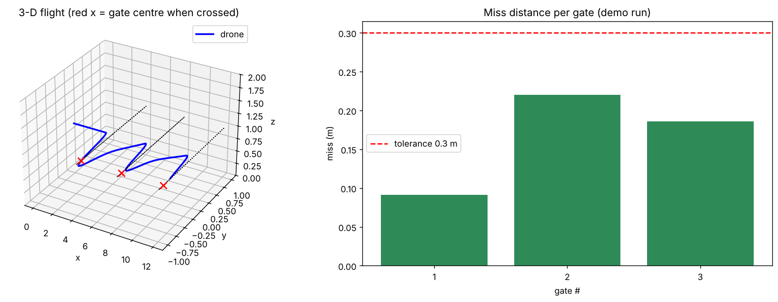
Results: 100% in the designed setup
100%
100%
0.13 m
single gate, 100 seeds
3-gate chain, 50 seeds
median miss (worst 0.21 m)
Gates are phase-synced: each is at the same point of its cycle when the drone arrives. Next slides show what happens without that help.

Slide 9
Is the prediction necessary? Yes
Same pipeline, three planners; only the gate information differs
At 1 m/s peak speed: 83% vs 25% vs 24%
Only on very slow gates do all three work
Filtering alone does not help; the velocity forecast is what matters

Slide 10
Honest limits
83%
with random gate phase (100% when phase-synced)
Why it fails
A constant-velocity forecast cannot see a sine reversing, so it is weakest when the gate turns around near the crossing. Slow gates fail for a different reason: up to 1 m of sideways travel in 0.7 s.
Next step
Fit a sinusoid (or a constant-acceleration filter) to forecast through reversals.
38%
when sensor noise is 20 cm (84% at 2 cm)
70%
at the fastest gate (1.6 m/s peak)

Slide 11
What went wrong, and how we fixed it
Problem | Symptom | Fix
Wrong Q matrix | velocity error 0.9 m/s | white-noise-acceleration Q: 0.25 m/s
Long prediction horizon | forecast through reversal | cruise, then 0.7 s intercept
Tilt saturation | above ~2 m/s | keep speeds near 1 m/s
Lateral offset carried over | chain collapsed | re-centre cruise on next gate
Leg time vs gate period | 3-gate success 0 to 3% | phase sync per gate
Quintic dipped backwards | x end-velocity ≈ 0 | force x velocity = cruise speed

Slide 12
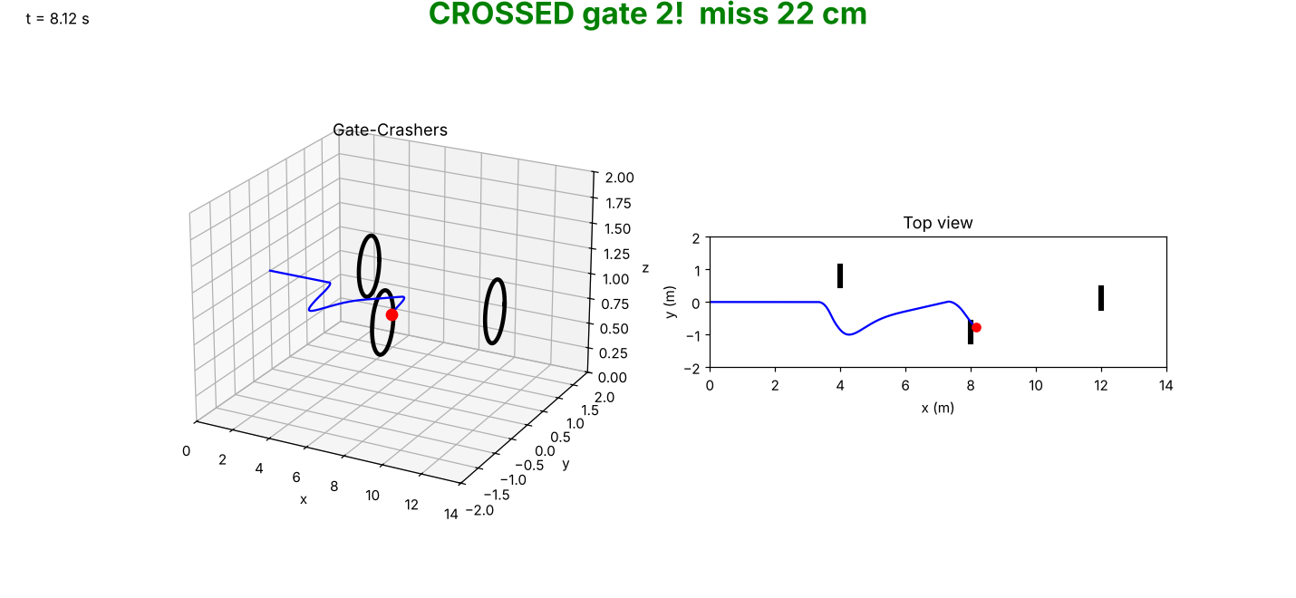
Demo and how to run it
python run_all.py
runs 5 steps (~5 min):
components, single gate, 3 gates, baselines, animation
Output: results/*.png and gate_crashers.mp4
Software-only: Python + NumPy + Matplotlib

