Slide 1
LSTM
Long Short Term Memory

Slide 2
Problem of Long-Term Dependencies
1) Sometimes, we only need to look at recent information to perform the present task.
Example-Language model trying to predict the next word based on the previous ones
Trying to predict the last word in “the clouds are in the sky,” we don’t need any further context – it’s pretty obvious the next word is going to be sky. In such cases, where the gap between the relevant information and the place that it’s needed is small,

Slide 3
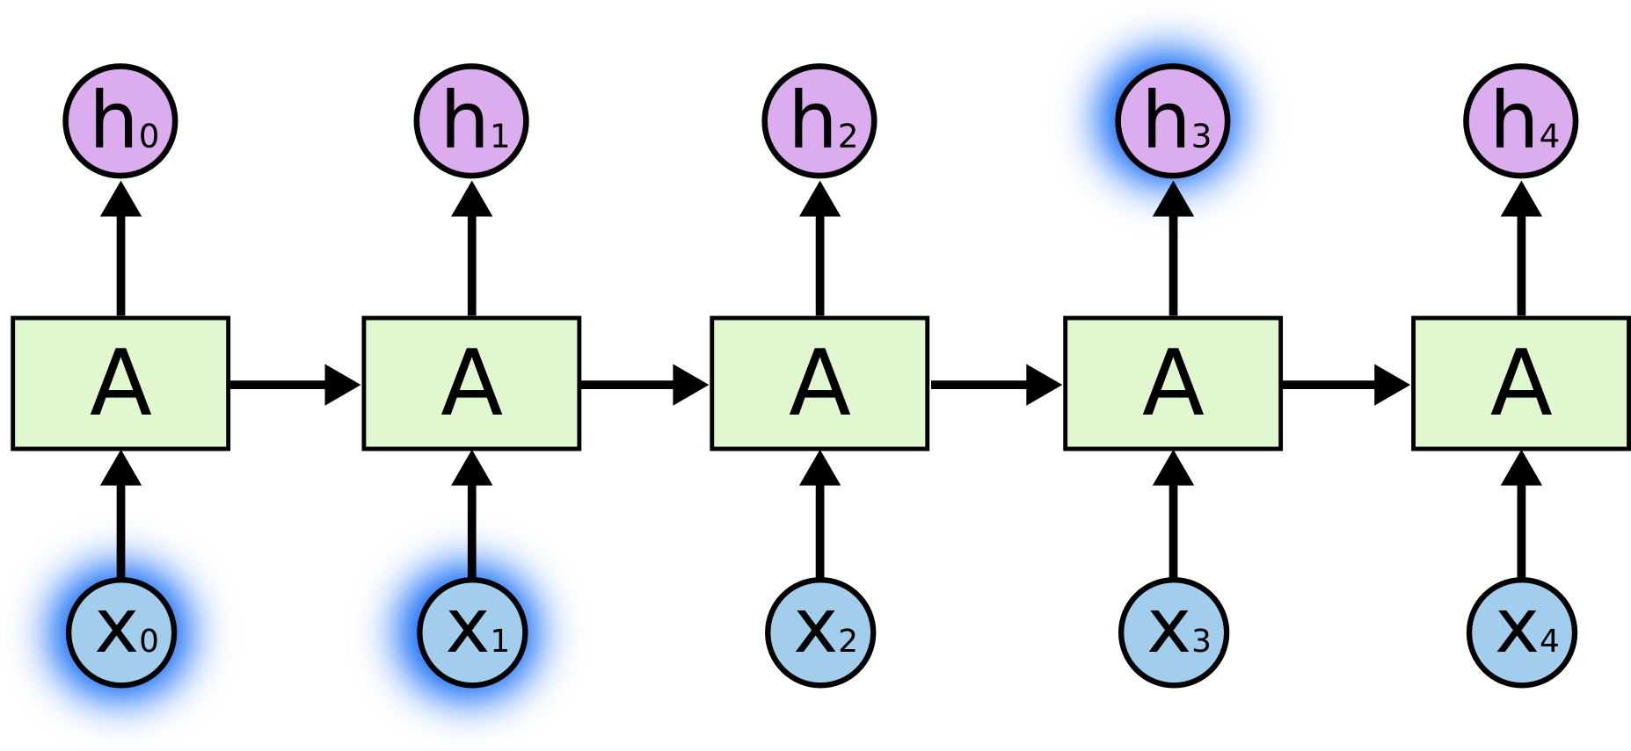
Problem of Long-Term Dependencies

Slide 4
Problem of Long-Term Dependencies
Here are also cases where we need more context. Consider trying to predict the last word in the text
“I grew up in India… I speak fluent Hindi”.
Recent information suggests that the next word is probably the name of a language, but if we want to narrow down which language, we need the context of France, from further back.
It’s entirely possible for the gap between the relevant information and the point where it is needed to become very large.

Slide 5
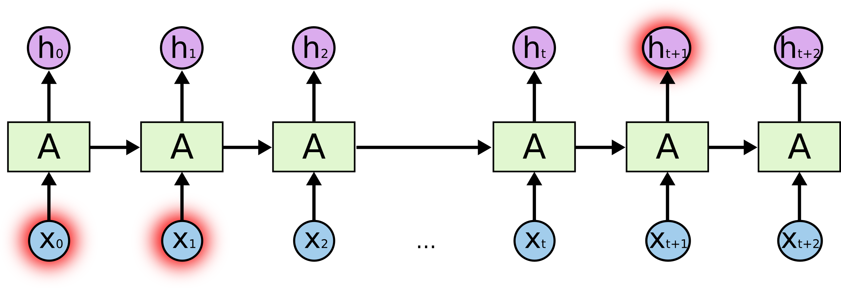

Slide 6
LSTM
They are a special kind of RNN, capable of learning long-term dependencies.
LSTMs are explicitly designed to avoid the long-term dependency problem.
Remembering information for long periods of time is practically their default behavior, not something they struggle to learn!

Slide 7
LSTM
All recurrent neural networks have the form of a chain of repeating modules of neural network.
In standard RNNs, this repeating module will have a very simple structure, such as a single tanh layer.

Slide 8
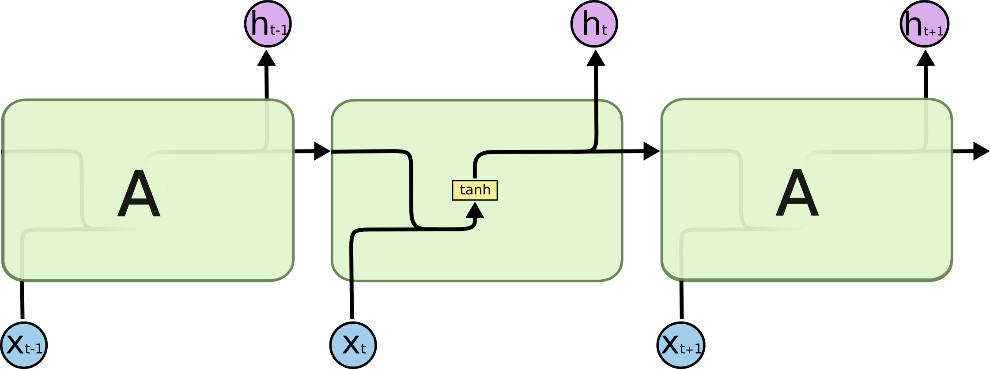
LSTM

Slide 9

LSTMs also have this chain like structure, but the repeating module has a different structure. Instead of having a single neural network layer, there are four, interacting in a very special way.

Slide 10
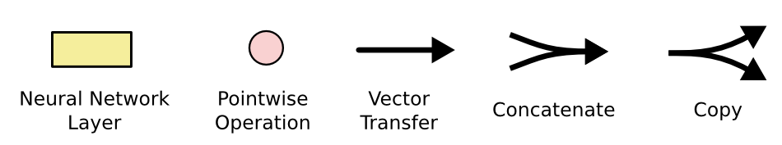
LSTM notation

Slide 11
Cell ,cell state & Hidden STATE
A typical LSTM network is comprised of different memory blocks called cells (the rectangles that we see in the image).
There are two states that are being transferred to the next cell; the cell state and the hidden state.
The memory blocks are responsible for remembering things and manipulations to this memory is done through three major mechanisms, called gates.

Slide 12
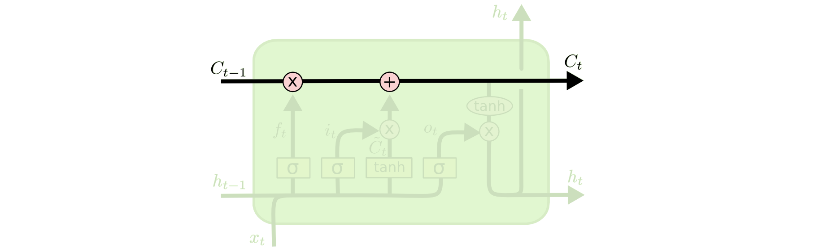
Idea Behind LSTMs
The key to LSTMs is the cell state, the horizontal line running through the top of the diagram.
The cell state is kind of like a conveyor belt. It runs straight down the entire chain, with only some minor linear interactions. It’s very easy for information to just flow along it unchanged.

Slide 13
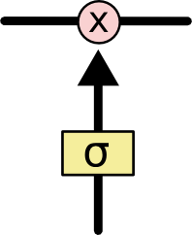
Gates
ability to remove or add information to the cell state, carefully regulated by structures called gates.
Gates are a way to optionally let information through. They are composed out of a
sigmoid neural net layer
pointwise multiplication operation.

Slide 14
Gates
The sigmoid layer outputs numbers between zero and one, describing how much of each component should be let through.
A value of zero means “let nothing through,” while a value of one means “let everything through!”
An LSTM has three of these gates, to protect and control the cell state.

Slide 15
Step-by-Step LSTM Walk Through
1)FORGET GATE
2)INPUT GATE
3)OUTPUT GATE

Slide 16
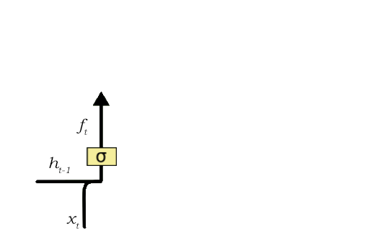
Forget gate
The first step in our LSTM is to decide what information we’re going to throw away from the cell state. This decision is made by a sigmoid layer called the “forget gate layer.
ht−1 and xt, and outputs a number between 0 and 1 for each number in the cell state Ct−1.
A 1 represents “completely keep this” while a 0 represents “completely get rid of this.”

Slide 17
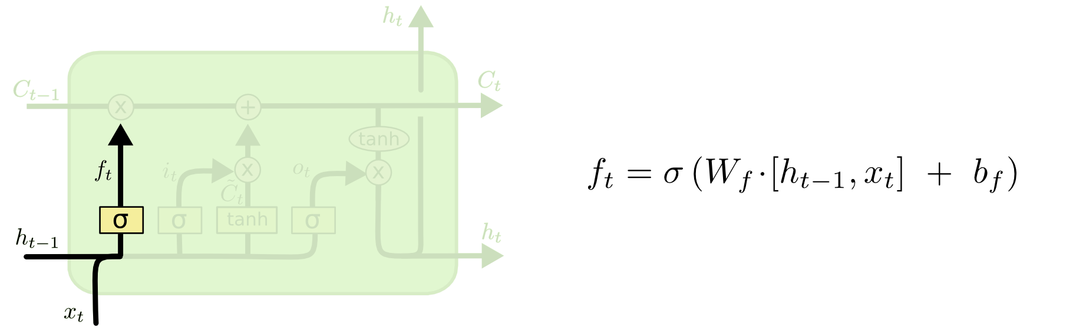
Forget gate
Sigmoid function is responsible for deciding which values to keep and which to discard.
If a ‘0’ is output for a particular value in the cell state, it means that the forget gate wants the cell state to forget that piece of information completely.
Similarly, a ‘1’ means that the forget gate wants to remember that entire piece of information. This vector output from the sigmoid function is multiplied to the cell state.

Slide 18

Forget gate Example
As soon as the first full stop after “person” is encountered, the forget gate realizes that there may be a change of context in the next sentence.
As a result of this, the subject of the sentence is forgotten and the place for the subject is vacated. And when we start speaking about “Dan” this position of the subject is allocated to “Dan”. This process of forgetting the subject is brought about by the forget gate.

Slide 19
Input gate
The next step is to decide what new information we’re going to store in the cell state. This has two parts.
First, a sigmoid layer called the “input gate layer” decides which values we’ll update.
Next, a tanh layer creates a vector of new candidate values, C~t, that could be added to the state.
In the next step, we’ll combine these two to create an update to the state.
The input gate is responsible for the addition of information to the cell state

Slide 20
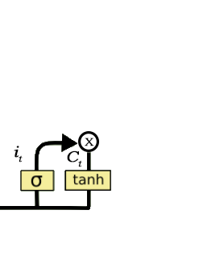
three-step process
Regulating what values need to be added to the cell state by involving a sigmoid function. This is basically very similar to the forget gate and acts as a filter for all the information from h_t-1 and x_t.
Creating a vector containing all possible values that can be added (as perceived from h_t-1 and x_t) to the cell state. This is done using the tanh function, which outputs values from -1 to +1.
Multiplying the value of the regulatory filter (the sigmoid gate) to the created vector (the tanh function) and then adding this useful information to the cell state via addition operation.

Slide 21
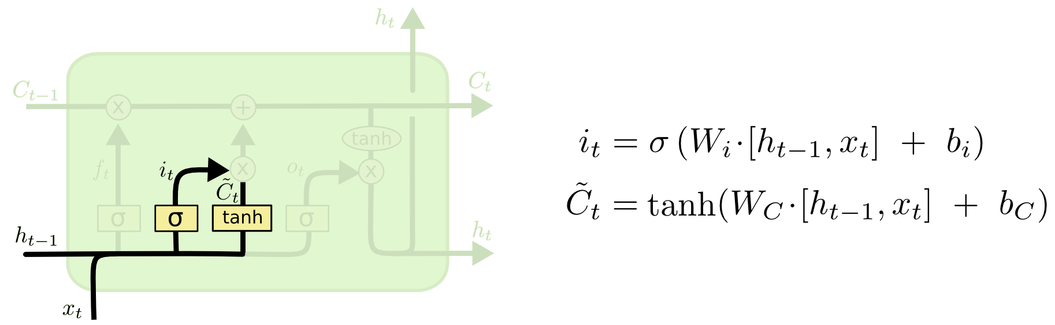
It’s now time to update the old cell state, Ct−1, into the new cell state Ct. The previous steps already decided what to do, we just need to actually do it.
We multiply the old state by ft, forgetting the things we decided to forget earlier. Then we add it∗C~t. This is the new candidate values, scaled by how much we decided to update each state value.

Slide 22
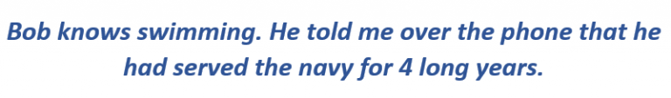
INPUT Gate example
Now the important information here is that “Bob” knows swimming and that he has served the Navy for four years. This can be added to the cell state,
However, the fact that he told all this over the phone is a less important fact and can be ignored.
This process of adding some new information can be done via the input gate.

Slide 23
Output gate
we need to decide what we’re going to output.
This output will be based on our cell state, but will be a filtered version.
First, we run a sigmoid layer which decides what parts of the cell state we’re going to output.
Then, we put the cell state through tanh (to push the values to be between −1 and 1) and multiply it by the output of the sigmoid gate, so that we only output the parts we decided to.

Slide 24
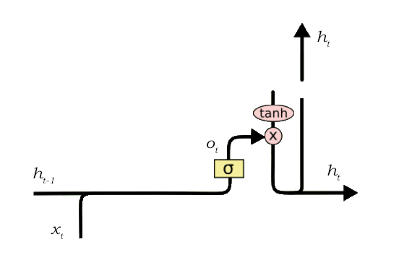
Output gate
Creating a vector after applying tanh function to the cell state, thereby scaling the values to the range -1 to +1.
Making a filter using the values of h_t-1 and x_t, such that it can regulate the values that need to be output from the vector created above. This filter again employs a sigmoid function.
Multiplying the value of this regulatory filter to the vector created in step 1, and sending it out as a output and also to the hidden state of the next cell.

Slide 25
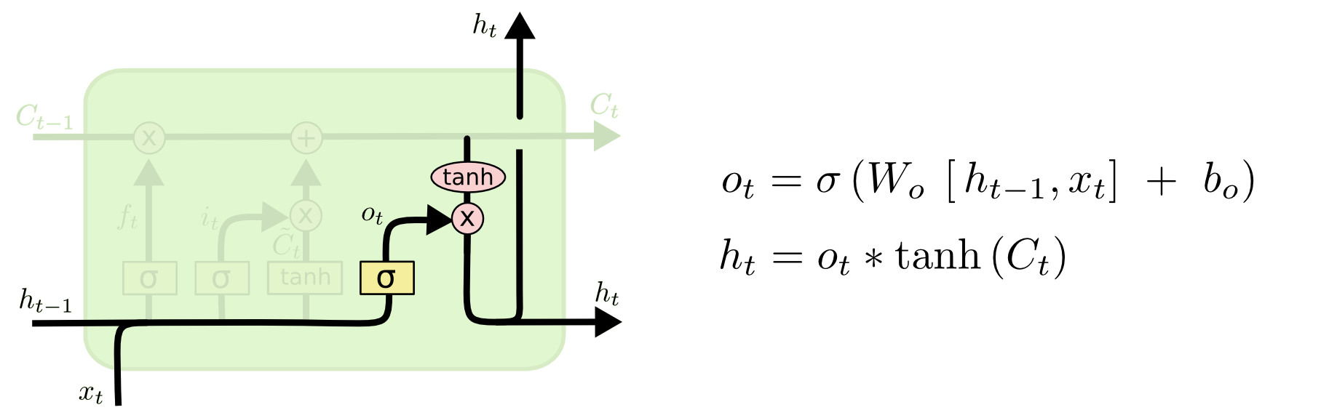
OUTPUT GATE

Slide 26
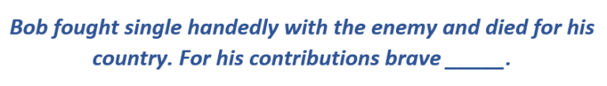
Output gate
In this phrase, there could be a number of options for the empty space. But we know that the current input of ‘brave’, is an adjective that is used to describe a noun.
Thus, whatever word follows, has a strong tendency of being a noun. And thus, Bob could be an apt output.
This job of selecting useful information from the current cell state and showing it out as an output is done via the output g

