Slide 1


Supervised Classification Techniques for Remotely Sensed Data
CE672 TERM PAPER PRESENTATION
INSTRUCTOR: PROF. ONKAR DIKSHIT
Presented by: Group 1
Aayush Sidana (220023)
Amipriya Anand (220122)
Hardik Gupta (220419)
Kumar Aditya (220592)

Slide 2

INTRODUCTION & MOTIVATION
Focus on supervised classification of hyperspectral remote sensing imagery.
Techniques: GML, Parallelepiped, Minimum Distance to Means, KNN, and SVM.
Dataset: Indian Pines hyperspectral imagery.
Key Terms: Image classification, training samples, thematic classes.
Project Aim: Implement and compare standard supervised classifiers and investigate the impact of feature extraction on classification accuracy for the Indian Pines dataset.

Slide 3
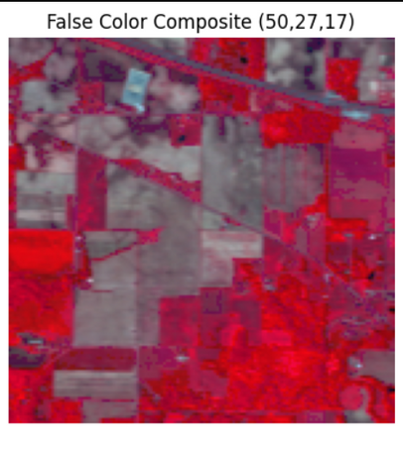
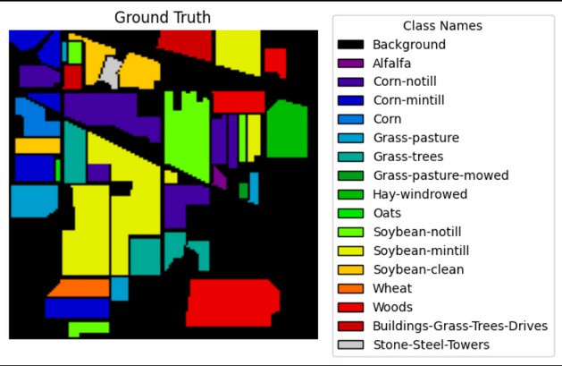
DATA USED & STUDY AREA
Dataset: Indian Pines (AVIRIS, 1992).
Location: Northwestern Indiana, USA.
Characteristics:
200 clean spectral bands (0.4-2.5 µm).
145x145 pixel image.
16 land cover classes.
Challenges: High-dimensional data,spectral similarity, mixed pixels.

Slide 4
METHODOLOGY
Loaded the dataset
Feature Extraction Approaches:
None (Raw Image)
PCA
RPNet
Raw Image (200 bands)
Principal Component Analysis (PCA)
RPNet Feature Extraction (using random patches) [Additional]
Classification Algorithms:
Applied to extracted feature spaces using classifiers.
Goal: Assign a class label to each pixel based on its features using models trained on labeled data

Slide 5


CLASSIFICATION ALGORITHMS USED
Minimum Distance to Means
Euclidean distance to the mean vector for each class.
Computationally efficient but ignores variances.
Parallelepiped
Rule-based method using min/max values for each band.
May result in overlaps or unclassified pixels.

Slide 6
CLASSIFICATION ALGORITHMS USED
Gaussian Maximum Likelihood (GML)
Assumes Gaussian distribution for class pixels.
Uses a priori probabilities to assign pixels.
Support Vector Machine (SVM)
Find the best hyperplane which can separate the feature space into distinct classes
Useful for high dimensional data
K-Nearest Neighbors (KNN)
Non-parametric method assigning the class of nearest neighbors.
Sensitive to K value and computationally intensive.

Slide 7

ACCURACY ASSESSMENT
Kappa Coefficient (κ)
Kappa = (Observed Accuracy - Expected Accuracy) / (1 - Expected Accuracy)
Average Accuracy (AA)
Average accuracy is mean of individual class accuracies
Overall Accuracy (OA)
OA = (Sum of Diagonal Elements) / Total Samples

Slide 8
FLOWCHART OF METHODOLOGY
Training and Testing
Preprocessing
Feature Extraction
Data Loading

Slide 9
FLOWCHART OF METHODOLOGY
Accuracy Assessment
Classification
Results

Slide 10
USING RAW SPECTRAL FEATURES
Approach: Used the original 200 spectral bands directly as features for classification.
Training/Testing: Split labeled data (80% Test, 20% Train, Stratified). Scaled using StandardScaler (fit on train).
Key Observations (Overall Accuracy - OA on Test Set):
SVM (RBF): ~83.5% (Best performer on raw data)
KNN (k=5): ~70.5%
Minimum Distance: ~42.2%
GML (QDA): ~39.4%
Parallelepiped: ~16.8% (Poor performance)
Conclusion: Standard classifiers (GML, MinDist, Parallelepiped) struggled. SVM and KNN better, but room for improvement exists. Low accuracy motivates exploring feature extraction

Slide 11
MOTIVATION FOR FEATURE EXTRACTION
Why Extract Features?
Reduce Dimensionality: Combat the "curse of dimensionality", reduce computational cost.
Remove Redundancy: Hyperspectral bands are often highly correlated.
Enhance Discriminability: Create new features that better separate classes.
Incorporate Spatial Context: Pixel labels often depend on neighboring pixels (not captured by raw spectral features alone).
Methods Explored:
Principal Component Analysis (PCA)
Random Patches Network (RPNet) - Spatial-Spectral

Slide 12
Feature Extraction Method 1: PCA
Concept: Transforms original correlated bands into a smaller set of uncorrelated Principal Components (PCs) that capture maximum variance.
Implementation: sklearn.decomposition.PCA
Experiment: Used first 4 Principal Components (based on variance vs. accuracy analysis in Project) Features were scaled post-PCA.
(Optional): Include plot showing variance explained vs. number of components.

Slide 13
Feature Extraction Method 2: RPNet
Concept: Unsupervised method to learn spatial-spectral features. Aims to capture local spatial context often missed by purely spectral methods.
Implementation Steps :
Initial PCA + Whitening on raw data (e.g., 4 components).
Iteratively:
Extract random patches (e.g., 20x20) from feature map.
Use patches as fixed filters in a Convolutional layer (torch).
Optional intermediate PCA between layers (L=3 layers used).
Concatenate features from all layers.
Combine: Concatenate derived RPNet features with original (scaled) spectral data.
Final Scaling (StandardScaler).

Slide 14
Results with PCA Features (n=4)
Approach: Classified using the first 4 Principal Components as features.
Key Observations (OA on Test Set):
GML (QDA): ~60.2% (Improved significantly vs. Raw)
SVM (RBF): ~68.8% (Decreased vs. Raw)
KNN (k=5): ~68.7% (Decreased vs. Raw)
Minimum Distance: ~39.9% (Slight Decrease)
Parallelepiped: ~3.8% (Decreased significantly)
Conclusion: Mixed results. PCA (n=4) helped GML but hindered the top performers (SVM, KNN) likely due to loss of some discriminative information in discarded components.

Slide 15
Results with RPNet Features
Approach: Classified using the combined spatial (RPNet) and spectral features.
Key Observations (OA on Test Set):
SVM (RBF): ~97.4% (Highest accuracy achieved!)
KNN (k=5): ~91.1% (Significant improvement)
Minimum Distance: ~57.6% (Improved vs. Raw/PCA)
Parallelepiped: ~52.1% (Vastly improved vs. Raw/PCA)
GML (QDA): ~40.9% (Similar to Raw, worse than PCA)
Conclusion: RPNet features dramatically improved performance for most classifiers, especially SVM and KNN. Highlights the importance of spatial context.

Slide 16
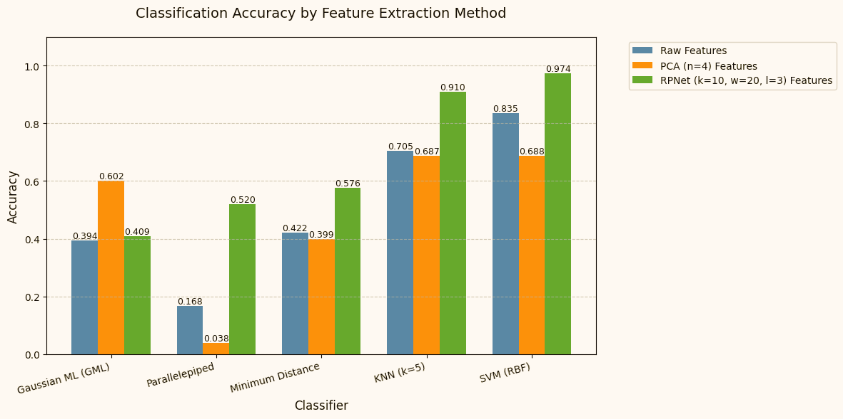
ANALYSIS & RESULTS
We can see that RPNet-
based features have given us the most accuracy. Also, the SVM classifier was found to be giving us the best performance

Slide 17
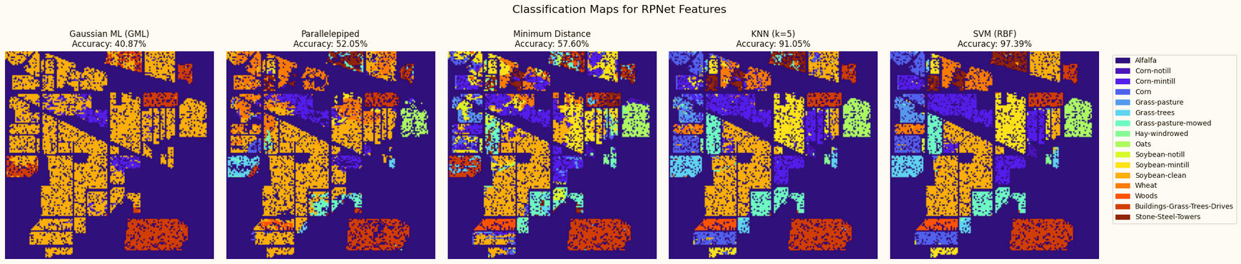
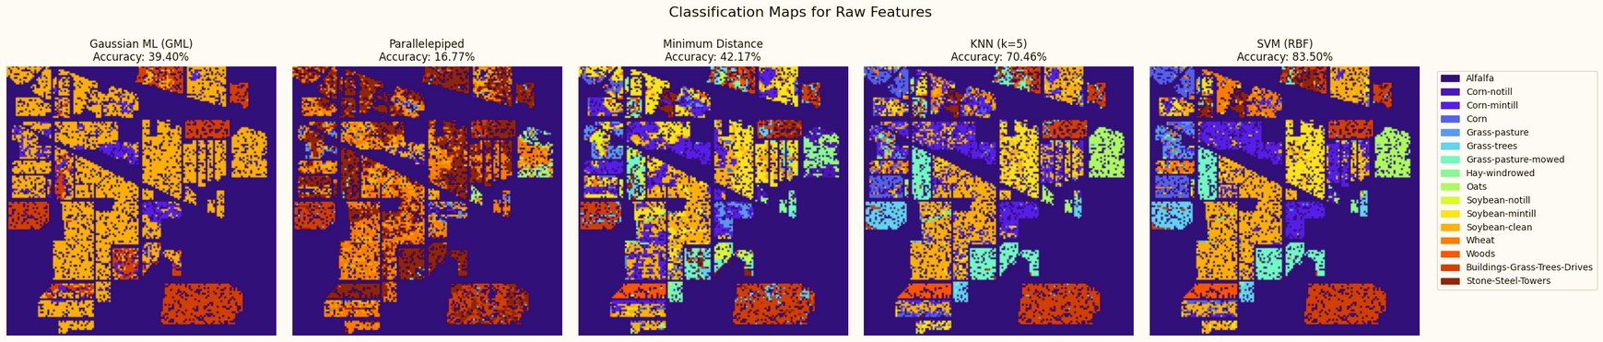
ANALYSIS & RESULTS
Some Classified Maps from our analysis

Slide 18
CONCLUSION
The study successfully applied supervised classification algorithms.
We achieved the best accuracy of nearly ~99.27% using the RPNet-based features and Gaussian Maximum Likelihood (QDA) as the classifier.
RPNet feature extraction proved the most effective in terms of accuracy.

Slide 19
CONCLUSION
Spatial Features may contain important pattern which may often get missed if we use only Spectral Features.
Future work can explore enhanced feature selection and advanced models.

Slide 20
THANK YOU
QUESTIONS?

