Slide 1


GIT Assignment On
Push and Pull
Submitted By : Aayush Srivastava

Slide 2


Contents
Introduction
My Work
Conclusion

Slide 3
Introduction
What is GIT?
Git is software for tracking changes in any set of files, usually used for coordinating work among programmers collaboratively developing source code during software development. Its goals include speed, data integrity, and support for distributed, non-linear workflows.
Git thinks of its data more like a series of snapshots of a miniature file system. With Git, every time you commit, or save the state of your project, Git basically takes a picture of what all your files look like at that moment and stores a reference to that snapshot, to be efficient.

Slide 4
My Work
Creating a file and new repository.
Committing to the new repository.
Pushing and pulling file to and from remote repository.

Slide 5
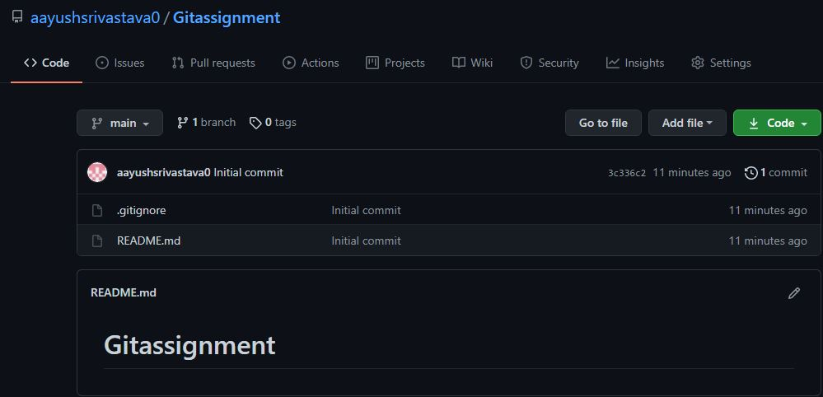
My Work
Creating a new repository

Slide 6
My Work
What is git commit
The git commit command captures a snapshot of the project's currently staged changes. Committed snapshots can be thought of as “safe” versions of a project. Git will never change them unless you explicitly ask it to.
The command is : git commit –m ‘commit message’ Before committing make sure to add the file using ‘git add .’ command and make sure the changes that you have made are executable, and don’t forget to write a good commit message.

Slide 7
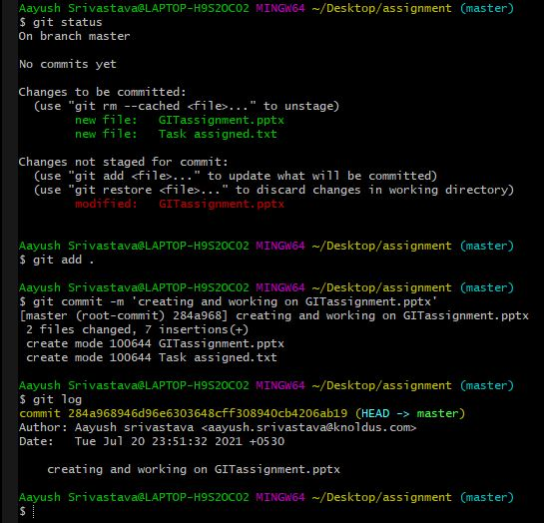
My Work
Git commit

Slide 8
My Work
What is git push
The git push command is used to upload local repository contents to a remote repository. Pushing is how you transfer commits from your local repository to a remote repository. It’s the counterpart to git fetch.
The command is : git push –u origin master

Slide 9
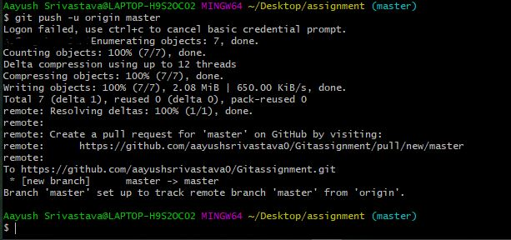
My Work
Git push

Slide 10
My Work
What is git pull
The git pull command is used to fetch and download content from a remote repository and immediately update the local repository to match that content. Merging remote upstream changes into your local repository is a common task in Git-based collaboration work flows. The git pull command is combination of two command git fetch followed by git merge.
The git pull command is : git pull
Commit your changes before pulling so that your commits are merged with the remote changes during the pull, and always clone the repository before making new changes.

Slide 11
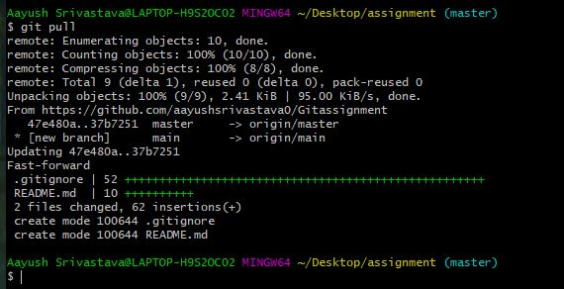
My Work
Git pull

Slide 12
Conclusion
Creation and committing to a new repository along with pushing files and pulling to and from a remote repository is successfully done. To access the remote repository use : https://github.com/aayushsrivastava0/Gitassignment.git .

Slide 13
Thank You

