Slide 1




MAJOR PROJECT MID-TERM PRESENTATION
Status: 100% Core Engine Verified
School of Computer Science • UPES Dehradun
Project Aegis: Unified ML-Driven Fraud Detection & Deceptive Honeypot
A Multi-Layer Fraud Prevention Platform for UPI and Card Payments Powered by Real-Time Telemetry CSV Pipelines, Behavioral Biometrics, and Active Deception.
PRESENTED BY
CORE TECH STACK
INTEGRATED DATASETS
Aayush Tripathi (590017378)
XGBoost • Flask REST APIs
4 Specialized Telemetry CSVs
Akhil Pundir (590016767) • Aryan Singh (590017232)
Haversine Physics • Levenshtein NLP • WebRTC
1.7ms Latency • Live Prototype Tested

Slide 2



01 / Introduction & Problem Context
Motivation, Vulnerabilities & Telemetry Inputs
System Overview
Technical Background & Problem
Structured Dataset & Telemetry Inputs
Instant UPI Settlement Pressure: Sub-second transactions leave zero room for post-facto chargeback retrieval.
honeypot_login_telemetry.csv: 2,000 synthetic rows tracking mouse entropy and typing dynamics.
Human Coercion Exploits: Scammers manipulate victims over calls into scanning gallery QR codes and entering valid PINs.
card_velocity_telemetry.csv: 2,000 rows calculating Haversine speed between POS coordinates.
Hard Decline Flaws: Rule-based hard declines immediately alert fraudsters, prompting rapid SIM and proxy rotation.
unified_transaction_risk.csv: 5,000 rows fusing call state, screen sharing, and VPA similarity.
Algorithms Deployed: XGBoost Classifiers, Haversine Spacetime Velocity, Levenshtein Distance, Shannon Path Entropy.
REST API: JSON Payloads

Slide 3





02 / Research Foundation
Literature Review & Strategic SWOT Analysis
Academic Context
Strengths
Weaknesses
Opportunities
Threats
• Proportionate response engine prevents blanket lockouts.
• Initial model trained on rule-labelled synthetic data.
• Exploding UPI transaction volumes in India (>14B/mo).
• Attacker adaptation with human-in-the-loop bots.
• Transparent feature importances.
• Novel scam vectors require rapid heuristic rules.
• RBI & NPCI mandates for real-time fraud mitigation.
• Spoofed device-state indicators.
• Sub-2ms low latency scoring via XGBoost.
• DPDP Act 2023 compliance restrictions on telemetry.
• Cold-start user profile constraints.
• Scalable API licensing to regional cooperative banks.
Cited Literature: Chen & Guestrin (2016), Levenshtein (1966), Sinnott (1984), Chawla et al. SMOTE (2002).
Inference: Tree ensembles fit tabular fraud

Slide 4
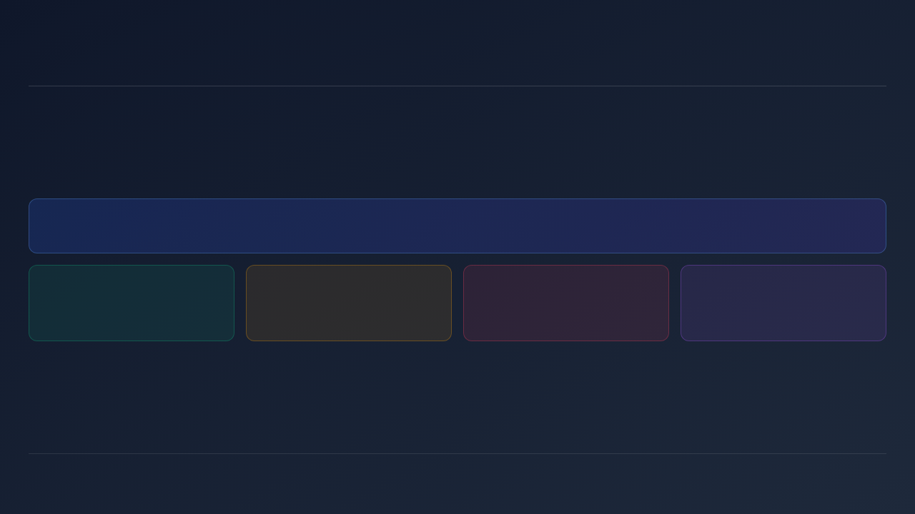
03 / Project Scope
Main Objectives & Four-Tier Decision Matrix
Core Goals
PRIMARY OBJECTIVE
Build a unified, explainable fraud detection platform that replaces hard-decline binary logic with proportionate, context-aware responses tailored to real-time risk.
APPROVE
FRICTION
BLOCK
HONEYPOT
P < 0.30
0.30 ≤ P ≤ 0.70
P > 0.70
Bot Trigger
Instant, frictionless settlement for genuine trusted users.
5-second mandatory countdown warning breaks social coercion.
Upstream API gateway rejection halts unauthorized payouts.
2,400ms PoW tarpit drains proxy resources & logs mules.
Sub-Objective 1: Train 3 XGBoost classifiers on structured telemetry CSVs.
Sub-Objective 2: Implement sub-15ms Haversine & Levenshtein engines.
Sub-Objective 3: Build ghost session honeypot with WebRTC forensics.

Slide 5

04 / Data Architecture
Core Datasets: Named Telemetry CSV Architecture
Project CSV Files
CSV File Name | Dataset Scale | Key Telemetry Feature Attributes | Target Label & Defense Function
honeypot_login_telemetry.csv | 2,000 Rows | failed_attempts, typing_speed_similarity, mouse_movement_entropy, is_new_device, vpn_data_center_flag | target_honeypot_action: Detects automated bot ingress & credential stuffers.
card_velocity_telemetry.csv | 2,000 Rows | time_delta_seconds, distance_miles, required_speed_mph, merchant_risk_score | is_card_fraud: Enforces Haversine spacetime physics (speed > 650 mph).
unified_transaction_risk.csv | 5,000 Rows | screen_sharing_active, upi_brand_similarity, is_collect_request, sender_spam_score, travel_speed_mph | is_fraud: Real-time XGBoost scoring of UPI interaction semantics.
honeypot_session_forensics.csv | Live Ledger | webrtc_reflexive_ip, dwell_time_seconds, target_beneficiary_vpa, attempted_amount, simulated_error_code | Forensic Intel: Traps attacker IP and blacklists destination mule accounts.
Supplemental Data Files: bot_telemetry_micro_samples.csv (millisecond flight times) & fraud_labels.csv (chargeback loop).
100% Traceable Pipeline

Slide 6







05 / Biometric Engineering
Behavioral Biometrics: Math & Sensor Execution
Passive Sensors
Mouse Path Entropy
Keystroke Flight Dynamics
Web Worker Optimization
Human movement contains physiological micro-tremors across directional bins. Automated scripts travel in strict linear vectors.
Monitors inter-key latency via performance.now(). Automated autofill scripts inject strings with 0ms flight time.
Telemetry calculation is decoupled from the main thread using circular ring buffers to maintain 60 FPS UI responsiveness.
T_Dwell = t_keyup - t_keydown
H(D) = -∑ p(bₖ) log₂ p(bₖ)
T_Flight = t_keydown(i) - t_keyup(i-1)
• Circular Ring Buffer (128 samples)
• Human: H = 2.40 to 3.80
• Script Bot: T_Flight ≤ 2.5 ms (0ms Injection)
• Zero-Copy postMessage transfers
• Bot: H < 0.60 (Collinear Vector)
• Web Worker isolated sandbox
• CPU Load: < 0.4% Main Thread
Client Privacy: Captures physics metadata only; raw passwords and sensitive inputs are never transmitted.
DPDP Act 2023 Compliant

Slide 7


06 / Methodology & Timeline
Incremental Prototype Model & Completion Status
Timeline: Sep - Oct 2026
Attained Deliverables (Done)
Pending Milestones (Next Sprint)
3 CSV Datasets: Generated and validated 9,000 synthetic rows across login, card, and UPI.
Signed Mobile SDK Signals: Hardware-backed cryptographic HMAC tagging of live camera QR optics.
3 XGBoost Models: Trained classifiers with SMOTE class rebalancing and hyperparameter tuning.
Gateway Shadow Integration: Production Envoy/Kong proxy configuration for transparent tarpit routing.
Mathematical Engines: Implemented Haversine velocity and Levenshtein VPA matching modules.
Mule Account Graph DB: Deploying Neo4j to track multi-hop money laundering velocity across nodes.
Working Prototype: 9 Flask REST APIs, 5 UI portals, Chrome Bot Extension & 100% test pass.
Production Hardening: Dockerized orchestration and ONNX model runtime acceleration.
Development Lifecycle: Analysis → Data Generation → Model Training → Engines → Flask API → UI & Honeypot → Testing.
SRS Completed

Slide 8



07 / System Implementation
Working Model: REST APIs & Microservices Architecture
9 REST Endpoints
SENSORS & UI
Frontend
FLASK API CORE
Backend
GHOST STATE
Redis Ephemeral
Client Telemetry Capture
Risk Scoring Engines
Honeypot & Forensics
Captures passive biometrics and submits JSON payloads via fetch() API.
Orchestrates three XGBoost models with sub-15ms algorithmic checks.
Isolates attackers in synthetic pods while capturing real IPs and mule accounts.
• Mouse entropy buffer
• POST /api/v1/auth/login
• Synthetic ledger balance (₹50k decoy)
• Keystroke flight times
• POST /api/v1/upi/evaluate
• 2,400ms PoW tarpit stall challenge
• Telephony call state
• POST /api/v1/card/verify
• WebRTC STUN IP capture (103.21.14.88)
• Virtual display flag
• POST /api/v1/test-bot-sample
• Traps mule wire: mule_sweep01@okaxis
Core Libraries: Flask, XGBoost, scikit-learn, NumPy, pandas, Gunicorn, csv, time, os, math.
Live Demo: /demo & Extension (8 Scenarios)

Slide 9


08 / Verification & Benchmark
Attack Scenario Benchmark & Model ROC-AUC
Empirical Results
Attack Test Scenario | Trigger Telemetry / Sensor | Evaluated P | Enforced Action | Target Defensive Outcome
1. Clean Genuine Payment | Normal biometrics, trusted device | 0.0002 | Approve | Zero friction settlement
2. Call + Gallery QR | AudioManager active, file stream | 0.6200 | Friction | 5-second warning modal
3. Collect + Active Call | Inbound pull request + live call | 0.9450 | Block | Halts coercive transfer
4. Screen Share + Call | AnyDesk virtual display hook | 0.9920 | Block | Blinds PIN keypad layer
5. Typo-Squatted VPA | Levenshtein similarity ≥ 0.75 | 0.8950 | Block | Flags brand impersonation
6. Impossible Travel | Haversine speed > 650 mph | 0.9840 | Block | Rejects physical spacetime break
7. Automated Bot Login | Mouse entropy < 0.6, 0ms flight | 0.9960 | Honeypot | 2,400ms PoW tarpit & mule capture
Approve
Friction
Block
Block
Block
Block
Honeypot
Login ROC-AUC
Card Physics ROC-AUC
Unified UPI ROC-AUC
Average Inference Latency
0.9995
1.0000
1.0000
1.7 ms

Slide 10

09 / Conclusion & Next Phase
Justification of Objectives & Future Scope
Ready for Q&A
Justification of Objectives
Future Scope & Production Hardening
All 8 Attack Scenarios Verified: Produced expected deterministic and proportional actions.
Mule Account Graph Intelligence: Deploying Neo4j to freeze multi-hop beneficiary laundering networks.
Unified Multi-Rail Pipeline: Evaluates login, card, and UPI risk within a sub-2ms latency envelope.
Signed Mobile SDK Signals: Hardware-backed cryptographic HMAC tagging of live camera QR optics.
Active Honeypot Tarpit: Stalls bot automation 2,400ms, extracting origin IPs & mule VPAs.
Continuous Feedback Loop: Ingesting bank dispute data into fraud_labels.csv for drift retraining.
Thank You! Questions, Feedback & Live Demo Demonstration.
Project Aegis • UPES Dehradun

