Slide 1
Neural Curator
Aayush Verma
https://github.com/aayushv001/wikiartGenreClassification

Slide 2
Challenge
Classify 81,444 Pieces of Art into 10 Categories using a custom CNN.
The Art is created by over 120 artists creating a Diverse and Variant Dataset.
The data can be found at https://huggingface.co/datasets/huggan/wikiart for more information.
The 10 Categories are :- Landscape, Portrait, Unknown Genre, Genre Painting, Sketch and Study, City Scape, Religious Painting, Illustration, Still Life and Other
This Task is a Multi-Class Classifcation on an imbalanced Dataset.

Slide 3
Modifications
Since this project had to be completed on an M1 Macbook pro and for the sake of time, the labels were downsampled to 5 out of 10 the original 10, dropping the minorities.
The Images were downsampled to 128X128 pixels because The Largest Images went up to 4K resolution.
The Final Labels Selected Were:- Genre Painting, Landscape, Portrait, Religious Painting, and Still Life.
Final Dataset Size was 2 GB with a total of over 44000 Images.

Slide 4
Basic Configuration
This Model was compiled with Adam and Nadam Optimizers, For my final Optimizer I have chosen Adam. Nadam introduced a degree of “Bouncing” around the minima that Adam did not. This may be fixed with a lower learning rate. Learning Rate for Adam was 0.0005
I have chosen accuracy as my primary metric for comparison with Sparse Cross-Entropy Loss as my Loss.
Each of My Model’s was run for 10 Epochs in one Run.

Slide 5

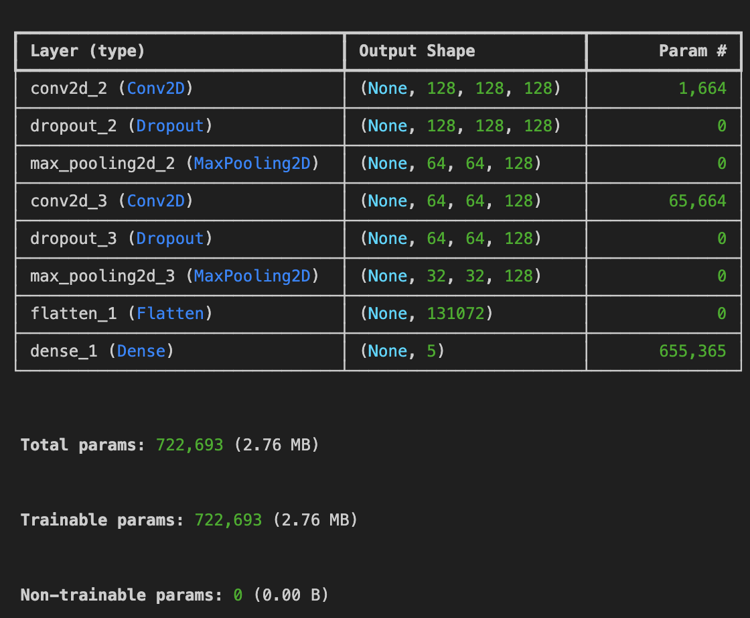
My First Shot
My First Architecture consisted of 2 Convolutional Layers of Size 128.
The Kernel Size selected was (2,2).
The Pooling Operation selected was Max Pooling.
Minimal Dropout was introduced.
Activation for convolutions was ReLU and Softmax For Dense.

Slide 6
Performance
The model instantly overfitted to the data in two epochs, reaching an accuracy of 75% on the training set.
The Validation Set Accuracy became stagnant at 32%.
The model was not Learning anything and One Epoch was 45 minutes long.
Some changes in architecture were needed.

Slide 7
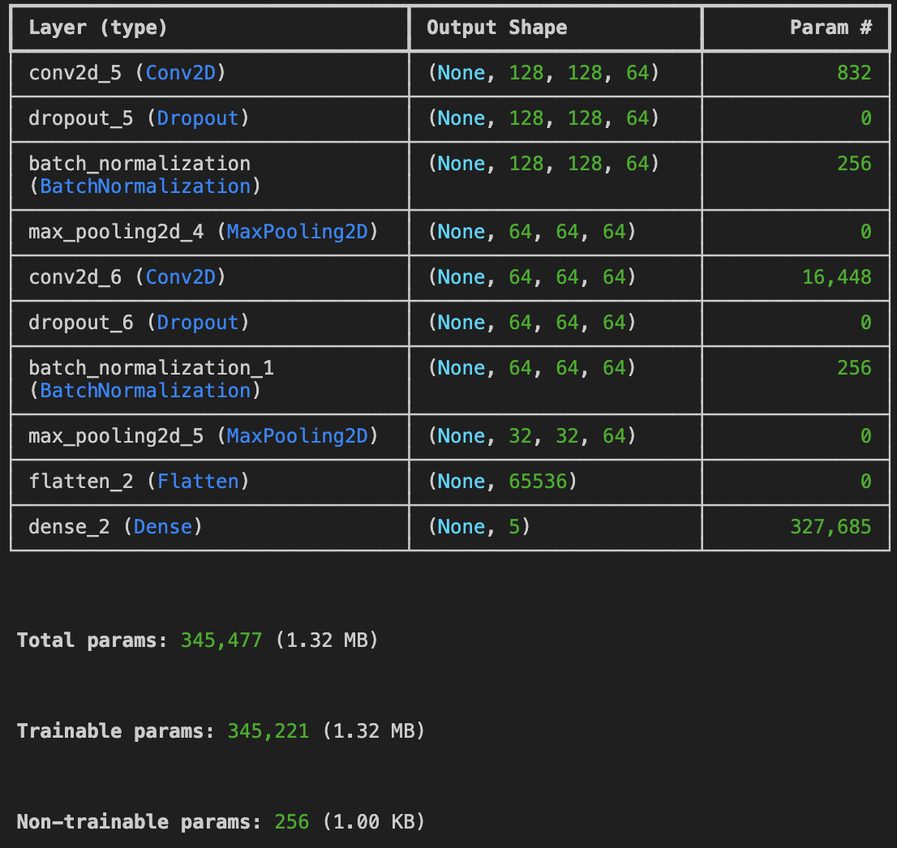
Scaling Down
For the Second architecture I halved the number of neurons to 64 but kept the number of layers constant.
Anticipating the huge training times I added A Batch Normalization Layer after every Convolution to increase convergence speed.
I also added a rescaling layer just before the first CNN to improve the quality of the gradient to improve convergence.
The Dropout was also increased to 0.5 as Geoffrey Hinton recommends!

Slide 8
Improvements?
The Changes Worked! Convergence became much speedier, with model converging to its maximum accuracy in 20 epochs.
The Epoch speed was also improved due to the Smaller model and the lesser number of parameters.
The increased Dropout with the Added Benefit of the BatchNormalization increased the Generalization performance and allowing the model to gain up to 43% Accuracy on the Validation and Test Sets.
All that being said, the model was still overfitting to a degree with the Training Accuracy going up to 60%.
Still not the Best, But on the right track.

Slide 9
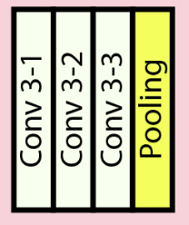
Adapting VGG-16’s consecutive layers.
VGG -16 employs consecutive convolution of 3X3 kernel size.
These 3X3 Convolutions all add up to a larger kernel size due to them being placed consecutively without a pooling operation in between. I.e 2 (3X3)’s is equivalent to a (5X5) and 3 (3X3)’s are equivalent to a (7X7).
The advantage this brings is in the total parameters of the model, for example a 5X5 kernel is 25 parameters but a 3X3 kernel is 18 parameters.
This Architecture will improve our use case of processing large amounts of data quickly.

Slide 10
Layer Weight Initializers and Regularizers
Layer Weight Initializers allow a starting point for the random weights to be optimized from instead of from a random distribution.
Layer Weight Initializers when used with the right activation function help the model converge faster also relieving vanishing gradients for sigmoids and Dying ReLU’s
I Used He Normal for ReLu activated Layers and Glorot Normal for Sigmoid Layers.
Kernel Regularizers add weight penalties to the layer’s weights pruning noisy features or decreasing their importance. Regularization is paramount to controlling Variance in our modelling and improving generalization.
I have employed L2 Regularization of the order 0.001 to achieve a good balance.

Slide 11
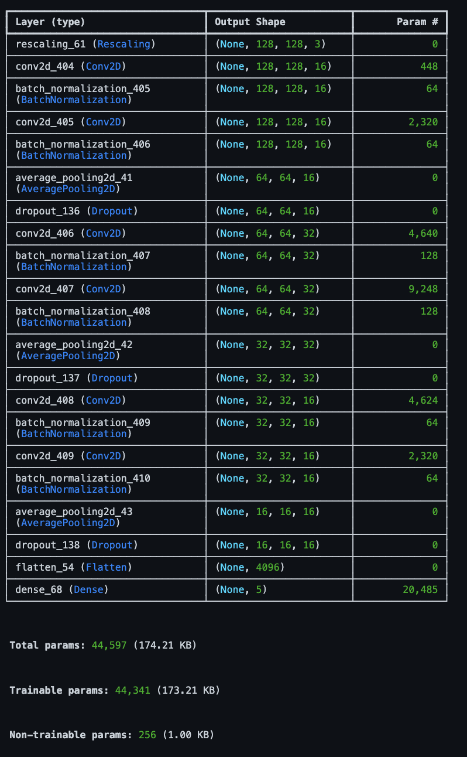
Final Model
For My Final Model I chose to add average pooling instead of max pooling, because of increased performance.
I also made a thinner but deeper network to aid my network in gaining more representations of the data. Deeper Networks seem to work better than Wider Networks.
I Also learned that BatchNormalization must be placed before the Dropout because Batchnormalization will learn to fight the covariate shift from the dropout layer during predictions on the test set when the dropout layer is inactive.
I used VGG-16’s Consecutive Layer strategy to create efficient 5X5 kernels.
All these optimizations created a Fast, Efficient, Generalizable and Proficient model.
The model achieved almost 60% Accuracy on the Test set with low Variance. There is Some amount of Bias in the model which may be removed with further optimizations and training.
I will now benchmark our model against other popular Convolutional Frameworks to gauge its performance.

Slide 12
Transfer Learning
I will now Fine-Tune other popular frameworks for Image Classification for our dataset to guage the performance of our purpose built model, Below are the models we will test against.
VGG-16
ResNet-50
InceptionV3
EfficientNetB0
EfficientNetB1
All Models were initialized with their ImageNet Weights and Average pooling Fed into a Single Dense Classification Layer.

Slide 13
Results
Name | Accuracy | Loss
CNN-1 | 32% | 1.87
CNN-2 | 43% | 1.54
CNN-3 | 58% | 1.12
VGG-16 | 57% | 1.04
ResNet-50 | 54% | 1.35
InceptionV3 | 60% | 1.13
EfficientNetB0 | 70% | 0.78
EfficientNetB1 | 69% | 0.77

Slide 14
Takeaways
Deeper Networks perform Better than Shallow but wider ones
Layer weight initializers are essential, they may change the entire loss curve of a training sequence.
Layer Regularizers are just as important as they were in regular machine Learning models.
Dropout is not the solution to overfitting alone.
Batchnormalization is imperative to convergence.
Learning Rate is important to set manually and not just use the defaults from keras.

Slide 15
Closing
This Project Documented my personal journey of building a cnn for the First time, there were a lot of new techniques I learnt and a many rule of thumb’s that I was doing wrong.
In the end I was able to beat VGG-16 and ResNet on this Dataset.
The best model for this dataset turned out to be EfficientNetB0 with 70% Accuracy and 0.78 loss. The model achieved this performance in only one Epoch i.e 12 minutes.

