Slide 1


Extend
The Moment
A brand campaign for outdoor heating.
Humour is the only unclaimed territory in this category.
44 CONCEPTS · 6 FILMS · 4 RECEIPTS · 4 PRICED SCENES · US + AUS
Notes:
Bromic keeps its promise — Extend The Moment. This campaign supplies the argument underneath it.

Slide 2
THE PROBLEM
Every ad in this category
is the same ad.
Golden hour. Infinity pool. Cashmere throw. Two glasses of wine nobody drinks.
Bought once
Considered slowly
Closed at a counter
One decision. One chance to be the name.
Months between the first thought and the quote.
A person recommends the brand they remember.
Humour is the only unclaimed territory here.

Slide 3
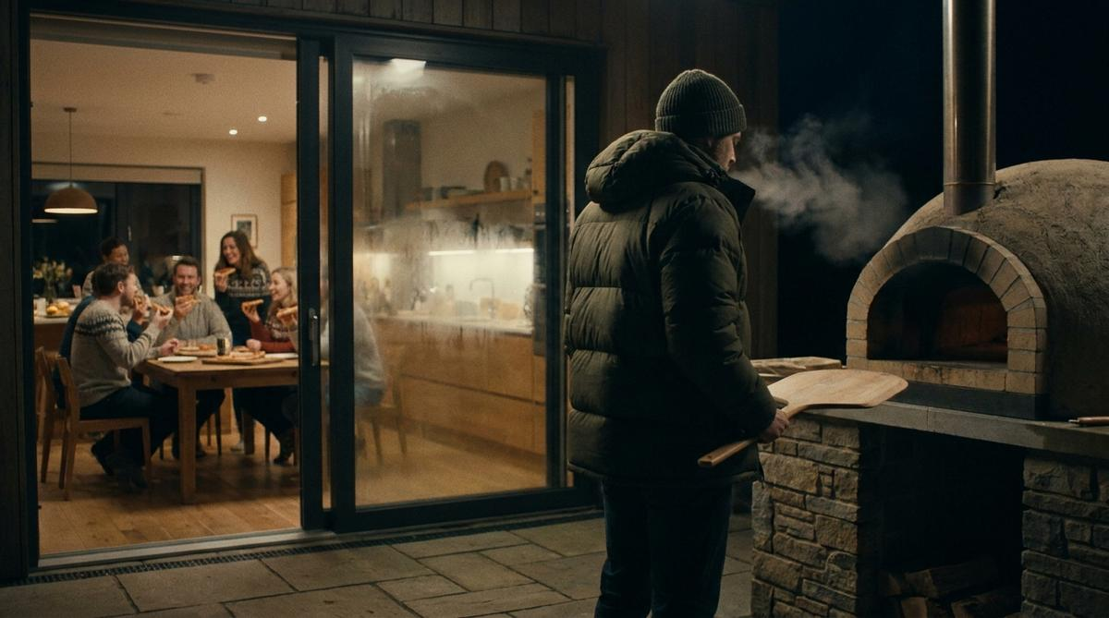
01
The films
Six plates. One shoot, both hemispheres. Cold misery held straight-faced for twenty-five seconds — then the heat comes on and the space fills.

Slide 4
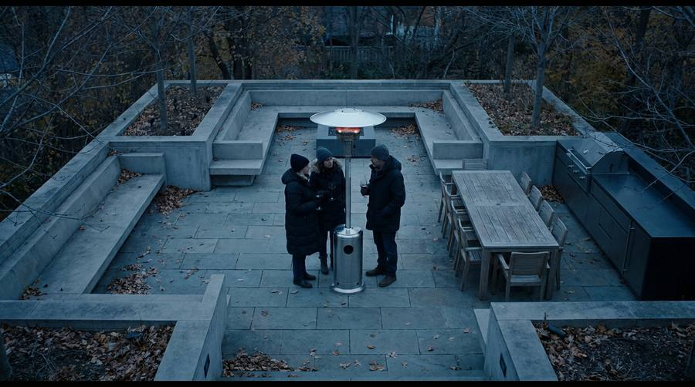
01 · THE MUSHROOM
BOTH · ASSET · :30 · REMODEL · FAME
Seventy thousand dollars of outdoor kitchen. Heated by an eighty-nine dollar mushroom.
A $70,000 alfresco build. Dead centre of it, one cheap mushroom heater standing like a traffic cone. Three adults pressed shoulder to shoulder inside its one-metre radius while the outdoor kitchen, the twelve-seat table and the built-in sofa sit empty around them.
Notes:
Best single concept in the bank — it does the price reframe and the gag in one frame. Bunnings in AUS, Home Depot in US: the object is identical and instantly readable in both.

Slide 5
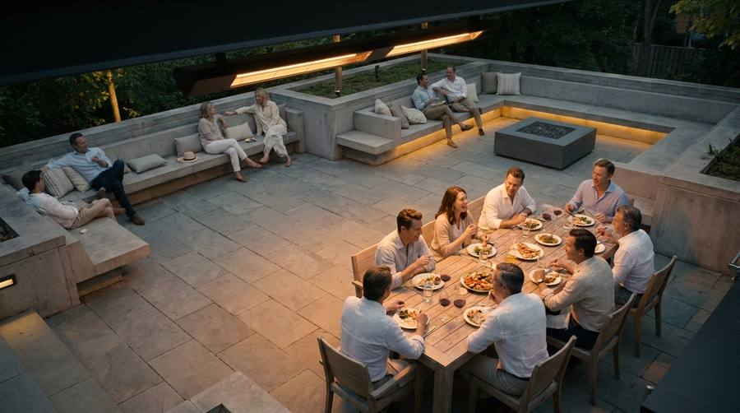
Extend The Moment.
01 · THE TURN

Slide 6
02 · THE PIZZA OVEN
BOTH · SUNKCOST · :30 · ADDON · FAME
Four times a year.
A $9,000 wood-fired oven. He fires it, tends it, peels the pizza — beautiful. Everyone takes a slice and goes inside. He stands alone in the dark in a puffer, holding the peel, beside the most expensive appliance he has ever bought.
Notes:
Pizza ovens are an epidemic in both markets. Painfully recognisable, zero cultural translation needed.

Slide 7
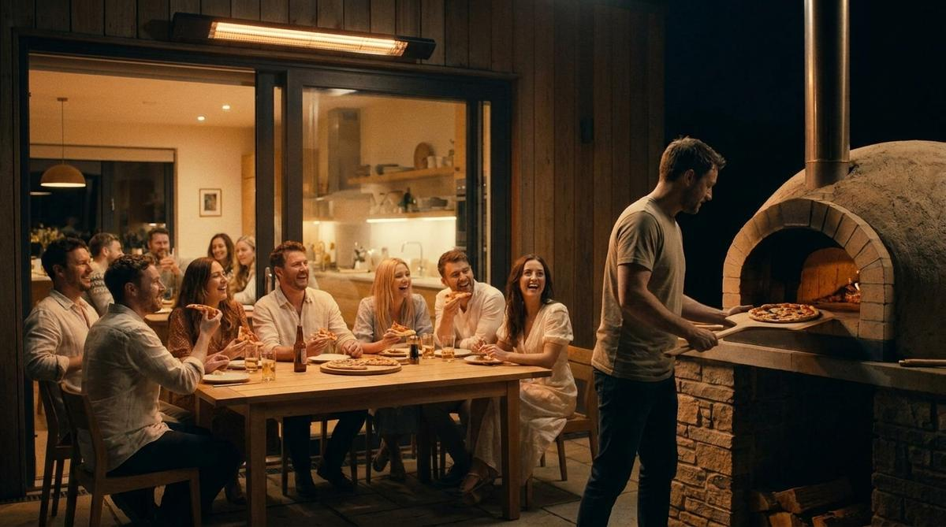
Extend The Moment.
02 · THE TURN

Slide 8
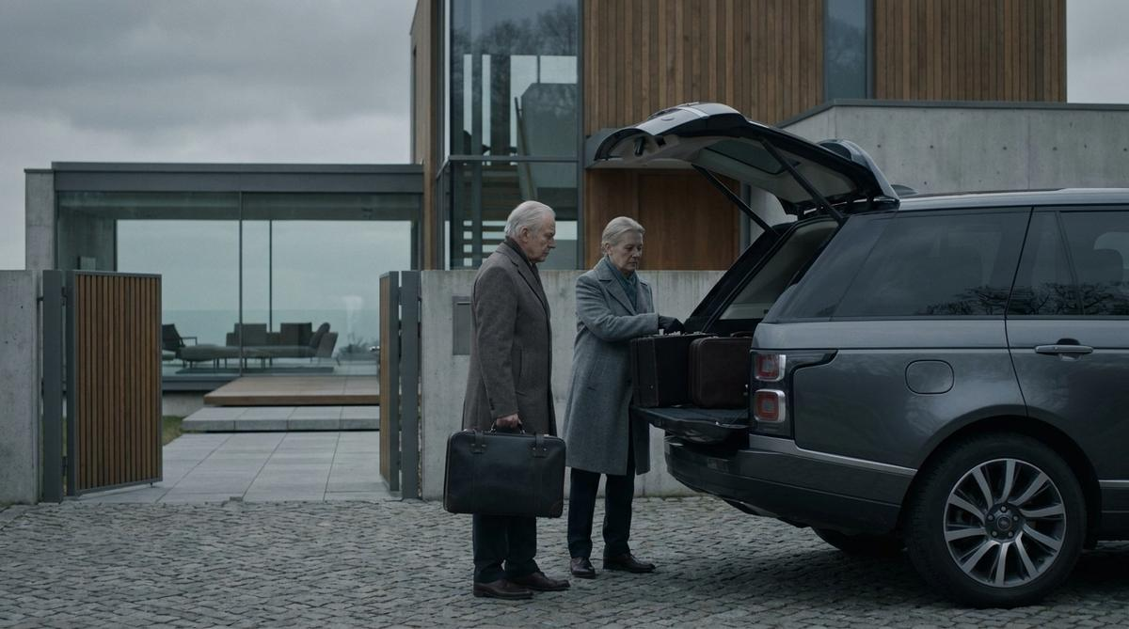
03 · THE SNOWBIRDS / THE QUEENSLAND RUN
TWIN · ASSET · :30 · REMODEL · FAME
The Wilsons solved their outdoor heating problem. It cost four hundred thousand dollars.
A retired couple's entire plan was the terrace. Instead, every year, they pack the car and drive five hours north for five months. Cut to the second property.
Notes:
Snowbirds in the US, the winter run to Queensland in AUS — same behaviour, same joke, swap the destination plate. The most extreme possible statement of the price reframe, and it lands hardest at the 55–70 end.

Slide 9
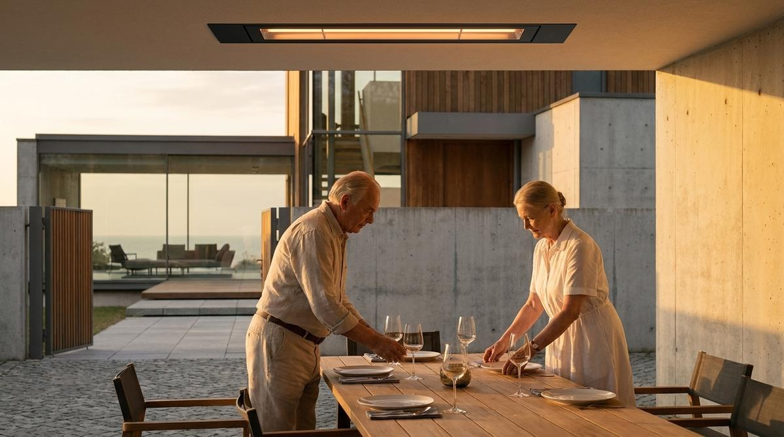
Extend The Moment.
03 · THE TURN

Slide 10
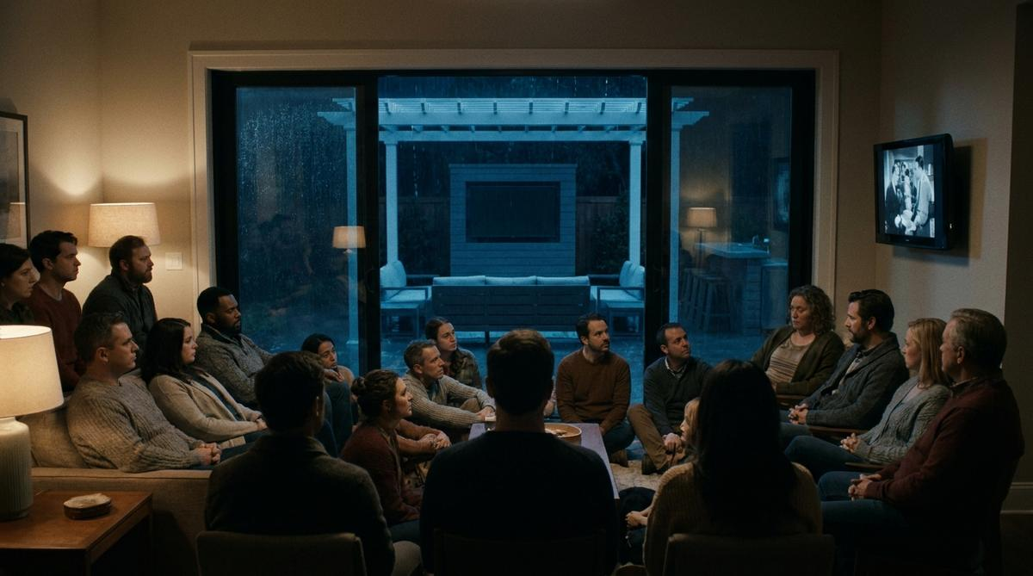
04 · THE BIG GAME / THE GRAND FINAL
TWIN · ASSET · :30 · ADDON · FAME
The outdoor TV cost six thousand dollars. Everyone is watching the small one.
Twenty-two people crammed into a living room around a modest screen. Push through the glass behind them to reveal the outdoor lounge, the bar and its own 85-inch television — dark, dry under the roof, completely empty.
Notes:
US: Super Bowl Sunday, February. AUS: the Grand Final, September. Identical shot, opposite hemisphere, opposite month — one film ships to both markets with a single supered date card.

Slide 11
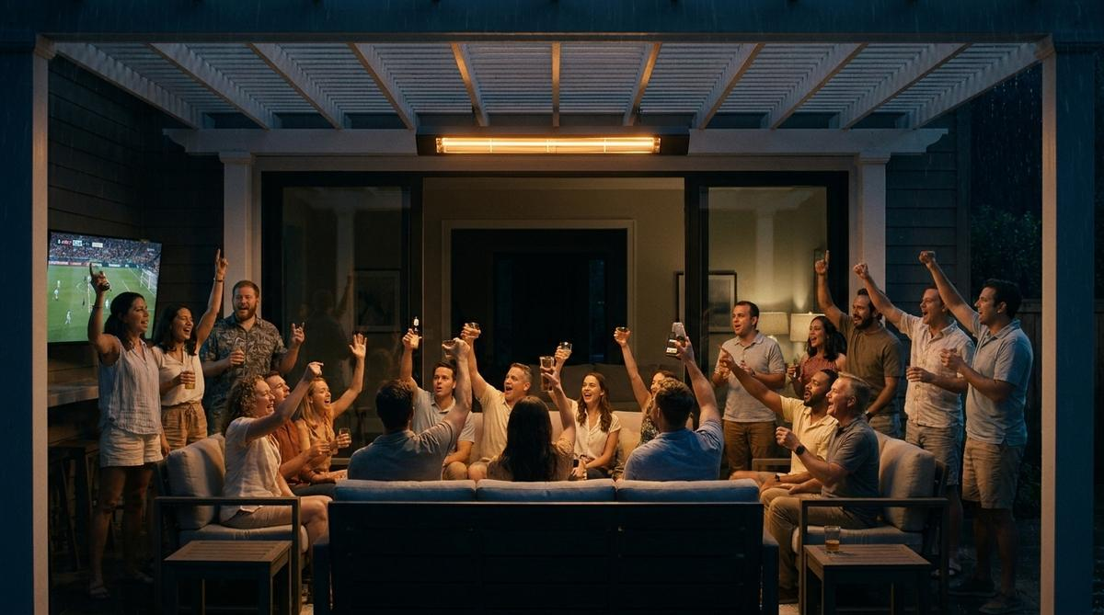
Extend The Moment.
04 · THE TURN

Slide 12
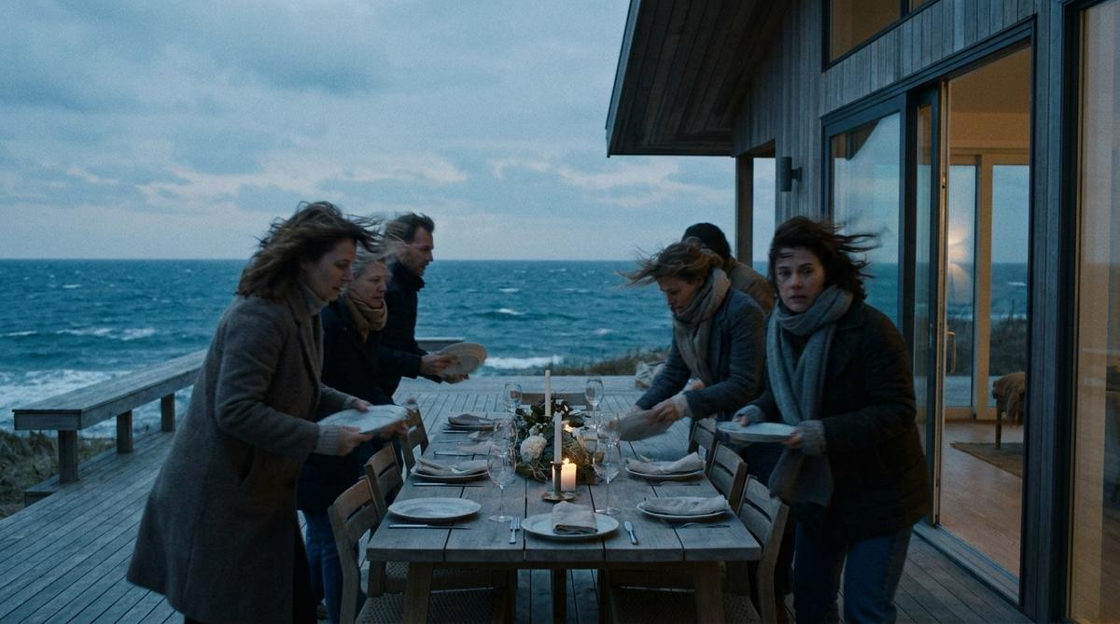
05 · THE COASTAL BREEZE
BOTH · ASSET · :30 · NEWBUILD · CONSIDER
Built for the view. Emptied by the breeze.
The beach house. Flawless. Every evening at five past five the wind arrives and the deck empties in under a minute — plates lifted, napkins gone, everyone in. Time-lapsed across a week until it becomes a rhythm.
Notes:
The only concept that dramatises Bromic's actual technical differentiator — wind-resistant infrared, which the main US competitor cannot answer at all. Byron and Mornington in AUS; Cape Cod, the Hamptons and coastal California in the US. Put this one in front of architects.

Slide 13
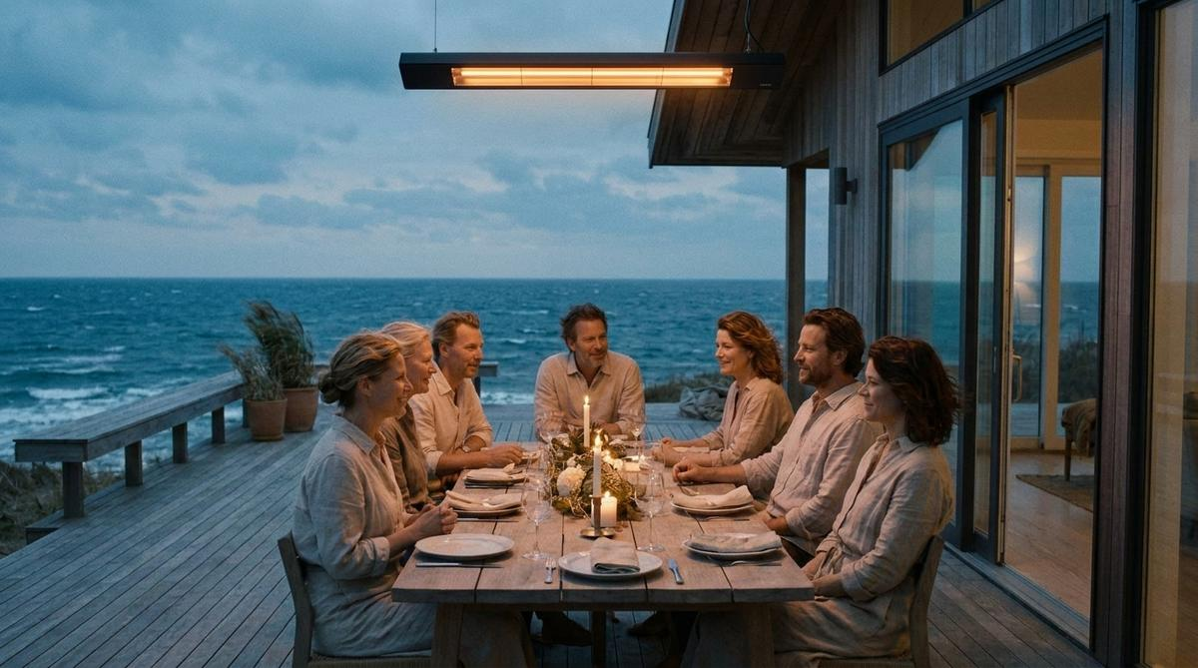
Extend The Moment.
05 · THE TURN

Slide 14
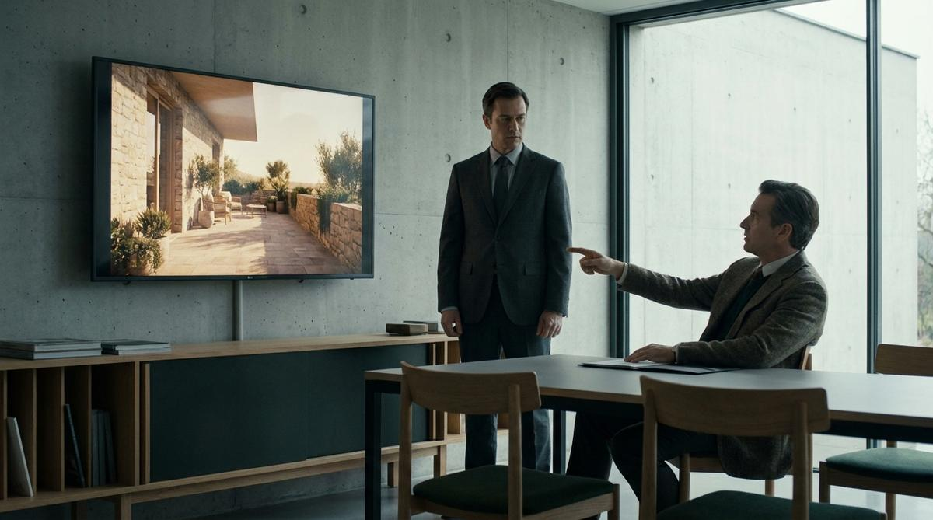
06 · THE SPECIFICATION
BOTH · ASSET · :30 · TRADE · CONSIDER
Specify the season. Not just the space.
An architect presents a gorgeous render — golden light, people, wine. The client studies it, then points. “And in November?” (AUS: “And in July?”) The architect opens their mouth. Nothing comes out. Hold on it.
Notes:
The trade-tier workhorse — LinkedIn, trade press, rep leave-behind. Keeps the endline and shifts the victim to the specifier's competence, the only currency that moves that audience.

Slide 15
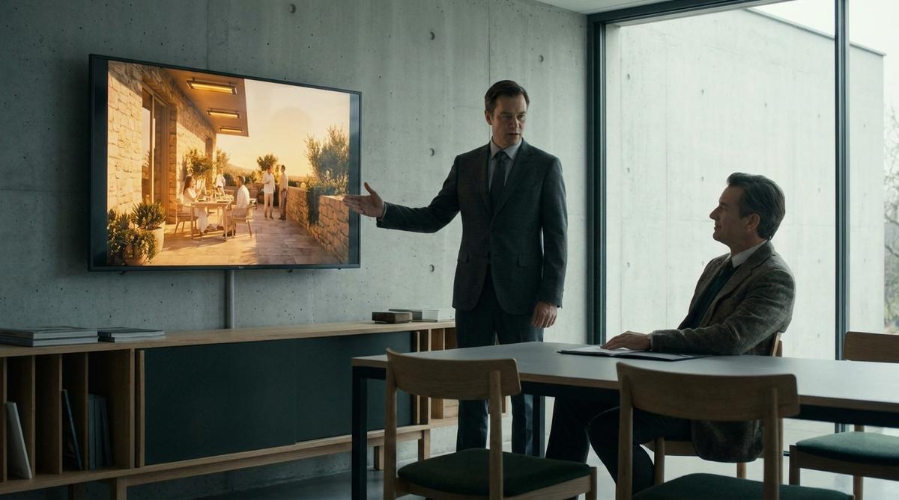
Extend The Moment.
06 · THE TURN

Slide 16
02
The Receipt
The same argument, stated as arithmetic. A stack of itemised prices — then the ending inverts, because the thing that unlocks the backyard is the cheapest line on the list.

Slide 17
CONSUMER · HOMEOWNER
The Backyard
Outdoor sofa and dining set
$11,400
Nobody has ever added up what their outdoor room cost and set it against the days they use it.
Pergola
$24,000
Outdoor kitchen
$41,000
Wood-fired oven
$9,000
Landscaping and lighting
$16,000
Total
$101,400
Being able to sit in any of it in October
$4,200
Extend The Moment.
Notes:
States the argument as arithmetic in the customer's own numbers. The heater is the smallest line on a list they wrote themselves.

Slide 18
TRADE · CUSTOM BUILDER
The Rough-In
Cedar-lined ceiling
$18,000
Retrofit is the most expensive way to add outdoor heat and the most common, because nobody ran the circuit.
Stone paving
$31,000
Integrated lighting
$7,200
Cutting all of it open later to run a circuit
$6,000
What that change order costs everyone
$6,000
Roughing it in at framing, before any of it exists
$400
Extend The Moment.
Notes:
Four hundred dollars at framing against six thousand after handover. It hands the builder a defensible upsell they can quote today.

Slide 19
COMMERCIAL · HOSPITALITY
The Covers
Terrace fit-out
$54,000
Every operator knows their cover count and revenue per cover to the dollar, and has never applied it to the terrace.
Furniture, planters and screens
$46,000
Forty covers, sold every night in February
$312,000 / yr
Forty covers, sold every night in May
$0
Revenue currently left on the terrace
$—
Making May sellable
$9,000
Extend The Moment.
Notes:
Capacity, not comfort. Forty covers times average spend times the nights you cannot currently sell them. The payback fits on one slide.

Slide 20
COMMERCIAL · PROCUREMENT
Buying It Twice
Patio heater
$89
Every venue has a storeroom of dead heaters and nobody has ever totalled it.
Patio heater, again
$89
Patio heater, again
$89
…and eleven more over ten years
$979
Gas, ten years
$4,100
Staff hours spent moving bottles
$18,000
Ten years of not solving it
$23,346
Solving it once
$9,000
Extend The Moment.
Notes:
Total cost of ownership — the argument that wins procurement. Ten years of disposable heaters costs more than installing permanent ones once.

Slide 21
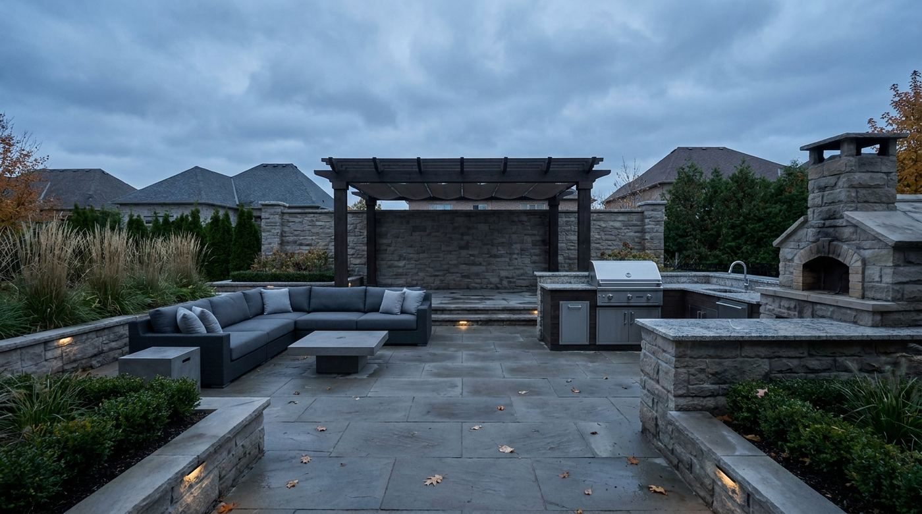
03
Priced scenes
The Receipt told as photography. Every object wears its price like a showroom tag — then the last tag lands on the only thing nobody costed, and it is the cheapest number on screen.

Slide 22
CONSUMER · HOMEOWNER
The Priced Backyard
Pergola
$24,000
Being able to use any of it in October
$4,200
Wood-fired oven
Planting + landscape lighting
$9,000
$16,000
Outdoor kitchen
$41,000
Sectional + coffee table
$11,400
Stone paving
$19,000
Every object in this photograph is priced except the one that decides whether the photograph ever has people in it.

Slide 23
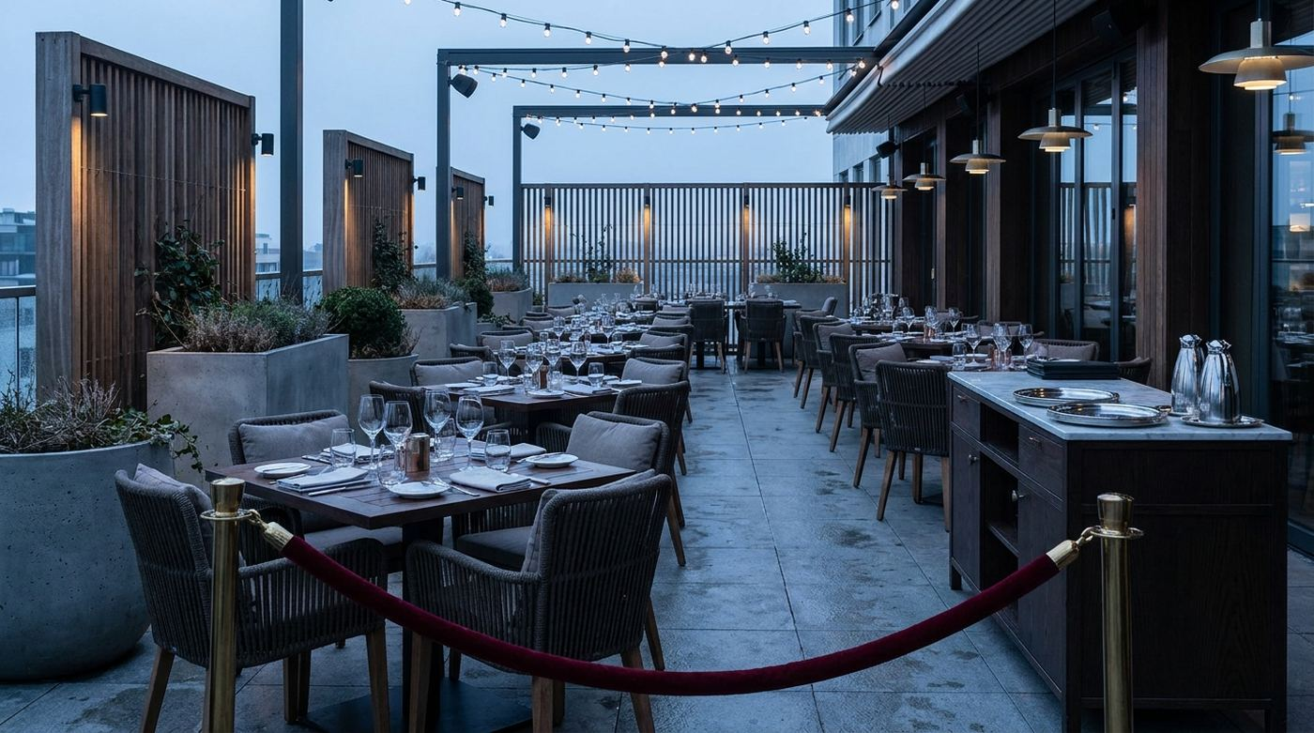
COMMERCIAL · HOSPITALITY
The Priced Terrace
Making those forty covers sellable in May
$9,000
Festoon + downlighting
$8,000
Planters + timber screens
$14,000
Tables, chairs, glassware
Service station + fit-out
$46,000
$54,000
Forty covers, roped off till spring
$0
The rope is the only line item that costs nothing and takes everything.

Slide 24
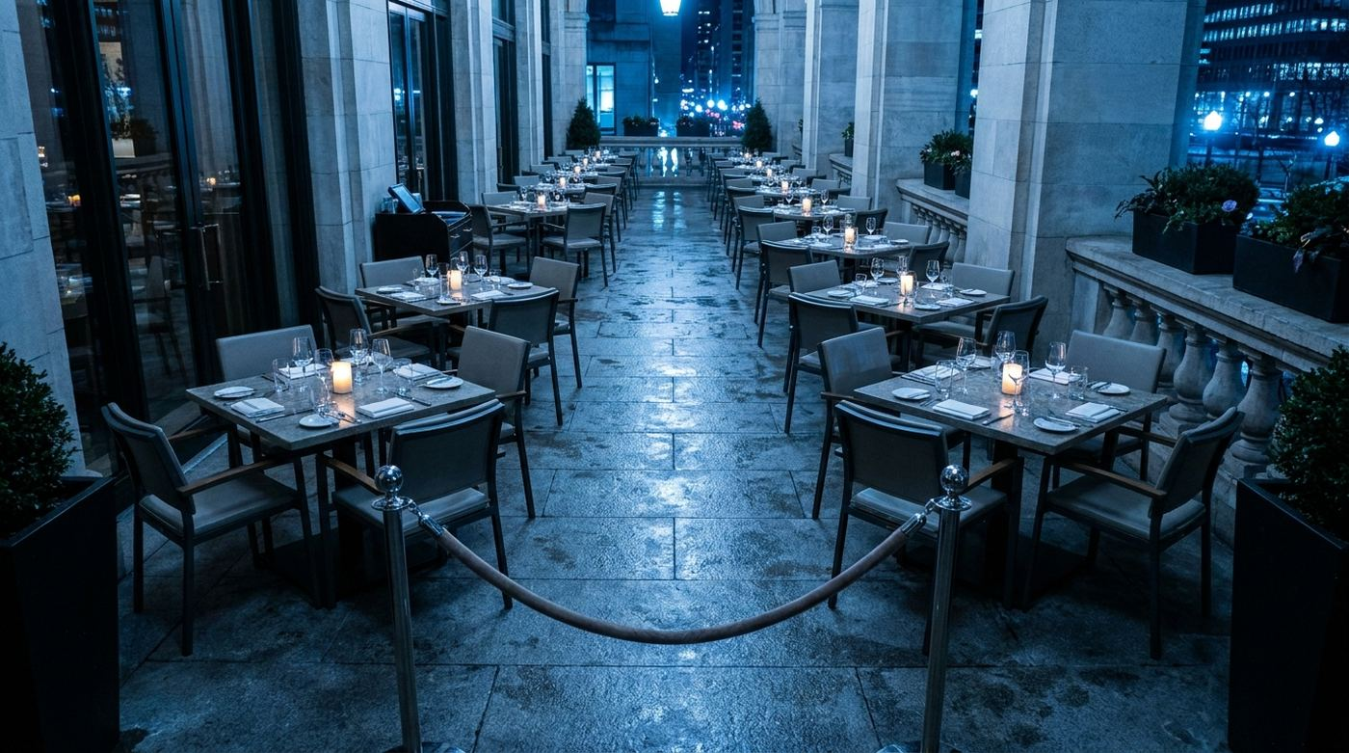
COMMERCIAL · HOSPITALITY
The Covers
Making those forty covers sellable in May
$9,000
4 covers
4 covers
$312
$312
The other 24 covers
$1,872
4 covers
4 covers
$312
$312
Roped off until spring
$0
Forty seats, priced at what one night of them earns. The rope is the only line item that costs nothing and takes everything.

Slide 25
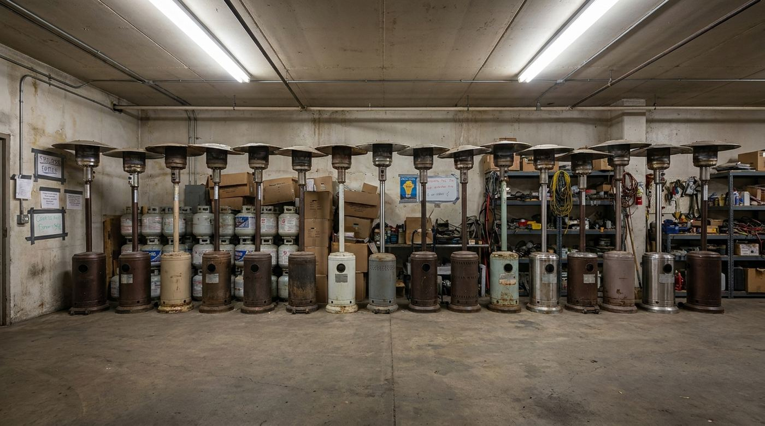
COMMERCIAL · PROCUREMENT
Buying It Twice
Solving it once
$9,000
Patio heater
Again
…and eleven more
$89
$89
$979
Again
Again
Gas + staff hours, ten years
$89
$89
$22,100
Nobody in this building has ever added up what is in this room. It took ten years and fifteen decisions to not solve one problem.

Slide 26
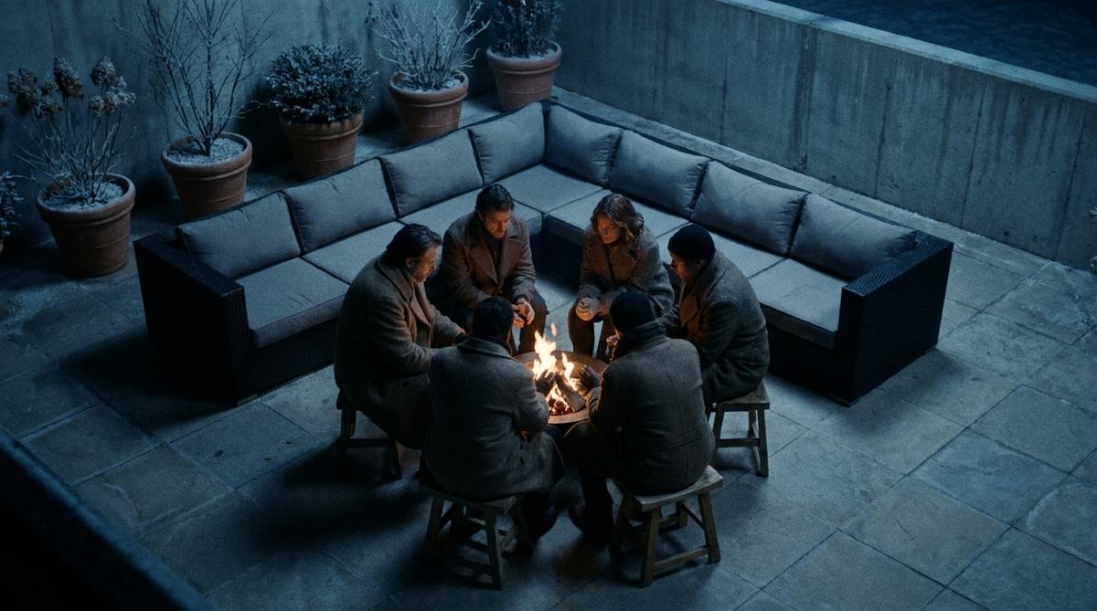
04
The concept bank
32 concepts for the US and Australia, plus 12 for builders, architects and commercial operators. Every one carries four registers — deadpan, dry, absurd and dark.

Slide 27
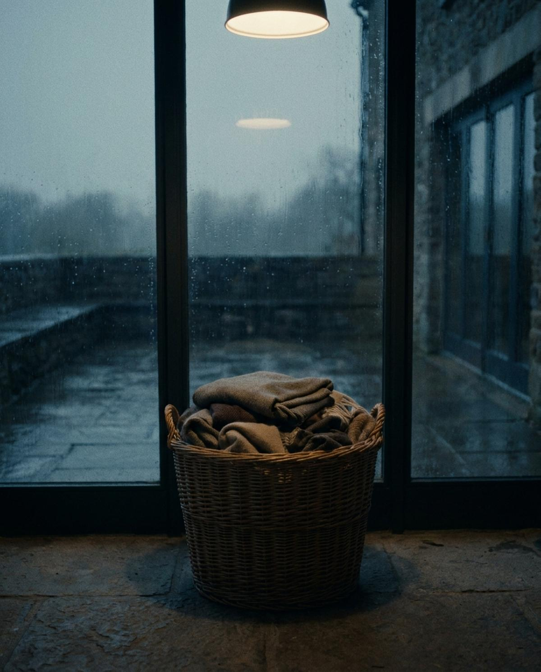
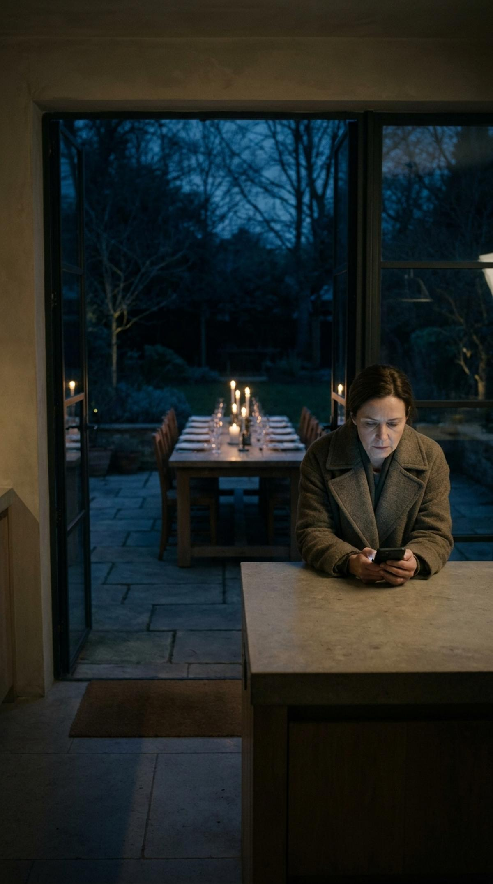

The wasted asset
Jokes only a premium, specified brand can tell
BOARD TO BE SHOT
01
The Mushroom
02
The Pizza Oven
03
The Snowbirds / The Queensland Run
04
The Reno Show Reveal
Seventy thousand dollars of outdoor kitchen. Heated by an eighty-nine dollar mushroom.
Four times a year.
They solved their outdoor heating problem. It cost four hundred thousand dollars.
“Alfresco. Big tick.” … “Can we go back inside?”
05
The Coastal Breeze
06
The Fire Pit Rotisserie
07
The Blanket Basket
08
The Group Chat
Built for the view. Emptied by the breeze.
The outdoor sofa cost eleven thousand dollars. Everyone is sitting on a log.
Erected in memory of the outdoor season.
“Still on for tonight?” · “Yes! Though it's meant to drop to nine.” · “…indoors?” · “Indoors 👍”

Slide 28
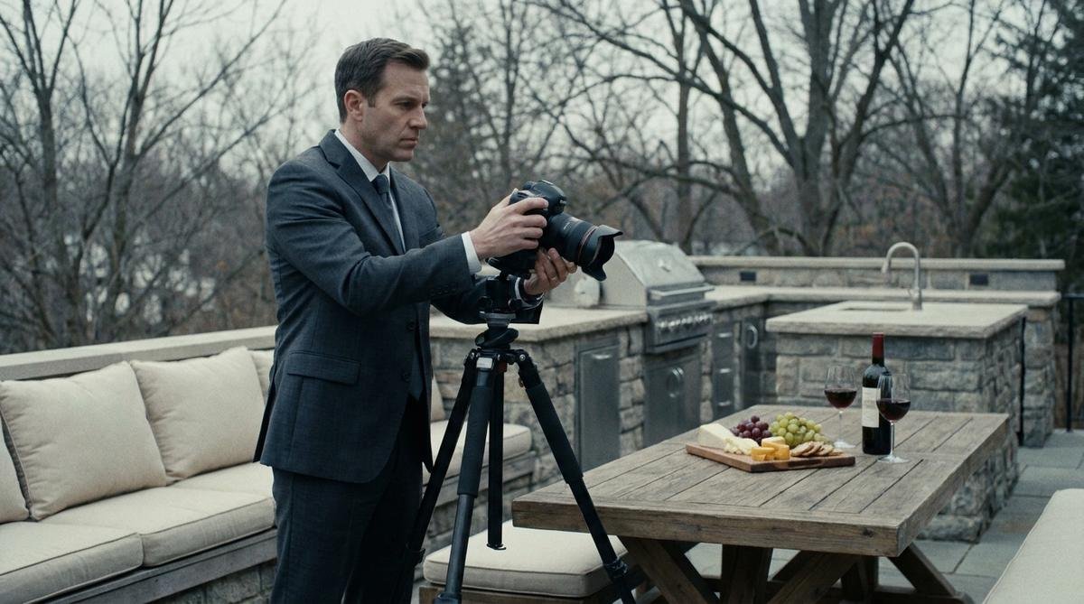
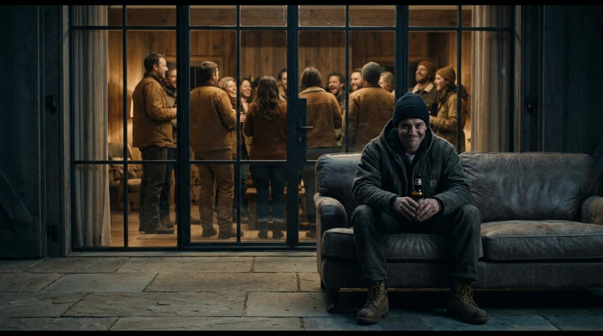
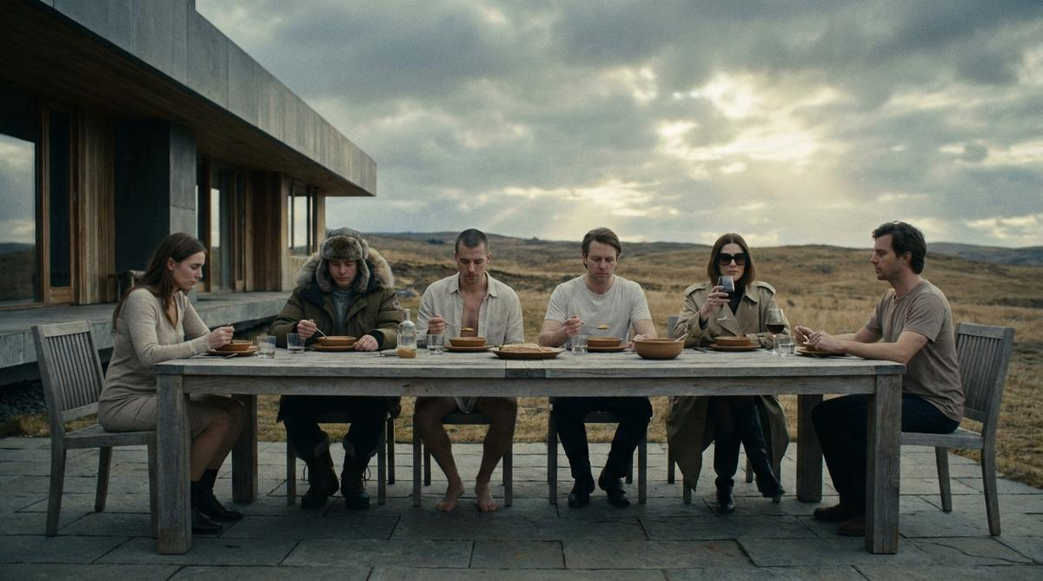
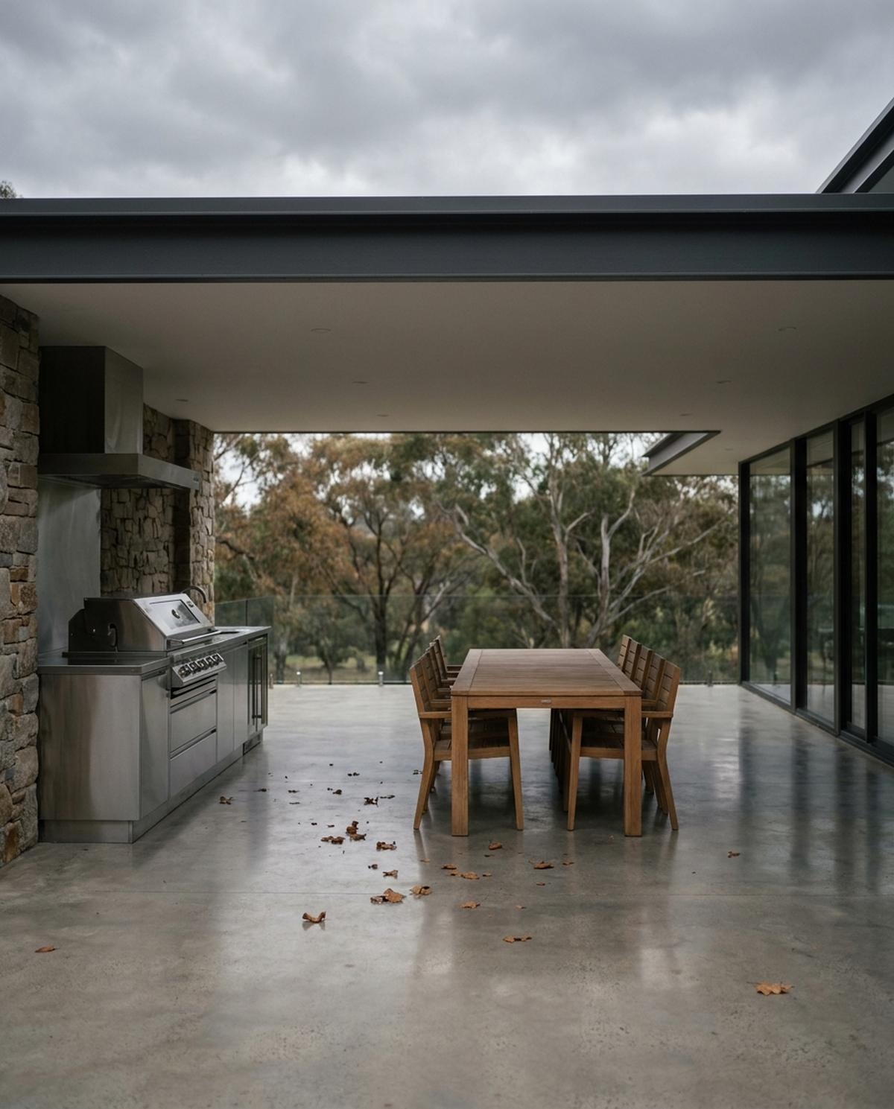
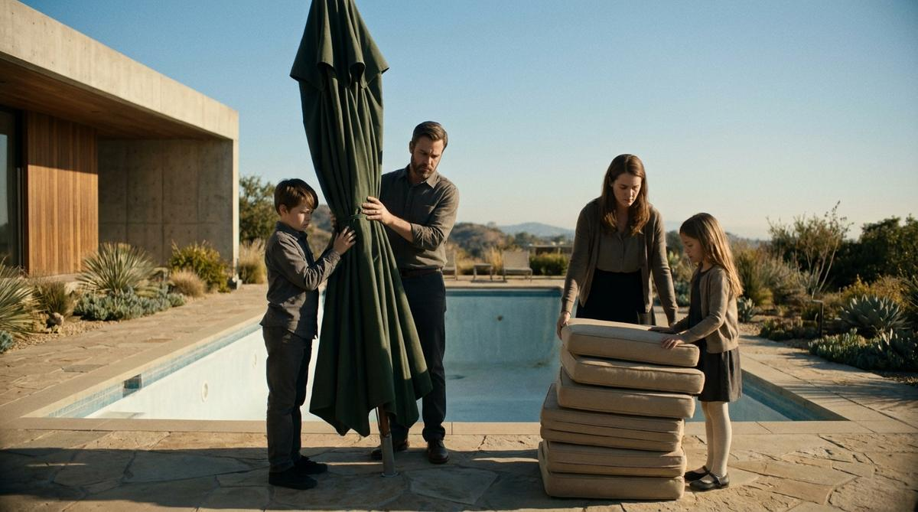
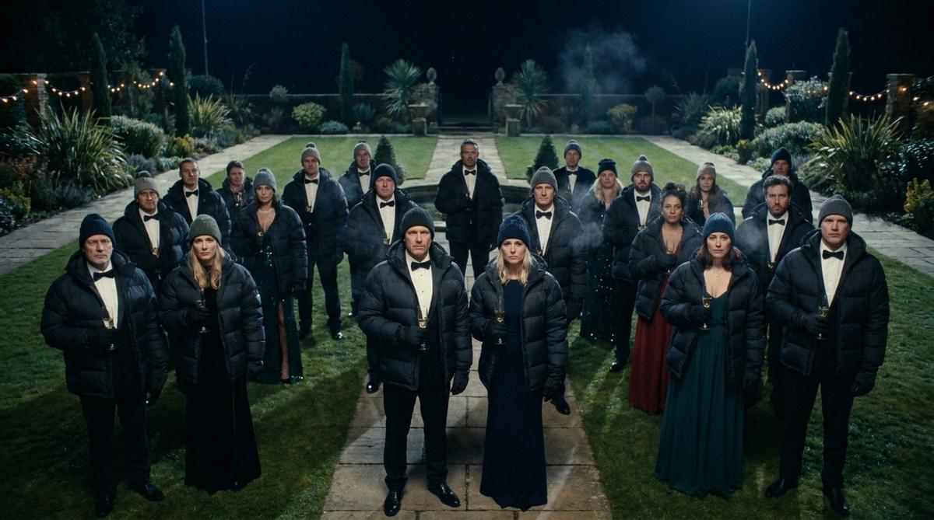
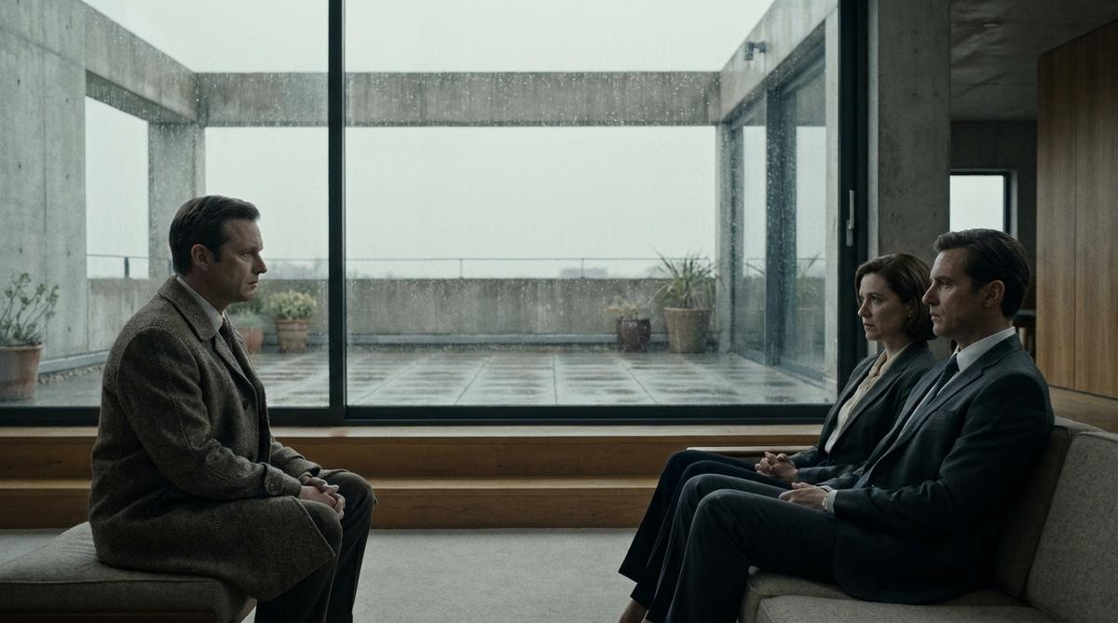
The season, the house, the habit
Concepts 09–16
09
The Open Home / The Listing Photo
10
It's Not That Cold / She'll Be Right
11
Melbourne
12
Alfresco (n.)
“Seamless indoor-outdoor living.”
“It's actually really nice out here.” / “She'll be right.”
Melbourne.
Alfresco (n.) — Italian: “in the open air.” Australian: “the bit near the barbecue nobody uses after…
13
Labor Day / Easter — The Closing Ceremony
14
The Big Game / The Grand Final
15
The Housewarming
16
Grand Designs — The Year After
The Petersons observe the end of summer. It is seventy-eight degrees.
The outdoor TV cost six thousand dollars. Everyone is watching the small one.
You should not need equipment to attend a dinner party.
“And how are you finding the terrace?”

Slide 29
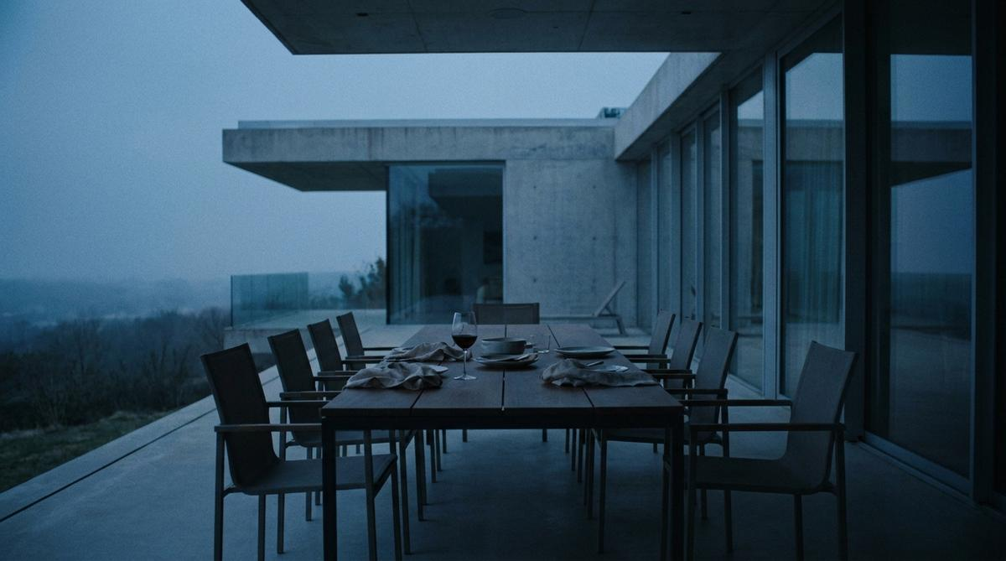
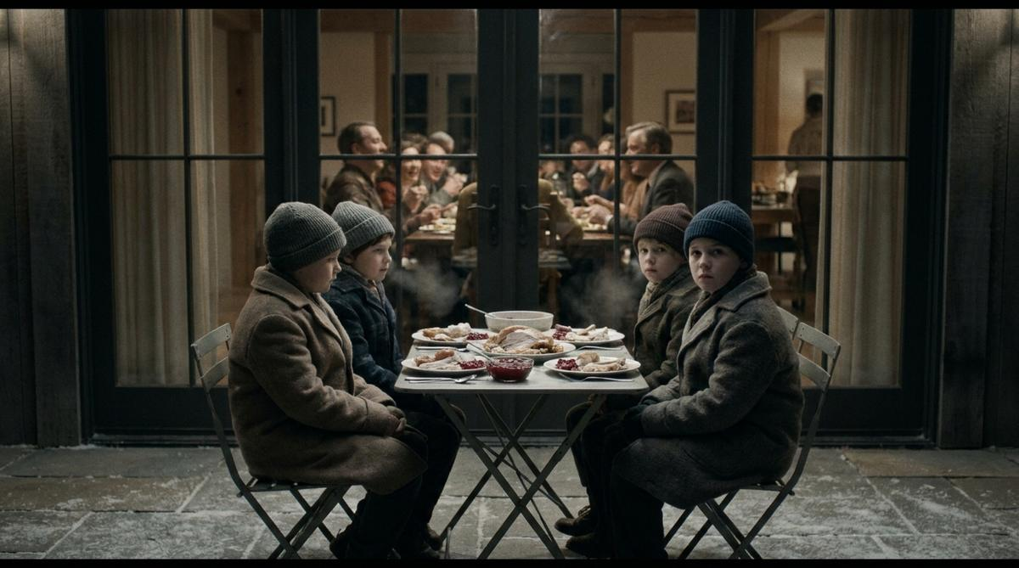
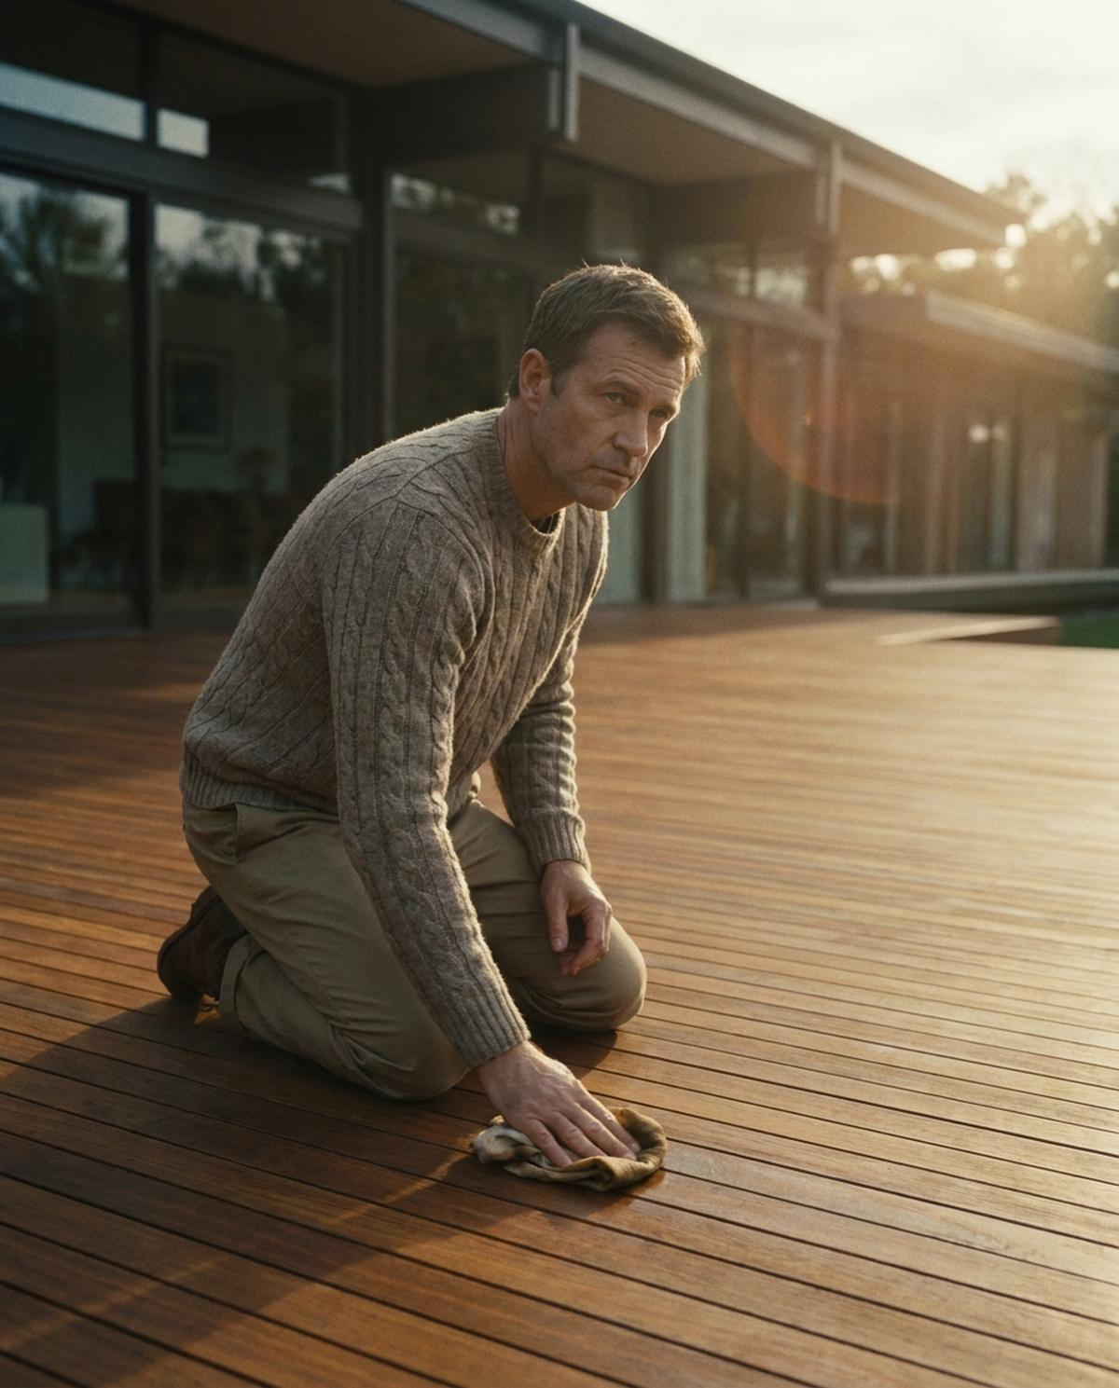
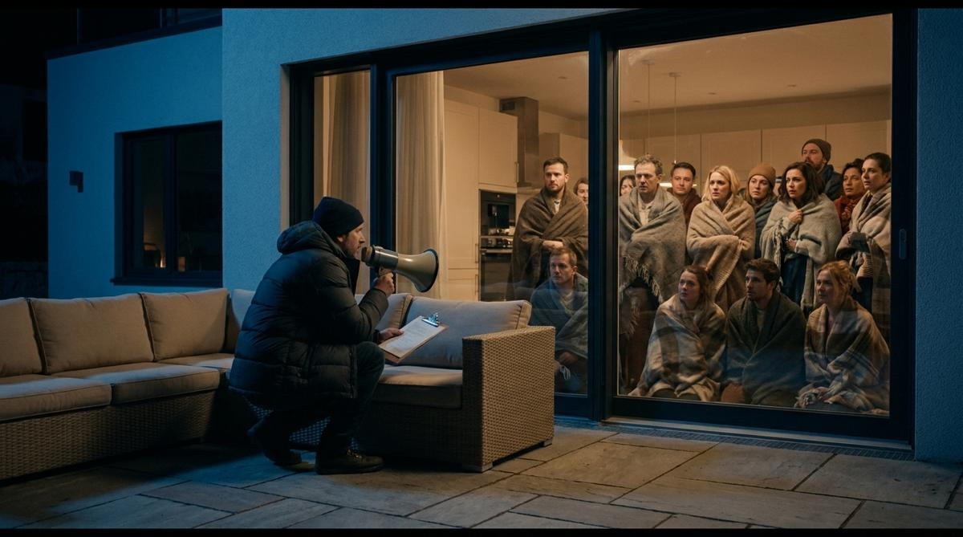
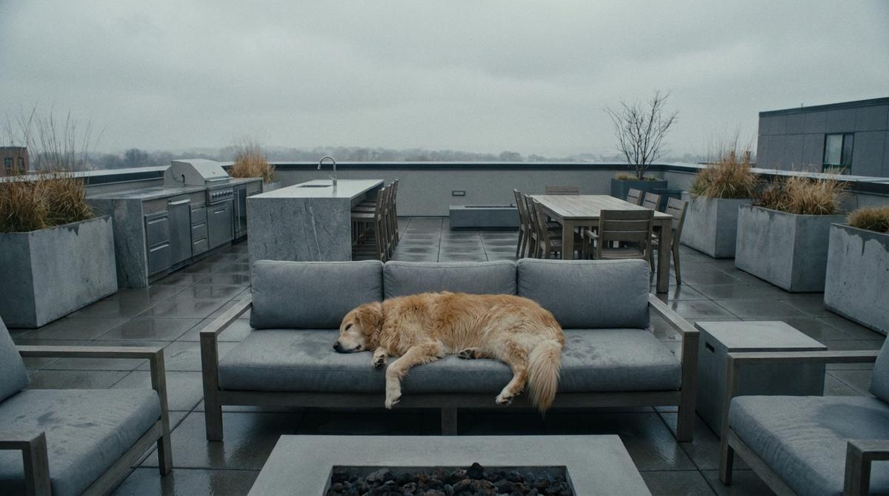
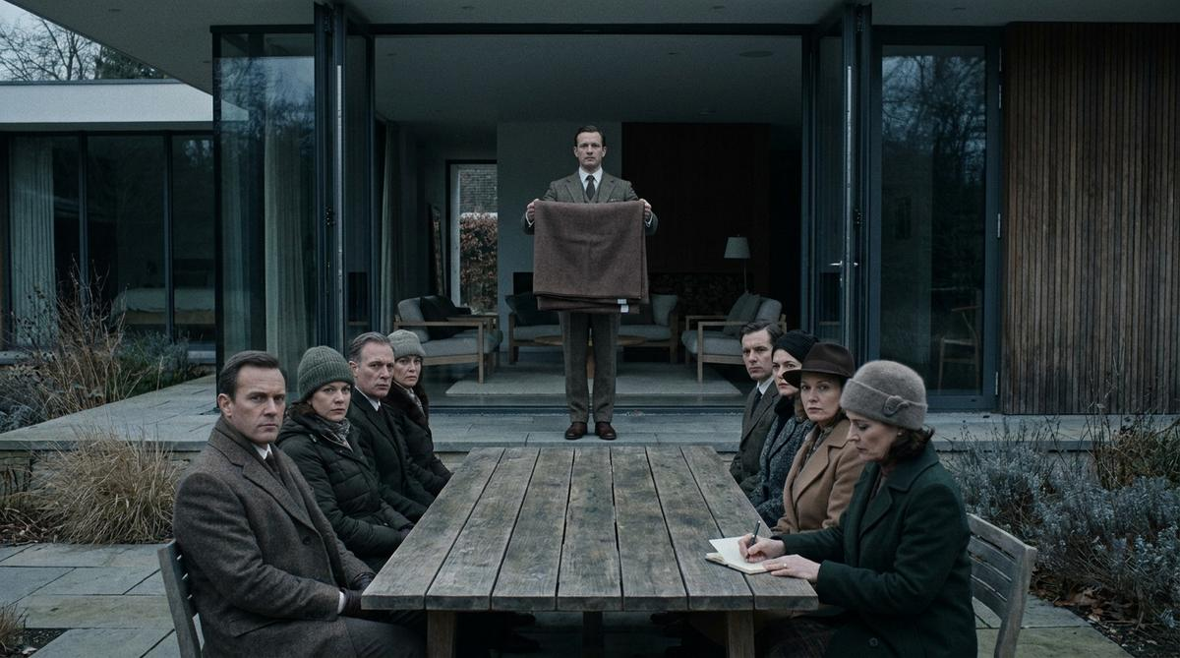
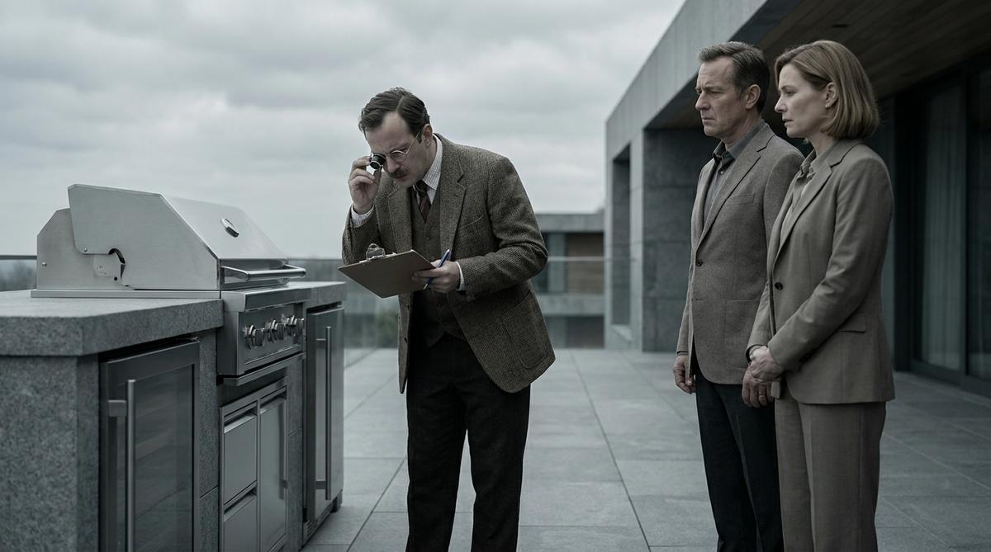
Pushed harder on comedy
Concepts 17–24
17
The Specification
18
Two Hours
19
The Kids' Table
20
The Deck
Specify the season. Not just the space.
Your terrace has an opening time and a closing time. You never agreed to either.
There is a better solution.
Beautifully maintained. Entirely unused.
21
The Hostage Negotiation
22
Rusty
23
The Safety Briefing
24
The Valuation
Negotiations broke down at 7:40pm.
Rusty is the only member of this family getting any value from the outdoor kitchen.
“Tonight's outdoor portion of the evening is expected to last approximately eleven minutes.”
“And how often would you say you use it?” … “I'll put ‘as new’.”

Slide 30
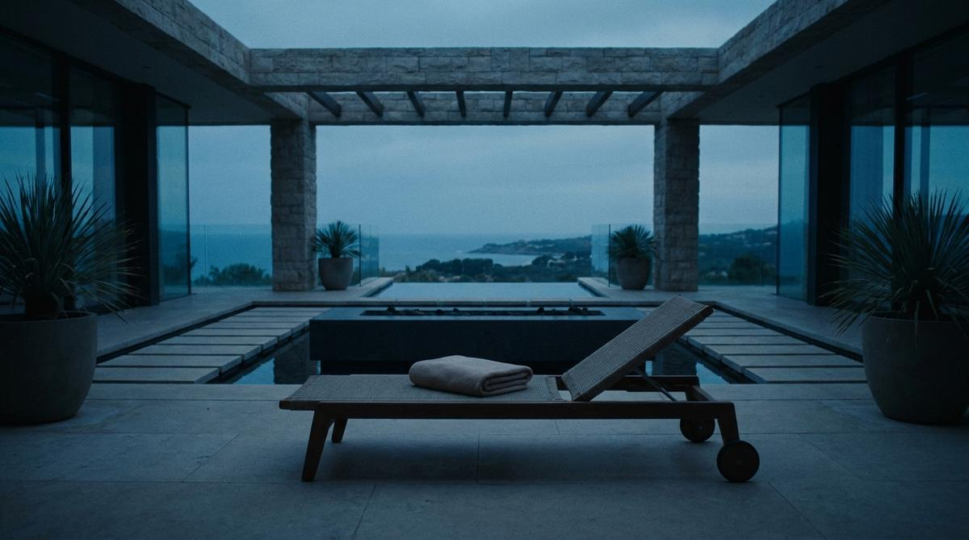
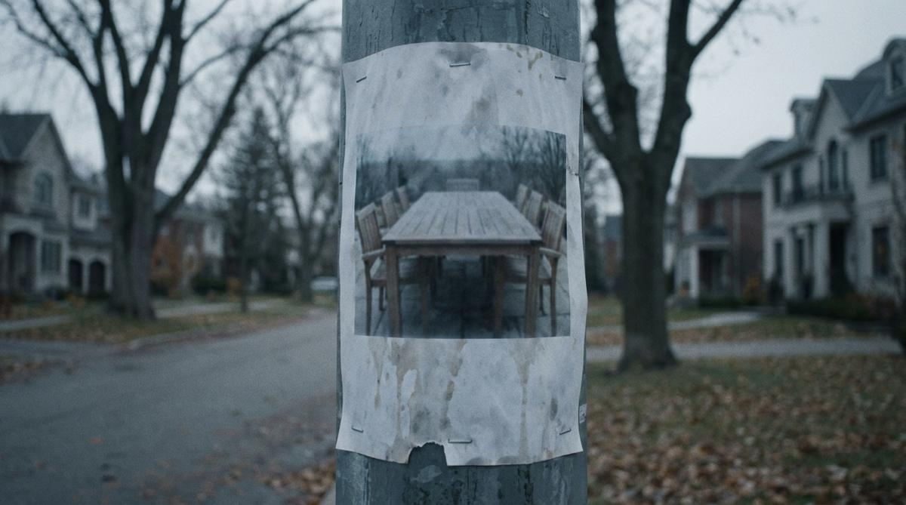
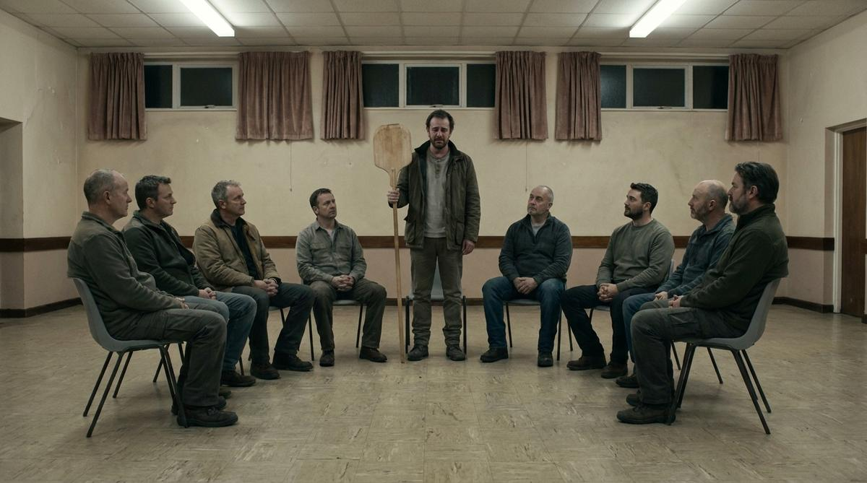
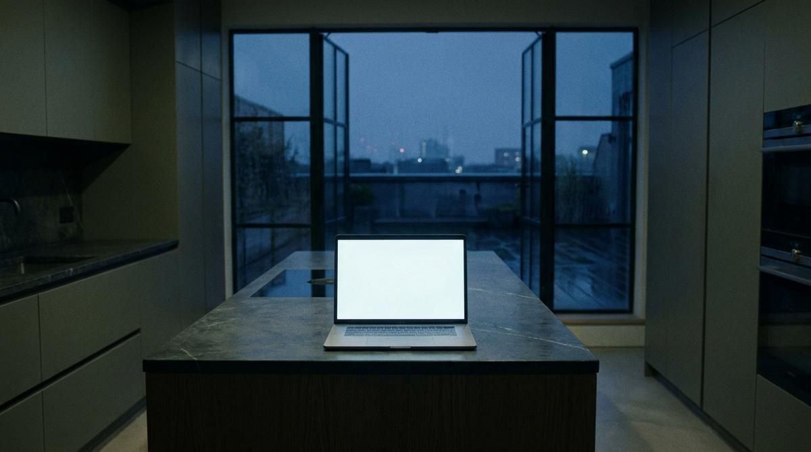
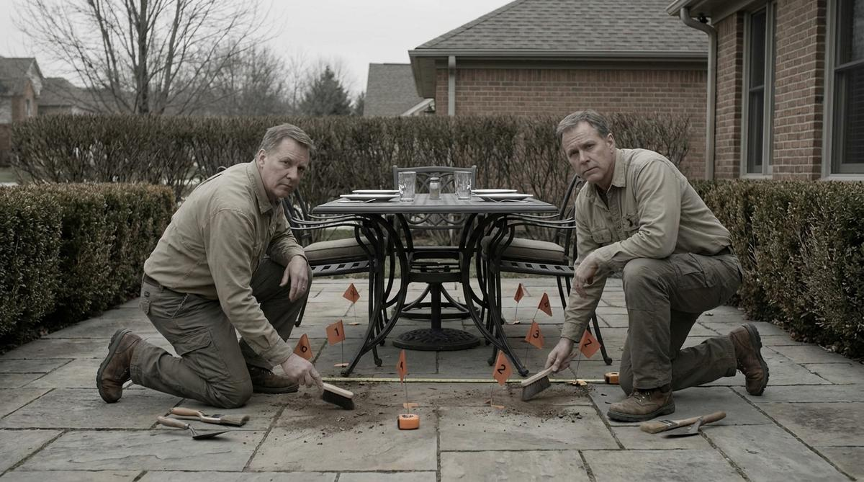
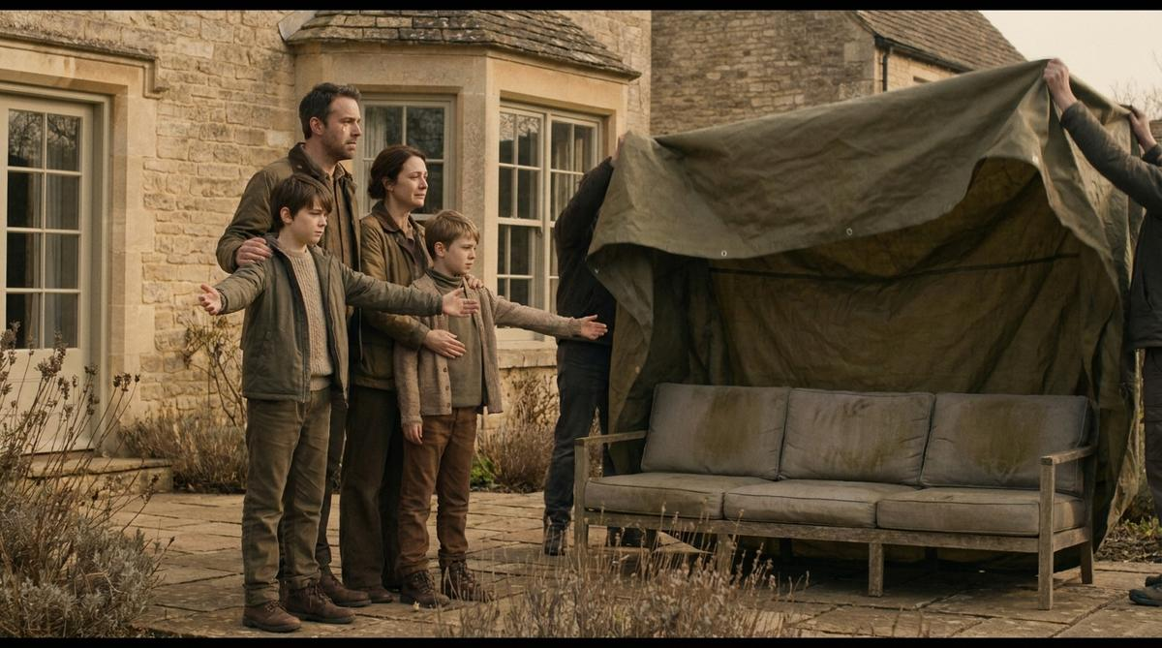
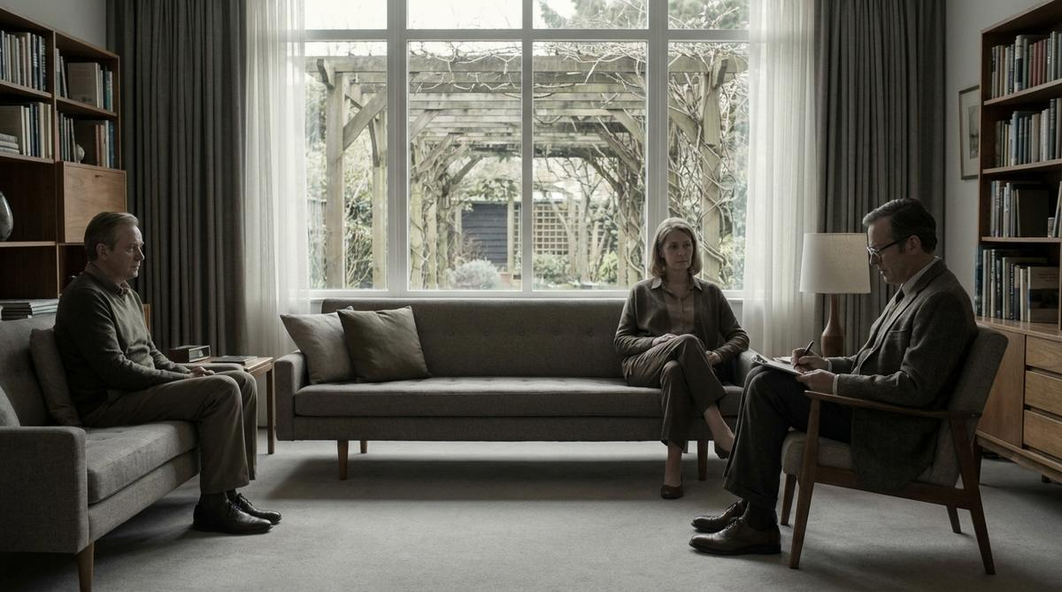
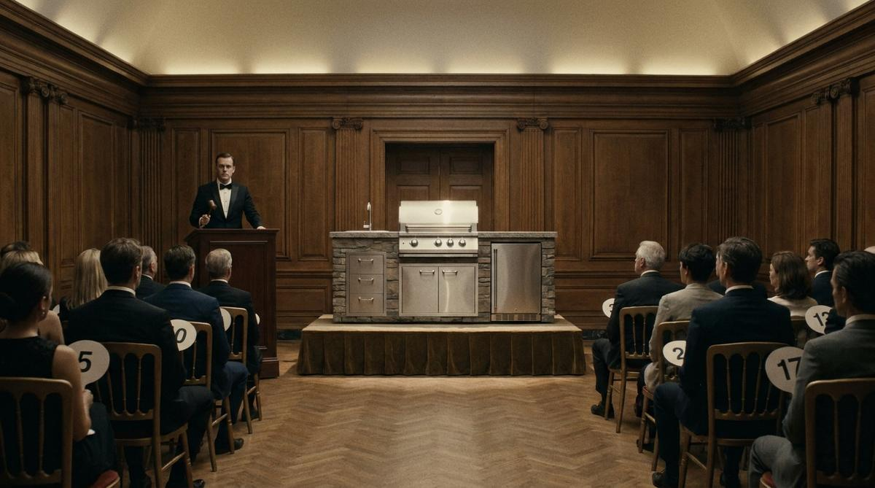
The long tail
Concepts 25–32
25
The Gym Membership
26
Missing Persons
27
Support Group
28
Out of Office
The most expensive thing you own and don't use isn't your gym membership.
LAST SEEN: MARCH. IF YOU HAVE ANY INFORMATION—
“Hi. I'm Dave. I've owned a wood-fired oven for four years.” … “Hi, Dave.”
The terrace is currently out of office and will return in May.
29
The Archaeologist
30
The Reunion
31
Couples Therapy
32
The Auction
“Evidence of a civilisation that gathered outdoors — briefly, and only in February.”
Nine months is a long time.
“It's the pergola.”
“Lot 42. Outdoor kitchen. One careful owner. Sixty-two hours' use.”

Slide 31
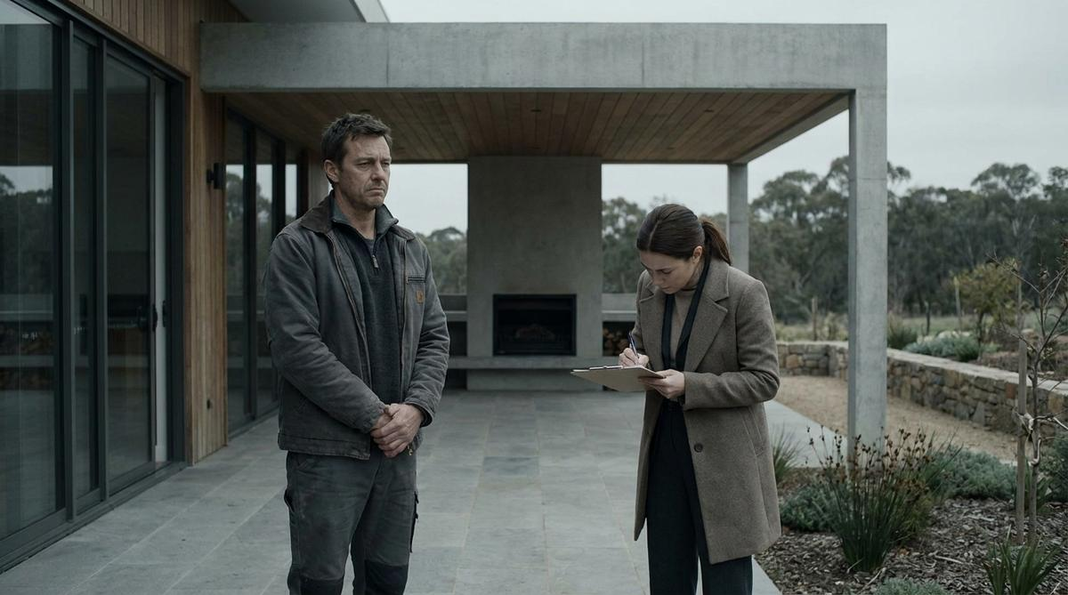
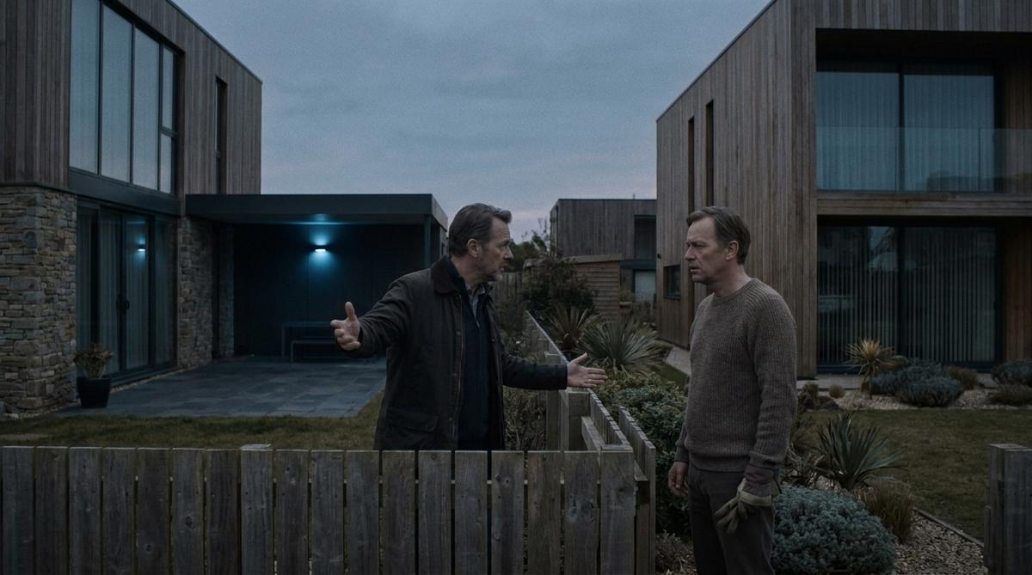
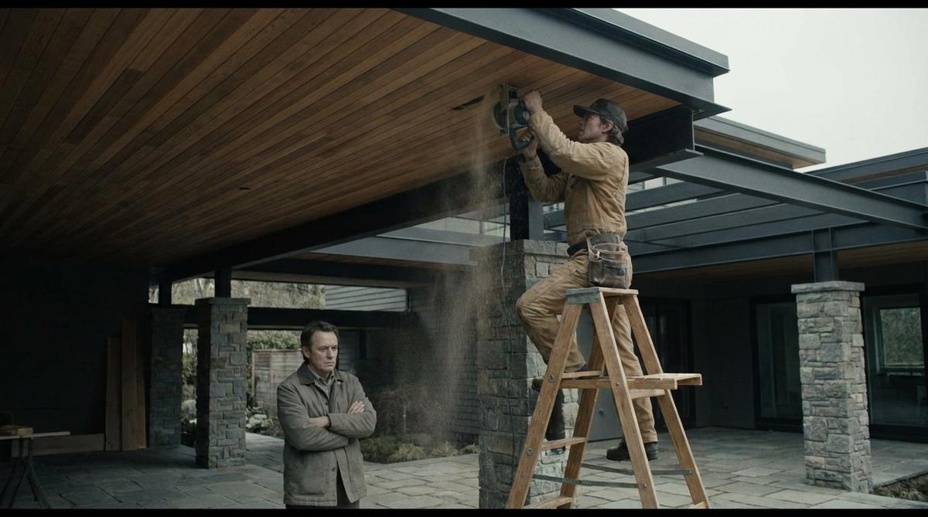
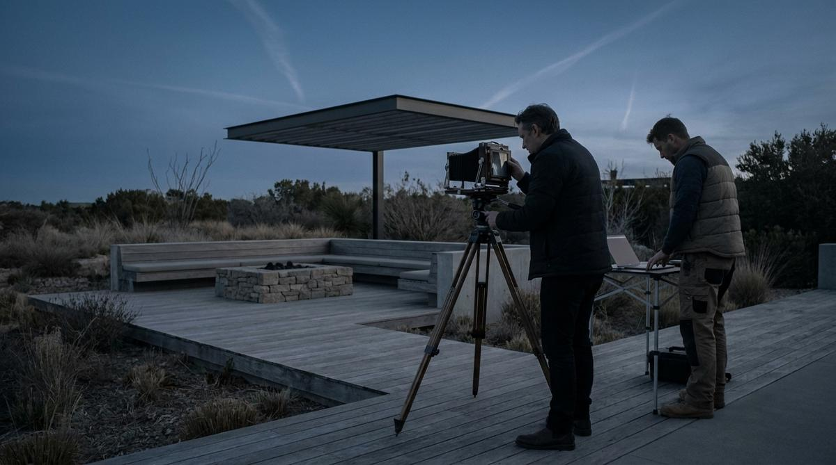
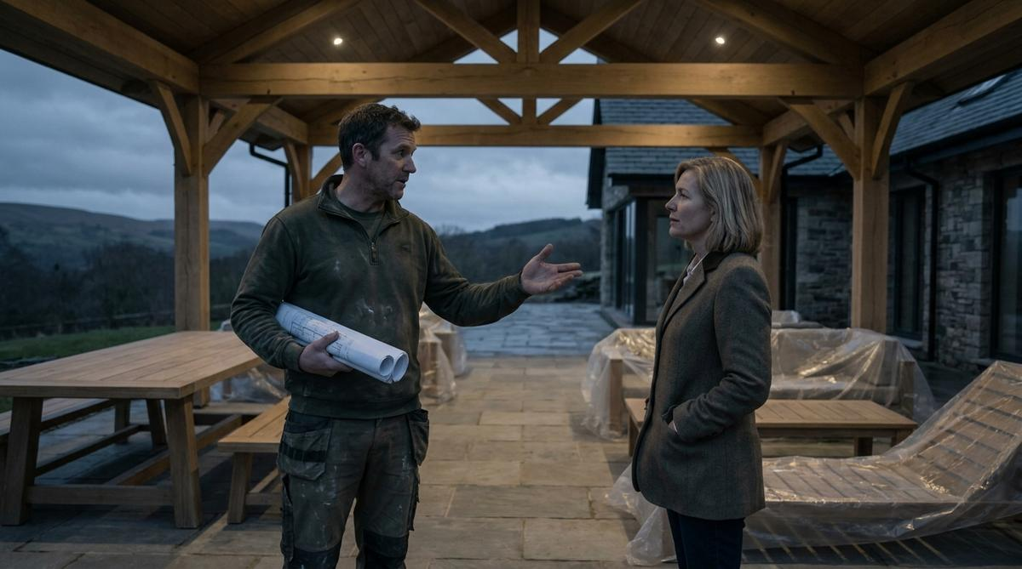
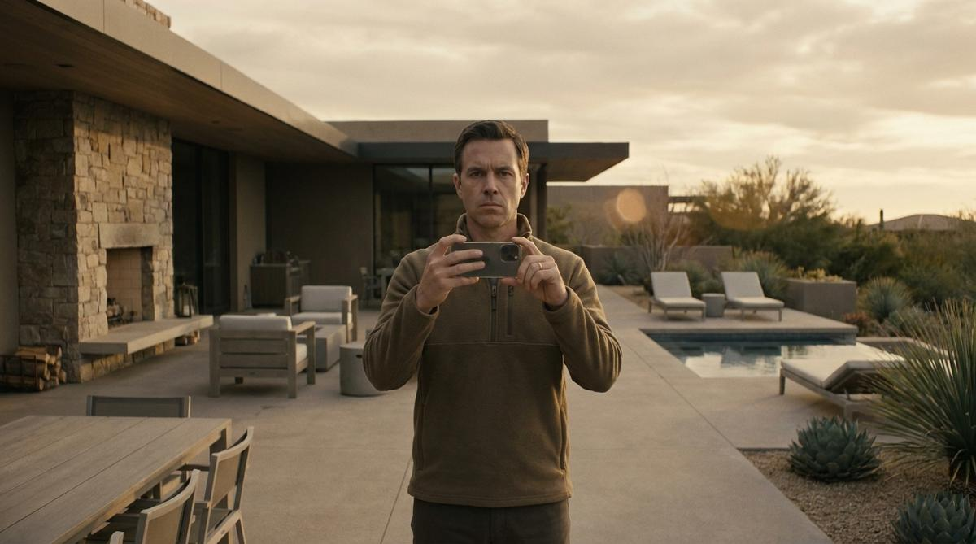
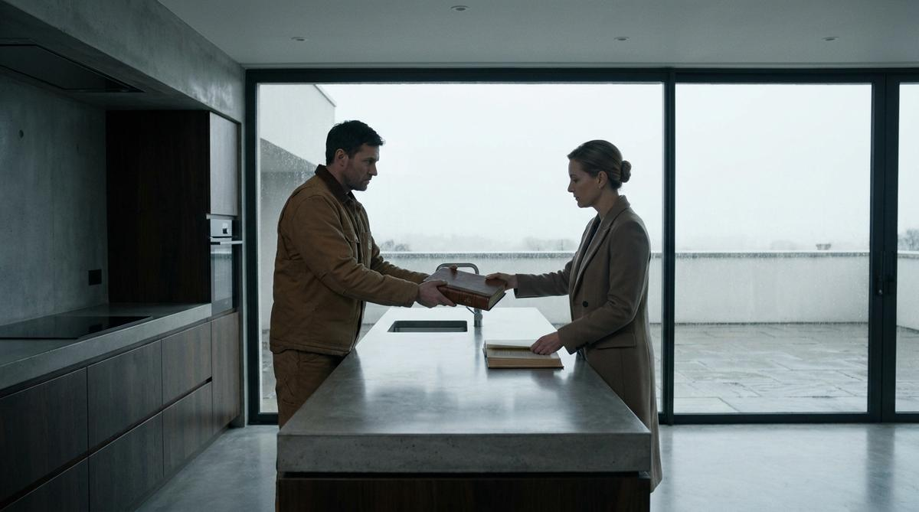
Builders, architects, remodellers
Their currency is reputation, callbacks and referral
B1
The Punch List
B2
The Referral That Never Came
B3
The Change Order
B4
The Portfolio Shot
The last item on every punch list is the one you didn’t quote for.
“Who built yours?” … “We love it. We’re inside a lot.”
Rough it in now. Or cut it open later.
“Can we get one with people in it?”
B5
Six Hundred Square Feet
B6
The LinkedIn Post
B7
The Handover Pack
You sold them 4,200 square feet. You built them 4,800 — for five months a year.
340 likes. Nobody has stood in it since.
Appliance warranties. Paint codes. Maintenance schedules. “Terrace — see Spring.”

Slide 32
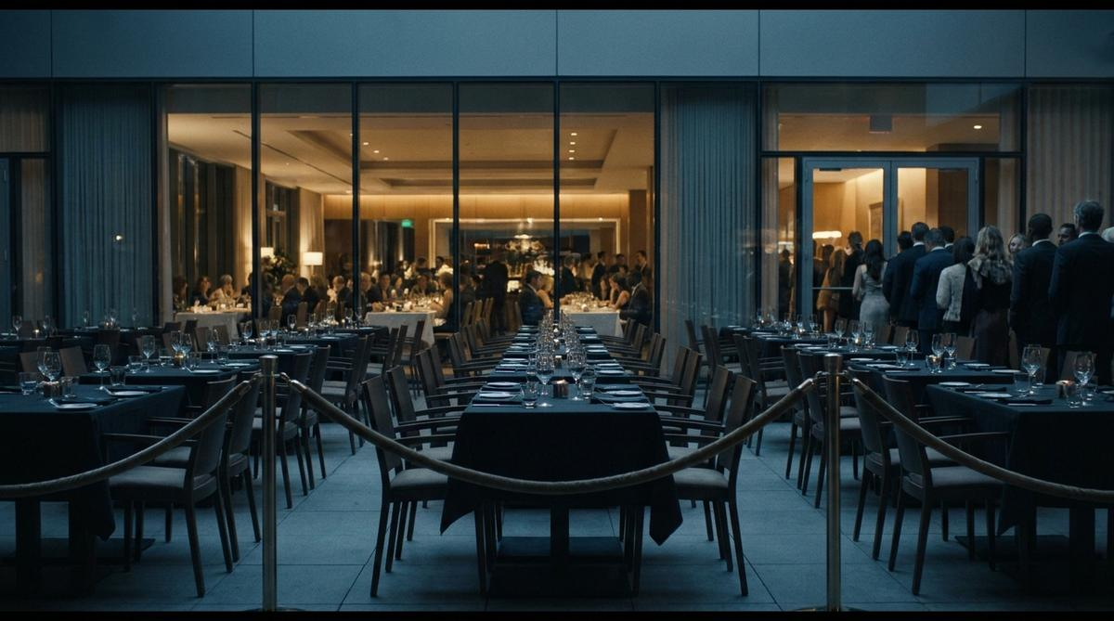
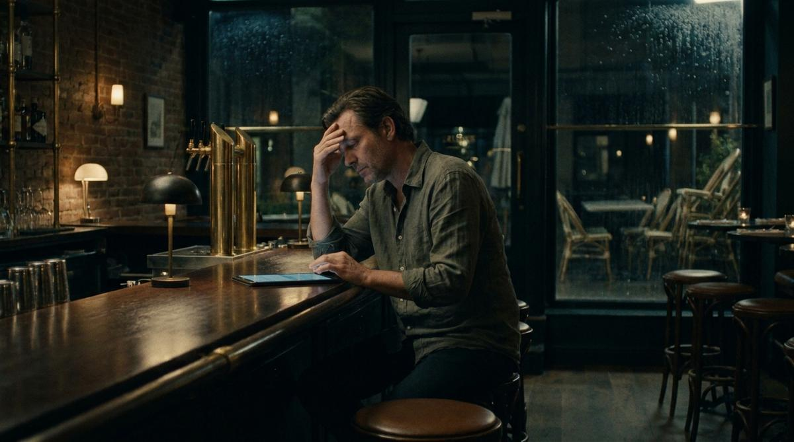



Commercial operators
Their currency is covers, reviews and labour
C1
Forty Covers
C2
The Two-Star Review
C3
The Meteorologist
C4
The Heater Graveyard
Forty covers. Closed for the season.
Your terrace is writing your reviews.
Your booking calendar should not have a meteorologist.
Ten years of solving it. Ten thousand dollars of not solving it.
C5
Four Hours a Week
Four hours a week. Moving gas bottles.

Slide 33
The heater is 4% of the build
and the difference between
eleven months and two.
Extend The Moment.

