Slide 1


Spam Filtering on Mail
Aayush Shah, 1641065
Nihar Shah, 1641054

Slide 2
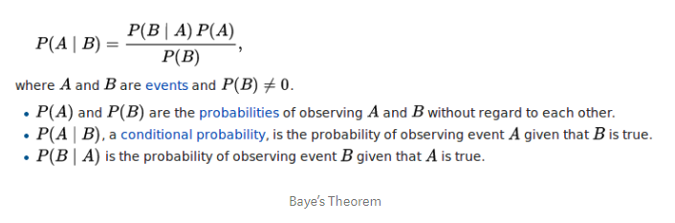
Overview
Spam Mail wastes the Internet’s two most precious resources Bandwidth and Time
It can eat up lot of inbox space and can contain malware and viruses that can compromise company security and data.
Very advantageous theorem of probability to classify spam mail : Bayes Theorem.

Slide 3


Problem Statement
We have message m = (w1, w2, w3, … , wn), where (w1, w2, w3, … , wn) is a set of unique words
Assume occurence of word are independent of all other words

Slide 4
Problem Statement (Cont.)
In order to classify we have to determine which is greater

Slide 5
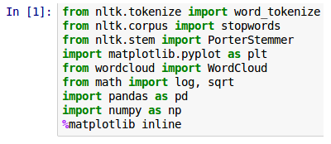
Loading dependencies
NLTK for processing the messages
WordCloud and matplotlib for visualization
Pandas for loading data
NumPy for generating random probabilities for train-test split

Slide 6
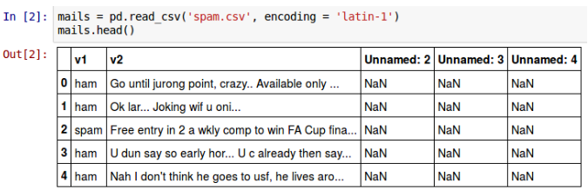
Loading Data
We do not require the columns ‘Unnamed: 2’, ‘Unnamed: 3’ and ‘Unnamed: 4’, so we remove them. We rename the column ‘v1’ as ‘label’ and ‘v2’ as ‘message’. ‘ham’ is replaced by 0 and ‘spam’ is replaced by 1 in the ‘label’ column.

Slide 7
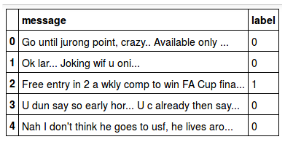
Loading Data (Cont.)

Slide 8
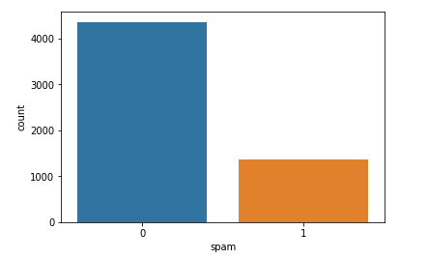
Data Visualization of Spam and Ham emails:
In UCI ML Dataset taken there are 5722 emails out of which 4120 are ham(legitimate) and remaining are spam emails.

Slide 9
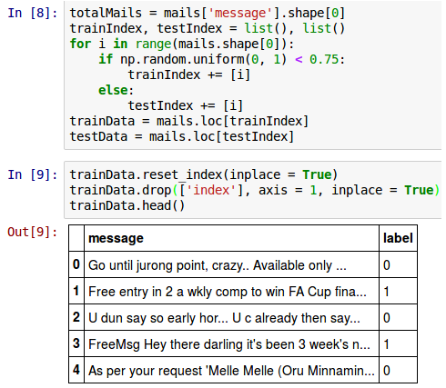
Train-Test split
Use 75% of the dataset as training and rest as test dataset. Selection of data is uniformly random.

Slide 10
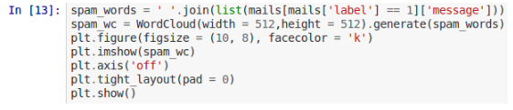
Visualizing Data
To see which are the most repeated words in the spam message we have used WordCloud library

Slide 11
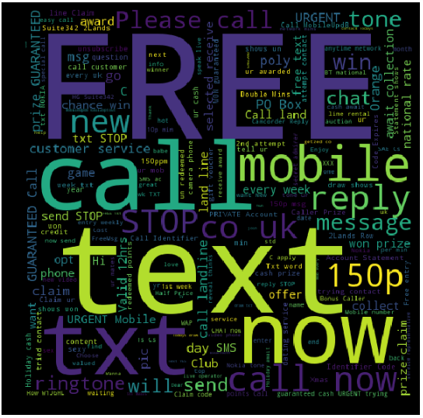
Visualizing Data (Cont.)
Result for spam mails is as expected
Messages contains the words like ‘FREE’, ‘call’, ‘text’, etc.

Slide 12
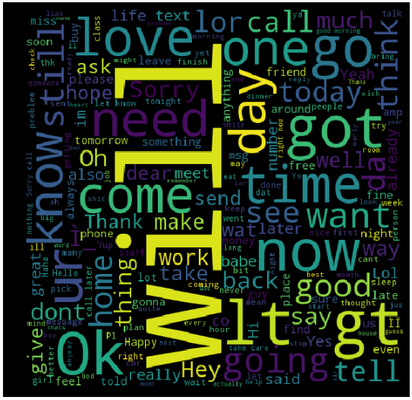
Visualizing Data (Cont.)
Result for ham mails.

Slide 13

Training the Model
Preprocessing a) Make all words to lowercase (FREE and free are same words). b) Tokenize each word (Split message into pieces and throw away the punctuation) c) Go, goes, going indicates the same activity. Replace all these words by go by using Porter Stemmer algorithm

Slide 14



Training the Model (Cont.)
d) Remove the stop words (‘a’, ‘an’, ‘the’ are the stop words). e) Find number of occurence of each word f) TF-IDF (Term frequency - Inverse document frequency)

Slide 15
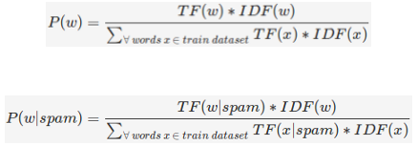
Training the Model (Cont.)
g) Probability of each word is counted as:

Slide 16
Training the Model (Cont.)
h) If some word comes in test dataset which is not part of training dataset then P(w) = 0 this creates problem. Additive smoothing must be done.

Slide 17
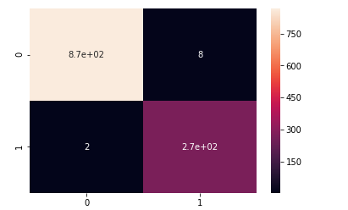
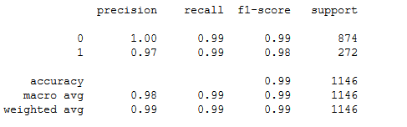
Classification and Evaluation Results:
Multinomial Naive Bayes Classifier is used and its results are as follows:

Slide 18
Thank You

