Slide 1
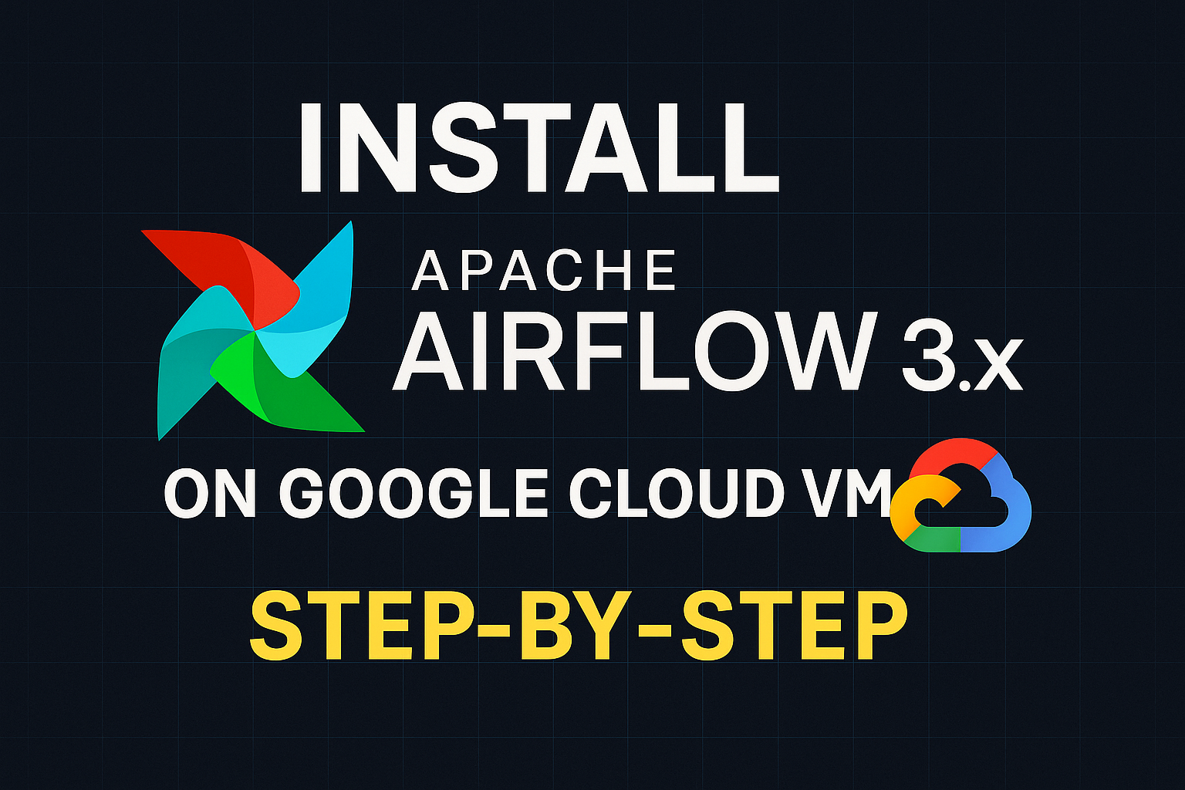
Learn-by-Doing Data Engineering

Slide 2
Cloud Composer VS Compute VM
UNDERSTANDING
Most teams rely on managed services like Cloud Composer and miss understanding Airflow’s core internals, which follows difficulties in debugging. Is a huge problem with upgrades.
Manual installation exposes you to the revised architecture using api-server, triggerer etc.
Airflow docs can be confusing being an open source project, clean install script on github for a production like setup.
COST
Upto 90% cost reduction compared to GCP Composer

Slide 3

First training to upload but not first training so stay tuned for an extensive Airflow training.

Slide 4
Prerequisites
Have a cloud provider free account, I use GCP, others would be almost same except the OS patches step.
Knowledge of Bash (terminal commands).
Familiarity with Python syntax and virtual environments.
If using Windows, install Git Bash to follow along step-by-step. Install zsh.

