Slide 1
DeepEcho
Edge-AI Water Intelligence
AI-Powered Dual-Frequency Acoustic Sludge Mapping
for India's Aquaculture Revolution
Edge AI
Dual-Frequency Sonar
Risk Prediction
Aquaculture
© 2025 DeepEcho Technologies | Confidential

Slide 2
THE PROBLEM
India's Aquaculture Sector is Losing Billions Every Year
₹28,000 Cr
15–20%
3.2 M+
#2
Annual loss from
pond productivity gaps
Productivity increase
possible with better monitoring
Aquaculture farmers
lacking real-time data
India — world's 2nd largest
aquaculture producer
Root Causes
🇮🇳 India Aquaculture Hotspots
Invisible sludge accumulation depletes oxygen, releases toxins
No real-time ammonia / hypoxia monitoring on pond floors
Manual inspection: inaccurate, expensive, time-consuming
Delayed treatment decisions → mass fish kills & economic loss
Andhra Pradesh → 38% of national output
West Bengal → Major inland fisheries
Tamil Nadu → Coastal shrimp farms
Odisha → Brackish water culture
Kerala → Backwater aquaculture

Slide 3
THE DEEPECHO SOLUTION
Autonomous Dual-Frequency Acoustic Intelligence Platform
🔊
🧠
📊
Dual-Frequency
Acoustic Sonar
Edge AI
Risk Engine
DeepEcho
Dashboard
38 kHz — deep penetration
through sludge layers
200 kHz — high-resolution
surface mapping
Centimetre-level sludge
thickness measurement
GPS-tagged hotspot
detection in real-time
On-device ML inference
(no cloud dependency)
Hypoxia & ammonia
forecast models
Anomaly detection
across sensor streams
Treatment plan
auto-generation
3D bathymetry &
sludge visualisation
Real-time risk gauges
& historical trends
Actionable treatment
action plans
CSV / report export
for farm records
Fully autonomous survey drone + edge computing module + web dashboard — no cloud, no lag, no data leakage

Slide 4
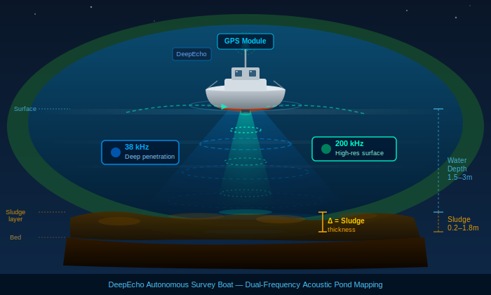
DUAL-FREQUENCY ACOUSTIC SLUDGE MAPPING
38 kHz
Deep Penetration Beam
Wide acoustic cone penetrates sludge & sediment up to 3m depth. Detects sub-bottom gas pockets (methane zones) and measures total organic accumulation.
200 kHz
High-Resolution Surface Scan
Narrow precision beam maps sludge-water interface at 2cm accuracy. Generates centimetre-level GPS-tagged bathymetric point cloud of the full pond floor.
Δ Combined
Sludge Thickness = 200kHz bottom − 38kHz sub-bottom
Subtracting the two echo returns gives exact sludge volume at every GPS coordinate. Enables hotspot ranking, desilting priority maps and treatment plans.
DeepEcho autonomous survey boat navigating a shrimp pond — real-time 3D sludge mapping
📍 Every sonar ping tagged to GPS coordinates — centimetre accuracy

Slide 5
AI PREDICTION ENGINE
Dual-Freq Sonar
🧠 DeepEcho AI Core
Hypoxia Risk Score
LSTM Time-Series Forecasting
(ammonia & DO trends)
Temperature
Sensor
▶
▶
Ammonia 24h Forecast
Gradient Boosted Risk Classifier
(hypoxia probability 0–1)
Convolutional Sludge Mapper
(3D volume from sonar points)
Treatment Action Plan
Turbidity
Probe
Rule Fusion Engine
(treatment plan generation)
Anomaly Detector
(sensor drift & fish stress alerts)
GPS Hotspot Map
Historical
DB
Edge inference — all models run on-device (Jetson Nano class) with <200ms latency. No internet required.

Slide 6
RISK ENGINE & ALERT SYSTEM
✅ NORMAL
⚠️ WARNING
🔴 CRITICAL
Hypoxia < 0.4
Hypoxia 0.4–0.7
Hypoxia > 0.7
Standard monitoring every 24h. Feed schedule unchanged. No intervention required.
+2h aeration/day. Reduce feed 15%. Partial water exchange 10–20%. Recheck every 8h.
Emergency: +4h aeration. Reduce feed 30%. 20–35% water exchange NOW. Desilting this week.
Live Sensor-Driven Reason Codes
AMM_CRIT
Ammonia > 2.5 mg/L → Immediate 20–35% water exchange
HYP_WARN
Hypoxia 0.4–0.7 → +2h aeration scheduled
SLG_HIGH
Critical sludge > 30% area → Desilting this week
FEED_REDUCE
Alert ≥ WARNING → Feed cut 15–30%
Every alert is traceable back to a specific live sensor reading — no black-box decisions.

Slide 7
DASHBOARD & SYSTEM ARCHITECTURE
📊 Dashboard Features
⚙️ System Architecture
▸ 3D Bathymetry Map
Hardware Layer
Interactive sludge / terrain / combined view with hotspot markers
Sonar drone (38/200kHz) + GPS + Temp + Turbidity sensors
▸ GPS Map Overlay
Real-world coordinate-referenced sludge heatmap
Edge AI Module
▸ Ammonia Forecast
Jetson-class device: data_simulator → risk_engine → database
24h time-series with threshold dash lines
▸ Hypoxia Gauge
Application Layer
Real-time 0–1 dial with colour-coded risk bands
Streamlit dashboard: real-time rendering, charts, alerts
▸ System Health
CPU, sensor signal, battery — live progress bars
Data Layer
▸ Auto Treatment Plan
SQLite local DB → CSV export → cloud sync (optional)
Auto-generated table: action, timeline, reason code, live basis
▸ Historical Trends
User Interface
Sidebar controls, GPS input, operation mode, auto-refresh
Hypoxia & ammonia trends across all sessions

Slide 8
IMPACT & MARKET OPPORTUNITY
15–20%
₹80,000
60%
3.2M
Productivity
Increase
Annual Savings
per Farmer
Reduction in
Fish Mortality
Target Farmers
Across India
per pond per cycle
avg 5-acre farm
from early intervention
addressable market
Why India? Why Now?
Market Size
PMSY & Blue Revolution investing ₹20,000+ Cr in aquaculture modernisation
India aims to double fish production by 2025 under National Fisheries Policy
88% of fish farms in India still use manual/visual pond inspection
Shrimp exports hit ₹57,000 Cr in FY24 — quality & survival rate are critical
PM-KUSUM & NABARD funds available for agri-tech deployments
TAM
₹12,400 Cr
India aqua-tech
SAM
₹3,800 Cr
Sludge & water mgmt
SOM
₹480 Cr
5-year target

Slide 9
PRODUCT ROADMAP
Q1–Q2 2025
Q3–Q4 2025
Q1–Q2 2026
2027+
Phase 1 · Pilot
Phase 2 · Scale
Phase 3 · Expand
Phase 4 · Platform
Q1–Q2 2025
Q3–Q4 2025
Q1–Q2 2026
2027+
5 pilot ponds
Andhra Pradesh
Hardware validation
of dual sonar
Edge AI v1.0
deployment
200 farms across
3 states
SaaS dashboard
launch
NABARD funding
application
Brackish & marine
extension
OEM sensor
partnerships
Export markets:
Vietnam, Bangladesh
National water
quality network
Satellite + sonar
fusion
Regulatory data
compliance APIs
Currently: MVP dashboard operational · Sonar prototype in testing · Seeking pilot partnerships & seed funding

Slide 10
DeepEcho
Giving India's Ponds a Voice
🤝 Partner with us for pilot ponds
💰 Seed/grant funding discussions
🏛️ Govt. scheme integration (PMSY)
🔬 Research & academic collaboration
contact@deepecho.in | www.deepecho.in | +91 98765 43210
"Every pond is a data source. DeepEcho makes it speak."

