Slide 1


Team 36: Self-Navigating, Obstacle Avoiding Robot
Bi-Weekly Update 1 Teammates:
Arkadi Zhanov
Nathan Sommer
Nikolai Paderin Sponsor: Stavros Kalafatis
Notes:
Michelle

Slide 2
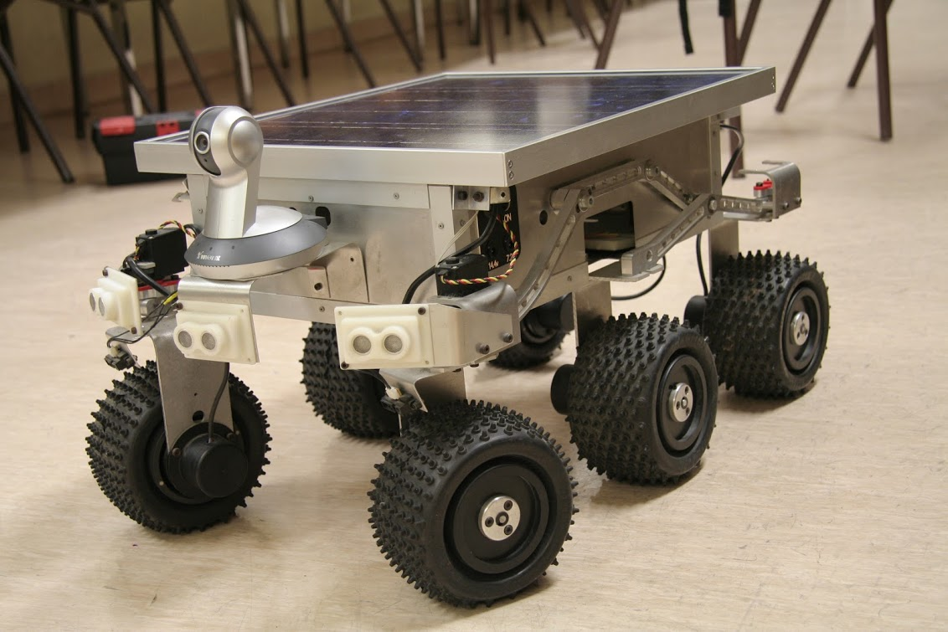
Project Summary
Create a system that takes in a point on a map as the rover’s destination, creates a route for the rover, and gets the rover to its destination and back while avoiding obstacles.
The main motivation for this project is for application in military settings such as aid delivery to wounded soldiers in the battlefield or local, residential delivery of food or mail.
Notes:
Kyle

Slide 3
Project/Subsystem Overview (Before)
User Interface/Communication
Navigation/Communication/Control
Pathfinding/Navigation
App
4G Hat
GPS module
Node/Edge Map Initializer
Login Page
Dijkstra Pathfinder Algorithm
Raspberry pi
Main Page
Obstacle Avoidance Path Interrupt
GPS Retrieval
Distance Sensor
Route Cells for Navigation
Route Retrieval
User Input
Motor Control
Used Cell Logger
Display Path Progress
Nathan Sommer
Nikolai Paderin
Arkadi Zhanov
Notes:
Eric

Slide 4
Project/Subsystem Overview (After)
User Interface/Communication
Navigation/Communication/Control
Pathfinding/Navigation
App
4G Hat
GPS module
Node/Edge Map Initializer
Login Page
Dijkstra Pathfinder Algorithm
Raspberry pi
Main Page
Obstacle Avoidance Path Interrupt
GPS Retrieval
Distance Sensor
Sample Nodes for Navigation
Route Retrieval
User Input
Motor Control
Record Nodes Used
Display Path Progress
Nathan Sommer
Nikolai Paderin
Arkadi Zhanov
Notes:
Eric

Slide 5
Major Project Changes for 404
Rover will only work on A&M campus
Design and implement alternative navigation strategy
Notes:
Eric

Slide 6
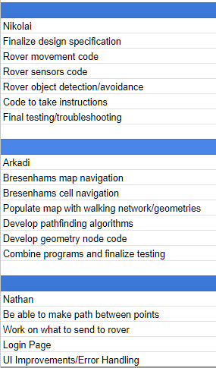
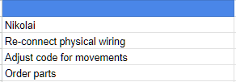
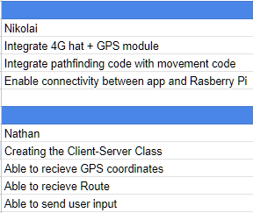
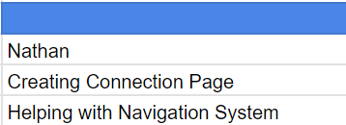

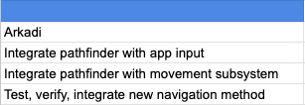
Project Timeline
What’s Completed (from 403): What we’re working on: What needs to be started:
Notes:
Eric

Slide 7
User Interface and Communication Overview
Nathan Sommer
Accomplishments since 403 3 Hours of Effort | Ongoing progress/problems and plans until the next presentation
Verified that the app is running and that everything is working correctly | Connection Page Create the connection Gps Retrieval Route Retrieval Sending user input to Rover UI Updates Navigation System

Slide 8
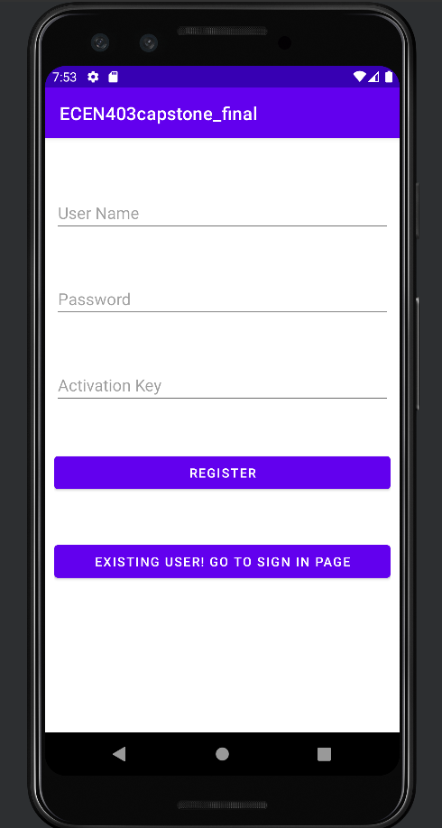
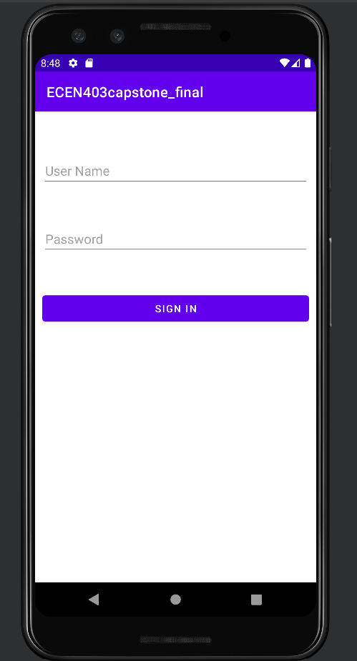
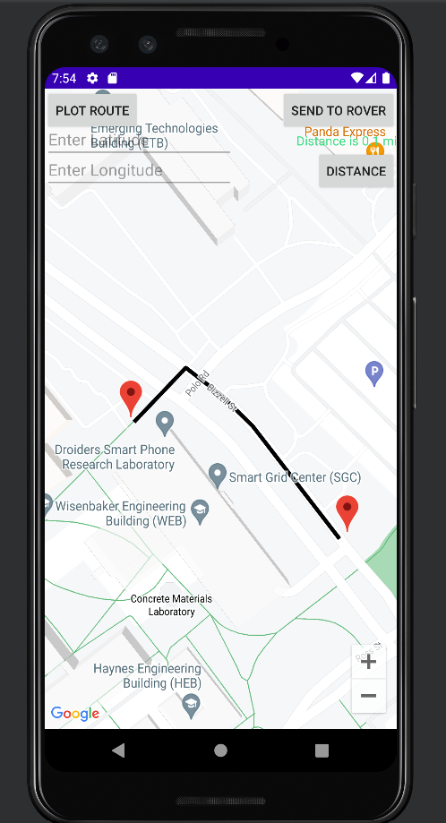
User Interface and Communication
Nathan Sommer
App works, however planning on changing route creation
Will be creating a connection page

Slide 9
Pathfinding and Navigation Overview
Arkadi Zhanov
Accomplishments since 403 3 Hours of Effort | Ongoing progress/problems and plans until the next presentation
Verified that the pathfinder algorithm is still functional Discovered that the navigation method may need reworking | Determine viability of cell approach for navigation or switch to a different approach Design, code, and test alternative navigation approach (node sampling from line path)

Slide 10
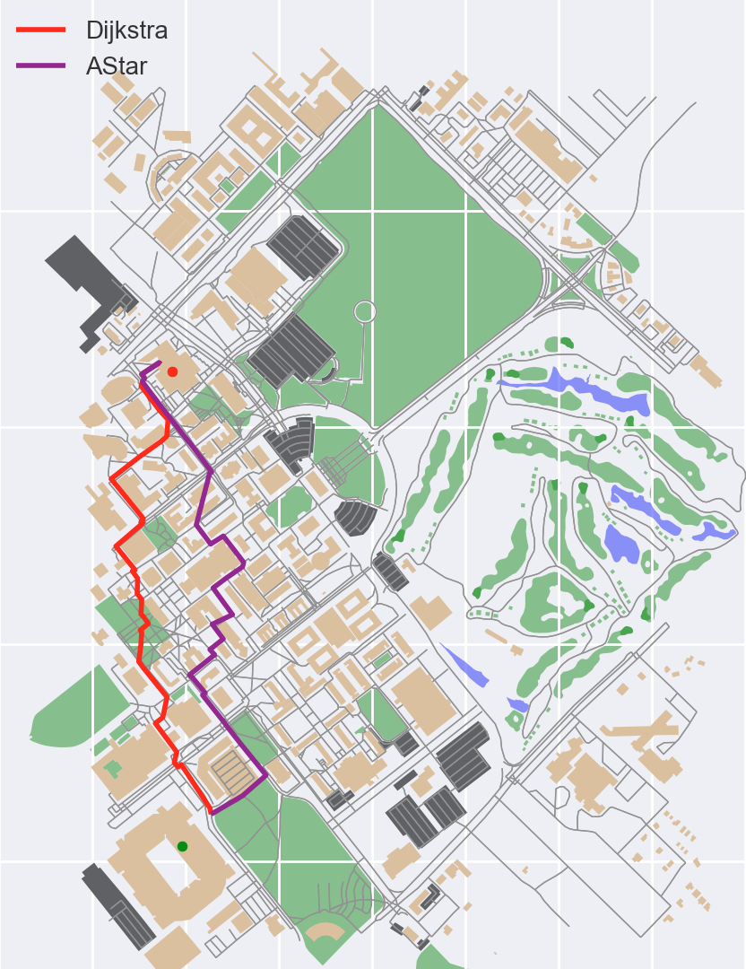
Pathfinding and Navigation
Arkadi Zhanov
Pathfinding algorithm works (Dijkstra)
Navigation approach worked independently in testing but discovered issues internal with compatibility and complexity
Navigation method will most likely be modified

Slide 11
Navigation, Communication and Control
Nikolai Paderin
Accomplished since 403 2.5 hours of effort | Ongoing progress/problems and plans until the next presentation
Verified some initial design flaws and came up with ways to improve upon them Acquired a portable power bank for Raspberry Pi. | Control code Made final adjustments to movement code for precise and accurate movements Object avoidance Rewire and re-test all sonar sensors to make sure they are all functioning together

Slide 12
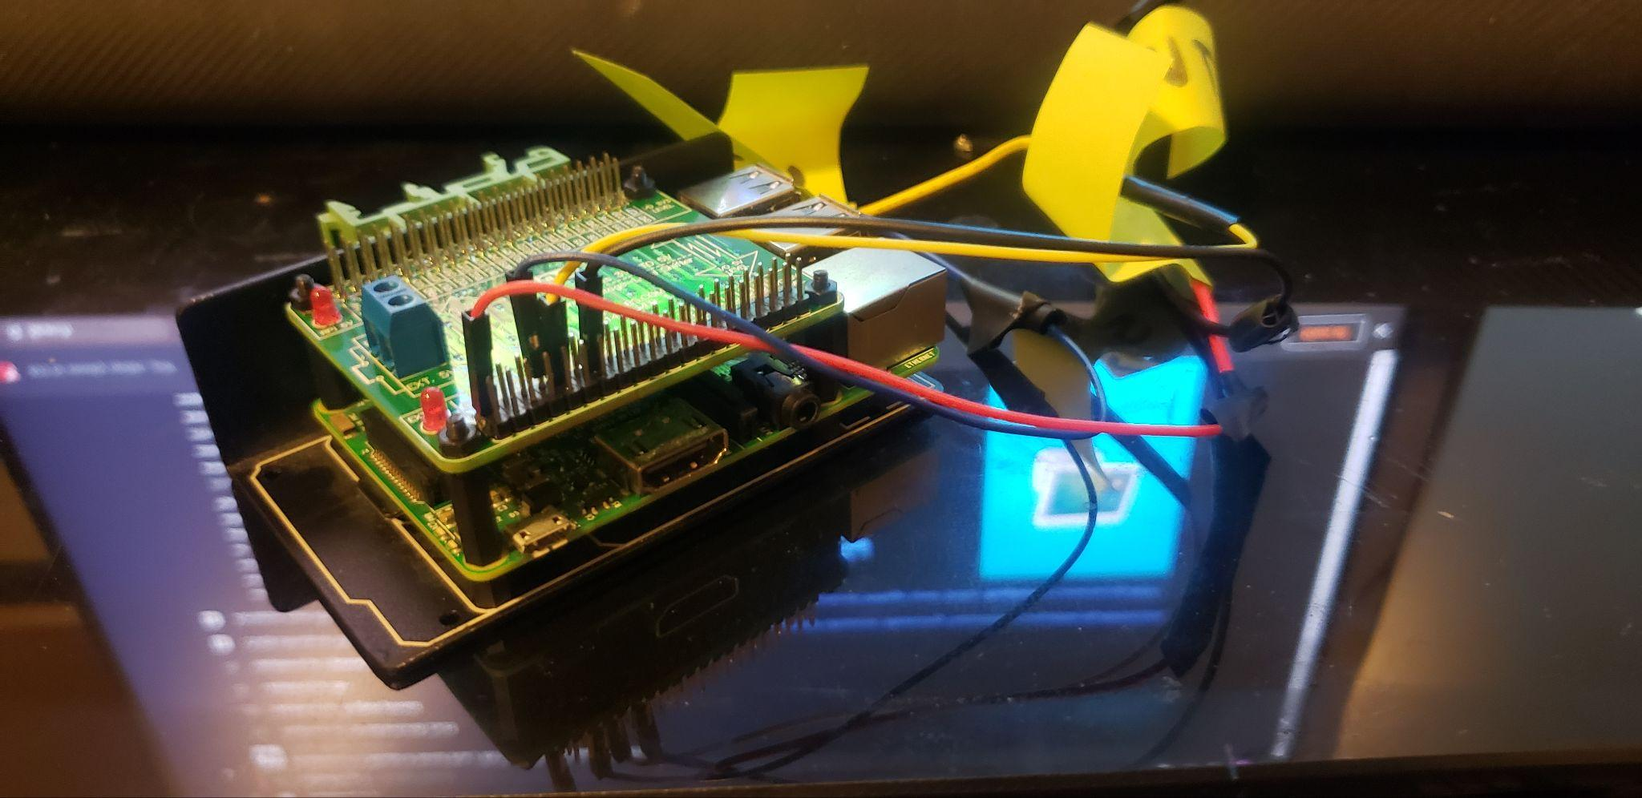
Navigation, Communication and Control
Nikolai Paderin
Rover works and will move by command, however code needs to be adjusted for more precise and accurate movements.
Will be integrating a 4G hat to enable communication between rover and application.
4G Hat
GPS
Raspberry pi
Distance Sensor
Motor Control

Slide 13
Parts Ordering Status
Parts ordered + received:
Level Shifter
Distance sensors
GPS Module
Parts on order waiting for delivery (Expected by Sep 7th):
4G hat
Global sim card
Notes:
Michelle

Slide 14
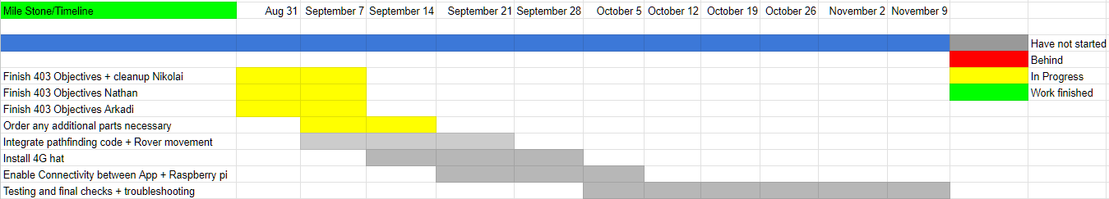
Execution & Plan
Notes:
Michelle

Slide 15
Q&A

