Slide 1


Team 36: Self-Navigating, Obstacle Avoiding Robot
Bi-Weekly Update 2 Teammates:
Arkadi Zhanov
Nathan Sommer
Nikolai Paderin Sponsor: Stavros Kalafatis
Notes:
Michelle

Slide 2
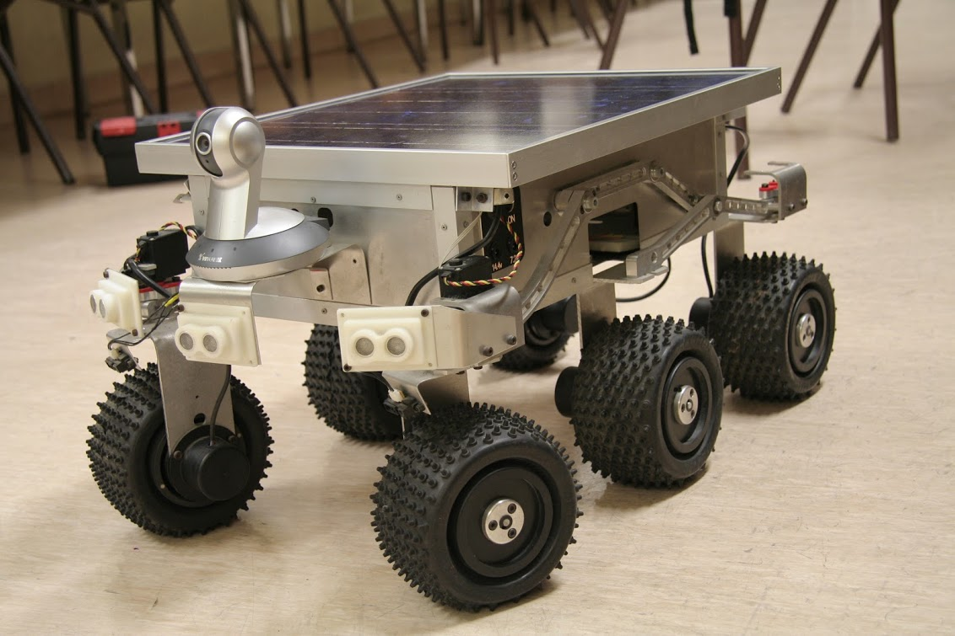
Project Summary
Create a system that takes in a point on a map as the rover’s destination, creates a route for the rover, and gets the rover to its destination and back while avoiding obstacles.
The main motivation for this project is for application in military settings such as aid delivery to wounded soldiers in the battlefield or local, residential delivery of food or mail.
Notes:
Kyle

Slide 3
Project/Subsystem Overview
User Interface/Communication
Navigation/Communication/Control
Pathfinding/Navigation
App
4G Hat
GPS module
Node/Edge Map Initializer
Login Page
Increase Node Resolution
Raspberry pi
Main Page
Dijkstra Pathfinder Algorithm
GPS Retrieval
Distance Sensor
Obstacle Avoidance Path Interrupt
Route Retrieval
User Input
Motor Control
Generate Node List
Display Path Progress
Nathan Sommer
Nikolai Paderin
Arkadi Zhanov
Notes:
Eric

Slide 4
Project Timeline
(Green done, yellow underway, red in trouble, white not started)
Subsystem Designs and Testing (completed 9/11) | Integrate Pathfinder and Movement/Controls and test (to complete by 9/20 | Integration with Android App and Raspberry Pi using cellular data (to complete by 10/5) | Final Integration (to complete by 10/15) | Systems Test (to complete by 11/2) | Validation (to complete by 11/26) | Demo and Report (to complete by 12/5)
Notes:
Eric

Slide 5
Interface and Communication
By Nathan Sommer
Accomplishments since 403 8-10 hrs of effort | Ongoing progress/problems and plans until the next presentation
Created the connection page where the connection with the rover will connect with the app Helped complete the pathfinding/navigation subsystem in preparation for integrating with the rover | Create a connection between 2 devices over cellular data Send and receive data between devices Integrate to Raspberry Pi GPS retrieval Route Retrieval

Slide 6
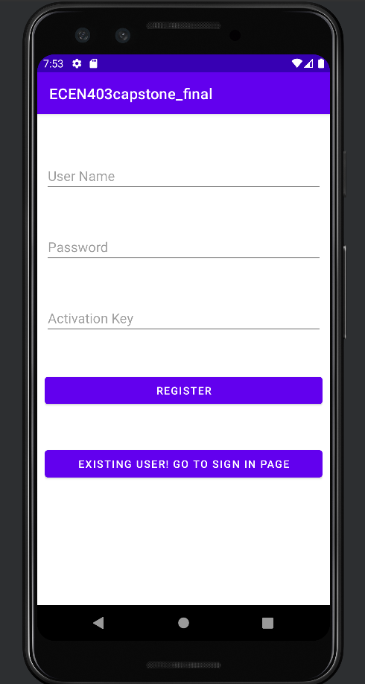
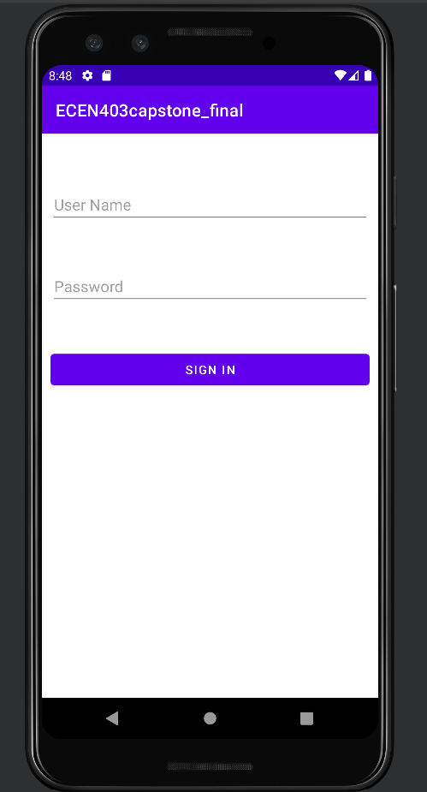
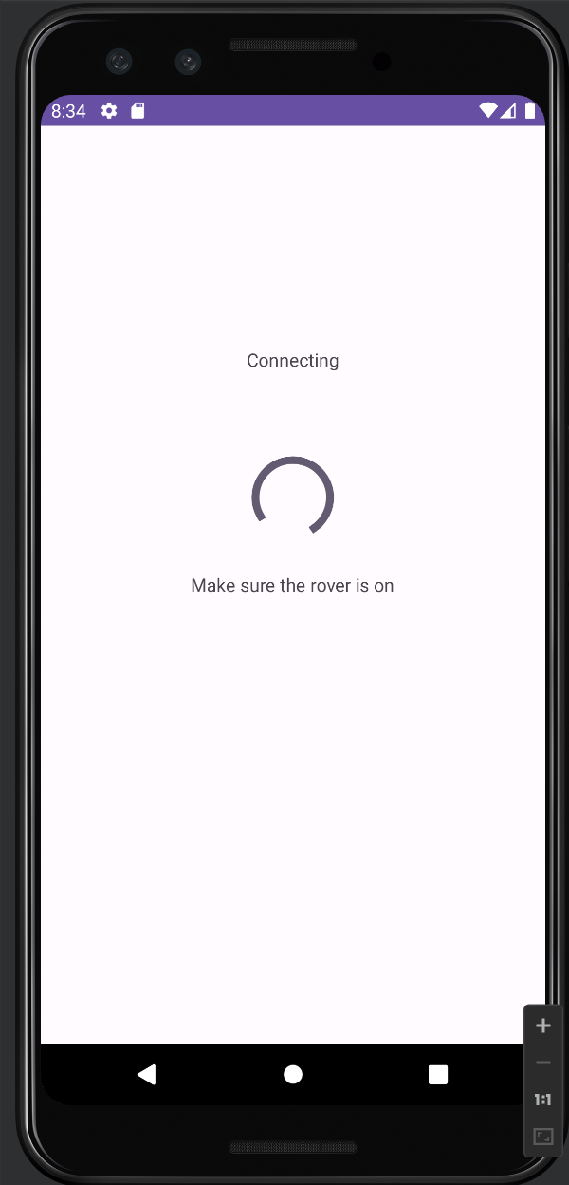
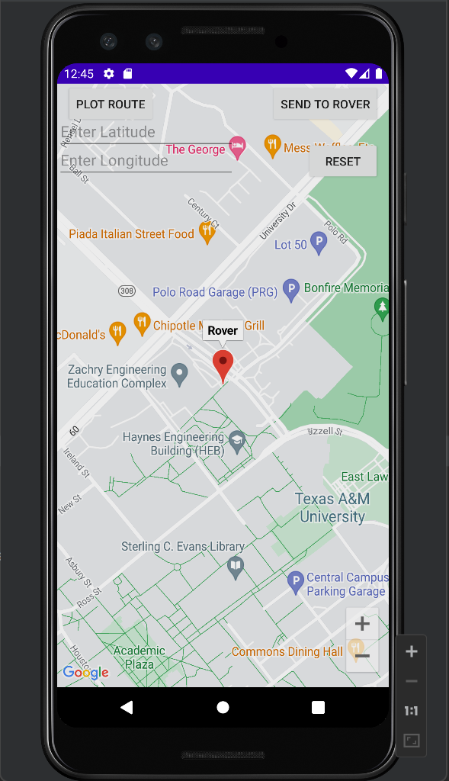
Interface and Communication
Nathan Sommer

Slide 7
Pathfinding and Navigation
Arkadi Zhanov
Accomplishments since 403 10 hrs of effort | Ongoing progress/problems and plans until the next presentation
Collected data to experimentally confirm best pathfinding algorithm for integration with Movement/Control subsystem Completed and improved pathfinding subsystem by increasing node resolution in preparation for integrating with Movement/Control subsystem | Integrate Pathfinder with Control subsystem for Navigation functionality Test integrated Navigation system Assist with code development of integrated Pathfinder and Control systems obstacle avoidance

Slide 8
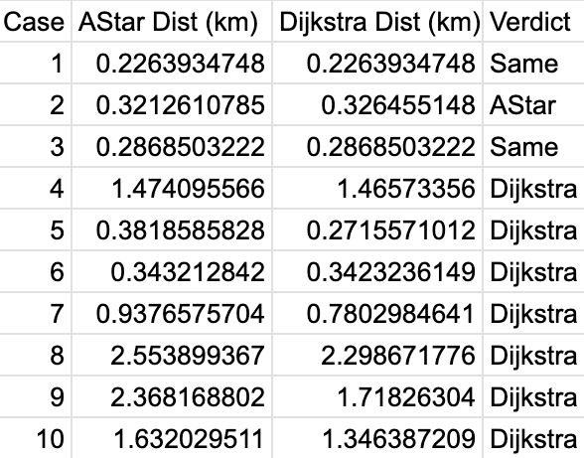
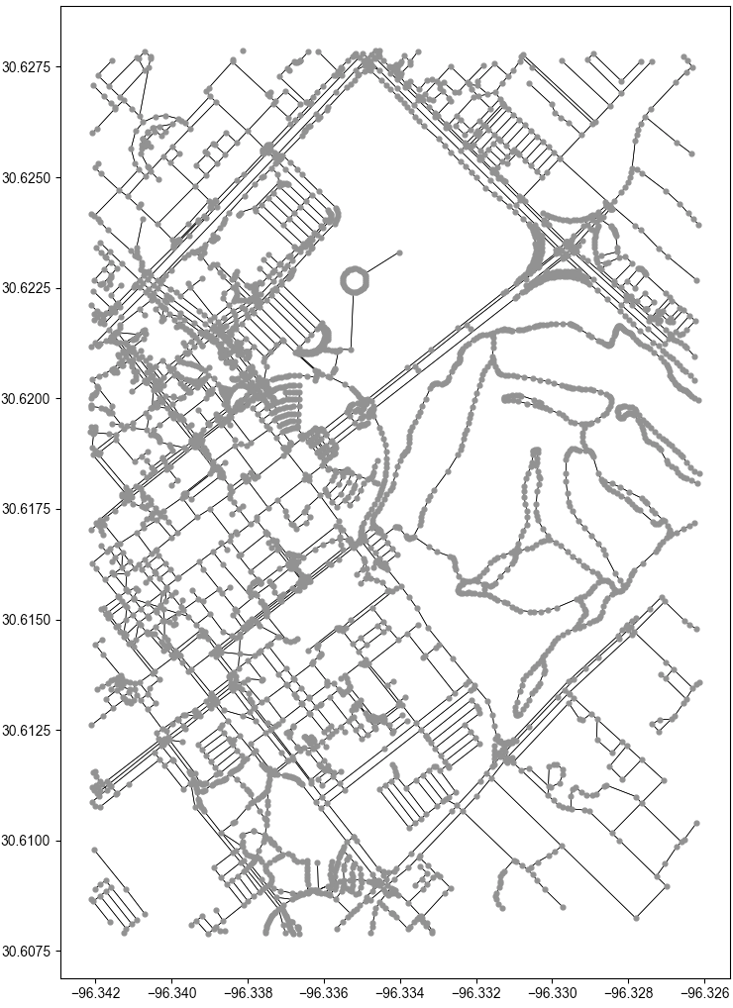
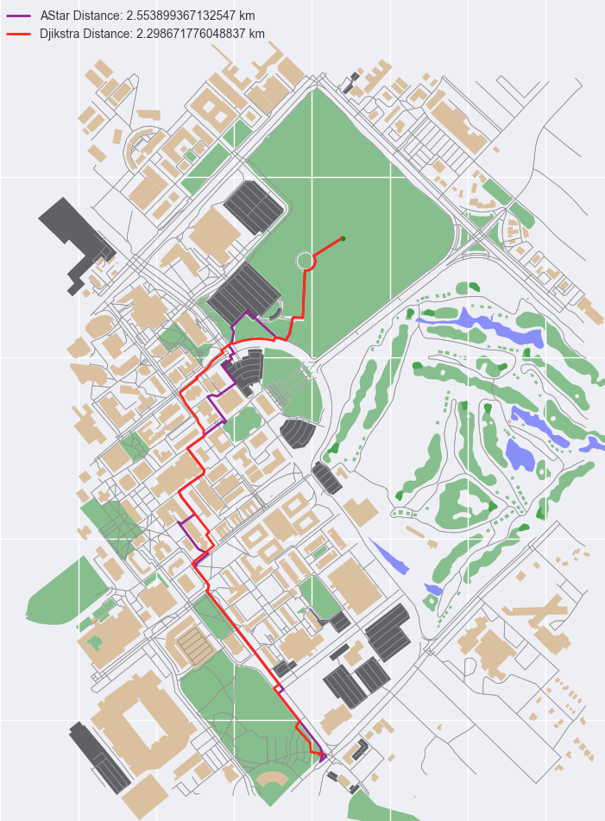
Pathfinding and Navigation
Arkadi Zhanov
Table 1. Experimental data collected to determine the better algorithm by running multiple pathfinding cases

Slide 9
Navigation/Movement/Control
Nikolai Paderin
Accomplishments since 403 7 hrs of effort | Ongoing progress/problems and plans until the next presentation
Sensor rewiring + 3D printed Built a new frame for rover Movement code adjusted Node navigation code started Ordered all remaining parts | Finish the node navigation code. Establish connection from Pi to App Finalize object avoidance algorithm Test rovers automated movements

Slide 10
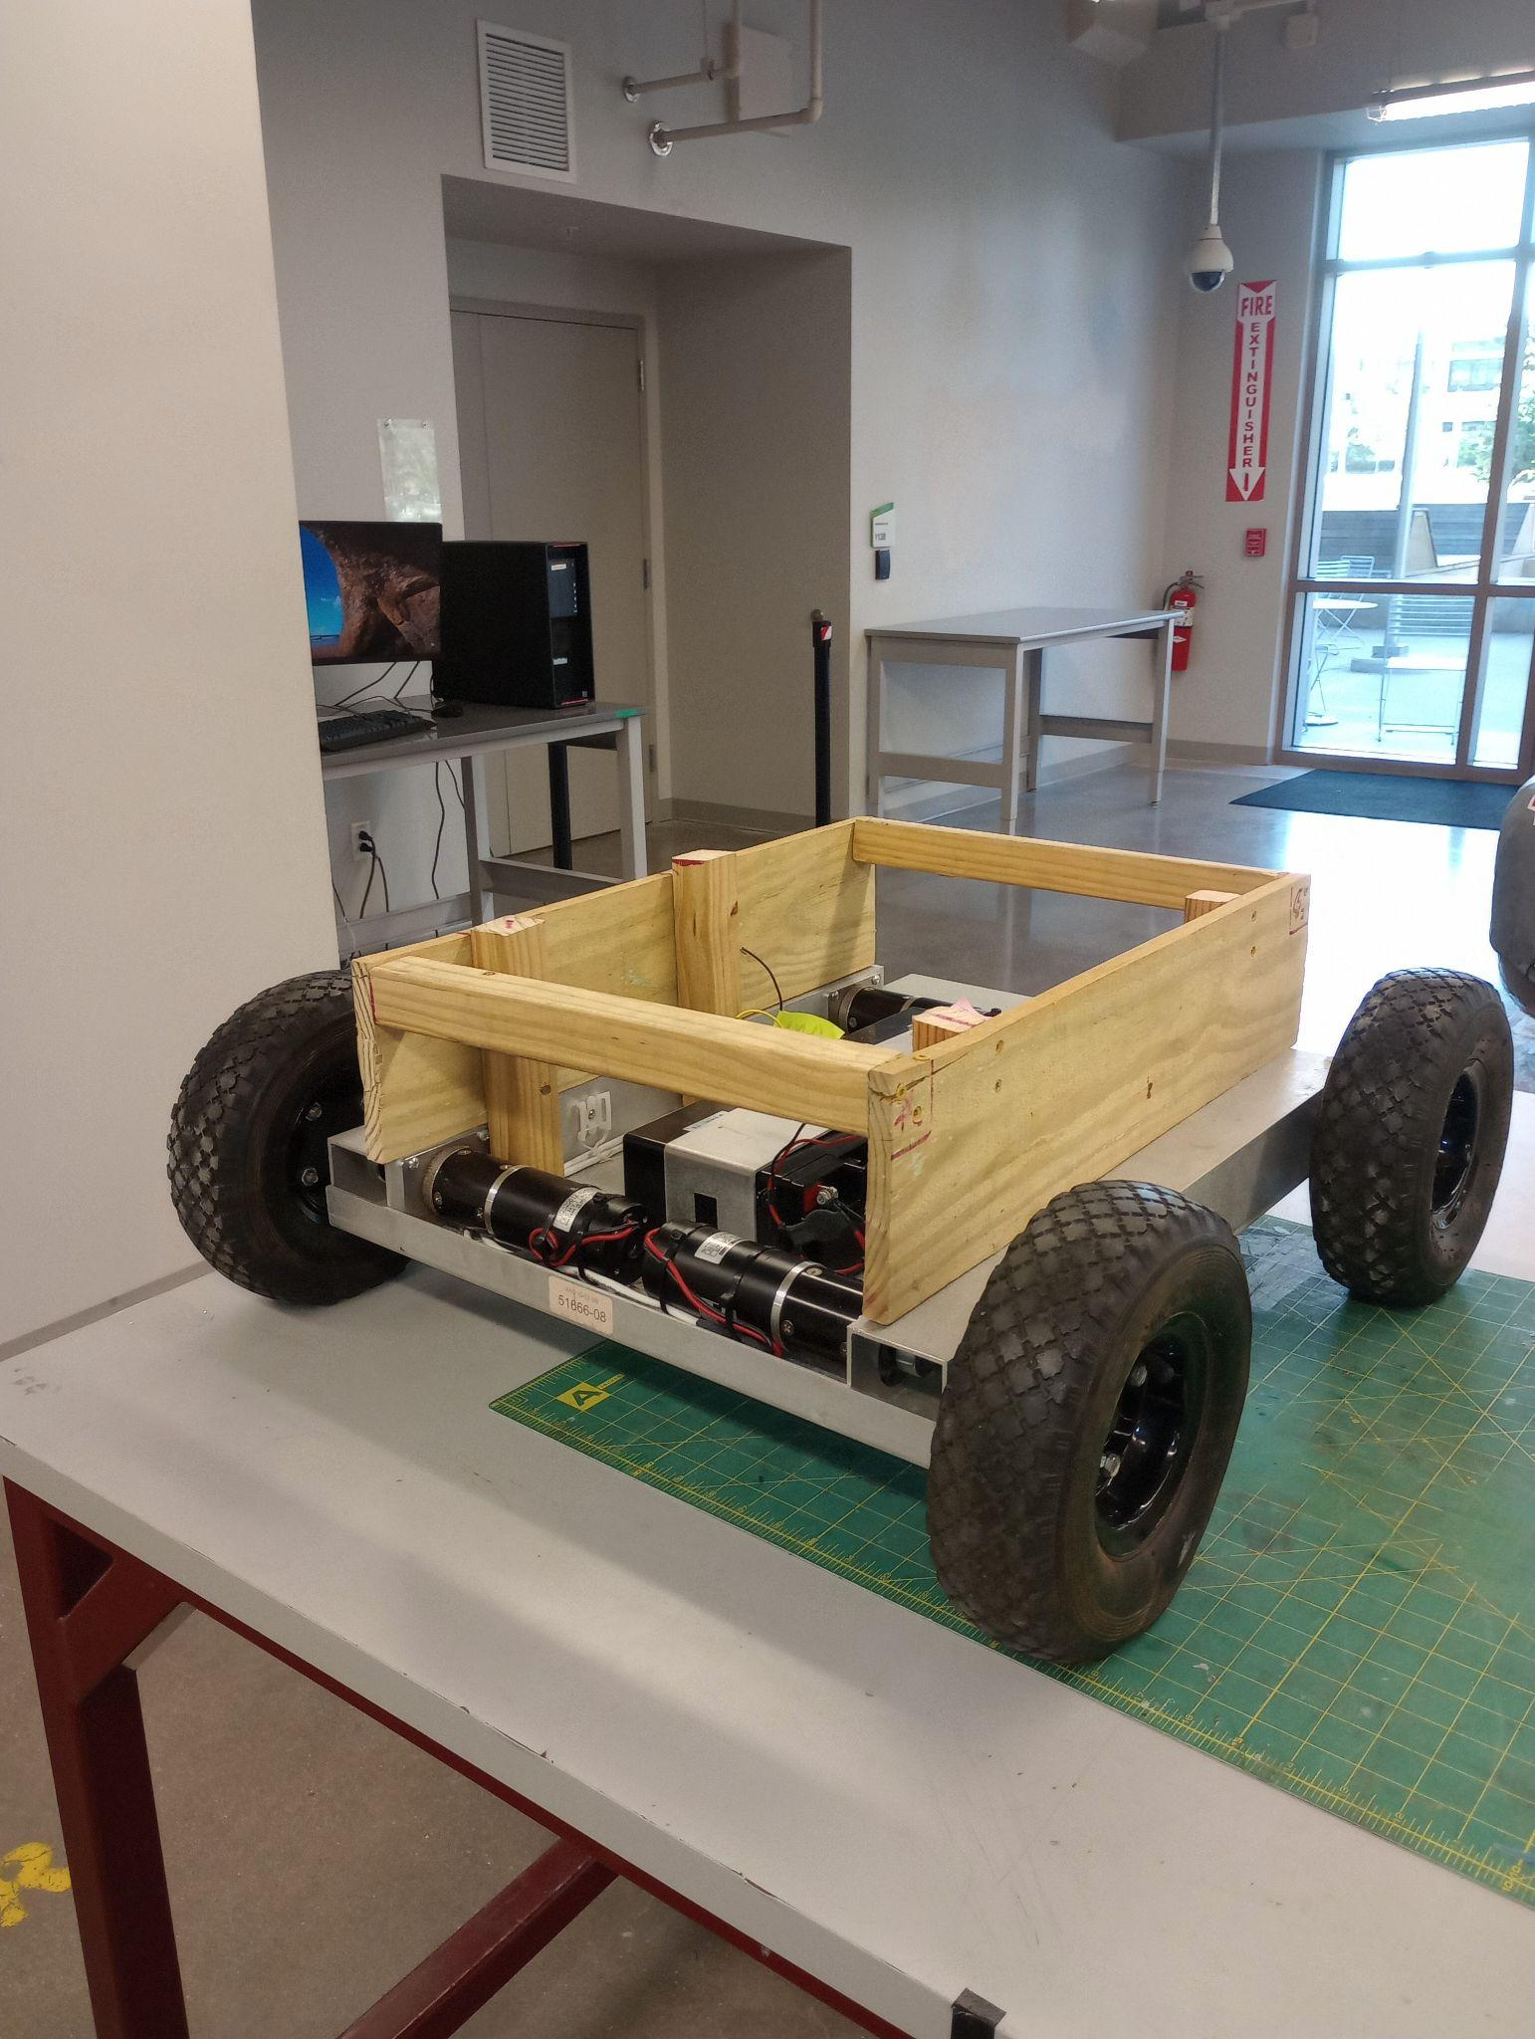
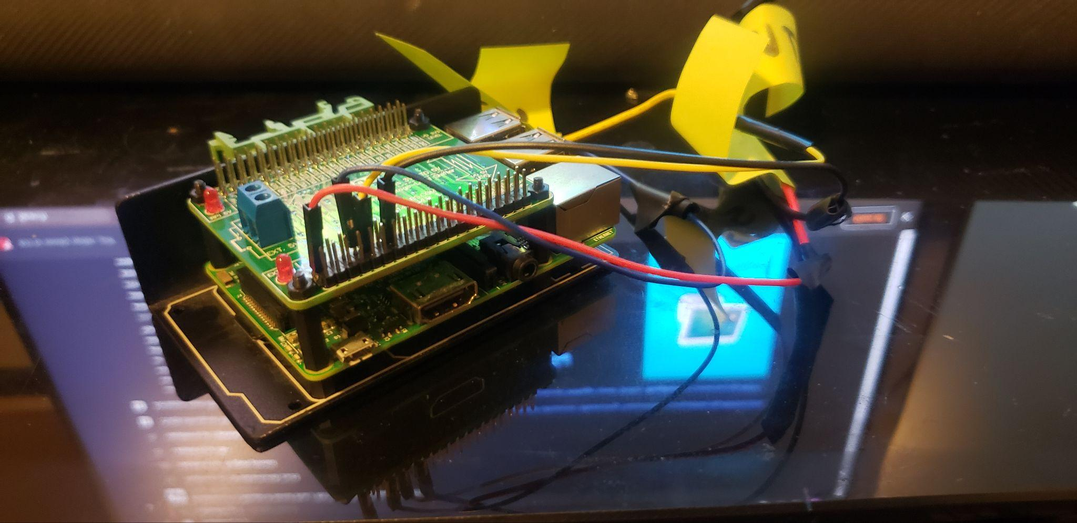
Navigation/Movement/Control
Nikolai Paderin

Slide 11
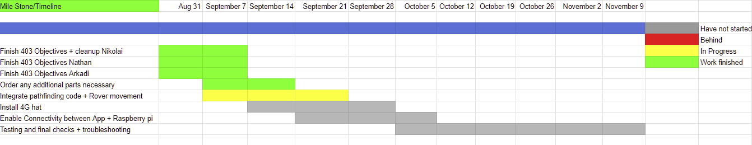
Execution & Plan
Notes:
Michelle

Slide 12
Thank you for your time and patience!
Any questions?

