Slide 1


Team 36: Self-Navigating, Obstacle Avoiding Robot
Bi-Weekly Update 3 Teammates:
Arkadi Zhanov
Nathan Sommer
Nikolai Paderin Sponsor: Stavros Kalafatis
Notes:
Michelle

Slide 2
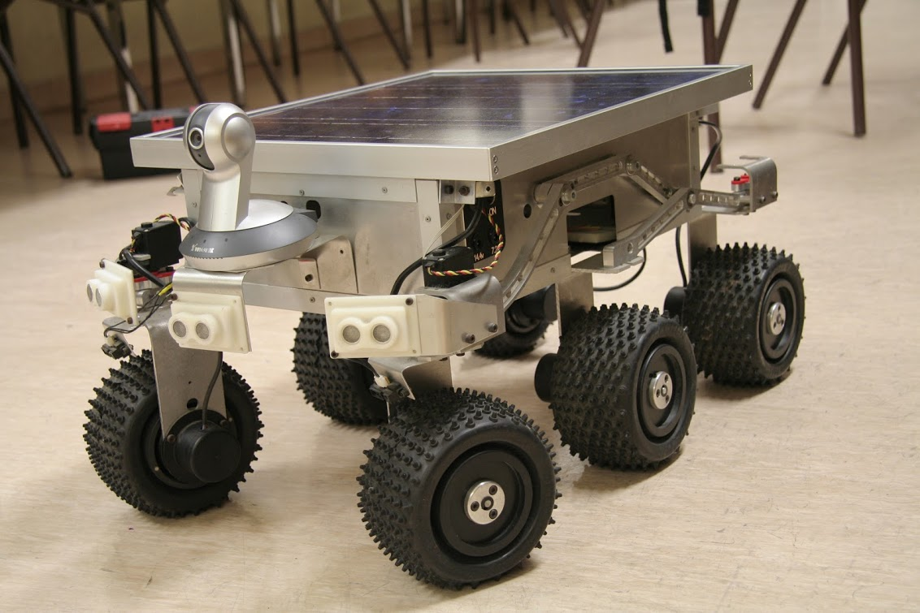
Project Summary
Create a system that takes in a point on a map as the rover’s destination, creates a route for the rover, and gets the rover to its destination and back while avoiding obstacles.
The main motivation for this project is for application in military settings such as aid delivery to wounded soldiers in the battlefield or local, residential delivery of food or mail.
Notes:
Kyle

Slide 3
Project/Subsystem Overview
User Interface/Communication
Navigation/Communication/Control
Pathfinding/Navigation
App
4G Hat
GPS module
Node/Edge Map Initializer
Login Page
Increase Node Resolution
Raspberry pi
Main Page
Dijkstra Pathfinder Algorithm
GPS Retrieval
Distance Sensor
Obstacle Avoidance Path Interrupt
Route Retrieval
User Input
Motor Control
Generate Node List
Display Path Progress
Nathan Sommer
Nikolai Paderin
Arkadi Zhanov
Notes:
Eric

Slide 4
Project Timeline
(Green done, yellow underway, red in trouble, white not started)
Subsystem Designs and Testing (completed 9/11) | Integrate Pathfinder and Movement/Controls and test (to complete by 9/20 | Integration with Android App and Raspberry Pi using cellular data (to complete by 10/5) | Final Integration (to complete by 10/15) | Systems Test (to complete by 11/2) | Validation (to complete by 11/26) | Demo and Report (to complete by 12/5)
Notes:
Eric

Slide 5
Interface and Communication
By Nathan Sommer
Accomplishments since last update 30 hrs of effort | Ongoing progress/problems and plans until the next presentation
Created a DDNS hostname to track the IP address of the client using a client application using Dnyu Created a VPN Server using WireGuard Created a VPC using OpenVPN | Problems: DDNS hostname only works when on same network (Can’t access hostname when on different network) Wireguard only works when on same network Currently trying to run the OpenVPN profile on raspberry pi (Working with OpenVPN helpdesk) Progress: Started Integrating the client code into app

Slide 6
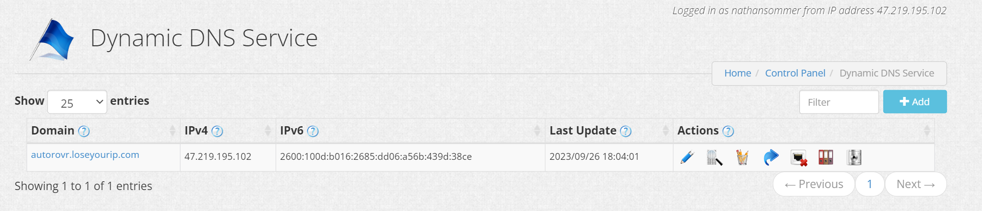
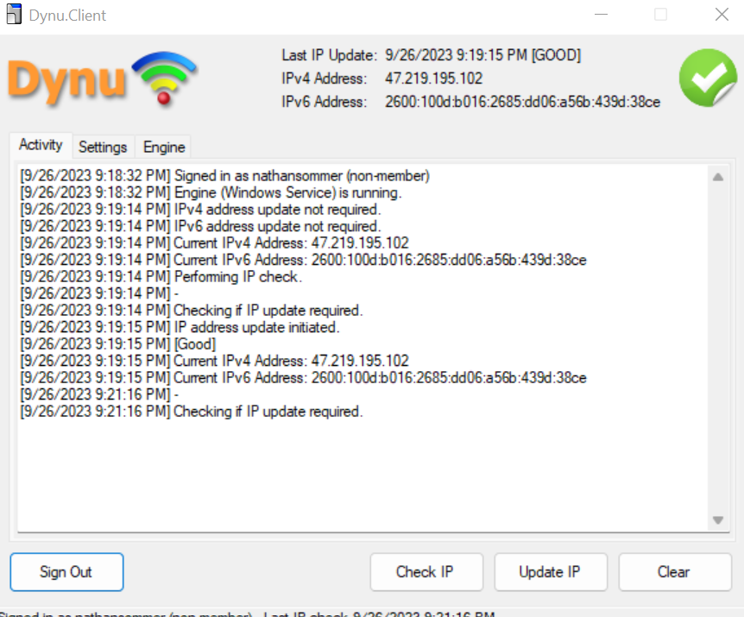
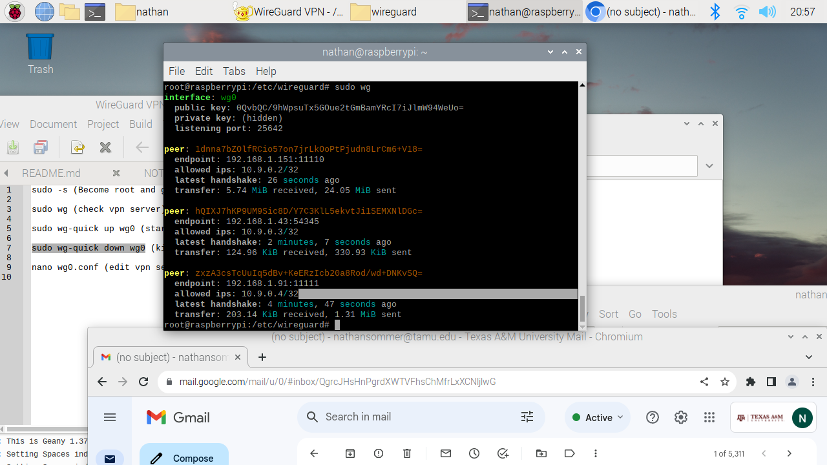
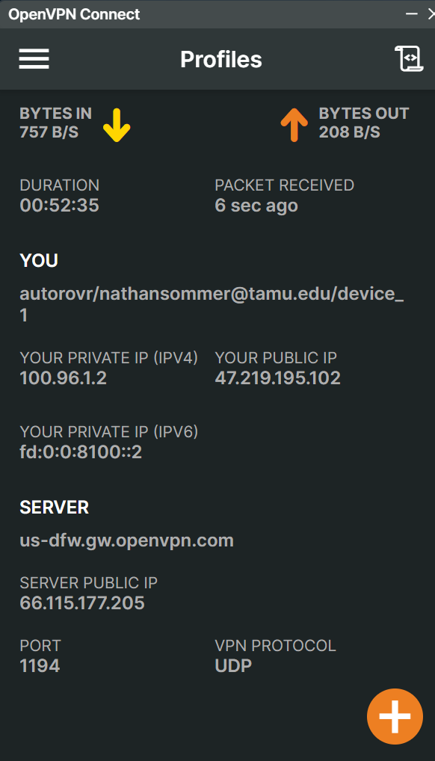
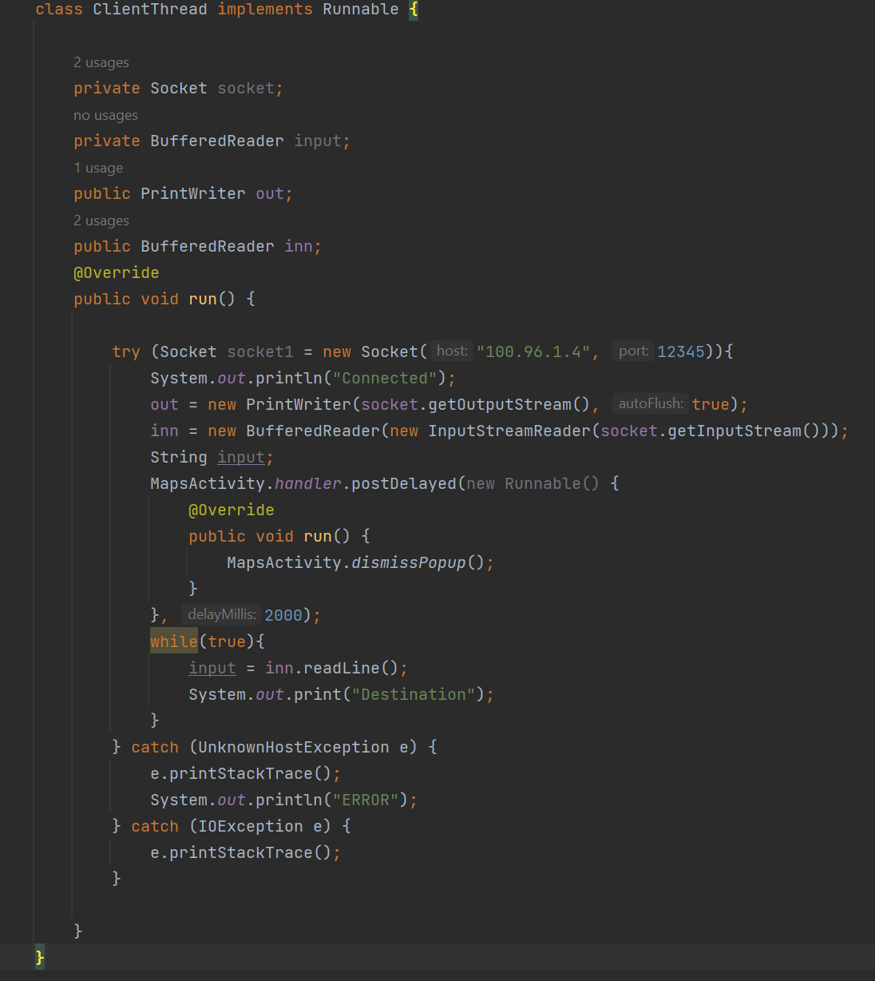
Interface and Communication
Nathan Sommer

Slide 7
Pathfinding and Navigation
Arkadi Zhanov
Accomplishments since last update 25 hrs of effort | Ongoing progress/problems and plans until the next presentation
Pathfinder integrated with the Movement/Control subsystem Developed algorithm and framework obstacle avoidance code which is integrated with the Movement/Control subsystem Created a common case obstacle avoidance testbench to validate functionality | Problems: Identify best weights and weight vector orders Ongoing Progress: Continue testing obstacle avoidance by adding more test cases to testbench Finish adjusting obstacle avoidance code as needed Final validation of obstacle avoidance code Complete final integration into Movement/Control subsystem

Slide 8
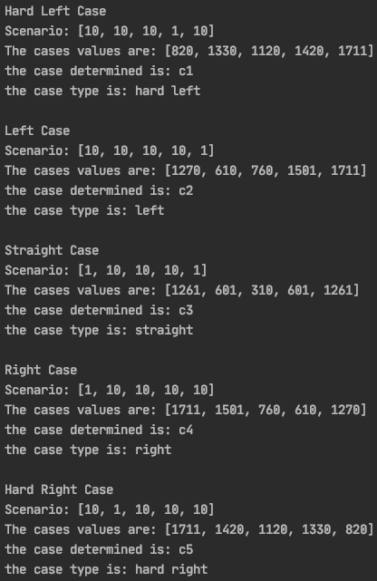
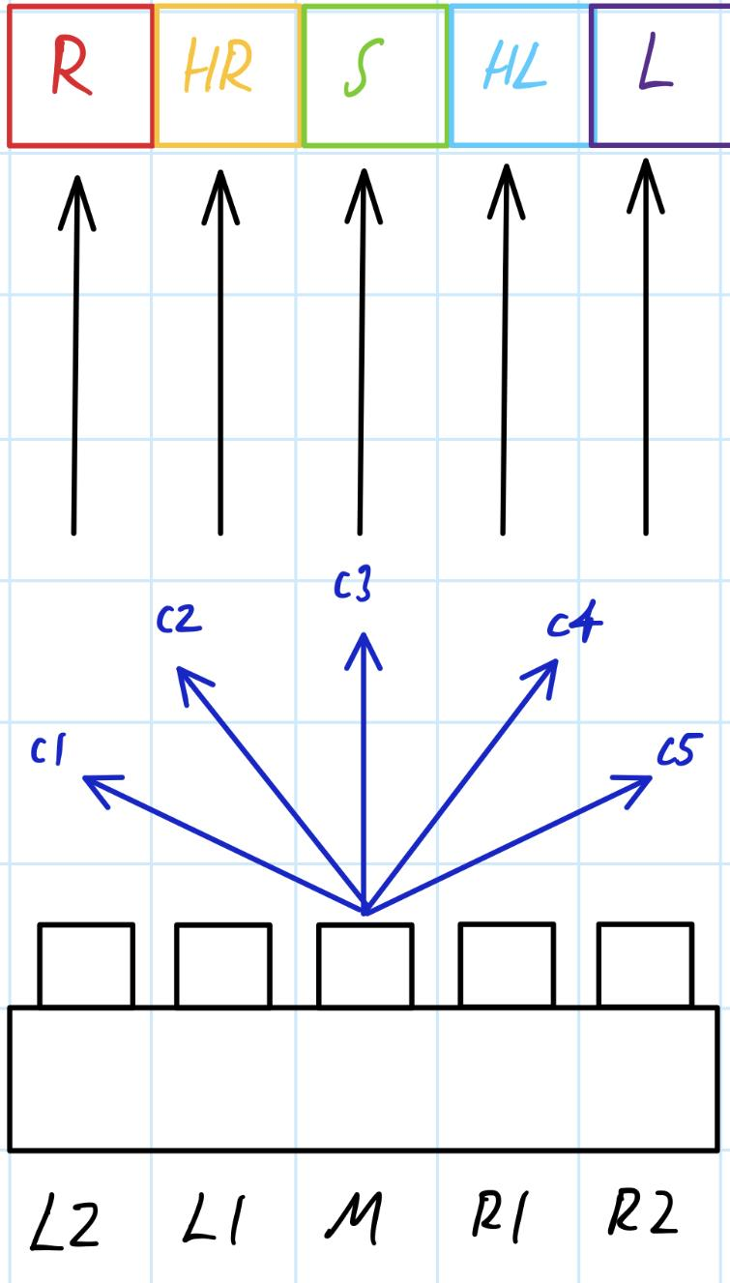
Pathfinding and Navigation
Arkadi Zhanov
Obstacle Avoidance Overview
Sample Output From Classifier for Obstacle Avoidance
Potential Obstacles and Desired Direction Based on Position
Vector Determination and Case Classifier Table
Cases | Type | Sensor Order (Highest to least effect
c1 | Hard Left | R1, R2, M, L1, L2
c2 | Left | R2, R1, M, L1, L2
c3 | Straight | M, (L1/R1), (L2/R2)
c4 | Right | L2, L1, M, R1, R2
c5 | Hard Right | L1, L2, M R1, R2
Top down view of sensor layout
This table is used to determine weight and set up weight vectors for the cases

Slide 9
Navigation/Movement/Control
Nikolai Paderin
Accomplishments since last update 12 hrs of effort | Ongoing progress/problems and plans until the next presentation
Node Navigation completed -Able to seek nodes autonomously -Segmented movements resolution in terms of location and direction(0.1 meter segmentations) Integration with other subsystem -Able to orient itself towards other nodes and navigate towards nodes - Fixed issues with Rover -⅓ chance of misfire command -movement refined to reduce over/undercompensation -re-allocated sensors to allow for greater object resolution detection | Object Avoidance integration -Adding corner cases to account for niche cases -account for road angles 4G Hat -Test out GPS accuracy + Precision -Test Internet connectivity -Send and receive instructions from application

Slide 10
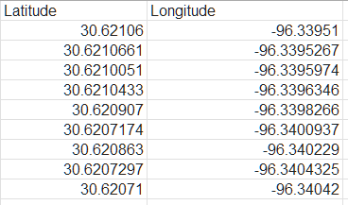
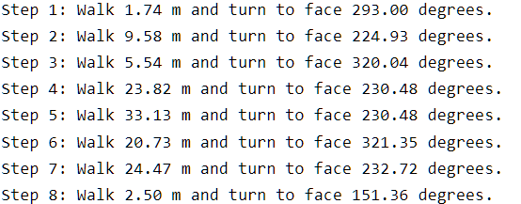
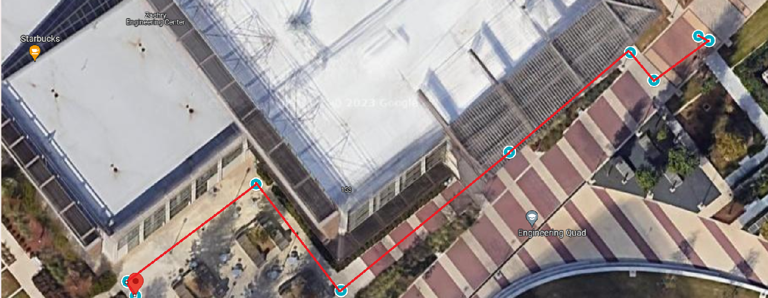
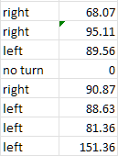
Navigation/Movement/Control
Nikolai Paderin

Slide 11
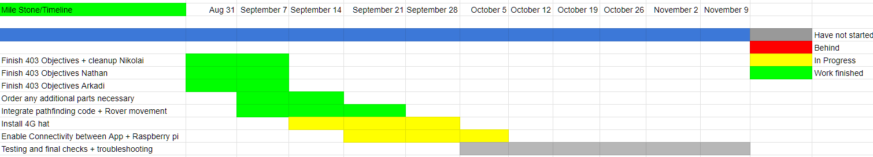
Execution & Plan
Notes:
Michelle

Slide 12
Thank you for your patience!
Any questions?

